Slide 1
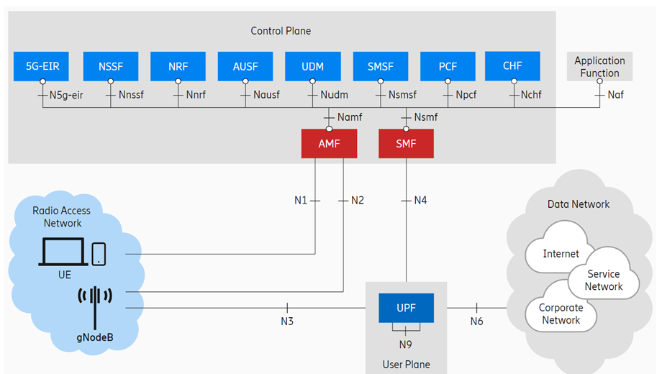
3GPP TS 22.104
Chapter A.2.2.3
Mobile Robots
Write something from this standard…
Customer Requirement:
CR1234: Our products must support
the function of Mobile Robots
NFR1234 Regarding mobile robots,
as described in TS 22.104, V19.1.0 (2023-09),
chapter A.2.2.3, Use Case 1:
UPF shall take less than X ms (one way latency),
with Y% reliability.

