Slide 1
Short-Term Weather Forecasting Using XGBoost
Prepared by: Omar Hammad

Slide 2

Introduction:
Weather Forecasting Importance
  Short-term weather forecasting is important for:
  HVAC energy optimization
  Smart buildings
  Renewable energy systems
  Agriculture
  Transportation systems
  Climate monitoring
Accurate forecasting helps improve:
  energy efficiency
  operational planning
  environmental sustainability

Slide 3

Project Objectives
Main Objective:
Replicate a research paper using XGBoost
Predict:
  Temperature
  Relative Humidity
Forecast horizons:
  1 hour ahead
  2 hours ahead
  3 hours ahead
(bonus Compare XGBoost with LSTM
Add Explainable AI using SHAP)

Slide 4
Research Paper Overview
Original Paper
The original paper used:
XGBoost regression
Multi-horizon forecasting
Weather prediction techniques
Main variables (features) :
1.Temperature
2.Humidity
3.Solar radiation
4.Wind speed
5.Surface pressure
Evaluation metrics in both the paper and our replication :
RMSE
R² Score

Slide 5

Research Paper Overview
DATA COLLECTION
The original XGBoost weather prediction paper used data collected from an outdoor environmental monitoring station installed at a university campus/building environment.
The measurements were collected continuously using IoT/weather sensors and stored as time-series environmental data.
China, Shenzhen

Slide 6


OUR replication (Overview)
Our Dataset Collection
Weather Dataset
Dataset source:
Open-Meteo API
Location:
Cairo, Egypt
Evaluation metrics in both the paper and our replication :
RMSE
R² Score
Collected Variables(features):
Temperature
Relative Humidity
Solar Radiation
Surface Pressure
Wind Speed
Dataset size:
4344 hourly samples

Slide 7
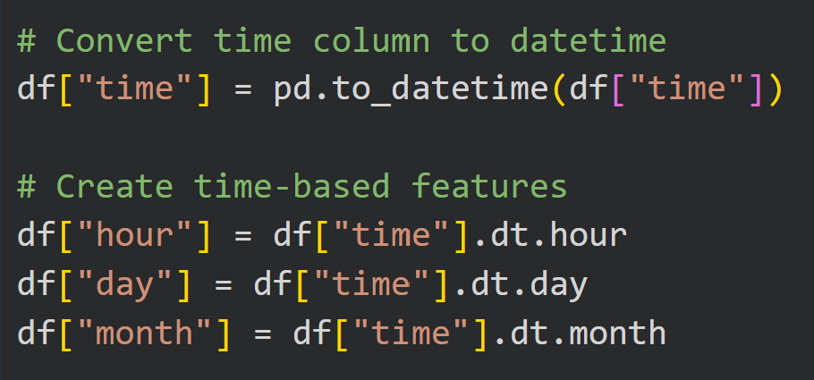
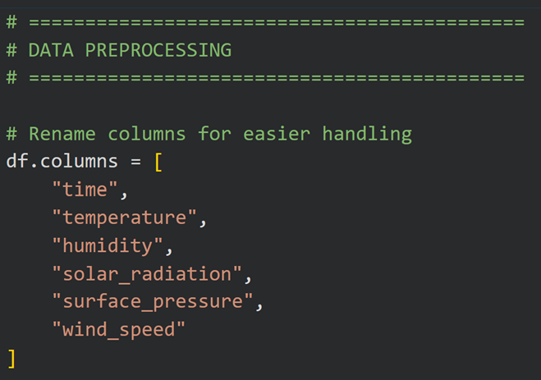
Data Preprocessing & Forecasting Pipeline
Data Cleaning and Preparation
Steps performed:
Converted time to datetime format Renamed columns

Slide 8



Data Preprocessing
Creating of Lag features:
temp_lag_1
temp_lag_2
temp_lag_3
humidity_lag_1
humidity_lag_2
humidity_lag_3
These represent:
previous 1 hour
previous 2 hours
previous 3 hours

Slide 9

Data Preprocessing
Why Lag Features Are Important for XGBoost
XGBoost is NOT naturally sequential like LSTM.
LSTM automatically remembers previous time steps.
But XGBoost only sees rows independently.
Therefore:
lag features manually provide memory to XGBoost.
Without lag features:
XGBoost would not understand time relationships properly.

Slide 10
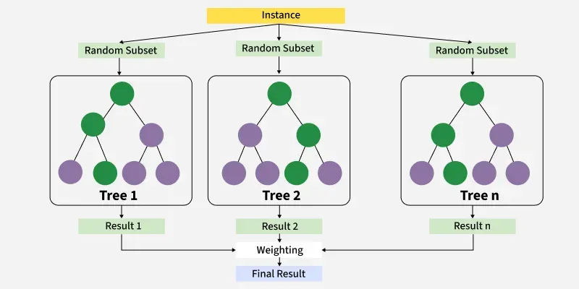
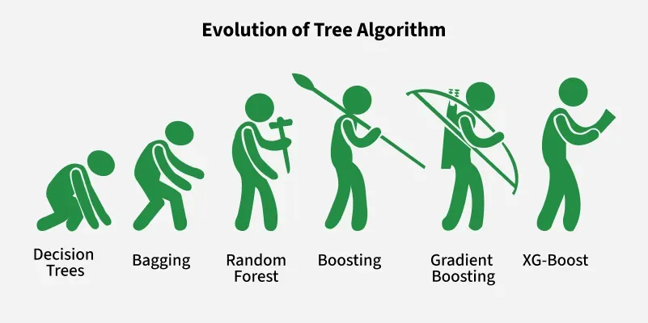
Our beloved XGBoost Model
XGBoost Configuration
Parameters used:
  n_estimators = 10000
  learning_rate = 0.05
  max_depth = 5
Advantages:
  Fast training
  High interpretability
  SHAP compatibility

Slide 11

Multi-Horizon Forecasting
OUR Features:
Temperature
Humidity
Solar radiation
Wind speed
Surface pressure
OUR TARGETS!!
Temperature & Humidity

Slide 12
Multi-Horizon Forecasting
Temperature prediction:
1-hour ahead
2-hours ahead
3-hours ahead
Humidity prediction:
1-hour ahead
2-hours ahead
3-hours ahead
Observation:
Forecast accuracy decreases as
prediction horizon increases.
OUR TARGETS!!
Temperature & Humidity

Slide 13
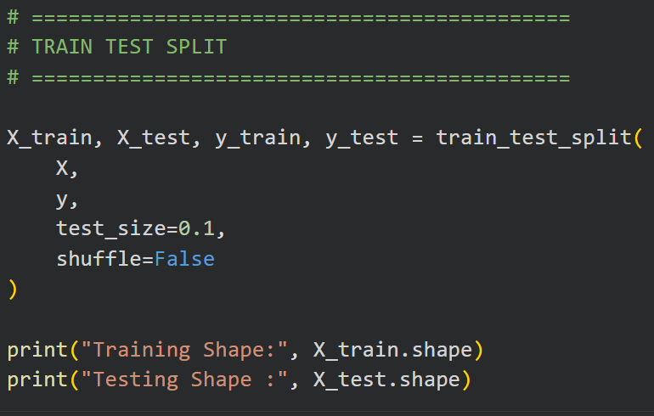
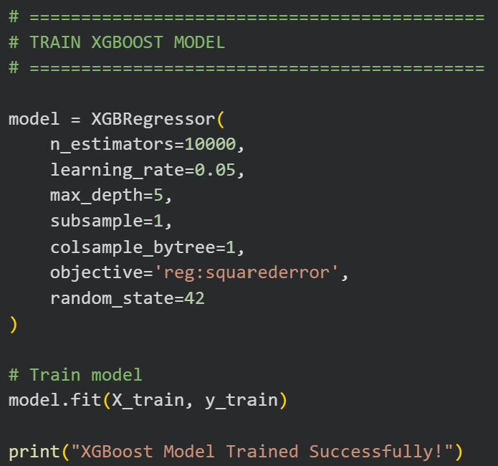
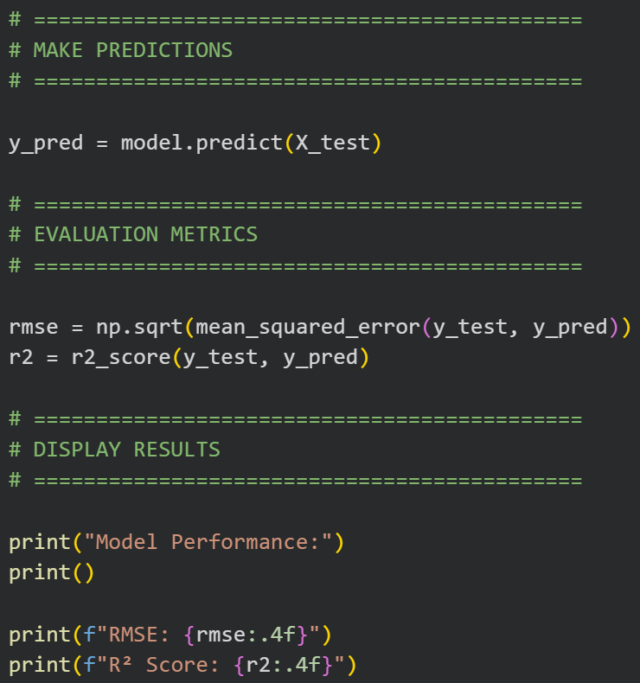
Splitting, Training, and testing

Slide 14
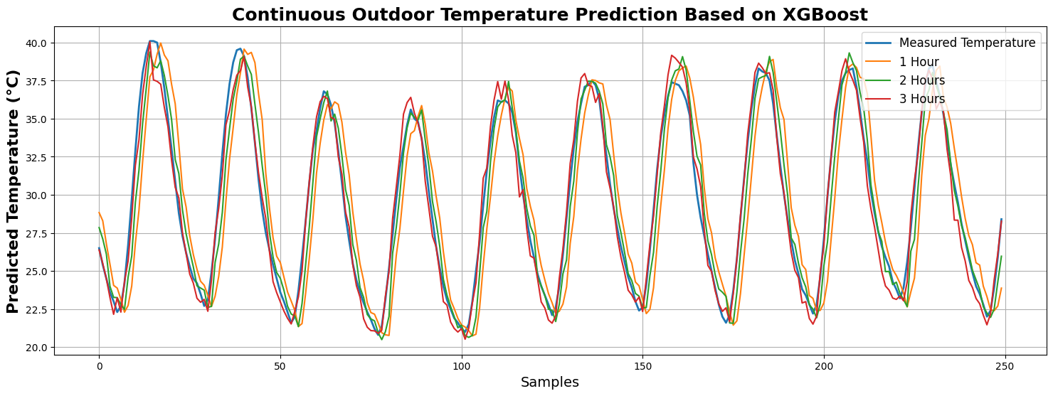
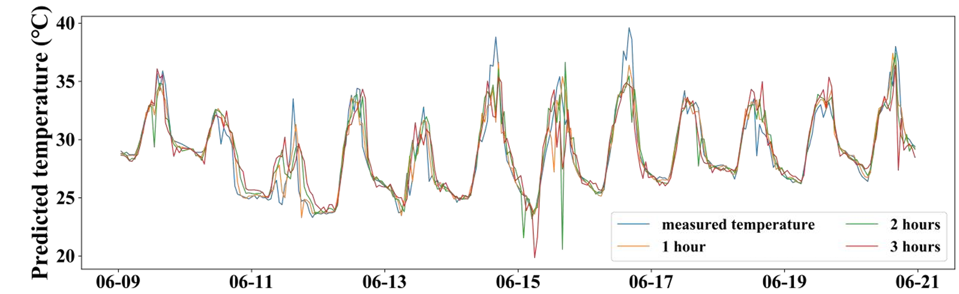
XGBoost Results
Our predicted temperature curve:
Paper’s prediction temperature curve:

Slide 15
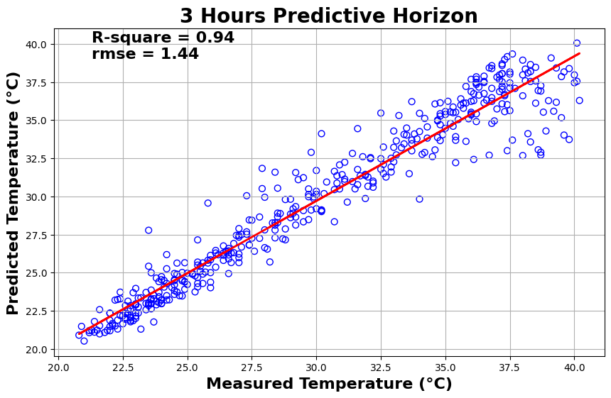
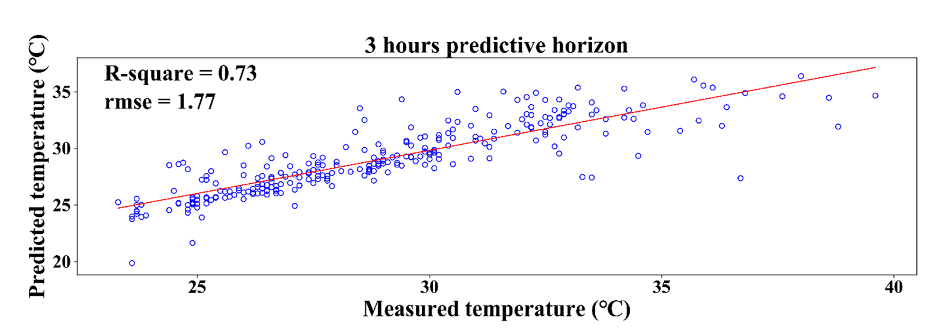
Our 3 hours horizon temperature
The paper 3 hours horizon temperature
Actual temperature =
Predicted =

Slide 16
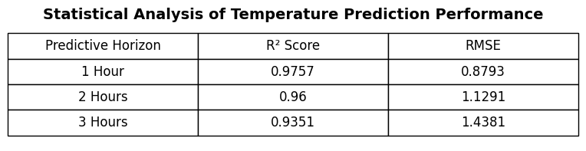
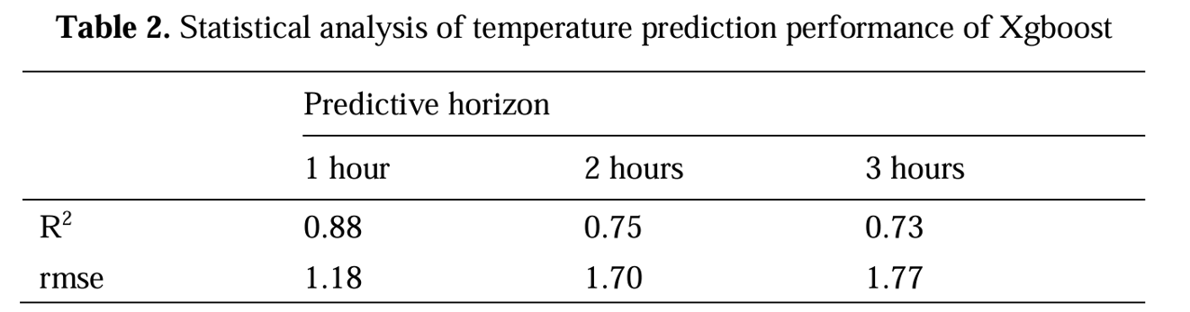
Our performance
The paper Performance

Slide 17
Temperature prediction results comparison
Predictive Horizon | Paper XGBoost R² | Our XGBoost R² | Improvement | Paper RMSE | Our RMSE | Improvement
1 Hour | 0.88 | 0.9757 | +10.9% | 1.18 | 0.8793 | Better by 25.5%
2 Hours | 0.75 | 0.9600 | +28.0% | 1.70 | 1.1291 | Better by 33.6%
3 Hours | 0.73 | 0.9351 | +28.1% | 1.77 | 1.4381 | Better by 18.8%
Our replicated XGBoost model significantly outperformed the original paper across all predictive horizons.
The largest improvement appeared in long-term forecasting (2-hour and 3-hour horizons).
Our model achieved:
  higher R² scores
  lower RMSE values
  smoother prediction curves
  better regression fitting
Main Reasons for Better Performance
Larger Dataset
We used:
continuous hourly weather data
4344+ samples
multiple consistent environmental features
which improved model learning.

Slide 18
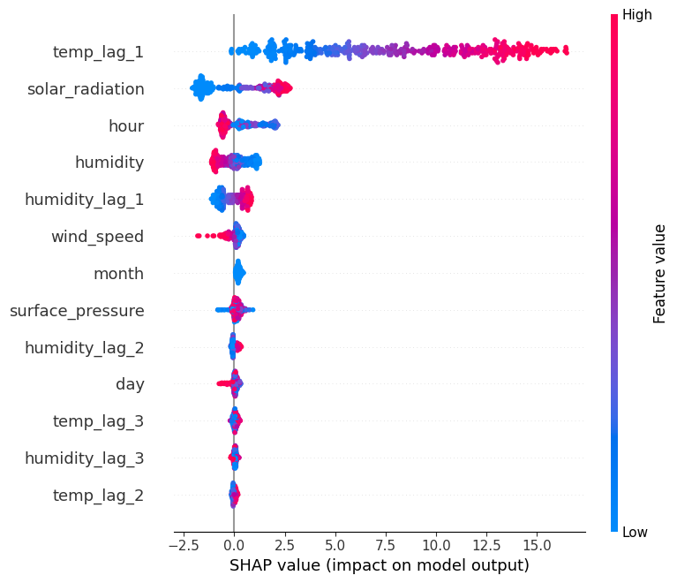
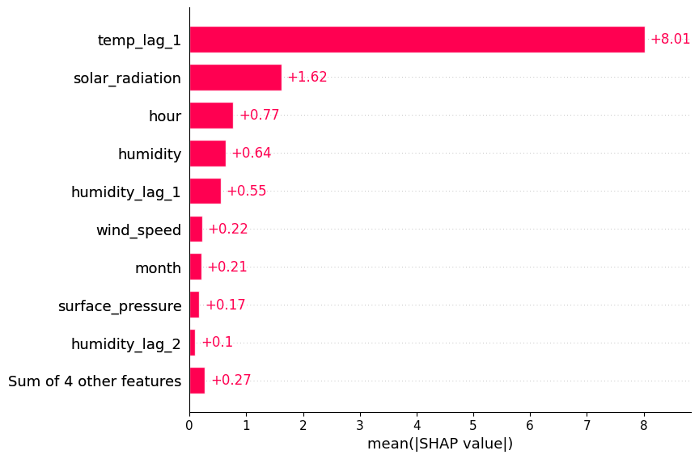
Bonus Part from us
In temperature prediction we added explainable AI for better understanding
Which feature had the most impact on our prediction:

Slide 19
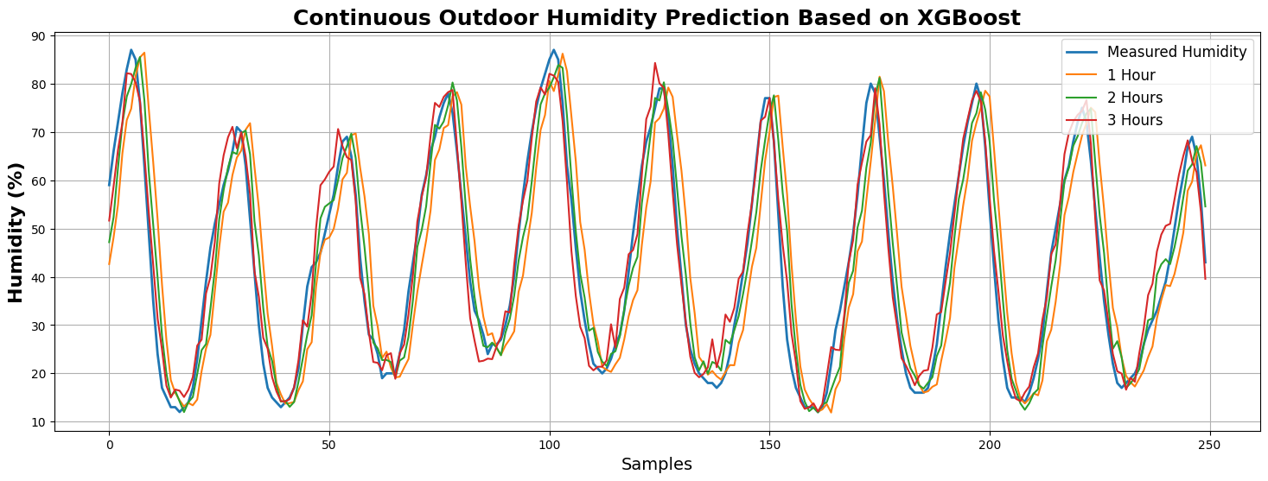
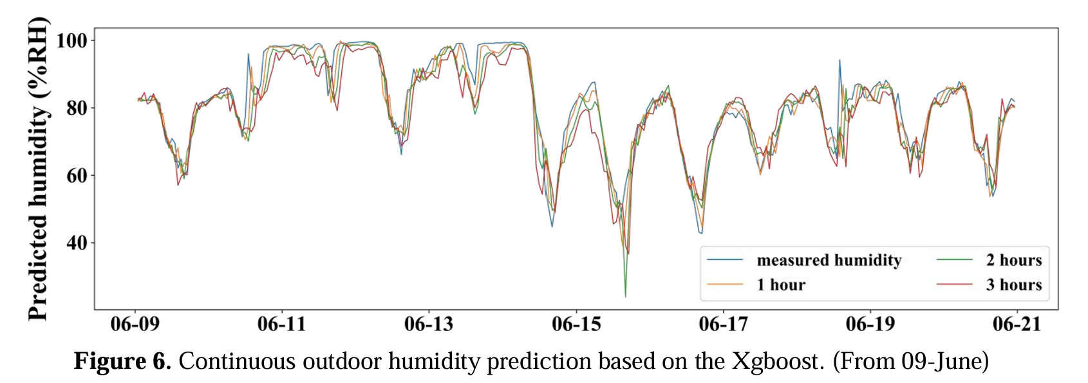
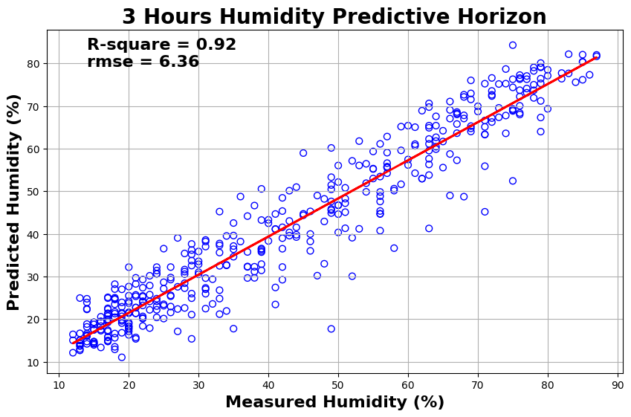
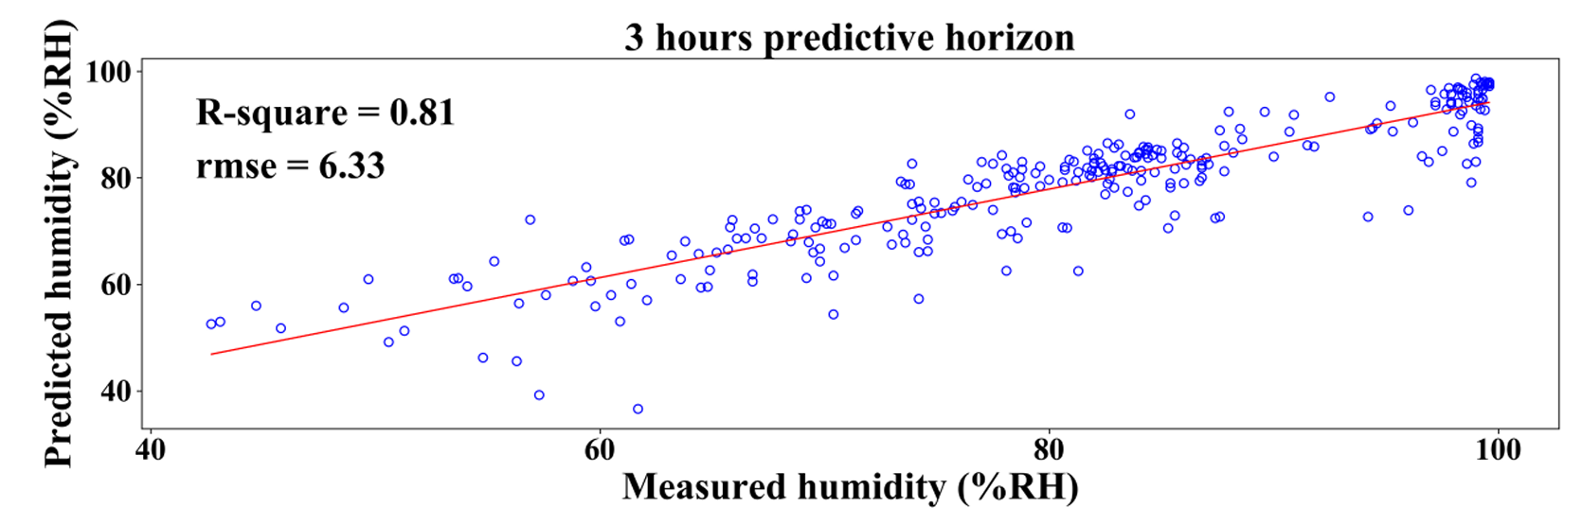
Now for results in humidity prediction (ours)
Paper results :
Actual temperature =
Predicted =

Slide 20
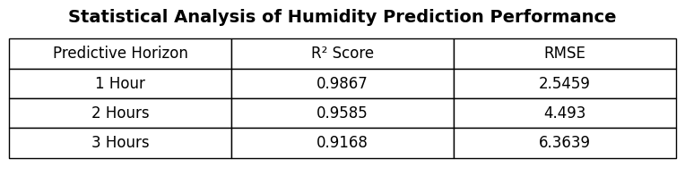
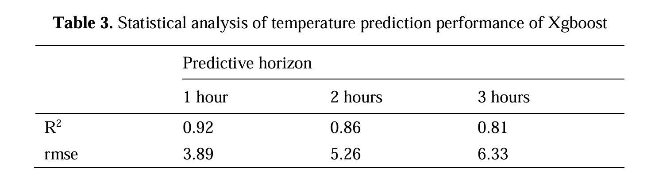
Our results:
Paper results :

Slide 21
Results of humidity prediction
Predictive Horizon | Paper XGBoost R² | Our XGBoost R² | Improvement | Paper RMSE | Our RMSE | Improvement
1 Hour | 0.92 | 0.9867 | +7.25% | 3.89 | 2.5459 | Better by 34.6%
2 Hours | 0.86 | 0.9585 | +11.45% | 5.26 | 4.4930 | Better by 14.6%
3 Hours | 0.81 | 0.9168 | +13.19% | 6.33 | 6.3639 | Nearly identical
Final Conclusion
The replicated and enhanced XGBoost model outperformed the original paper in humidity prediction across almost all forecasting horizons.
Key achievements:
higher R² values
lower RMSE
improved stability
better long-term prediction robustness
The study confirms that XGBoost is highly effective for short-term outdoor humidity forecasting when combined with proper feature engineering and temporal lag analysis.

Slide 22
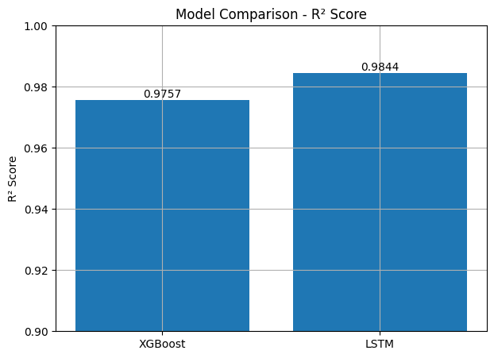
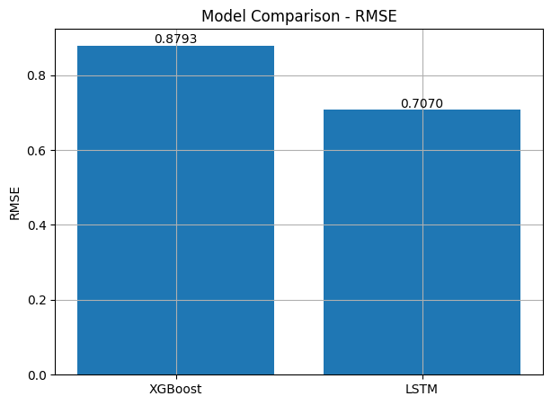
We did something more as a bonus!!!
We compared between LSTM & XBOOST in temperature prediction

Slide 23
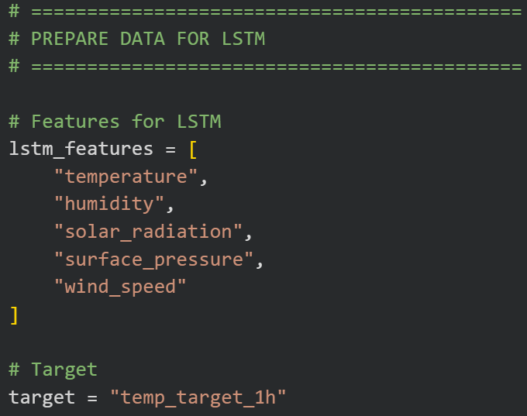
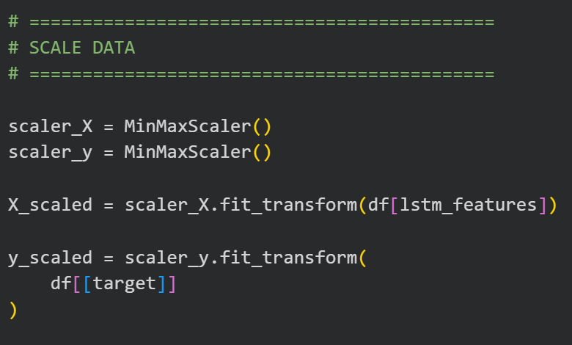
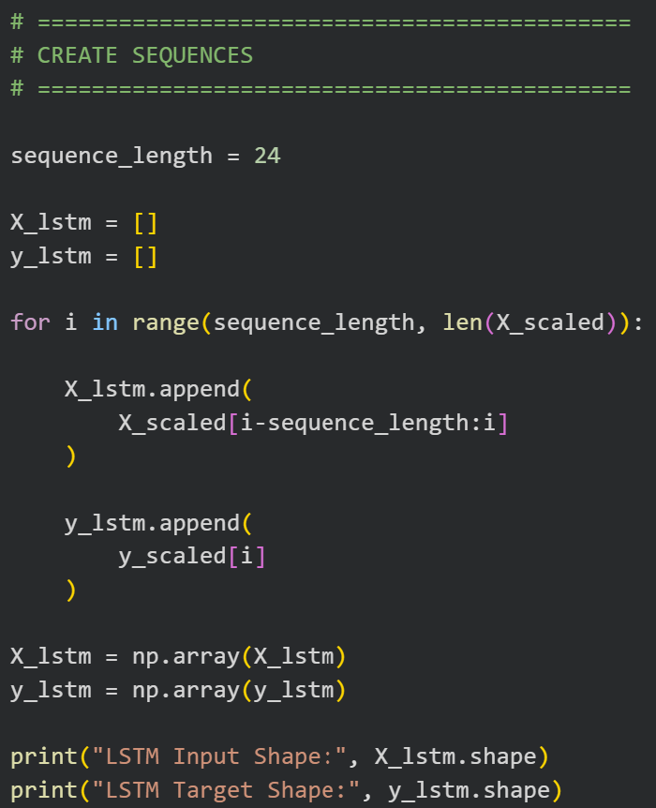
LSTM Training &code
Scaling improves:
  training stability
  convergence speed
  prediction accuracy.
Necessary for LSTM because neural networks are sensitive to feature magnitudes.
The LSTM uses these time-series sequences to learn temporal weather patterns.
This enables the model to predict future temperature based on historical behavior.
Main Idea
Use the previous 24 hours of temperature, humidity, solar radiation, pressure, and wind speed to predict future temperature.

Slide 24
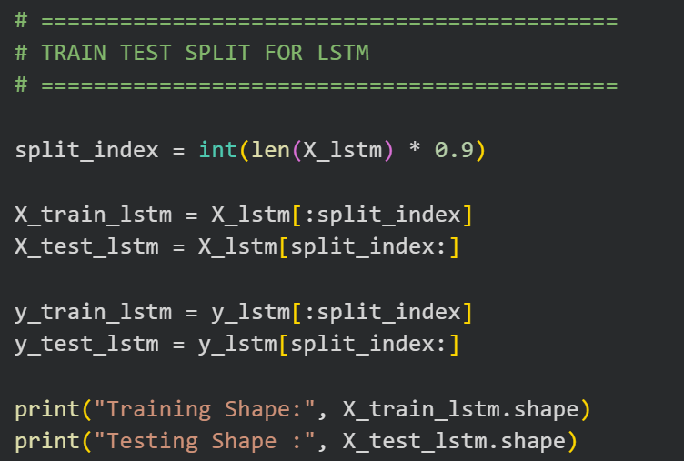
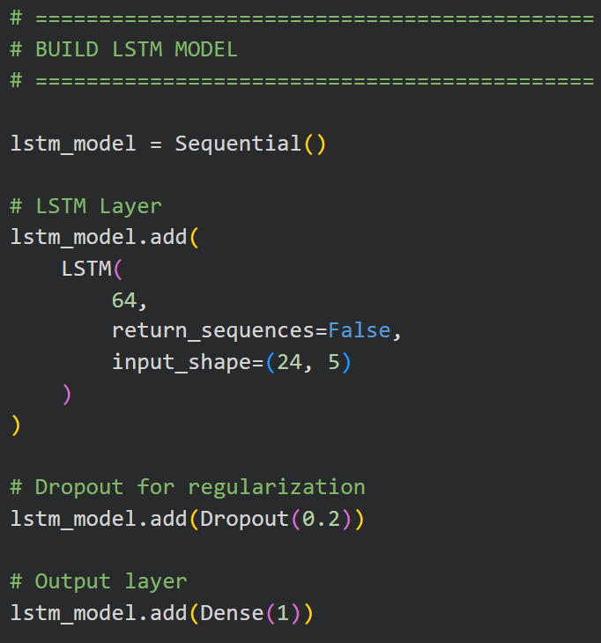
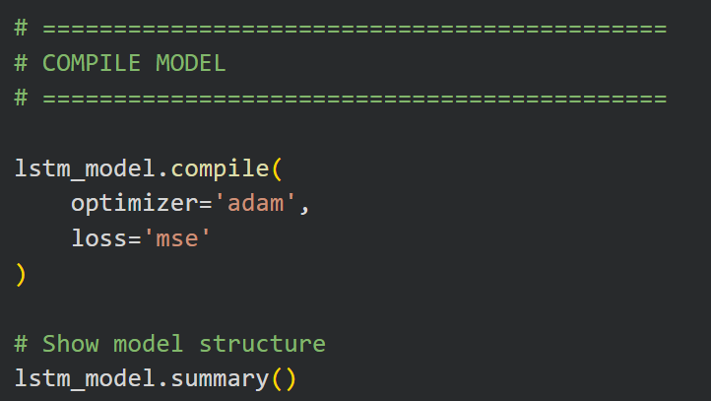
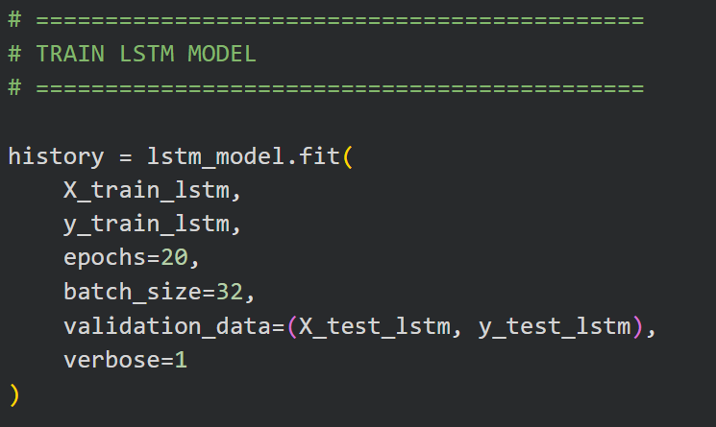
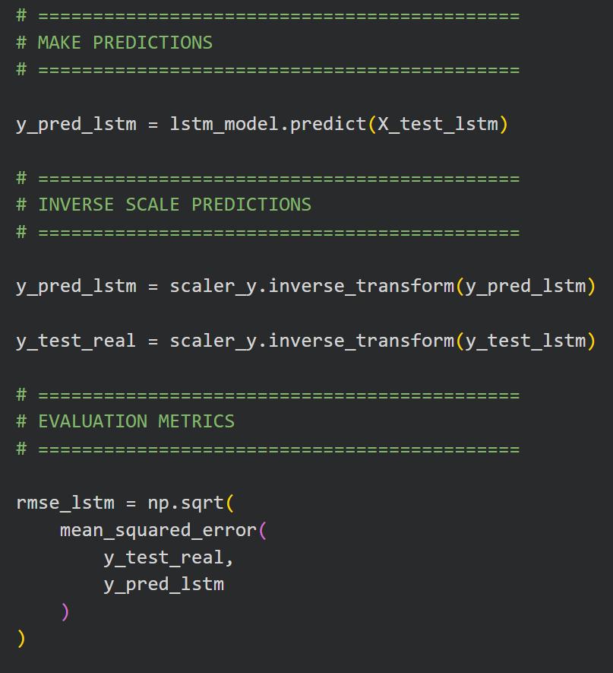
LSTM Training &code

Slide 25
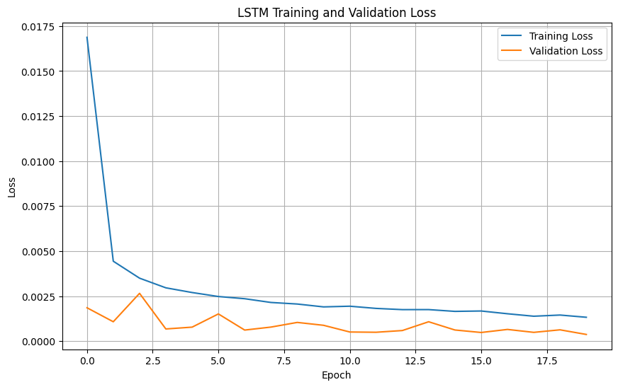
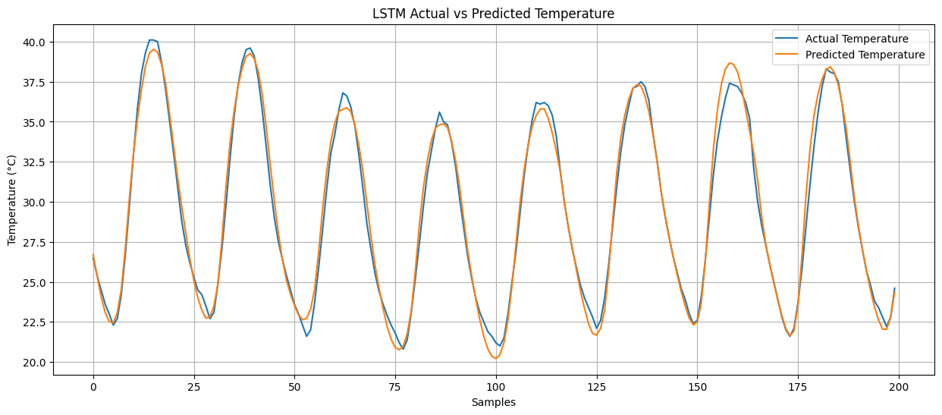
LSTM prediction and training curve

Slide 26
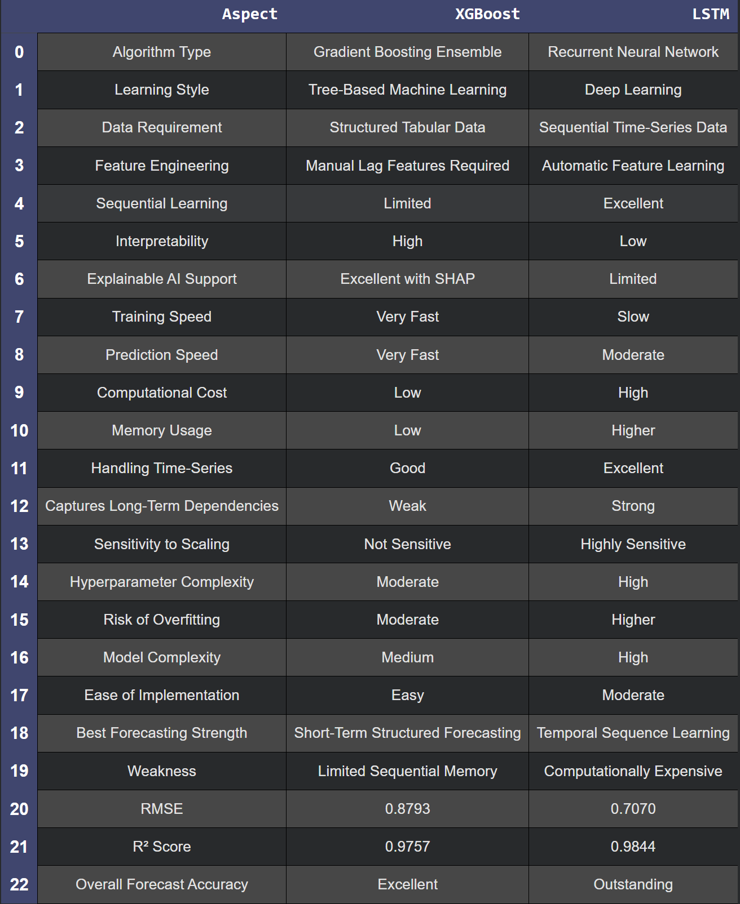
Final comparison between XBOOST & LSTM

Slide 27
Final comparison between XBOOST & LSTM
XGBoost Still Performed Exceptionally Well
Despite being simpler:
XGBoost achieved very high accuracy
R² > 0.97
excellent multi-horizon prediction
showing that gradient boosting remains highly competitive for environmental forecasting.

Slide 28
Final comparison between XBOOST & LSTM
Scientific Conclusion
The comparative study demonstrated that:
LSTM provides the best predictive accuracy for time-series weather forecasting.
XGBoost provides the best explainability, simplicity, and computational efficiency.
Combining both approaches creates a strong balance between: performance ,interpretability ,deployment practicality.

Slide 29
Final Research Contribution
Our work extended the original paper by:
  replicating XGBoost forecasting
  improving prediction performance
  integrating SHAP Explainable AI
  introducing LSTM comparison
  performing multi-horizon forecasting for both temperature and humidity
This transformed the original replication into a full comparative and explainable AI forecasting framework

Slide 30
references
References [1] G. Gao, J. Li, Y. Wen, “Energy-efficient thermal comfort control in smart buildings via deep reinforcement learning,” arXiv:1901.04693v1, 2019. [2] T. Wei, Y. Wang, and Q. Zhu, “Deep reinforcement learning for building HVAC control,” in Design Automation Conference (DAC), 2017 54th ACM/EDAC/IEEE. IEEE, 2017, pp. 1–6. [3] P. Fazenda and et al. Using reinforcement learning to optimize occupant comfort and energy usage in hvac systems. Journal of Ambient Intelligence and Smart Environments, pages 675{690, 2014. [4] D. Kolokotsa, D. Rovas, E. Kosmatopoulos, K. Kalaitzakis, A roadmap towardsintelligent net zero- and positive-energy buildings, Sol. Energy 85 (December(12)) (2011) 3067–3084. [5] D. Kolokotsa, A. Psomas, E. Karapidakis, Urban heat island in southern Europe:the case study of Hania, Crete, Sol. Energy 83 (October (10)) (2009)1871–1883. [6] K. Maragkogiannis, D. Kolokotsa, E. Maravelakis, A. Konstantaras, Combiningterrestrial laser scanning and computational fluid dynamics for the study ofthe urban thermal environment, Sustain. Cities Soc. 13 (2014) 207–216. [7] Nakano, A., Bueno, B., Norford, L. and Reinhart, C.F. (2015) Urban weather generator – A novel workflow for integrating urban heat island effect within urban design process. In Proceedings of 8 2019 The 2nd International Symposium on Water Pollution and Treatment IOP Conf. Series: Earth and Environmental Science 427 (2020) 012013 IOP Publishing doi:10.1088/1755-1315/427/1/012013 Building Simulation 2015, 14th Conference of International Building Performance Simulation Association Hyderabad, India, December 7-9, 2015, pp. 1901-1908. [8] A. Smargiassi, M. Fournier, C. Griot, Y. Baudouin, T. Kosatsky, Prediction of the indoor temperatures of an urban area with an in-time regression mapping approach, J. Expo. Sci. Environ. Epidemiol. 18 (3) (2008) 282–288. [9] K. Gobakis, D. Kolokotsa, A. Synnefa, M. Saliari, K. Giannopoulou, M.Santamouris, Development of a model for urban heat island prediction using neural network techniques, Sustain. Cities Soc. 1 (July (2)) (2011) 104–115. [10] S. Papantoniou, D. Kolokotsa, Prediction of outdoor air temperature using Neural Networks; application in 4 European cities, Third Internation Conference on Countermeasures to Urban Heat Island (2014) [11] Chen T, Guestrin C. XGBoost: a scalable tree boosting system. Proceedings of the 22nd ACM SIGKDD international conference on knowledge discovery and data mining. ACM; 2016. p. 785–94. [12] G. Mihalakakou, M. Santamouris, D.N. Asimakopoulos, The total solar radiation time series simulation in Athens, using neural networks, Theor. Appl. Climatol. 66 (3–4) (2000) 185–197. [13] G. Mihalakakou, M. Santamouris, D. Asimakopoulos, Modeling ambient air temperature time series using neural networks, J. Geophys. Res. 103 (1998)509–517. [14] M. Kolokotroni, M. Davies, B. Croxford, S. Bhuiyan, A. Mavrogianni, A validated methodology for the prediction of heating and cooling energy demand for buildings within the Urban Heat Island: case-study of London, Sol. Energy 84(12) (2010) 2246–2255. [15] Fan J., Wang X., Wu L., Zhou H., Zhang F., Yu X., Lu X., Xiang Y.Comparison of support vector machine and extreme gradient boosting for predicting daily global solar radiation using temperature and precipitation in humid subtropical climates: A case study in China Energy Convers. Manage., 164 (2018), pp. 102-111, 10.1016/j.enconman.2018.02.087

Slide 31
Thank You!!!
Questions?

