Slide 1
ERMES LOCALIZATION

Slide 2
ROS Node
Each node has a purpose
Each node run in a separated thread
Nodelet can run in the same thread
ROS topics to fulfill the communication layer

Slide 3
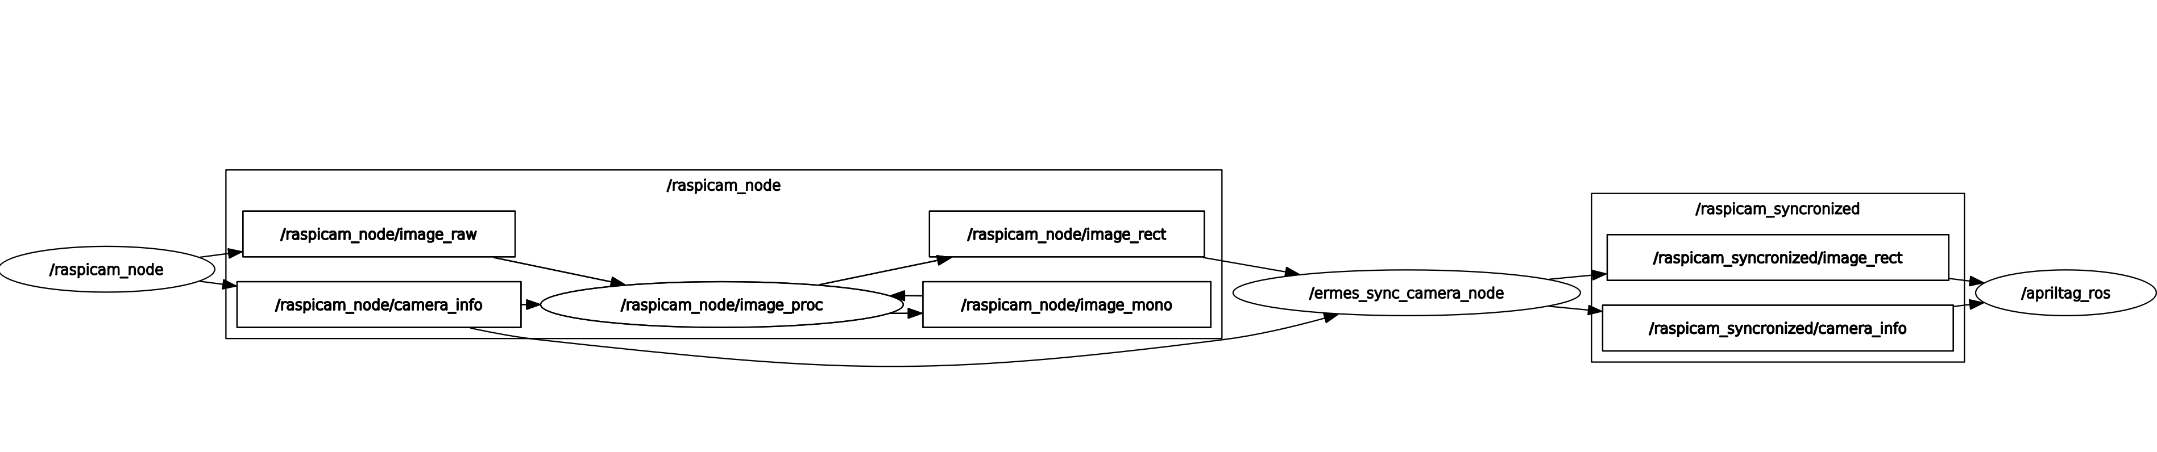
ERMES Nodes Structure
Raspicam
Image Processing
Synchronization
AprilTag

Slide 4
Raspicam Node
Register video from the raspberry camera
Publish camera_raw and camera_info topics
Frequency up to 90 Hz
Resolution 1280x960
Can compute image motion vector with GPU if necessary

Slide 5
Image Processing Node
Used to rectify the image using camera_info
Publish image_rect
Desynchronizes the image_rect and camera_info

Slide 6
Synchronization Node
Used to synchronize image_rect and camera_info
Approximate synchronization policy
Camera_info doesn’t change in our case

Slide 7
AprilTag Detection
Register to image_rect and camera_info topics
Publish tag_detections
Pose from raspicam frame
AprilTag 3 algorithm

Slide 8
To Optimize...
Camera resolution
Camera focus
Camera calibration (depends on the others 2)
Tag_refine
Tag number and positions
Tag type

Slide 9
Frame Tree
ROS uses transforms
Keep track of robot state and localization state
Transform coordinates from one frame to another via a Tree of dependent Frames
Static Frame
Dynamic Frame

Slide 10
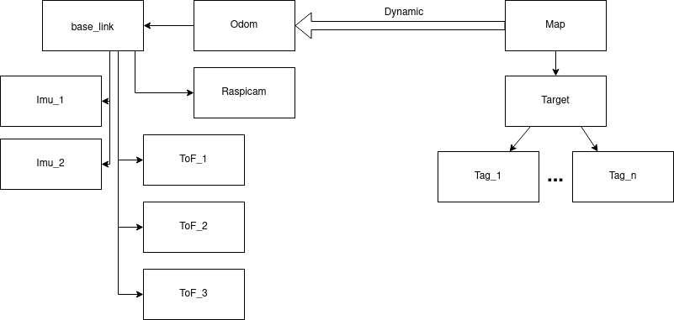
ERMES Frame Tree
Static Transforms
Each sensor has its frame

Slide 11
Apriltag to Odometry Node
Apriltag detection information can provide an Odometry Message
Pose provided by the detection itself
Twist calculated from two different timed detections
Provide odometry information in respect to the corresponding frame

Slide 12
Imu Node Arduino
Arduino should provide the 2 IMU topics
Evaluate if using ROS messaging or implement a lighter version
Trade off: less reliable -> lighter and faster and viceversa

Slide 13
IMU node Raspberry
Process arduino serial communication and provide a ROS publisher
If we choose a lighter version, this node must convert serial communication to ROS message framework

Slide 14
Chaser Localization
The target is the origin of the world
Each sensor has its own frame but they can convert to other frame
EKF with odometry from apriltag and two IMU sensors
Publish TF from map to base_link
Publish odometry/filtered and acceleration/filtered

Slide 15
EFK Node
Has a lot of parameter to tweak to improve performance in our use case scenario
I will use default values at the moment
Option of UKF available if there are enough resources

Slide 16
Guidance (and Control) Node
Calculate the trajectory to approach target
First iteration: naive guidance: fix rotation and decelerate
Control the trajectory sending appropriate commands to the low level control
The low level control accept commands in the form: acceleration, time
Acceleration only on one axis
Can overlap commands if they don’t saturate the system

Slide 17
State of the Work
Raspicam node: implemented, tested, missing calibration
Image processing: implemented and integrated
Synchronization node: implemented, tested
Apriltag detection: implemented and tested the communication and topic publishing
Frame tree: implemented the static part, working on transformation
IMU: tested on separated system without the low level control
EKF node: yet to be implemented
Guidance and control: yet to be implemented

Slide 18
Next steps available
Finish the transformation
Implement apriltag to odom node
Test an EKF implementation with available setup

Slide 19
Next steps with missing operations
Find the best apriltag configuration with the lowest computational power (trade off in tag dimensions, number, etc)
Test the entire chaser localization in a chaser mockup (just sensors in the correct position)
Develop a naive Guidance and Control node
Test the Control system (without guidance) in a mockup

Slide 20
Nice to Have Features
Using 3 ToF to detect the orientation of the target in close proximity (they are inaccurate in low distances)
Odometry from the low level control to fuse with other odometry information

Slide 21
Must Have Features but not Urgent
IMU Node with an arduino to attach on the release system, to detect the perfect time to release
Test the release system and the laptop backup
Implement a parallel system to register the video and take a copy of all sensors and topics published (parallel so if it fails it doesn’t interrupt the experiment)

