Slide 1
Behaviour of Test and Train Error
-Mirra (D18020)

Slide 2
Introduction
Studying the effect of training sample size on the test error.
As the training sample size increases, the test error decreases. When the sample size is small and the complexity is high, the model tends to over-fit the data.
Studying the effect of order of the model on the test error.
As the model complexity increases, the training error decreases and the test error first decreases then increases. The model tends to capture more of the variations in the data, hence the training error decreases, but the test data set may not have the same pattern, hence after a point, the test error increases which indicates that the model is over-fitted.
Tool Used : R
Git-hub link : https://github.com/mirra7/linear_regression
Data Set : diamonds (ggplot2)

Slide 3
Studying the effect of Sample Size on Test Error
The model is set at order 7(say)
Observe how training and test errors vary as we increase the sample size
Sample size – 10, 20, 30, 50, 70, 100, 200, 350, 500, 1000, 2000, 5000

Slide 4
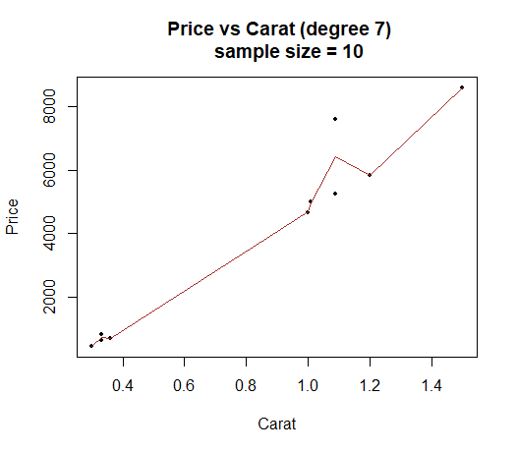
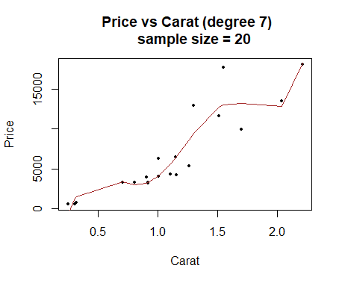
Studying the effect of Training Sample Size on Test Error
Train Error : 2722044
Test Error : 1.279174e+19
Train Error : 72096460
Test Error : 3.694552e+16

Slide 5
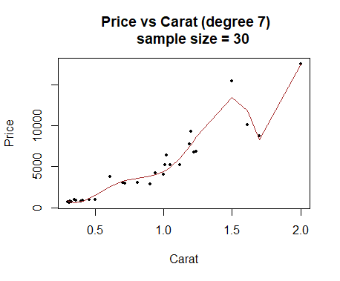
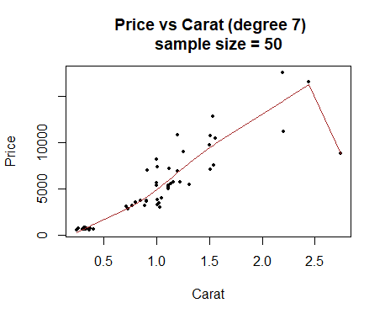
Train Error : 23520368
Test Error : 5.666741e+18
Train Error : 113949028
Test Error : 6.894873e+14

Slide 6
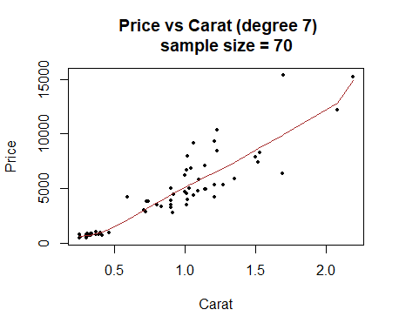
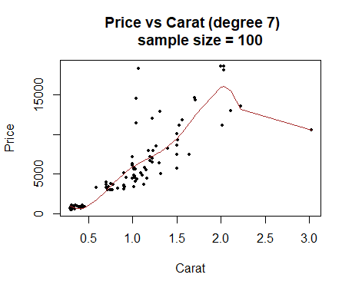
Train Error : 132637492
Test Error : 6.45815e+15
Train Error : 465975300
Test Error : 4.986555e+15

Slide 7
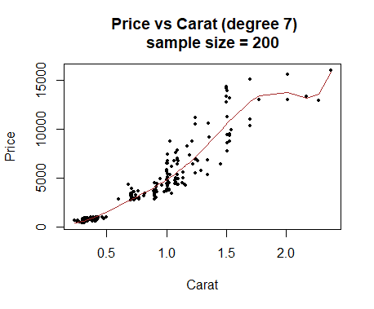
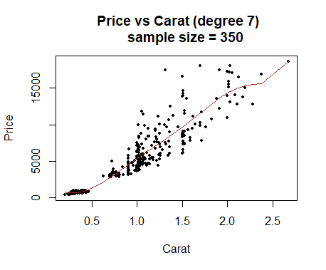
Train Error : 271187940
Test Error : 5.931176e+15
Train Error : 887088350
Test Error : 5.540374e+14

Slide 8
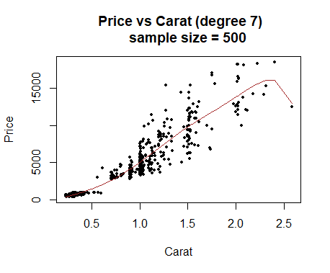
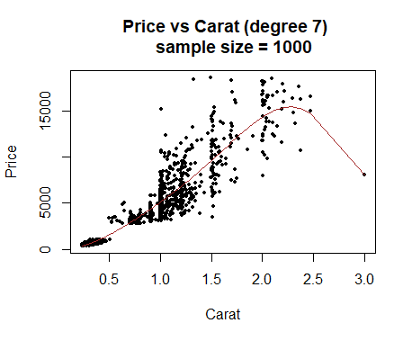
Train Error : 1074648367
Test Error : 5.893991e+14
Train Error : 2643844939
Test Error : 1.501901e+13

Slide 9
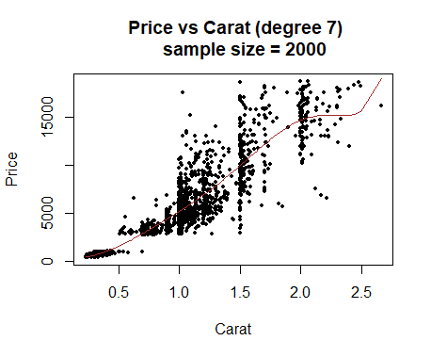
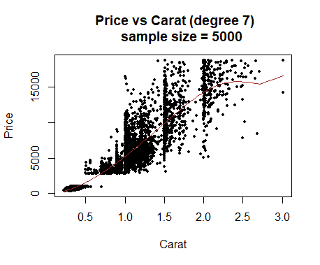
Train Error : 5915489980
Test Error : 4.63698e+14
Train Error : 14839584616
Test Error : 6.274471e+12

Slide 10
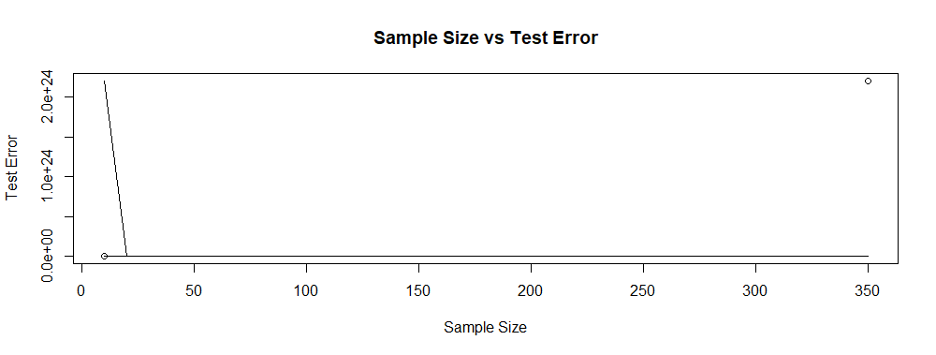
Polynomial Regression Order = 7
As the Sample Size increases, the Test Error decreases drastically and after a point, the test error becomes very small.

Slide 11
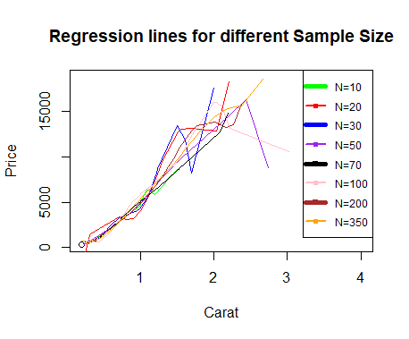
Regression lines for different Sample Sizes
Regression lines for all samples of different sizes plotted together.
When N is small, the model tends to be over-fitted.

Slide 12
Study the effect of Model complexity on Train and Test Error
Take 4 samples of size 50 each.
Take 4 samples of size 100 each.
Observe how the linear regression model of different orders (1,2,7,8,9,10) fit on these samples.

Slide 13
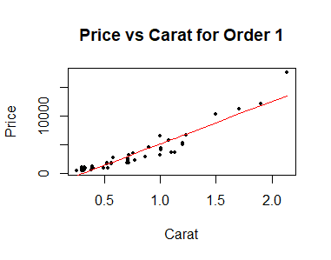
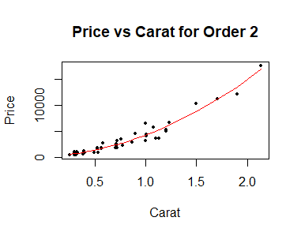
Studying the effect of polynomial regression order for one Sample (size 50)
Train Error : 5.8612e+7
Test Error : 1.2979e+9
Train Error : 2.446e+7
Test Error : 1.2973e+9

Slide 14


Train Error : 1.971e+7
Test Error : 1.2773e+9
Train Error : 1.957e+7
Test Error : 1.279e+9

Slide 15


Train Error : 1.777e+7
Test Error : 1.2822e+9
Train Error : 1.757e+7
Test Error : 1.2852e+9

Slide 16
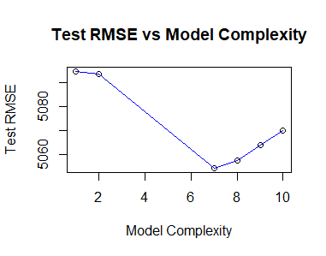
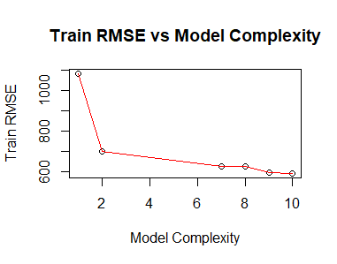
Effect of Model Complexity on Test and Train Error
This is for one sample (size 50), all other samples also follow similar pattern.

Slide 17
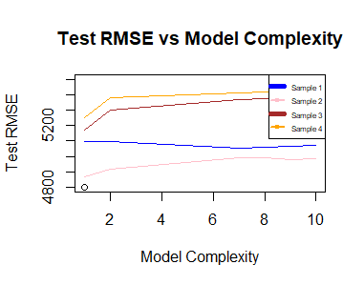
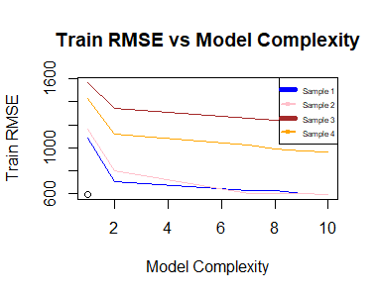
Train and Test Error for samples of size 50
Test Error decreases then increases, Train error decreases.

Slide 18
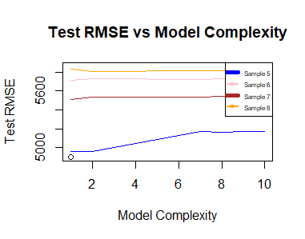
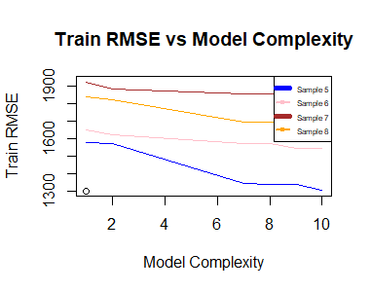
Train and Test error for samples of size 100
Test Error first decreases then increases. Train error decreases.

Slide 19
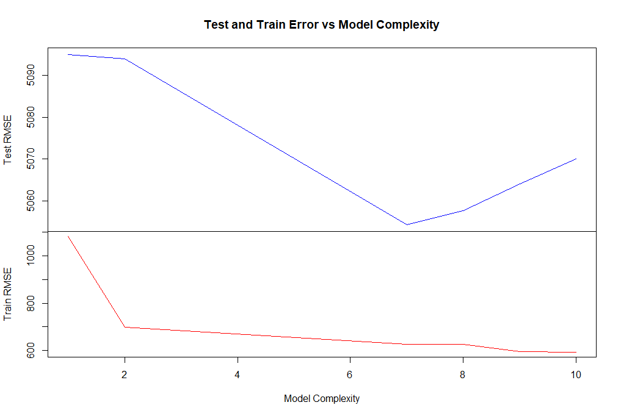
Train and Test Error vs Complexity

Slide 20
Thank You

