Slide 1
S-Mart Final Project
By Ed Bull, Forrest Wong & Shittul Mona

Slide 2
Demo

Slide 3
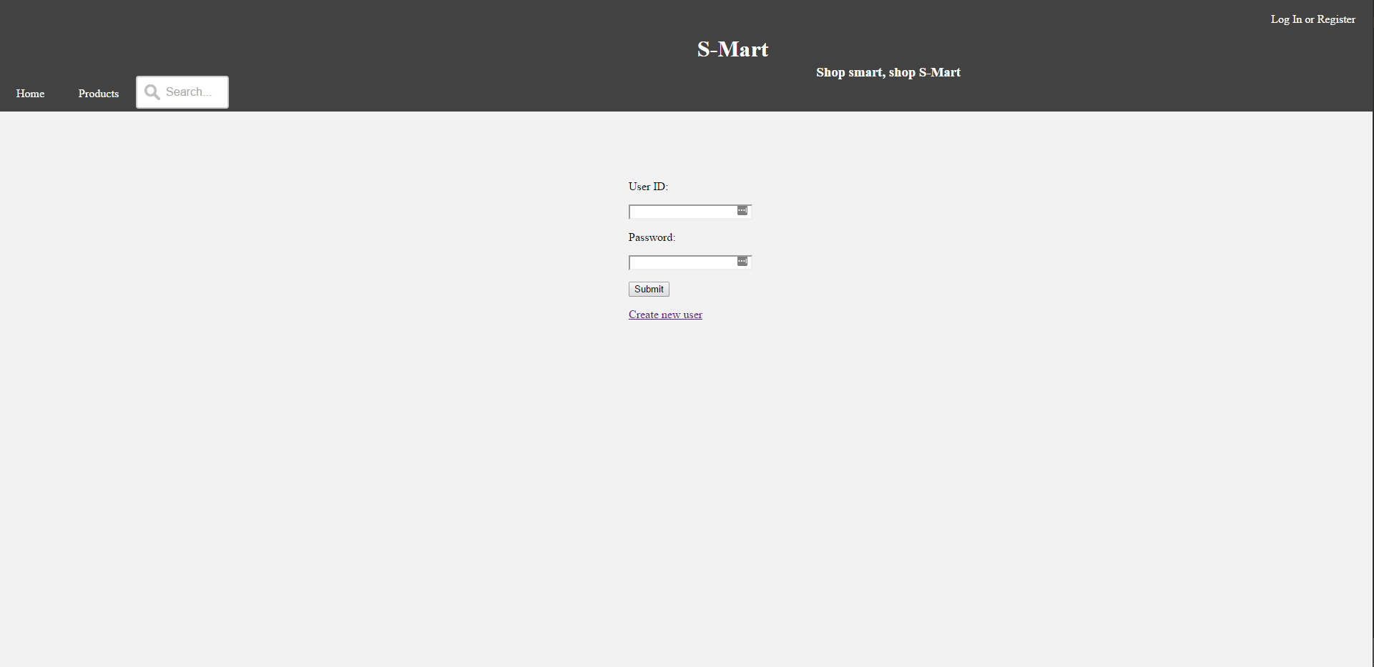
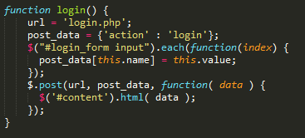
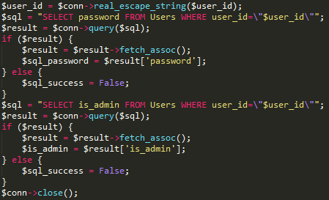
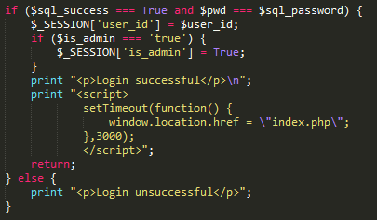
Logging in
From the login screen, there is a simple login form. Once the user id and password are entered, the Submit button calls login() to get the ball rolling.
Once at login.php a session is created and the user id and password are compared with what is in MySQL.
There’s no password hashing, so from here it’s just a simple equality check.
Once the user is authenticated, session credentials are set and the user is redirected back to the main page.

Slide 4
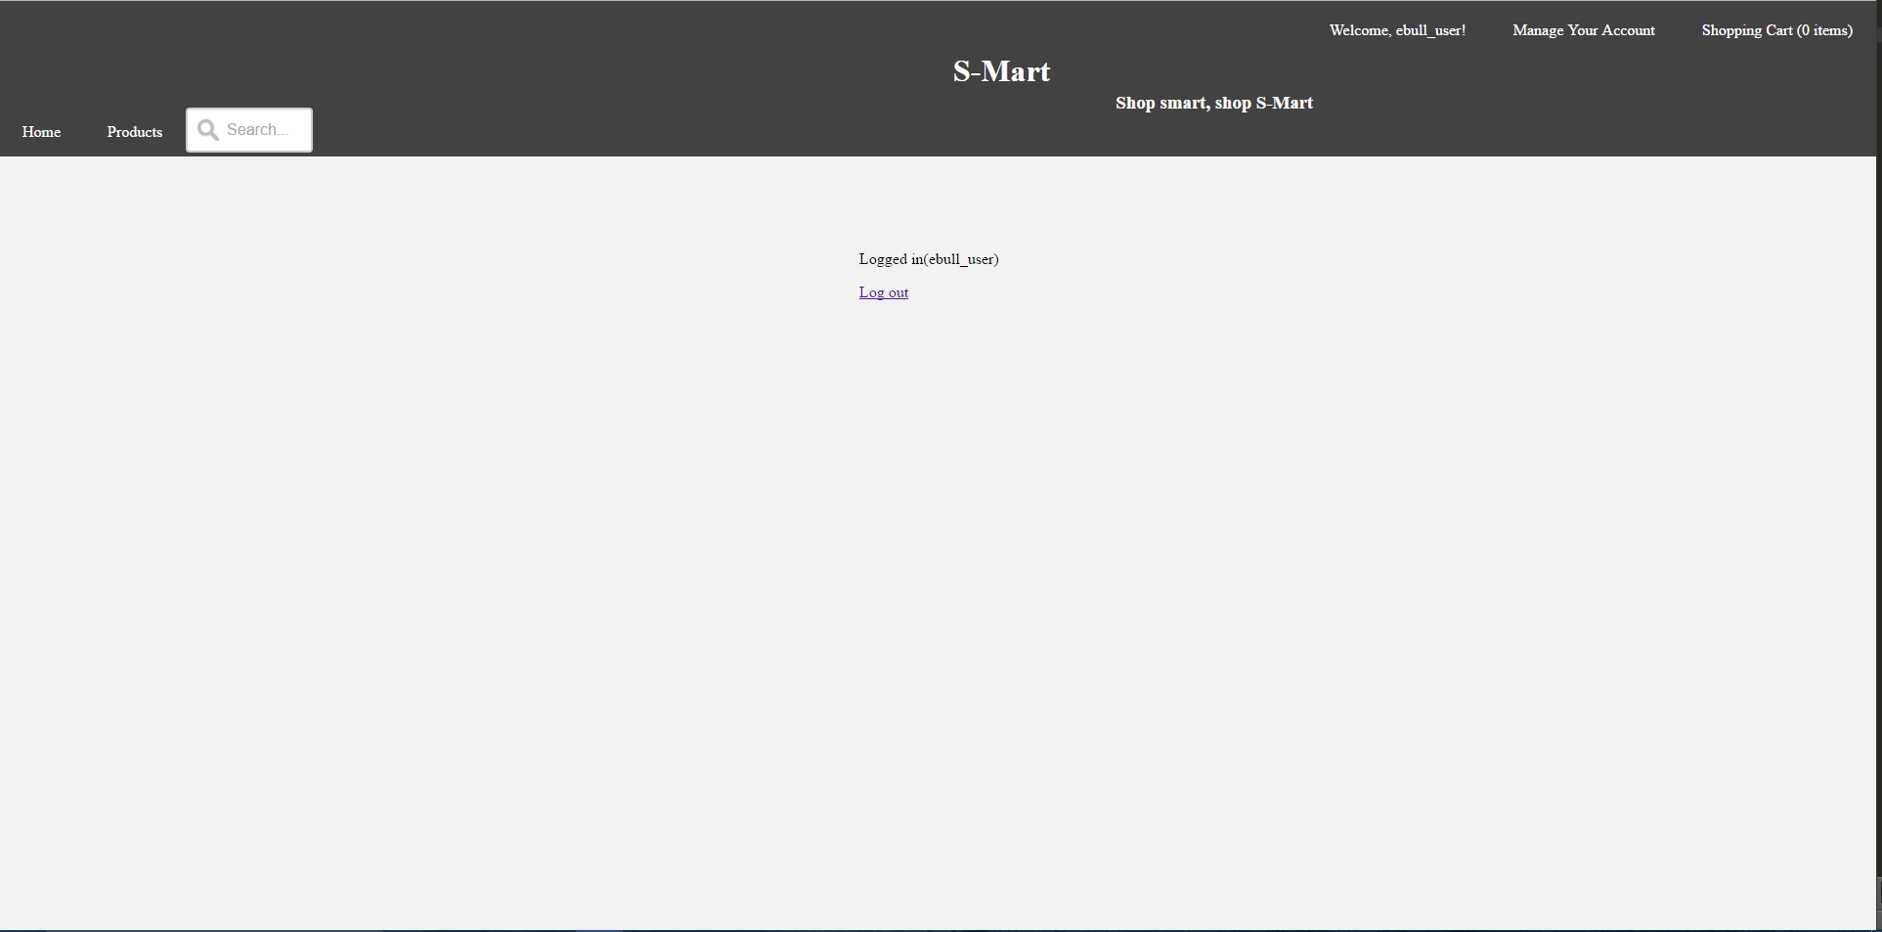
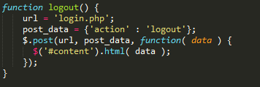
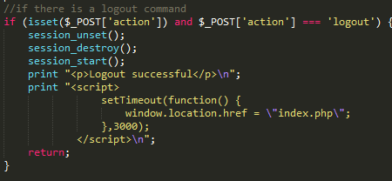
Logging out
Logging out is easier. Once logged in, the user can click on their user name button in the upper right to see the log out screen.
The logout command sends the action=logout command to login.php, which clears the session variables.
Once the logout is complete and the session variables are cleared, the user is redirected back to the front page.

Slide 5
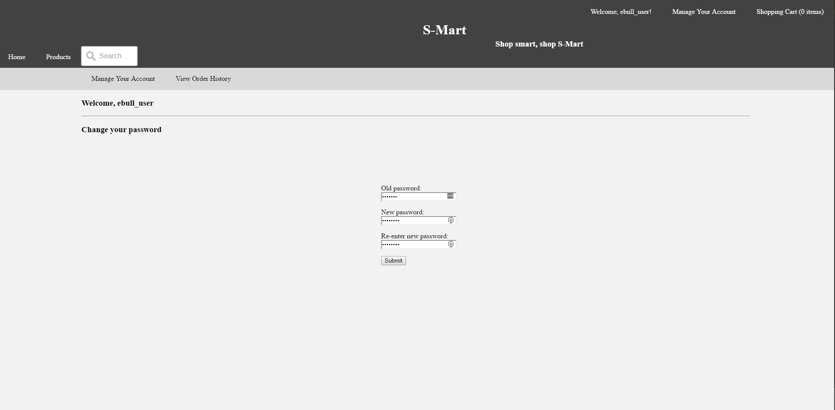
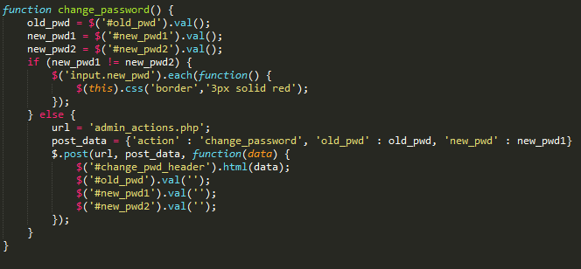
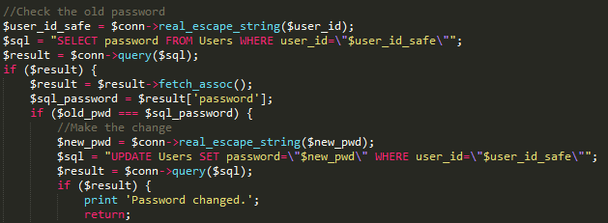
User functions – Password changing
From the ‘Manage Your Account’ menu, users have two options: Changing their password, and viewing order history. The submit button here calls change_password().
Once the user confirms the change they want to make, the values are passed to admin_actions.php where the user’s permissions are validated and the change is made.

Slide 6
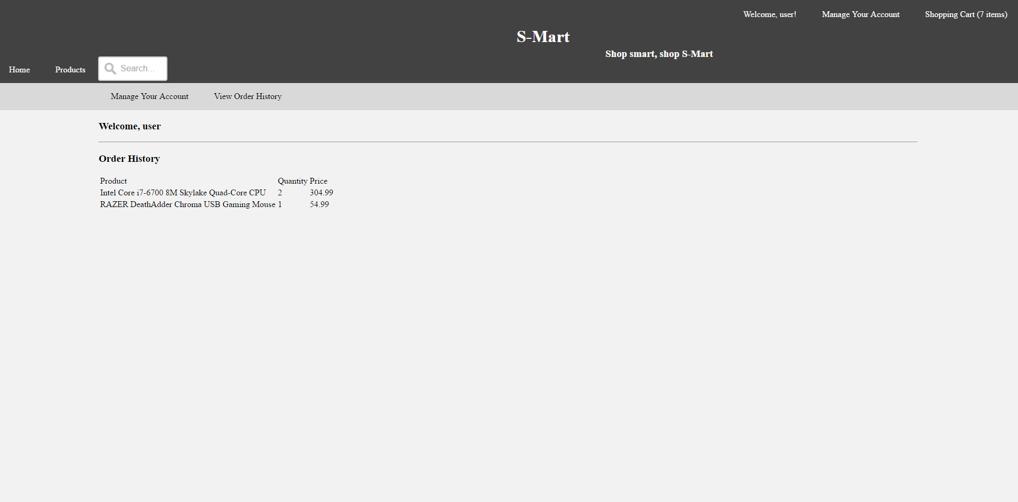
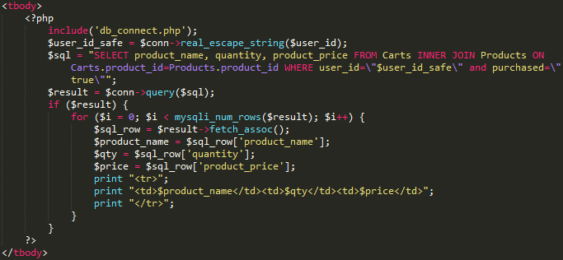
User functions – Order history
Users can also view their order history from the ‘Manage Your Account’ interface. It’s done via a simple php script in the display document itself.
Since the values are more or less static when the page is loaded, there’s no need for any fancy JavaScript. The values are just fetched and displayed.

Slide 7
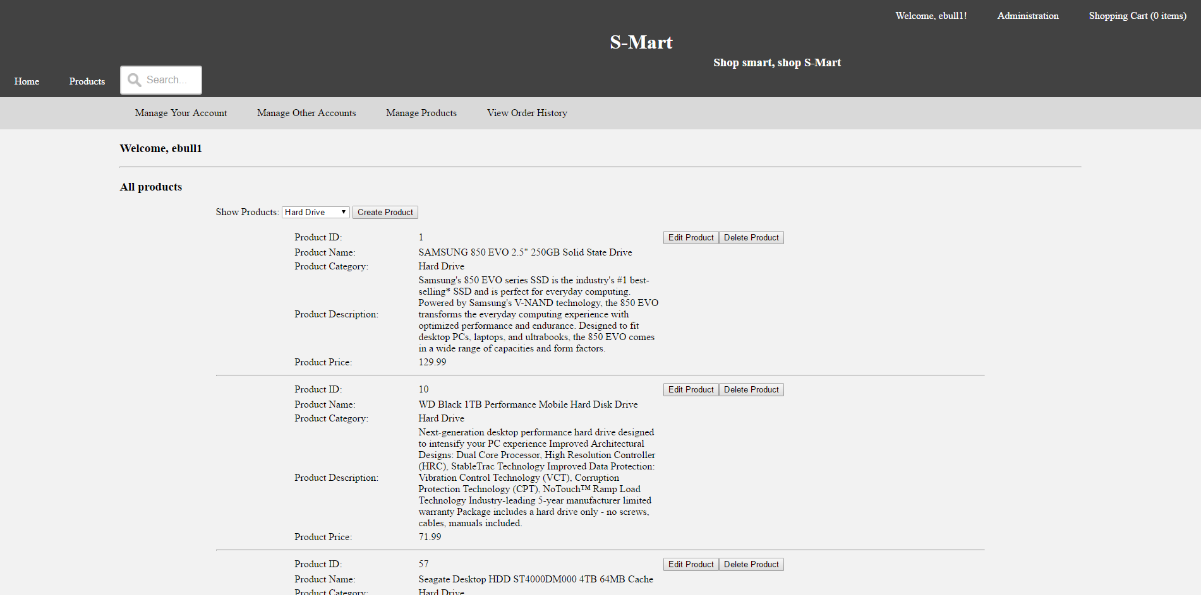
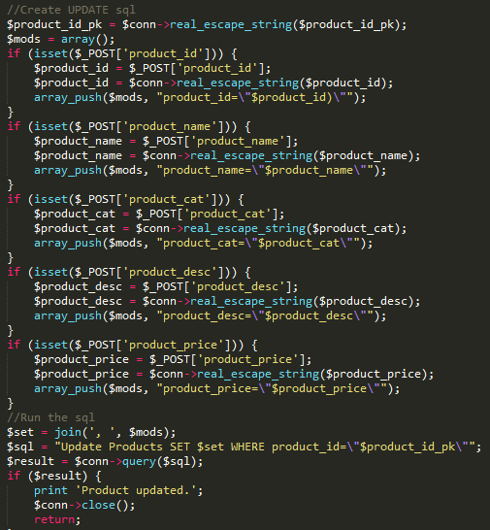
Admin functions – Manage Products
The admin can also manage all products on the website. From this interface, the admin can edit any value of any product, delete the product, or even create new products (and categories) which will immediately display for all users.
For example, when editing a product, once the JavaScript takes the user’s input then admin_actions.php constructs an UPDATE query based on the POST values it receives and submits the query to the database.

Slide 8
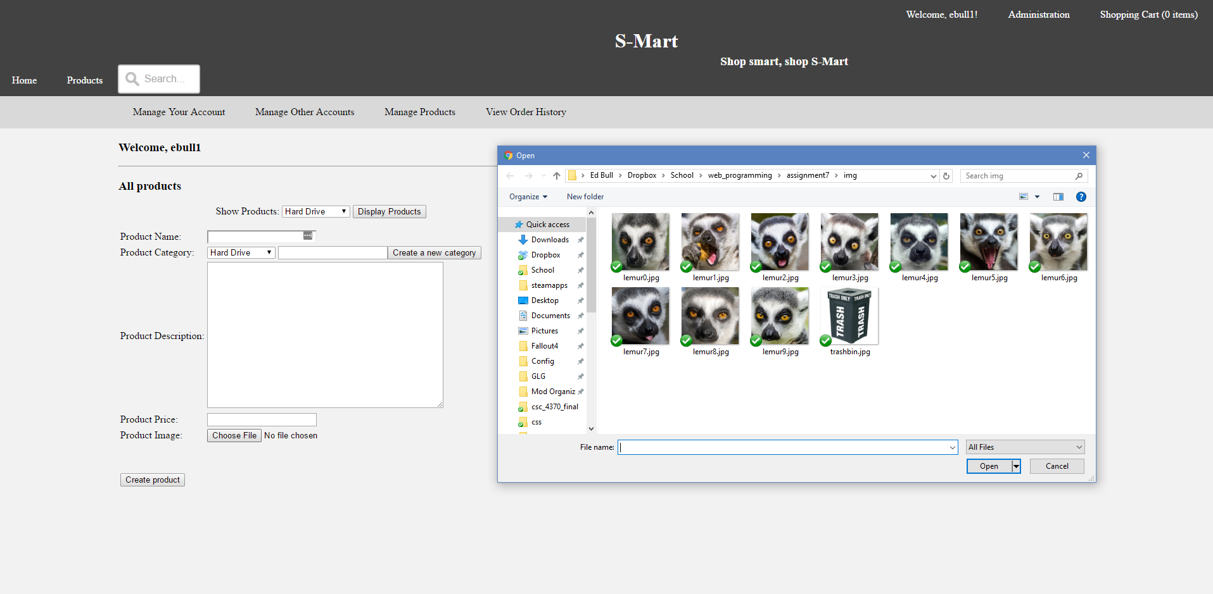
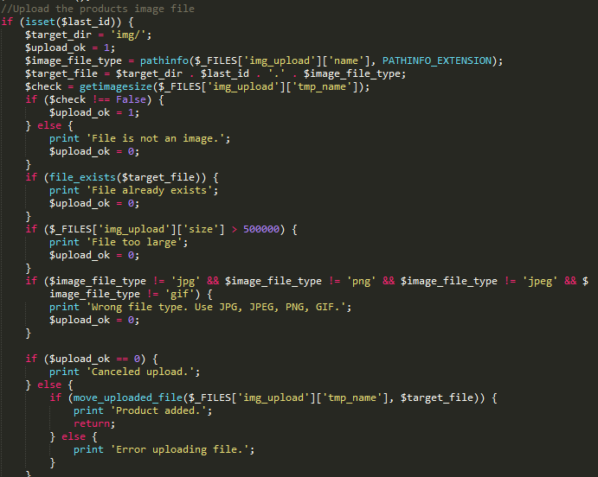
Admin functions – Adding products
In addition to editing existing products, admins can create new products and upload the image that will display for them in the Products portion of the website.
Uploading images is easy, but there is a sticking point that you can not upload images via Ajax POST requests. It only seems to work on older browsers through a normal form POST. So, if you don’t want your page to reload, you can point the form at a hidden iframe. Or, in my case, use it to display feedback.

Slide 9
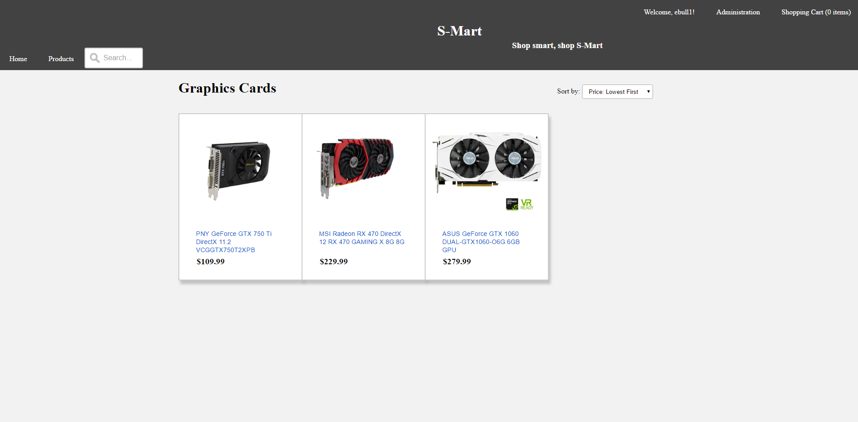
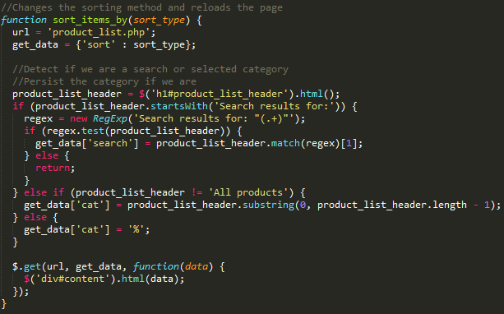
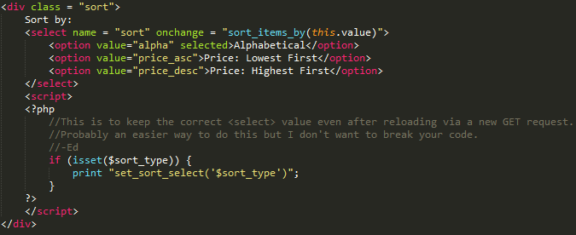
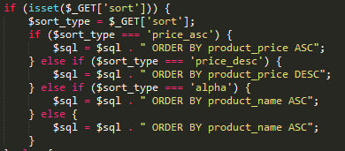
Product Sorting
Forrest handled most of the Product display work, but I did assist on getting the Products to sort accordingly. Here’s how:
The ‘Sort By’ <select> tag calls sort_items_by(sort_type) using onchange. So sort_items_by(sort_type) detects the current category or search term in order to keep them persistent, and passes them along with the new search type into a GET request.
Based on the sort type, the MySQL query is appended. The selected sort type is preserved across page reloads by a line of JavaScript.

Slide 10
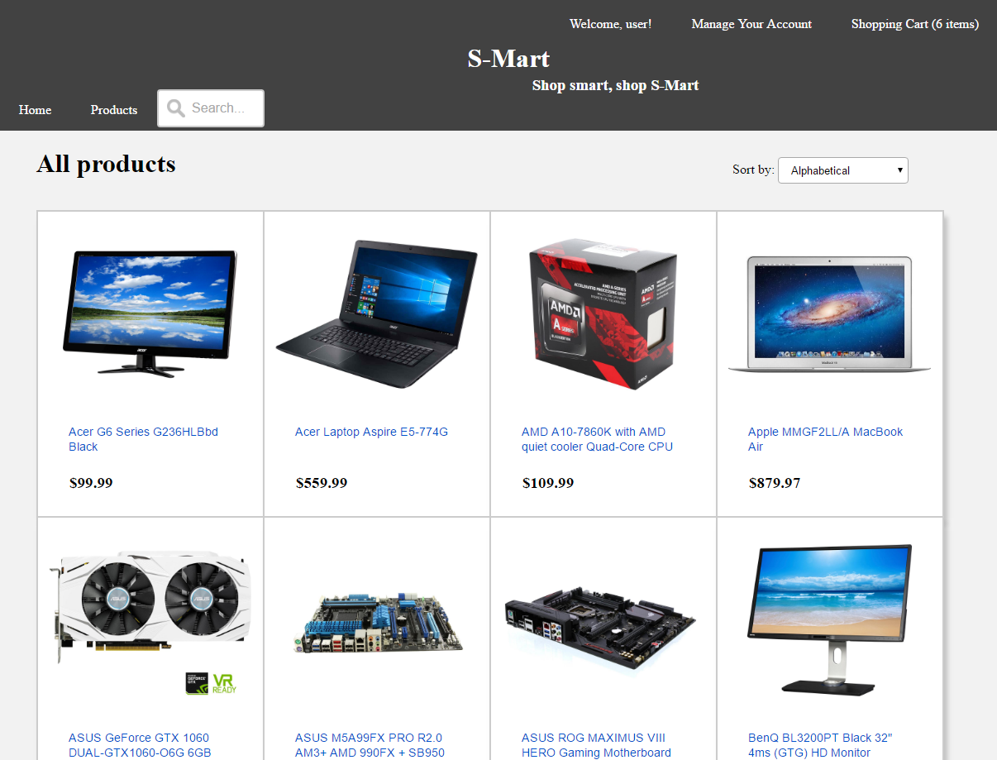
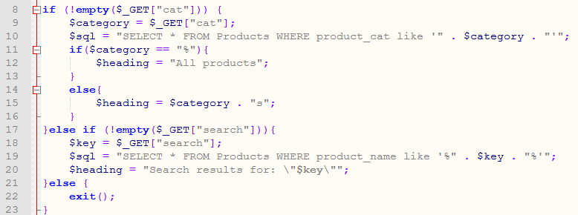
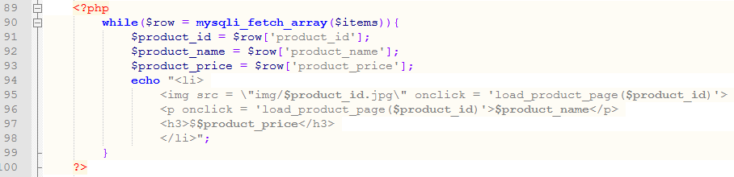
User functions – Inventory
When a user searches by category or text search, an AJAX get method makes a request. The PHP retrieves the results.
The SQL results are displayed.

Slide 11
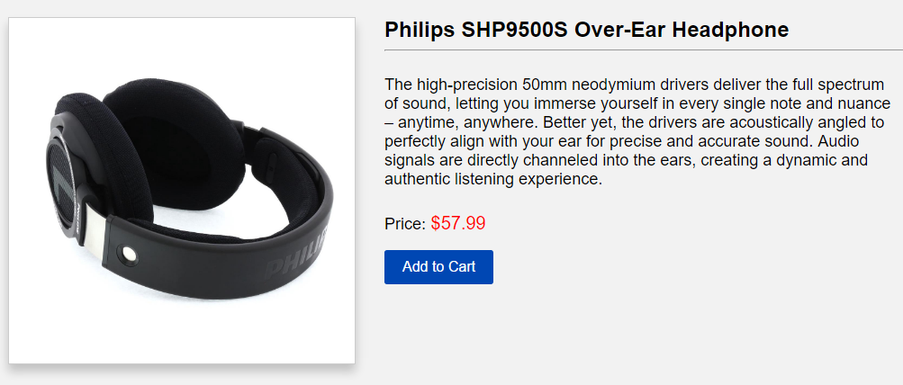
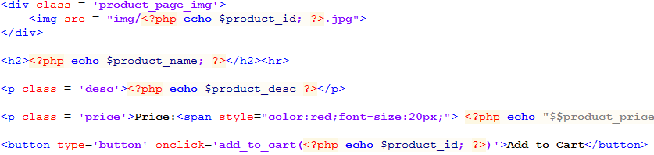
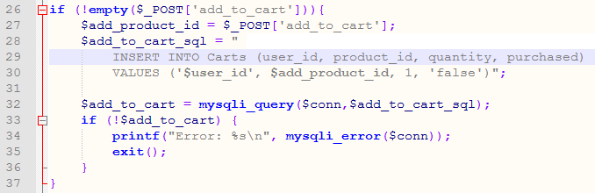
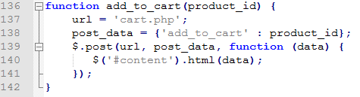
User functions – Add to Cart
When the “Add to Cart” button is clicked, the item is added to the cart of the current user.

Slide 12
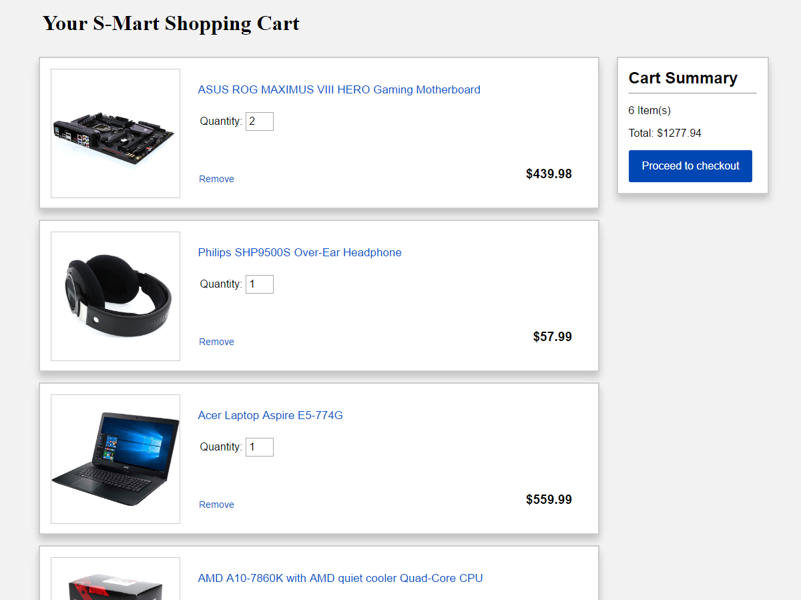
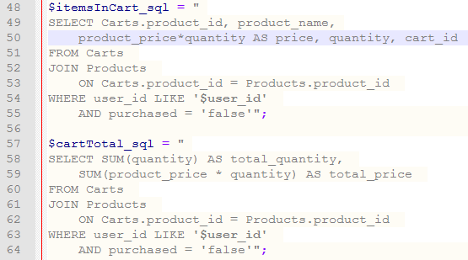
User functions – Cart
To display items in the cart of a specific user, a JOIN was made with the Cart table and User table.
Product_price and quantity were multiplied to get the total for each item for quantities > 1. For the cart total, the SUM of all the (product_price * quantity) was taken. (I realize now that the above 2 queries did not need to be separate.

Slide 13
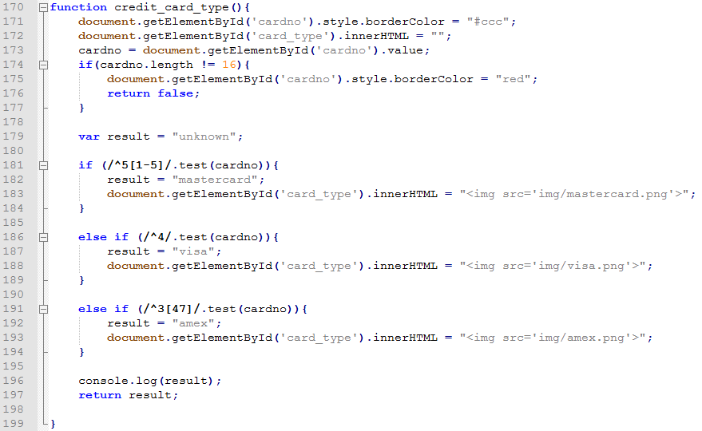
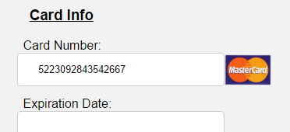
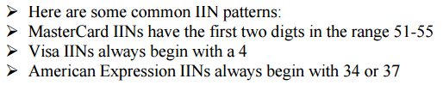
User functions – Card Detection

Slide 14
Q & A
Question ?

