Slide 1
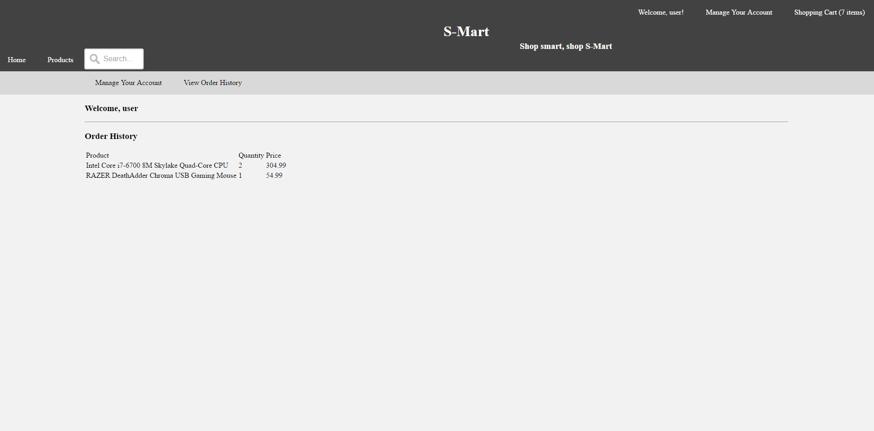
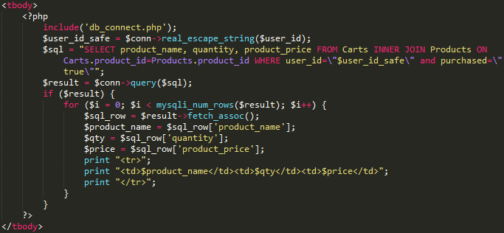
User functions – Order history
Users can also view their order history from the ‘Manage Your Account’ interface. It’s done via a simple php script in the display document itself.
Since the values are more or less static when the page is loaded, there’s no need for any fancy JavaScript. The values are just fetched and displayed.

Slide 2
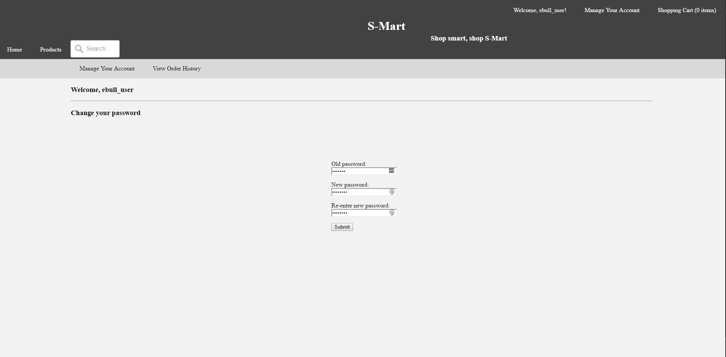
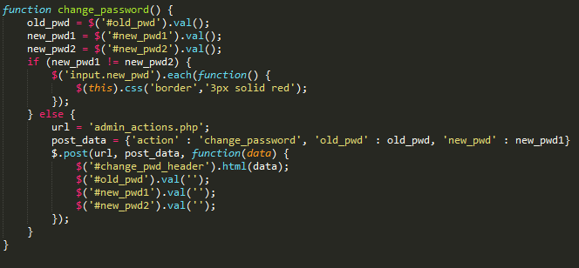
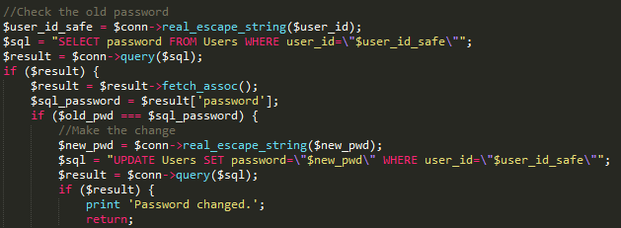
User functions – Password changing
From the ‘Manage Your Account’ menu, users have two options: Changing their password, and viewing order history. The submit button here calls change_password().
Once the user confirms the change they want to make, the values are passed to admin_actions.php where the user’s permissions are validated and the change is made.

Slide 3
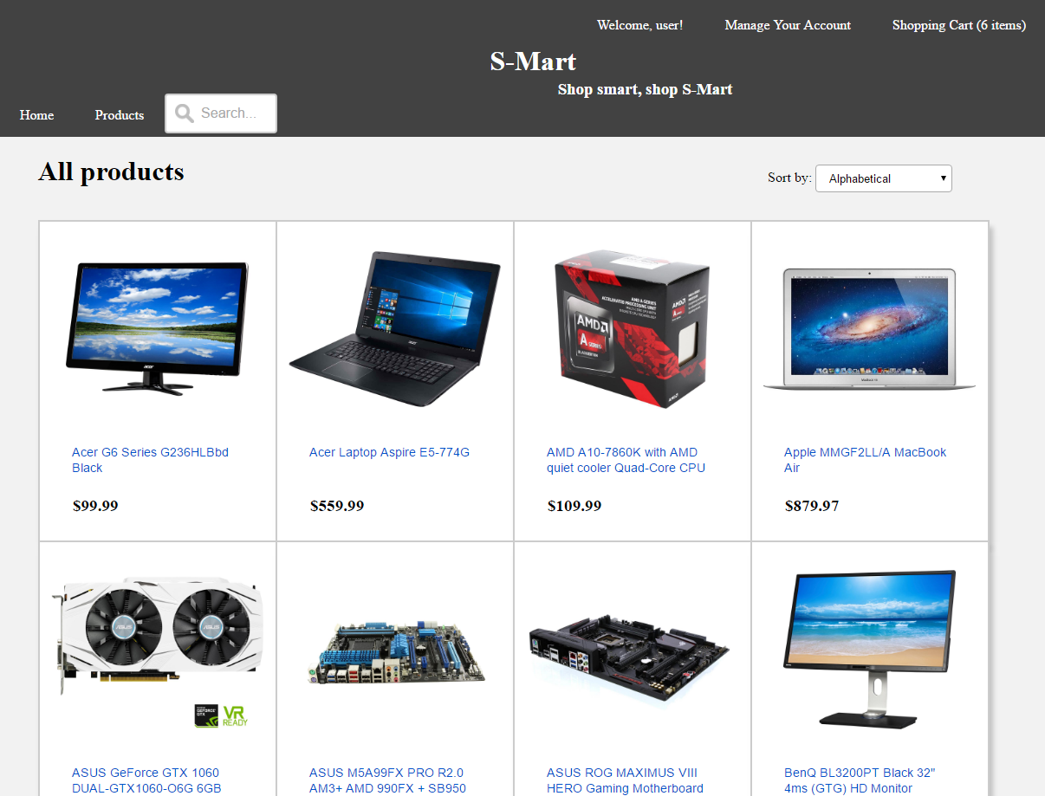
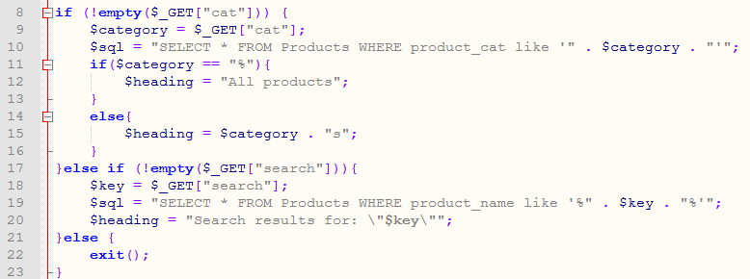
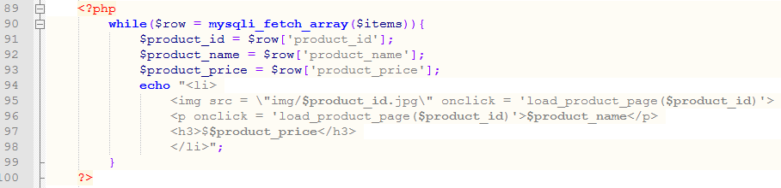
User functions – Inventory
When a user searches by category or text search, an AJAX get method makes a request. The PHP retrieves the results.
The SQL results are displayed.

Slide 4
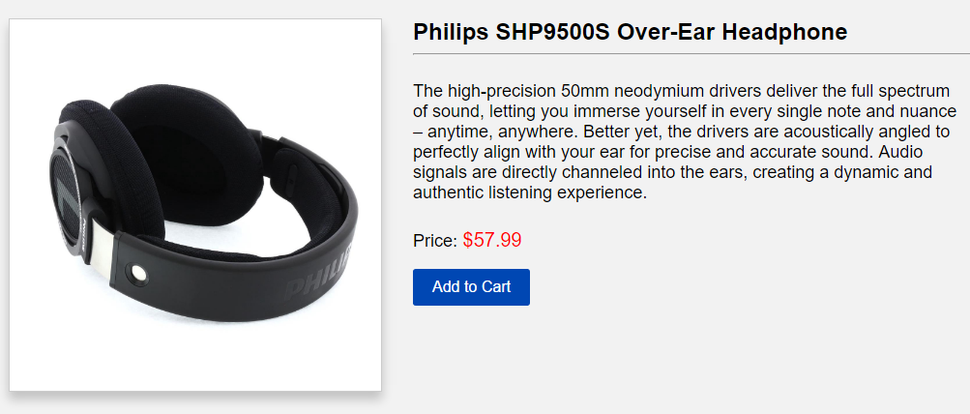
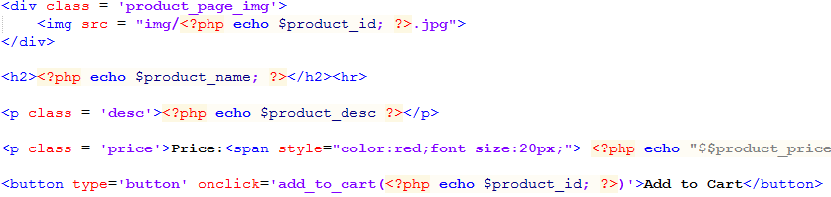
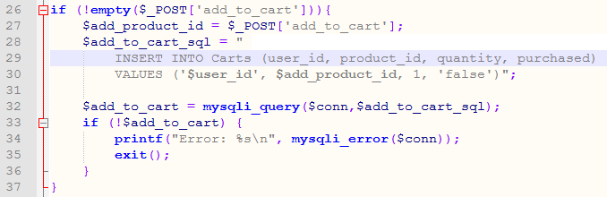
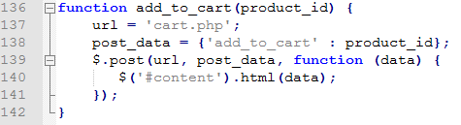
User functions – Add to Cart
When the “Add to Cart” button is clicked, the item is added to the cart of the current user.

Slide 5
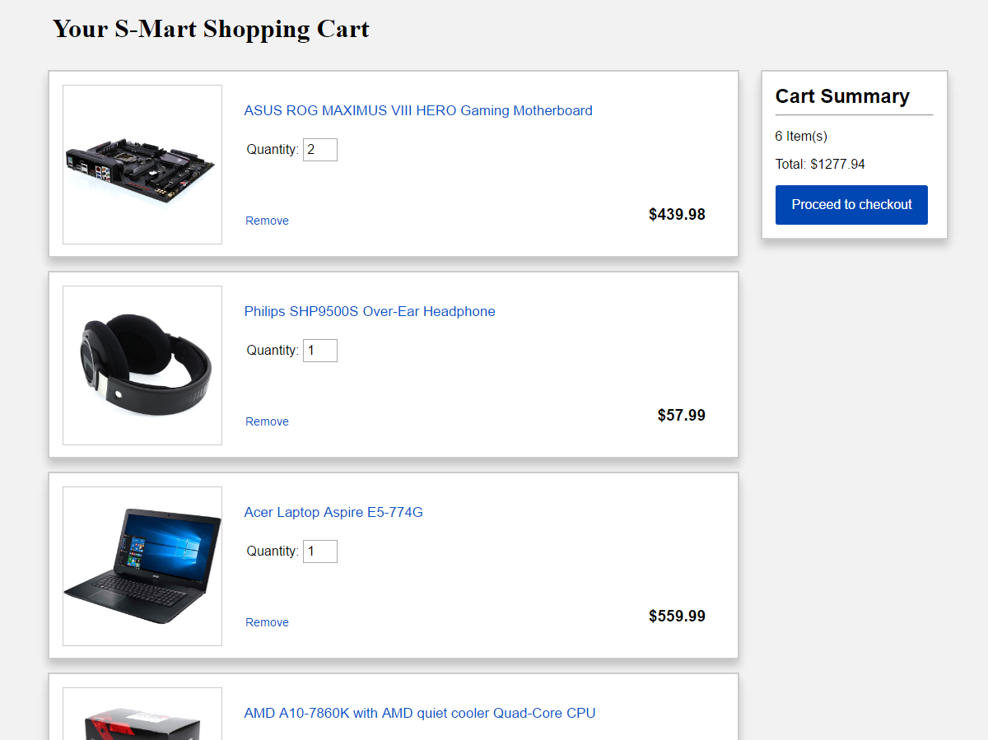
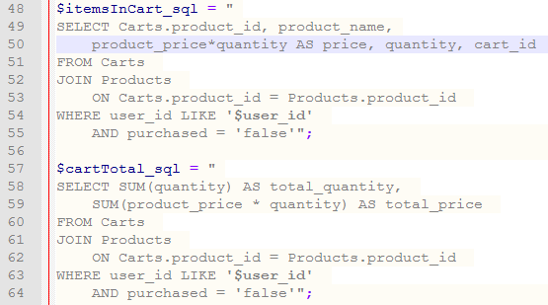
User functions – Cart
To display items in the cart of a specific user, a JOIN was made with the Cart table and User table.
Product_price and quantity were multiplied to get the total for each item for quantities > 1. For the cart total, the SUM of all the (product_price * quantity) was taken. (I realize now that the above 2 queries did not need to be separate.

Slide 6
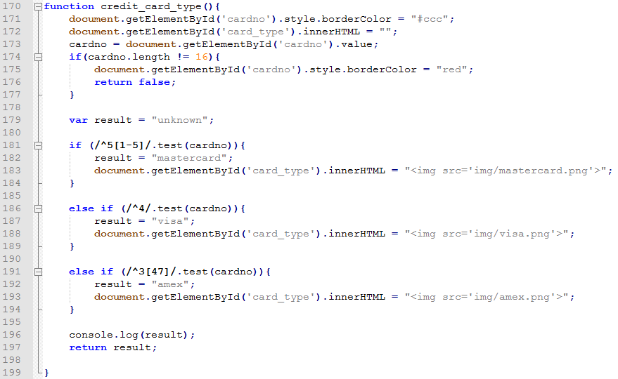
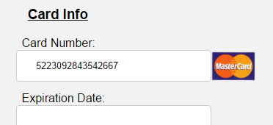
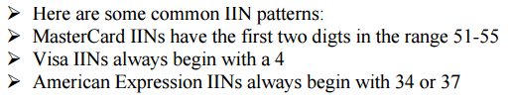
User functions – Card Detection

