Slide 1
FOR FAMILIES WITH A FEW MINUTES
Try This Fun
✦
TRY IT
Less deciding.
More doing.
Kumar Sridharamurthy + Lavanya Shirur Sudhakar
Husband-and-wife team · parents of a 6-year-old and a 2-year-old
Notes:
Open with the promise and the founders’ family context.
[Sources]
- Founder context supplied by Kumar Sridharamurthy and Lavanya Shirur Sudhakar.
[/Sources]

Slide 2
THE PROBLEM IS PERSONAL
We built this for
our own family.
2
2
+
parents
kids
Two working parents. A curious 6-year-old. A fearless 2-year-old. And a handful of minutes that too often disappeared while we searched for something to do.
5 spare minutes
should feel like an opportunity —
not another decision.
The real friction wasn’t a lack of ideas.
It was choosing the right one, right now.
TRYTHIS.FUN
02
Notes:
Tell the personal problem in thirty seconds: the family had ideas, but not the energy to search and adapt one in the moment.
[Sources]
- Founder context supplied by Kumar Sridharamurthy and Lavanya Shirur Sudhakar.
[/Sources]

Slide 3
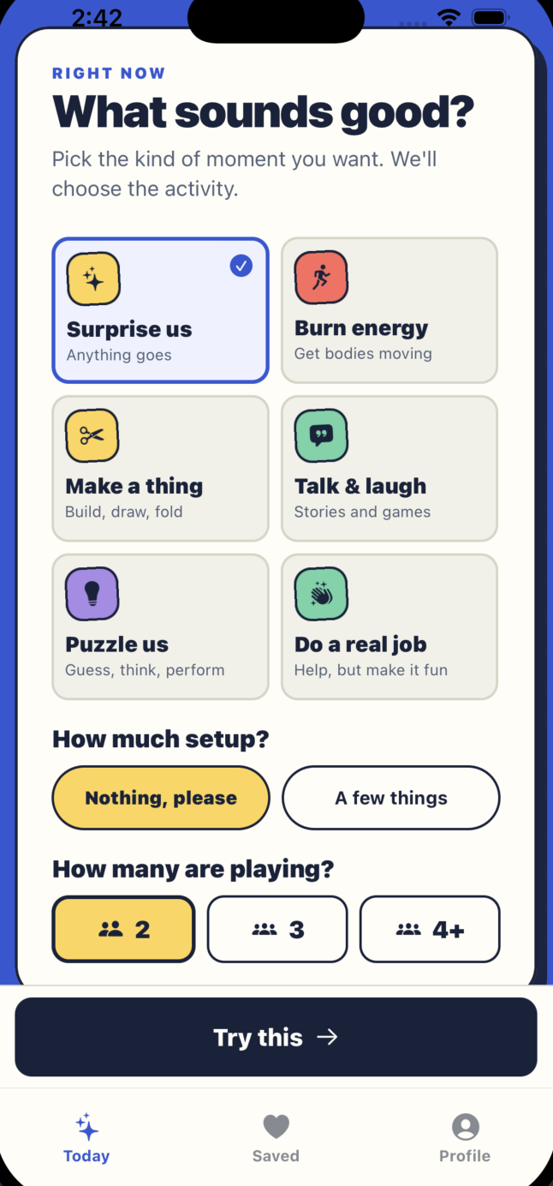
THE PRODUCT
One good idea beats
another endless list.
Try This asks only what matters in this moment — the mood, setup, and time available — then recommends one activity.
1
Pick the moment
2
Get one matched idea
3
Start playing
TRYTHIS.FUN
03
Notes:
Show the working homepage: choose the moment, receive one matched activity, and start with complete instructions.
[Sources]
- Product screenshot: /Users/lavanya/Desktop/screenshots/homepage.png
- Working prototype: https://trythis.fun
[/Sources]

Slide 4
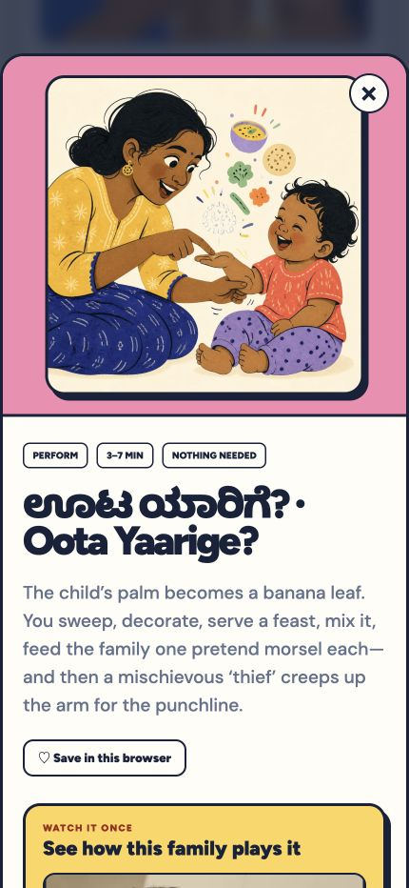
HERITAGE, MADE PLAYABLE
Watch once.
Play for years.
Oral family games survive when a new parent is never expected to already know the missing details:
✓
The original Kannada words
Lyrics preserved in Kannada script.
✓
A practical reading guide
Transliteration plus every movement.
✓
A real family demonstration
Video shows the rhythm and punchline.
TRYTHIS.FUN
04
Notes:
Use Oota Yaarige as proof that heritage preservation must include the words, motions, rhythm, and demonstration—not merely a title.
[Sources]
- Current Try This Fun product screenshot captured from https://trythis.fun
- Heritage content supplied and demonstrated by the founders’ family.
[/Sources]

Slide 5
SYSTEM ARCHITECTURE
Simple at runtime.
Deep before it ships.
The MVP keeps family data on-device and turns a reviewed content pipeline into one fast, explainable recommendation.
1
Research → typed catalog
2
Constraints → shuffled deck
3
Web + iOS + Android
TRYTHIS.FUN
05
Notes:
Explain the actual MVP architecture. No runtime LLM or login is required: reviewed content becomes a typed catalog, deterministic constraints create a compatible deck, and the same source feeds web and native apps.
[Sources]
- Repository architecture: /Users/lavanya/github/Bonding/README.md
- Implementation: /Users/lavanya/github/Bonding/web/components/play-deck.tsx
[/Sources]

Slide 6
THE TECHNICAL MOAT
The catalog is
the compounding asset.
The hard work happens before a card reaches a family:
✓
A shared typed schema
One reviewed catalog across every platform.
✓
Explainable matching
Hard constraints, safe fallback, fresh shuffle.
✓
Complete editorial playbooks
Starts, steps, remixes, media, and provenance.
TRYTHIS.FUN
06
Notes:
Technical depth is concentrated in content engineering, schema normalization, shared adapters, fallback logic, randomization, media optimization, and source provenance.
[Sources]
- Shared catalog implementation: /Users/lavanya/github/Bonding/web/lib/catalog.ts
- Source playbooks: /Users/lavanya/github/Bonding/src/data/source-ideas.ts
[/Sources]

Slide 7
BUSINESS VIABILITY
Low infrastructure.
Growing content value.
We can validate willingness to pay before adding payment complexity:
✓
Free starter collection
Prove repeat use through the account-free product.
✓
One-time family unlock
Complete library and offline media—no subscription.
✓
Collection partnerships
Libraries, schools, and cultural organizations.
TRYTHIS.FUN
07
Notes:
Present the commercial model as a hypothesis to validate: a free starter product followed by a single family unlock and institutional collection partnerships.
[Sources]
- Product strategy: /Users/lavanya/github/Bonding/docs/DEVFOLIO_SUBMISSION.md
[/Sources]

Slide 8
SIX-MONTH ROADMAP
Prove repetition.
Then expand the library.
The next phase turns the working prototype into a measurable, cross-platform family product.
1
Measure tried, saved & repeated
2
Add reviewed heritage packs
3
Launch iOS + Android stores
TRYTHIS.FUN
08
Notes:
The six-month roadmap includes opt-in outcome learning, reviewed heritage expansion, and production launches on both the iOS App Store and Android Play Store with a one-time unlock.
[Sources]
- Product roadmap: /Users/lavanya/github/Bonding/README.md
[/Sources]

Slide 9
THE OUTCOME
Preserve what families know.
Make the next laugh easier.
✦
Try This Fun turns scattered ideas and fading family traditions into clear, playable moments—on the web today, and across iOS and Android next.
TRY IT
trythis.fun →
Kumar Sridharamurthy + Lavanya Shirur Sudhakar
Play it now
Notes:
Close by returning to the opening tension: a few spare minutes should become play, not another search. Invite judges to use the account-free live product.
[Sources]
- Working prototype: https://trythis.fun
[/Sources]

