Slide 1
mirrorsme.ai
I²OS AGENTIC PLATFORM · HEALTHCARE
Home Health Nurse AI
An in-home visit copilot that listens to the visit, transcribes live, and auto-fills OASIS documentation as the nurse works — review and submit in one pass.
Ambient capture
Live OASIS-E auto-fill
Review & submit
Use Case Summary

Slide 2

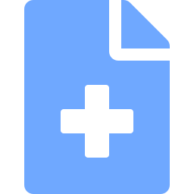

USE CASE SUMMARY
Documentation is eating the home visit
Home health nurses spend hours after every visit translating what happened into the OASIS assessment — a 100+ element instrument that drives care planning, PDGM reimbursement, and audit exposure.
Charting bleeds into evenings and weekends, accuracy slips under time pressure, and the patient gets a clinician staring at a laptop instead of at them.
Home Health Nurse AI sits in the visit as an ambient copilot: it listens, transcribes, and builds the OASIS record in real time so the nurse reviews and submits before leaving the driveway.
~1 in 4 hrs
of a home health nurse's day goes to documentation, much of it after hours
100+ items
per OASIS-E assessment — manually keyed from memory and notes
Audit risk
inaccurate or inconsistent coding threatens reimbursement and compliance
Figures are illustrative of well-documented home-health documentation burden.
mirrorsme.ai | I²OS Agentic Platform
Home Health Nurse AI

Slide 3




HOW IT WORKS
One pass, from doorway to submitted record
01
02
03
04
Listen
Transcribe
Auto-fill OASIS
Review & Submit
Nurse starts the visit. The copilot captures the conversation ambiently — no typing, no interruption.
Speech is transcribed live with speaker separation, clinical vocabulary, and offline buffering.
Findings are mapped to OASIS-E elements and the assessment is populated in real time with source links.
Nurse confirms flagged items, edits by voice or tap, and submits a clean record to the EHR.
Ambient capture replaces after-hours charting — the record is done when the visit is done.
mirrorsme.ai | I²OS Agentic Platform
Home Health Nurse AI

Slide 4



HIGH LEVEL SOLUTION
Agentic architecture on the I²OS platform
Capture Layer
Intelligence Layer
Integration Layer
Ambient audio capture on phone or tablet
Edge buffering for low-connectivity homes
Consent & session controls
Clinical ASR with speaker diarization
OASIS-E mapping & coding agent
Confidence scoring + gap detection
Review & submit workflow
EHR write-back (WellSky, HCHB, etc.)
Audit trail & compliance logging
Visit audio → Transcript → Mapped OASIS-E draft → Nurse review → Submitted to EHR
mirrorsme.ai | I²OS Agentic Platform
Home Health Nurse AI

Slide 5


CAPABILITIES
What the copilot does in the field
Ambient visit capture
Clinical live transcription
OASIS-E auto-population
Hands-free listening during the assessment — no forms, no typing mid-visit.
Speaker-separated transcript tuned to medical and home-health vocabulary.
Maps findings to M-items and GG functional items with linked source quotes.
Coding & gap assistance
Offline-capable
EHR integration
Flags missing data, inconsistencies, and likely coding for accuracy and PDGM.
Captures and processes in low- or no-connectivity homes, syncs when back online.
Write-back to WellSky, Homecare Homebase and other home-health systems.
mirrorsme.ai | I²OS Agentic Platform
Home Health Nurse AI

Slide 6
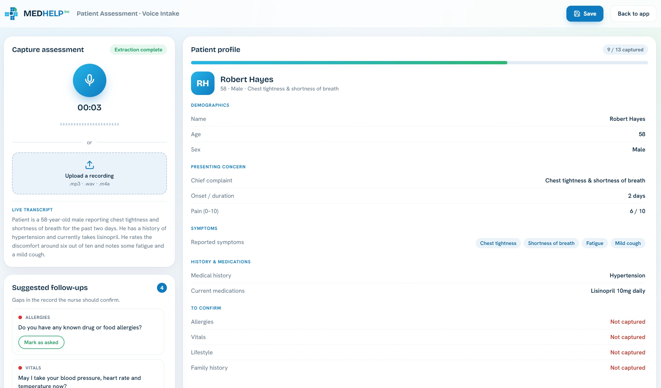
LIVE DEMO
Voice intake in action
Capture & transcribe
Ambient recording or uploaded audio, transcribed live as the visit happens.
Auto-built profile
Fields populate in real time with a completeness tracker — here, 9 of 13 captured.
Gap-aware follow-ups
Flags what's missing — allergies, vitals — and prompts the nurse to confirm.
MEDHELP voice intake — live extraction into a structured, EHR-ready patient profile.
mirrorsme.ai | I²OS Agentic Platform
Home Health Nurse AI

Slide 7



BENEFITS
Time back, accuracy up, patients first
Up to 70%
Near-zero
Cleaner
less time spent on OASIS documentation per visit
after-hours “pajama time” charting
coding for stronger PDGM accuracy & audit defense
For nurses
For patients
For the agency
Hours of charting reclaimed
Less burnout, lower turnover
Eyes on the patient, not the laptop
More present, human visits
Accurate care plans from day one
Faster start of care
Faster visit-to-bill cycle
Defensible, consistent OASIS coding
Higher clinician capacity
Benefit ranges are directional targets, validated per deployment.
mirrorsme.ai | I²OS Agentic Platform
Home Health Nurse AI

Slide 8
THE OUTCOME
The record is done
when the visit is done.
Home Health Nurse AI turns the OASIS burden into a review step — giving clinicians their evenings back, sharpening coding accuracy, and putting the focus back on the patient in front of them.
mirrorsme.ai · Built on the I²OS Agentic Platform

