Slide 1
Building & validating a GPU micromagnetic simulator with an AI coding agent
cross-implementation testing exposes a concurrency defect
Chun-Yeol You · DGIST | target: npj Computational Materials
Notes:
Opening. This talk is a case study: we used an AI coding agent to build a complete GPU micromagnetic simulator from scratch, validated it against the community standards, and — the punchline — the validation infrastructure itself caught a real GPU concurrency bug. So it is as much about a verification methodology as about the code. Target venue: npj Computational Materials.

Slide 2
Two questions
• AI coding agents now write substantial scientific software
• Q1 Can an agent build a *validated, performant* simulator — not a toy?
• Q2 What verification makes the result trustworthy?
– Micromagnetics: mature solvers (OOMMF, mumax3, mumax+), anchored to µMAG standard problems
– Prior AI work *optimized* existing codes; building+validating from scratch is the harder question
Notes:
Motivation. Two open questions. First, can an agent produce something real — validated and fast — not a demo? Second, and more subtle: how do we trust it? Micromagnetics is an ideal testbed because the field has mature reference solvers and the NIST µMAG standard problems to anchor correctness. Note prior AI-for-science work mostly optimized existing codes; building and validating one from scratch is harder, and that's what we do here.

Slide 3
Claude-SpinDynamics (Claude-SD)
• C++20 / CUDA core + Python API, built end-to-end with an AI agent (Claude Code)
– Solves LLG / stochastic-LLG on structured grids
• Distinctive capabilities
– float32 AND float64 — unique among GPU micromagnetic codes (mumax family is f32-only)
– two demag FFT backends: cuFFT and VkFFT
– native SOT / STT / Zhang-Li, DMI, RKKY, magnetoelastic; per-cell materials
– RK4 / RK45-DP / Heun + Relax/Minimize; auto-integrator selection
Notes:
What we built. A full C++20/CUDA simulator with a Python API, solving the Landau-Lifshitz-Gilbert and stochastic-LLG equations. The headline differentiator versus the mumax family is double precision — they are float32-only — plus a second FFT backend (VkFFT) and a broad native physics set: spin-orbit and spin-transfer torques, DMI, RKKY, magnetoelastic, per-cell materials. Three integrators plus energy minimizers, with an auto-selection helper.

Slide 4
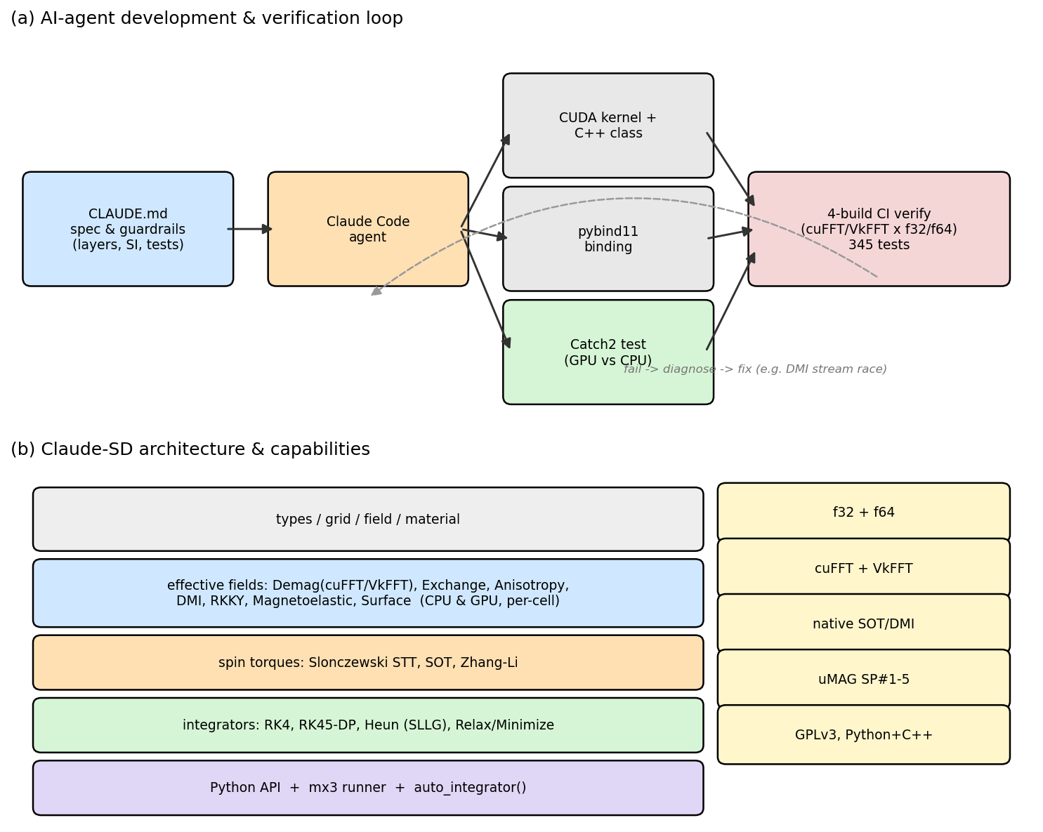
Agent-driven development & architecture
• Spec (CLAUDE.md): layers, SI conventions, test map
• Loop: kernel + CPU reference + Catch2 test
• Accept only if all 4 CUDA builds pass
• Fail -> diagnose -> fix (e.g. DMI race)
Fig 1 — (a) AI-agent development & verification loop; (b) Claude-SD architecture and capabilities.
Notes:
How it was built. A root specification file fixes the architecture layering, SI conventions, and the test map. The agent implements each feature as a CUDA kernel plus a CPU reference plus a Catch2 unit test, and a change is accepted only when all four CUDA build variants pass — f32/f64 times cuFFT/VkFFT. That redundant build matrix matters later. The loop closes with diagnose-and-fix; this is exactly how the DMI race we'll discuss was caught and repaired.

Slide 5
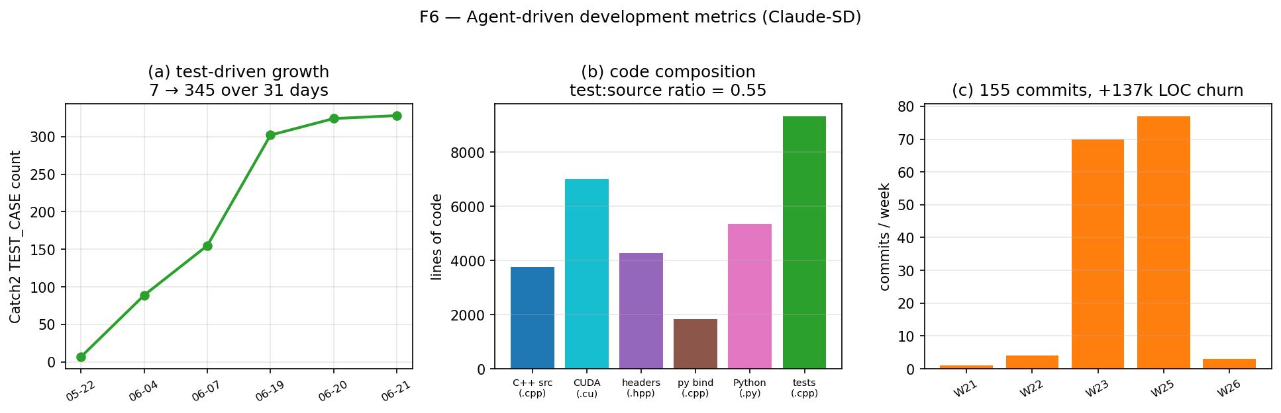
Development is quantified
• 155 commits over 31 days
• +136k lines of code churn
• tests 7 -> 345 (test-driven)
• test : source ratio = 0.55
• 25 effective-field implementations
Fig 6 — Agent-driven metrics: test-case growth, code composition, commit cadence.
Notes:
Scale of the effort, mined from git history. 155 commits over a month, ~137k lines of churn. The key point is the middle panel ratio: a test-to-source ratio of 0.55 and test cases growing in lockstep with features, from 7 to 345. This is test-driven development, not tests bolted on at the end — which is what made the cross-checking possible.

Slide 6
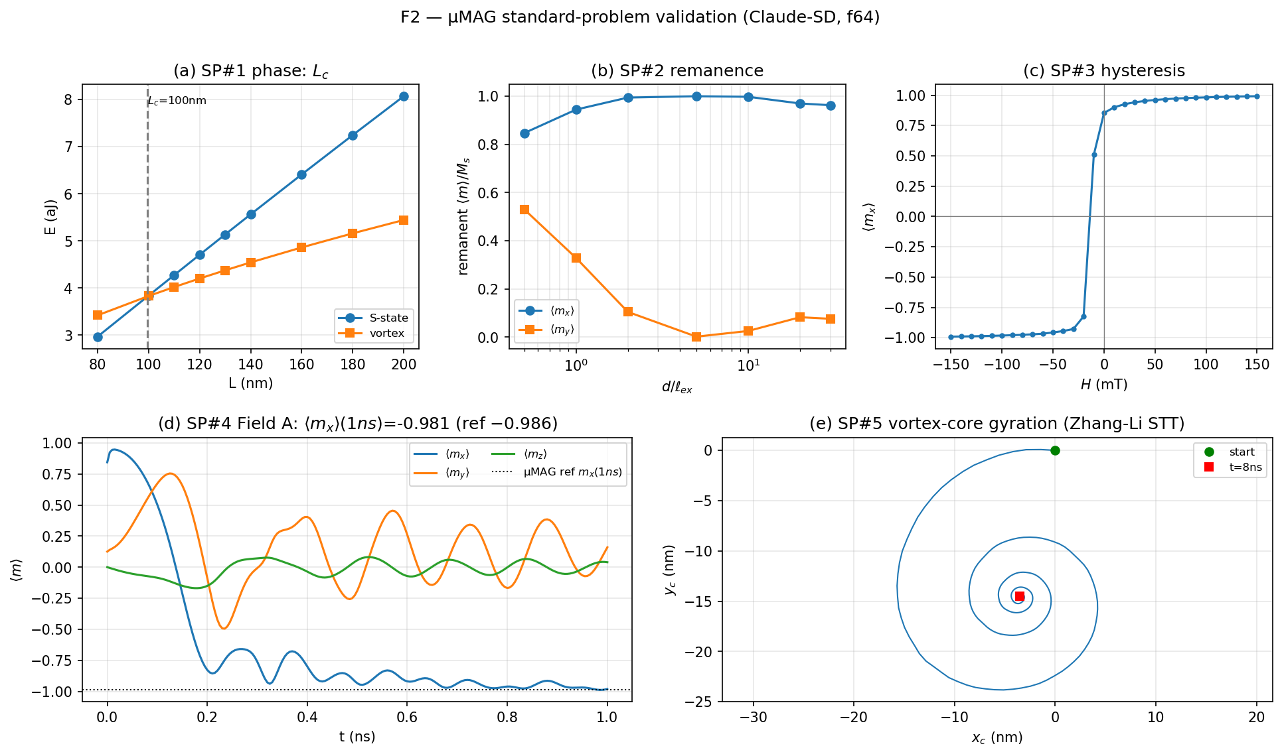
Validation: µMAG standard problems SP#1–5
• Agrees with mumax3 / mumax+ / OOMMF within their spread
• SP#4 <mx>(1ns): CS −0.979, OOMMF −0.984 (ref −0.986)
• SP#1 L_c = 99.7 nm (CS = mumax+)
• SP#2 (new): CS = mumax3 to ≤0.006
Fig 2 — µMAG standard problems SP#1–SP#5 reproduced (Claude-SD, double precision).
Notes:
Correctness. We reproduce all five µMAG standard problems and agree with the independent solvers within their mutual spread. For the dynamic switching problem SP#4, our ⟨mx⟩ at 1 ns is −0.979; the OOMMF double-precision anchor is −0.984; the reference is −0.986 — all within 2%. SP#1 crossover length matches mumax+, and our newly added SP#2 matches mumax3 to better than 0.006.

Slide 7
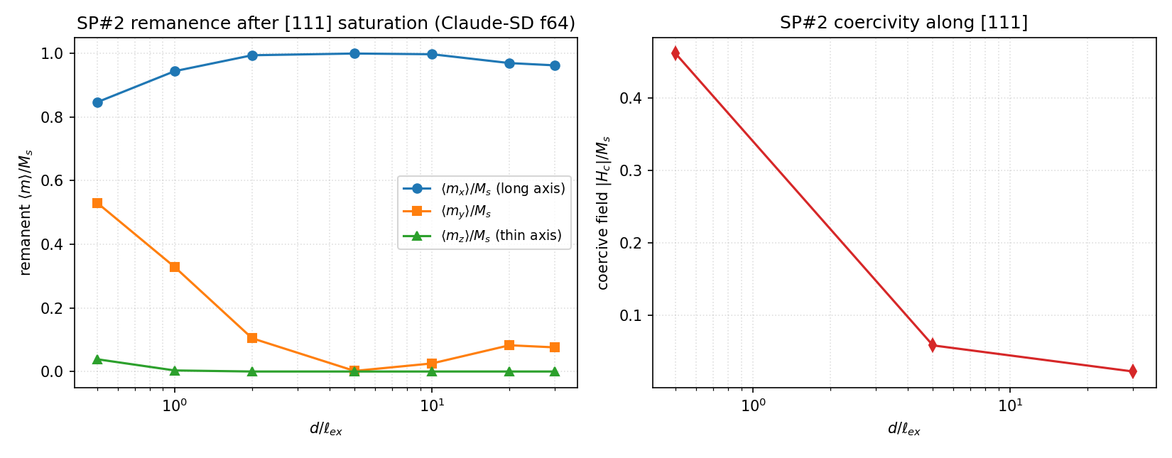
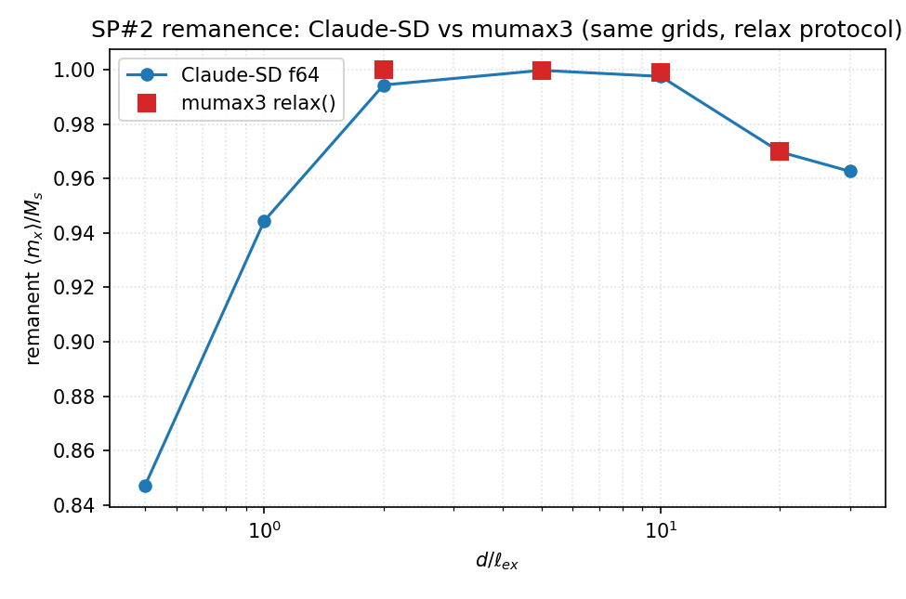
SP#2 remanence — cross-solver agreement
Fig S3 — SP#2 remanent ⟨m⟩/M_s and coercivity vs d/ℓ_ex; Claude-SD vs mumax3.
Notes:
A closer look at SP#2, which we implemented for this work: remanence and coercivity as a function of the reduced size d over the exchange length. Claude-SD (left) and the cross-solver overlay (right) track mumax3 to within 0.006 across the whole sweep, including the dip where flux closure sets in. This is a quantitative, not just qualitative, agreement.

Slide 8
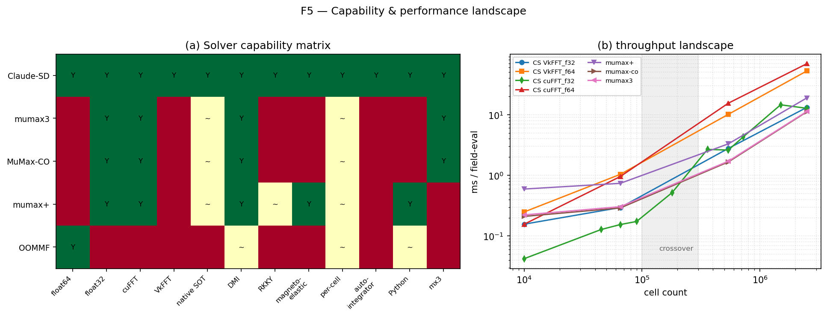
Performance: a precision/size trade-off
• Crossover ~0.1–0.5 M cells
• Small / 2-D: CS f32 fastest (5.3× vs mumax3) — CUDA-Graph
• Large 3-D: mumax3 / MuMax-CO lead (cuFFT-bound)
• f32 = 4–6× f64 (Blackwell Tensor-Core)
• No single code wins everywhere
Fig 5 — Solver capability matrix (left) and throughput landscape (right).
Notes:
Performance, the honest version. The capability matrix on the left shows where Claude-SD is broader (double precision, two backends). The landscape on the right shows a crossover near 0.1–0.5 million cells: below it our float32 build with CUDA-Graph replay is fastest — 5.3× over mumax3 on the SP#4 grid; above it the comparison becomes FFT-bound and the mumax family leads. Within Claude-SD, float32 is 4–6× faster than float64. The message: no single code wins everywhere.

Slide 9
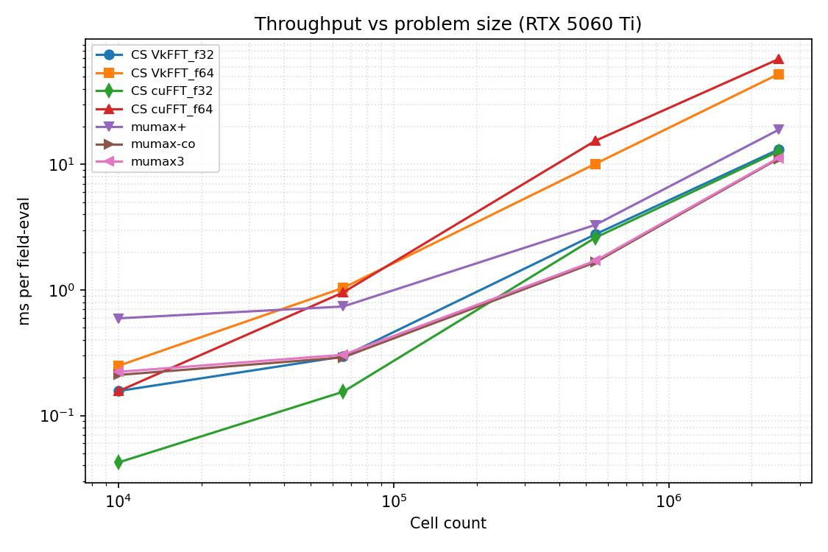
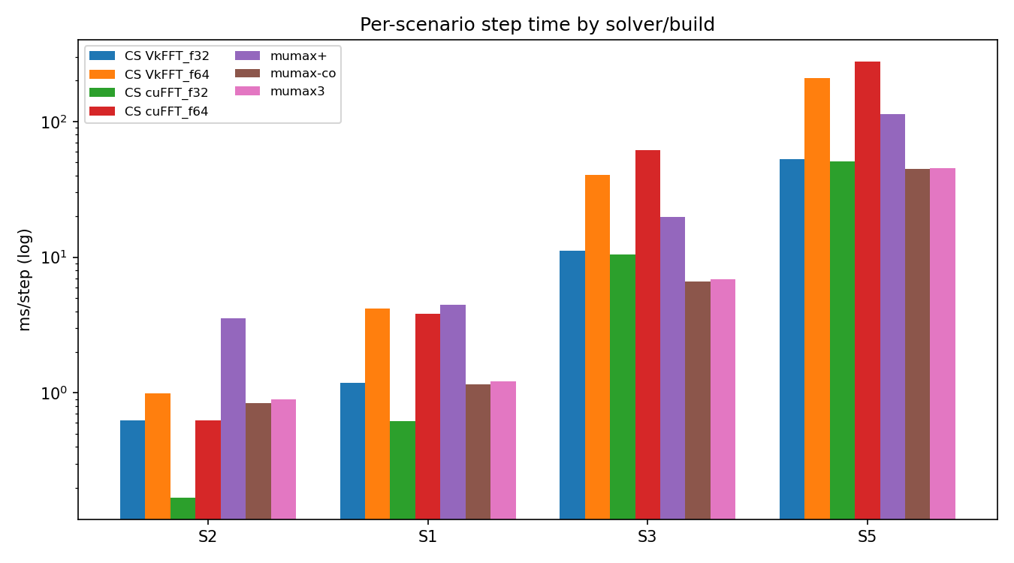
Performance: cross-solver throughput
Fig 3 — Throughput vs cell count (crossover) and per-scenario ms per field-eval.
Notes:
The same story in throughput terms. Left: milliseconds per field-evaluation versus cell count for every solver — note we normalize by field-evaluations because the codes use different-order integrators, which is the only fair comparison. Right: the per-scenario bars. Small/2-D goes to Claude-SD float32; the largest 3-D grids go to MuMax-CO, with Claude-SD within about 1.1×.

Slide 10
The key result: a hidden defect
• Relax a seeded skyrmion across the DMI boundary; record topological charge Q
• Same Claude-SD build, repeated identical runs → DIFFERENT Q
– run-to-run std of Q up to 0.48 — even in DOUBLE precision
– Q scattered across topological sectors [−1.5, +1.5]
• mumax3 (relax & minimize): deterministic, robust → the diagnostic signal
– A correct relaxation must not depend on thread scheduling → a defect
Fig. 4a
Notes:
Now the core result. We relax a seeded skyrmion across the DMI metastability boundary and record the topological charge Q. We found that the SAME build, run repeatedly with identical inputs, gave DIFFERENT Q — scatter up to 0.48 standard deviation, and crucially this happened even in double precision, so it is not a rounding-tolerance story. Meanwhile mumax3 was perfectly deterministic. A physically meaningful relaxation must not depend on thread scheduling, so this was a defect in our code — and the contrast with mumax3 is what flagged it.

Slide 11
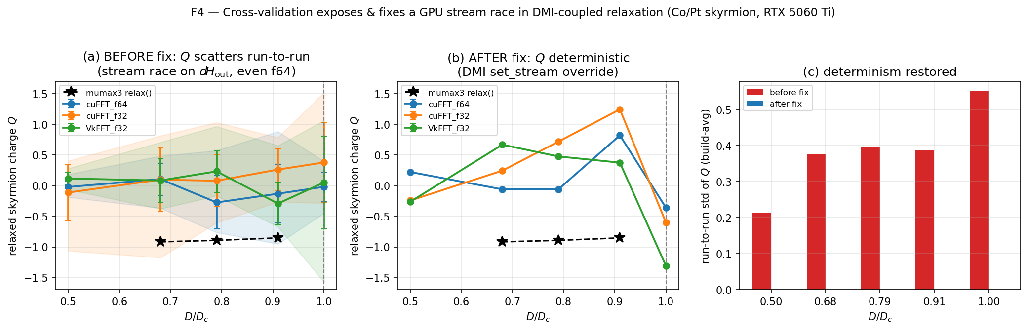
Diagnosis → fix → determinism restored
• Bisection: only damped-LLG + DMI scattered
• Cause: DMI GPU field missing set_stream override
• -> ran on its own stream, racing on d_H_out
• (FieldSumGPU single-stream mode skips sync)
• Fix: add override -> std(Q) = 0, all builds
• Invisible to single build & standard problems
Fig 4 — Cross-validation exposes & fixes a GPU stream race: Q before (scatter) → after (deterministic).
Notes:
Diagnosis by bisection: every field alone was deterministic, fixed-step RK4 was deterministic, but damped-LLG relaxation with DMI present scattered. The cause: the GPU DMI field carried its own CUDA stream but did not override the compositor's set_stream hook, so in single-stream mode — where the compositor skips inter-field synchronization — DMI ran concurrently and raced on the shared effective-field buffer. Near the bifurcation, last-bit differences flipped the topological sector. Adding the override collapses the Q standard deviation to zero across all builds, with all 113 GPU tests still green. The defect was invisible to any single build and to the standard problems.

Slide 12
Why it matters
• The agent did NOT write defect-free code — it wrote a subtle GPU race
– …that passed every unit test and every standard problem
• What caught it: deliberately redundant design
– multiple precisions × FFT backends × independent solvers
– Discrepancy (CS scatter vs mumax3 determinism) was the diagnostic
• Takeaway
– for AI-built scientific software, cross-implementation validation must be a
– first-class design goal — the failure mode is plausible code that is subtly wrong
Notes:
The generalizable lesson. The agent did not write perfect code — it wrote a subtle concurrency bug that passed every unit test and every standard problem. What caught it was deliberately redundant design: multiple precisions, multiple FFT backends, and benchmarking against independent solvers. Discrepancy was the diagnostic. So the takeaway for AI-assisted scientific software is that cross-implementation validation should be a first-class design goal, precisely because the failure mode of agent code is plausible-looking code that is quietly wrong.

Slide 13
Summary
• An AI agent built a µMAG-validated, dual-precision GPU micromagnetic simulator
• Competitive performance; uniquely offers double precision + two FFT backends
• Its multi-build / multi-solver design exposed AND fixed a real GPU concurrency bug
• Open & reproducible
– GPLv3 · github.com/mirryou-maker/Claude-SpinDynamics · Zenodo DOI (on release)
– make_report.py regenerates every table & figure from one results file
Notes:
To summarize: an AI agent built a validated, dual-precision GPU micromagnetic simulator with competitive performance and a unique capability set. More importantly, its redundant design exposed and let us fix a real GPU concurrency defect. Everything is open under GPLv3 and fully reproducible — one command regenerates every table and figure — and it will be archived with a citable DOI on release. Thank you.

