Slide 1

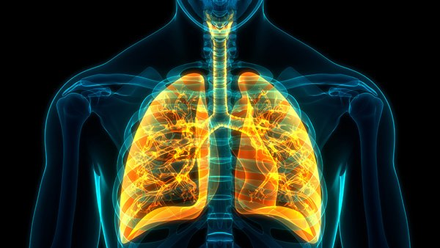
Covid-19 testing using Sobel and SVM
Multimedia computing(soc4020-002)
Spring 2020
U1610146 Mirzashomol Karshiev

Slide 2
Agenda
Introduction
Design
Challenges
1
2
3
Advantages
Disadvantages
Future Goal
4
5
6

Slide 3
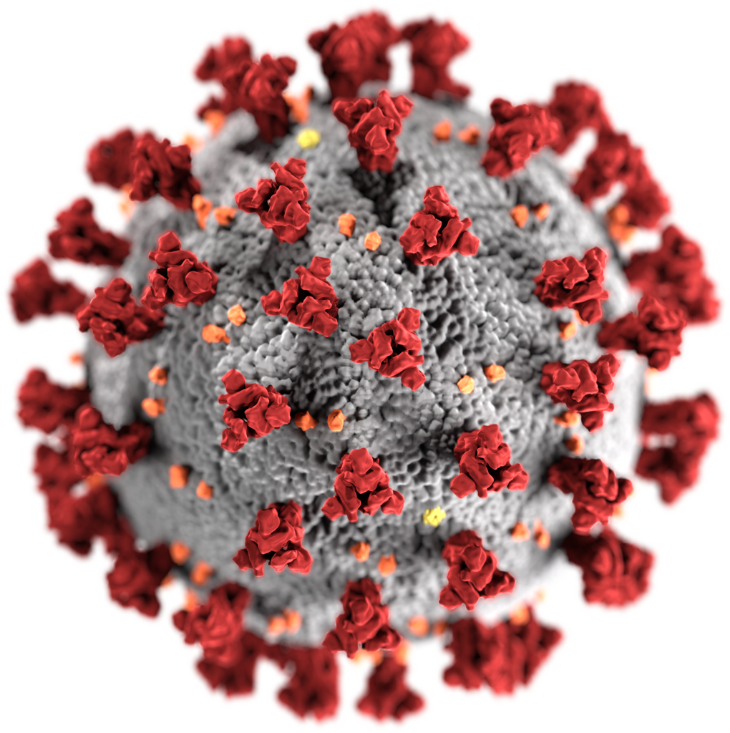
Introduction
Nowadays, we all facing the same problem COVID-19. Now people all around the world are fighting against coronavirus this outbreak. For that reason, it would be better to find solution for this pandemic virus using Image Processing Computer Vision and Machine learning.
Covid -19

Slide 4
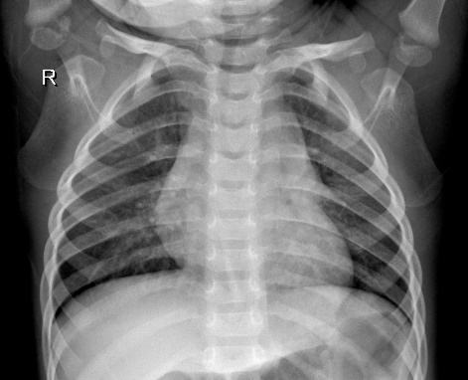
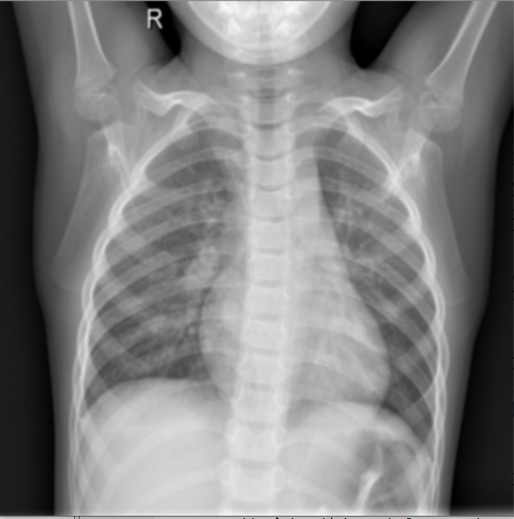
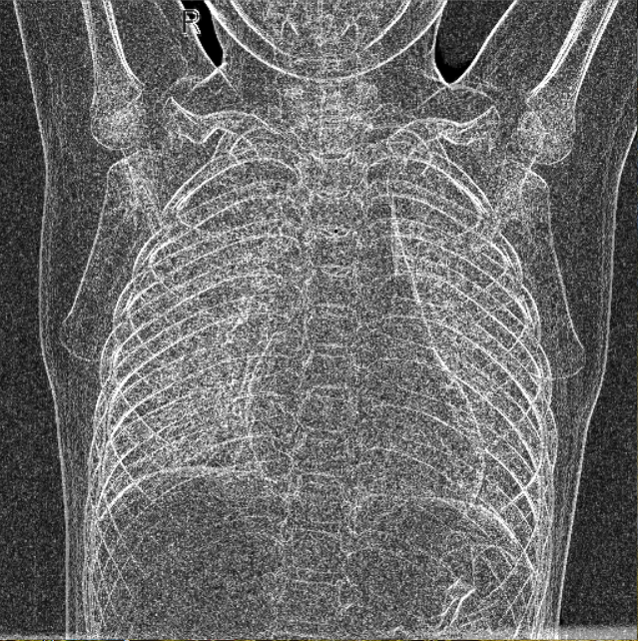
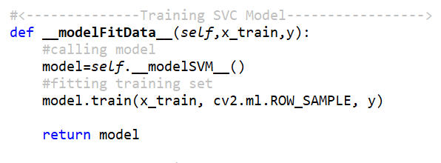
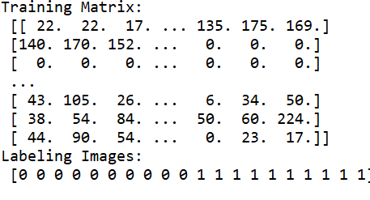
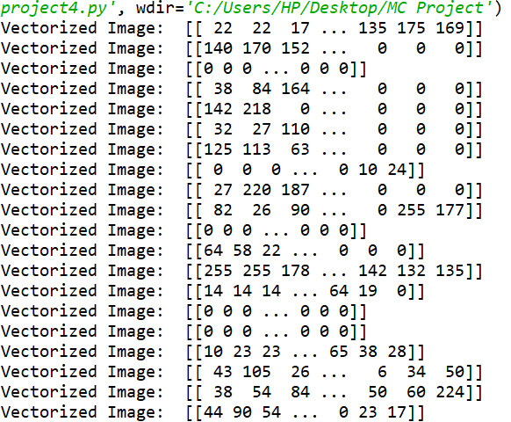
design
1. Load Dataset
2. Gaussian Blur
3. Sobel Filtering
6. Training Data
5. Collecting images into
One matrix and labeling
4. Vectorize Image

Slide 5
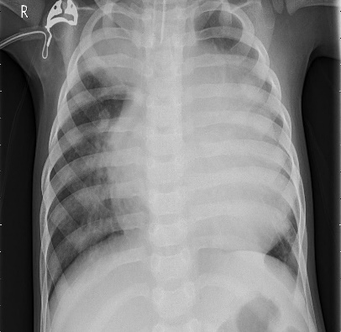
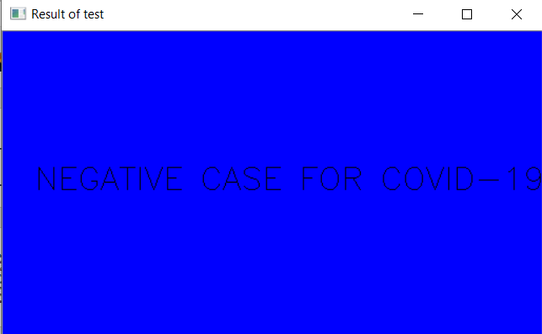
design
7. Predict test image
8. Result
Blue Background → means negative case for Covid-19
Red Background → means positive case for Covid-19

Slide 6
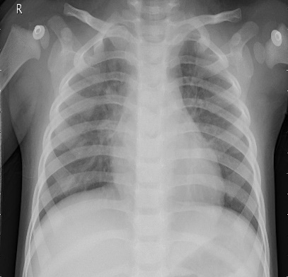
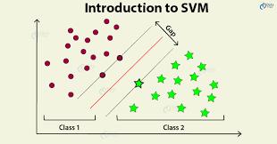
Challenges
1. Image Reshaping
3. Understanding SVM
2. Collecting all images into one matrix
4. Fitting train dataset

Slide 7
Advantages of project
1. Understanding all channels of image: RGB, BGR or Gray scale.
4. Preparing Training matrix for fitting it into model.
2. Searching for right dataset.
5. Enhances the knowledge with Computer Vision.
3. Understanding different types of machine learning algorithms.
6. Improves mathematical skills.

Slide 8

Disadvantages of project
NO DISADVANTAGES

Slide 9
Future goals
Enhance the knowledge of Computer Vision and Deep Learning.
Improve Image Processing skills and learning some specific field so that to apply all knowledge.

Slide 10
References
https://www.uth.edu/news/story.htm?id=b7d188be-d8a8-459c-b6a6-65d7684e81a5
https://www.google.com/search?q=covid+19+background&tbm=isch&ved=2ahUKEwi1oZXk757pAhUSH5oKHfkgC1QQ2-cCegQIABAA&oq=covid+19+background&gs_lcp=CgNpbWcQAzICCAAyBAgAEB4yBAgAEB4yBAgAEB4yBAgAEB4yBAgAEB4yBAgAEB4yBAgAEB4yBAgAEB4yBAgAEB5Qj39YuJIBYOqWAWgAcAB4AIABhAGIAfAIkgEEMC4xMJgBAKABAaoBC2d3cy13aXotaW1n&sclient=img&ei=hXyyXvXKA5K-6AT5waygBQ&bih=754&biw=1519&tbs=sur%3Afm&hl=ru#imgrc=Ic2mdKbiZzdHbM
https://www.google.com/search?q=SVM+classifier&tbm=isch&ved=2ahUKEwjo7KKuhJ_pAhXbycQBHVo_AMsQ2-cCegQIABAA&oq=SVM+classifier&gs_lcp=CgNpbWcQAzICCAAyBAgAEB4yBAgAEB4yBAgAEB4yBAgAEB4yBAgAEB4yBAgAEB4yBAgAEB4yBAgAEB4yBggAEAUQHjoFCAAQgwE6BAgAEENQ2IIVWLm1FWDjthVoAXAAeACAAaoBiAGxFpIBBDAuMjSYAQCgAQGqAQtnd3Mtd2l6LWltZw&sclient=img&ei=GZKyXqj8CtuTk74P2v6A2Aw&bih=706&biw=1536#imgrc=ymCdQWDbc2hFkM

