Slide 1

US Census Demographic Data

Slide 2
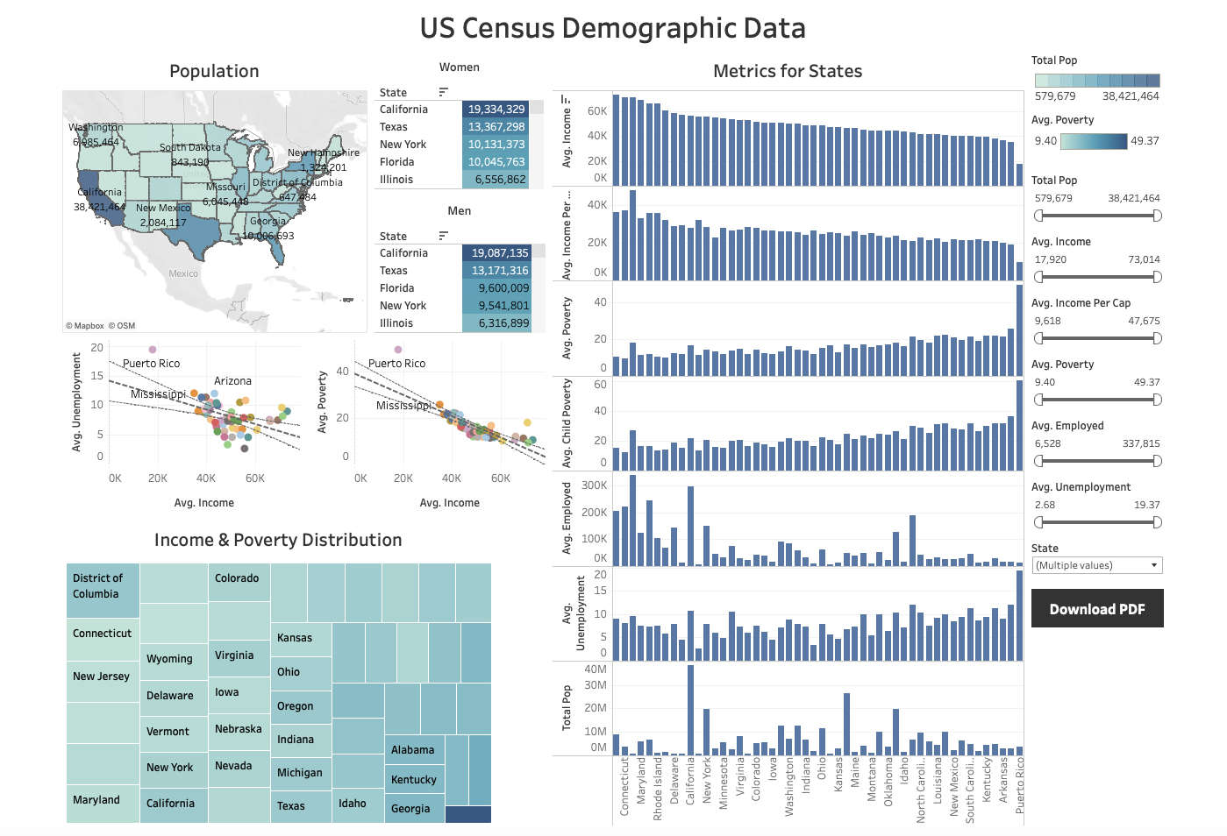
What are the main data in the dashboard?
Link: dashboard
Summary: This dashboard illustrates some metrics of the US census data mainly:
Population
Income, Poverty and Income correlation
Employment and unemployment distributions
Income and poverty distribution
…
Design: The tool includes several filters for categorizing the data if needed/desired.
Resources: N/A

Slide 3
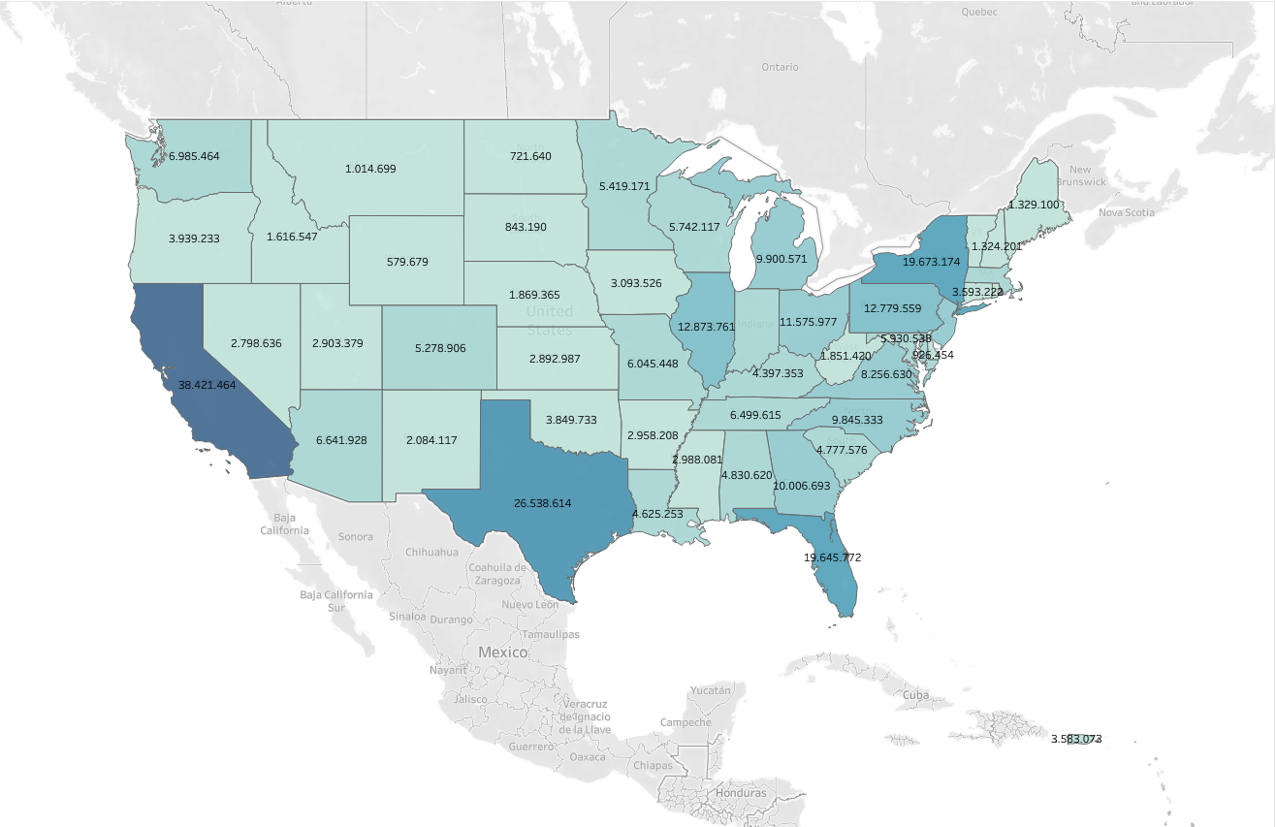
What is the population distribution across USA?
Link: population
Summary: This map gives the information on how is the population across USA. The population of each state is given as well. California has the highest population, following by Texas and New York.
Design: The sum(total pop) is used for preparation of this visualization. This gives the best understanding. A filter is added to highlight the states with filtered
Resources: N/A

Slide 4
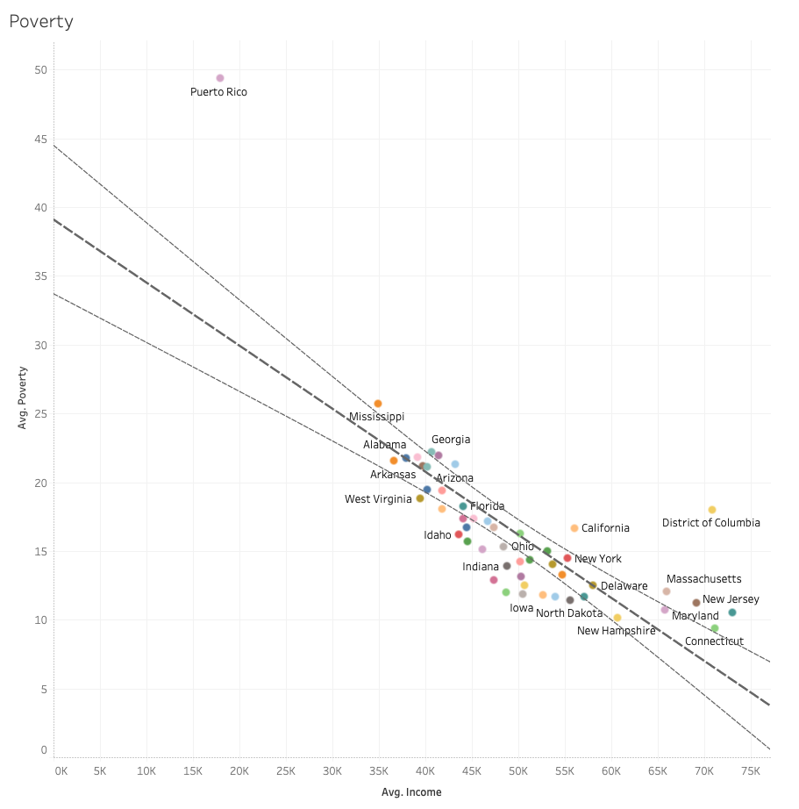
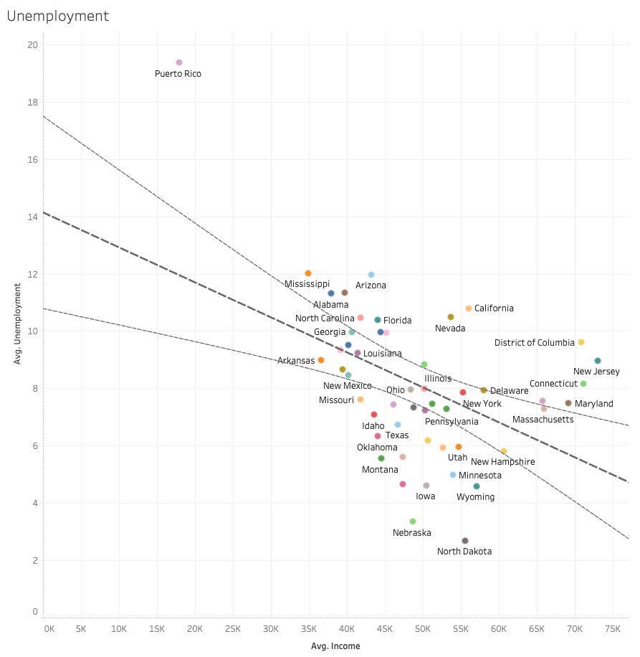
What is the relation between poverty, unemployment and income?
Link: poverty-income, unemployment-income
Summary: This plot gives the information on how the poverty and unemployment are related to average income. It can be seen that poverty and unemployment increases with lower average income.
Design: The scatter plot can show the results very well and the regression with confident bands can help of understanding the data.
Resources: N/A

Slide 5
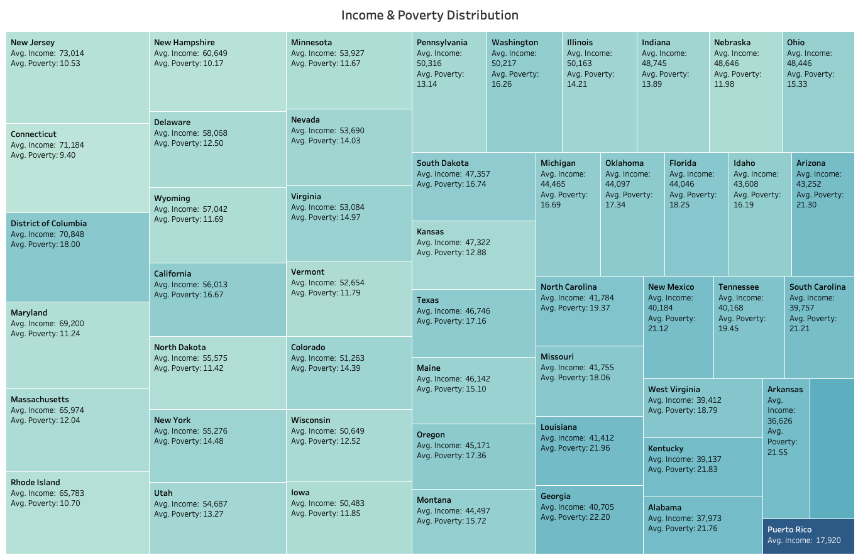
What is the relation between poverty and income?
Link: poverty-income
Summary: This map gives the information on how which state has the highest income (size of the boxes) and its poverty level (colour of boxes). It can be seen that the New Jersey has the highest average income and Puerto Rico the list! On the other side, Puerto Rico hast the highest average poverty among other states.
Design: The treemap is a useful tool for showing the size of a value in comparison to others. The colour provides an additional metric on the data.
Resources: N/A

Slide 6
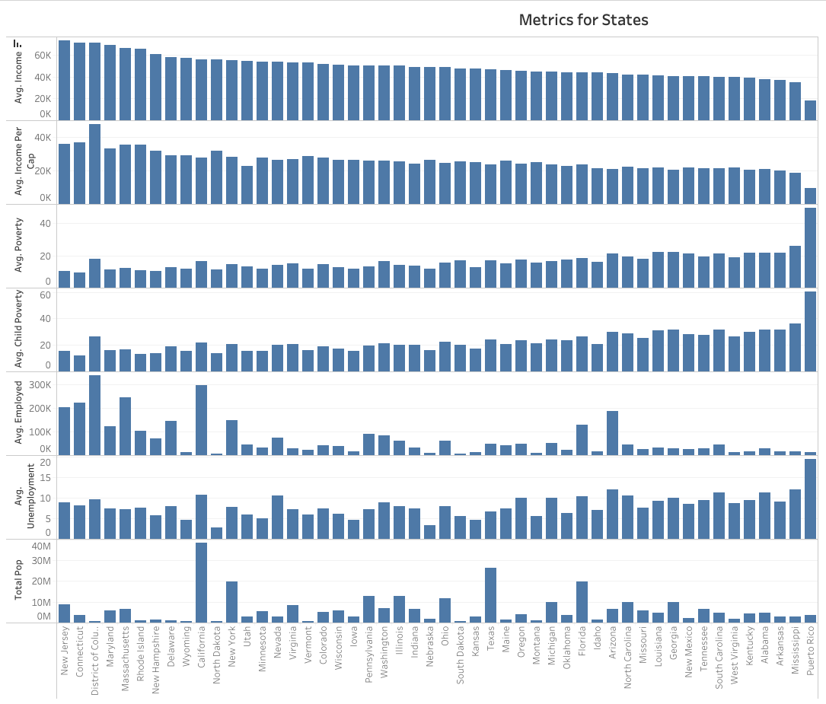
What is the relation between poverty and income?
Link: metrics
Summary: the bar plot are used to demonstrate some other metrics from the data like average income of each state, average income per cap, average poverty, average child poverty, average (un)employment and total population of states.
Design: The bar plots are using the same data source, so as soon as one is sorted the other plot are adapted based on that one.
Resources: N/A

