Slide 1

Creative ISE Design
Abdurasulov Mirsaid 12225253
Arduino activity

Slide 2
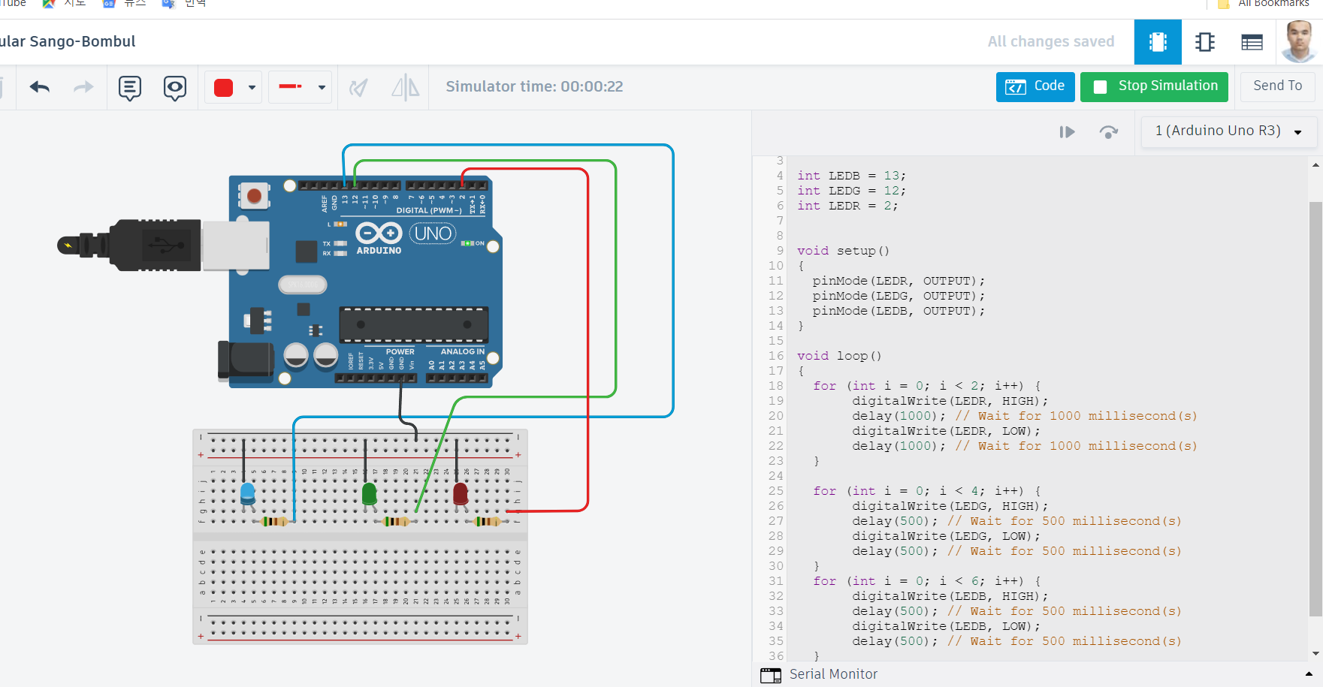
Arduino activity

Slide 3
C++ Code:
// C++ code
//
int LEDB = 13;
int LEDG = 12;
int LEDR = 2;
void setup()
{
pinMode(LEDR, OUTPUT);
pinMode(LEDG, OUTPUT);
pinMode(LEDB, OUTPUT);
}
void loop()
{
for (int i = 0; i < 2; i++) {
digitalWrite(LEDR, HIGH);
delay(1000); // Wait for 1000 millisecond(s)
digitalWrite(LEDR, LOW);
delay(1000); // Wait for 1000 millisecond(s)
}
for (int i = 0; i < 4; i++) {
digitalWrite(LEDG, HIGH);
delay(500); // Wait for 500 millisecond(s)
digitalWrite(LEDG, LOW);
delay(500); // Wait for 500 millisecond(s)
}
for (int i = 0; i < 6; i++) {
digitalWrite(LEDB, HIGH);
delay(500); // Wait for 500 millisecond(s)
digitalWrite(LEDB, LOW);
delay(500); // Wait for 500 millisecond(s)
}
}

