Slide 1

Creative ISE Design
Student ID: 12225253
Name: Abdurasulov Mirsaid

Slide 2
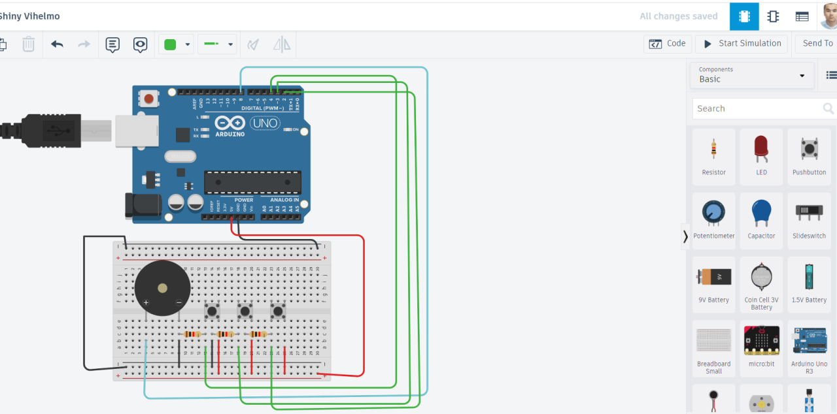

Slide 3
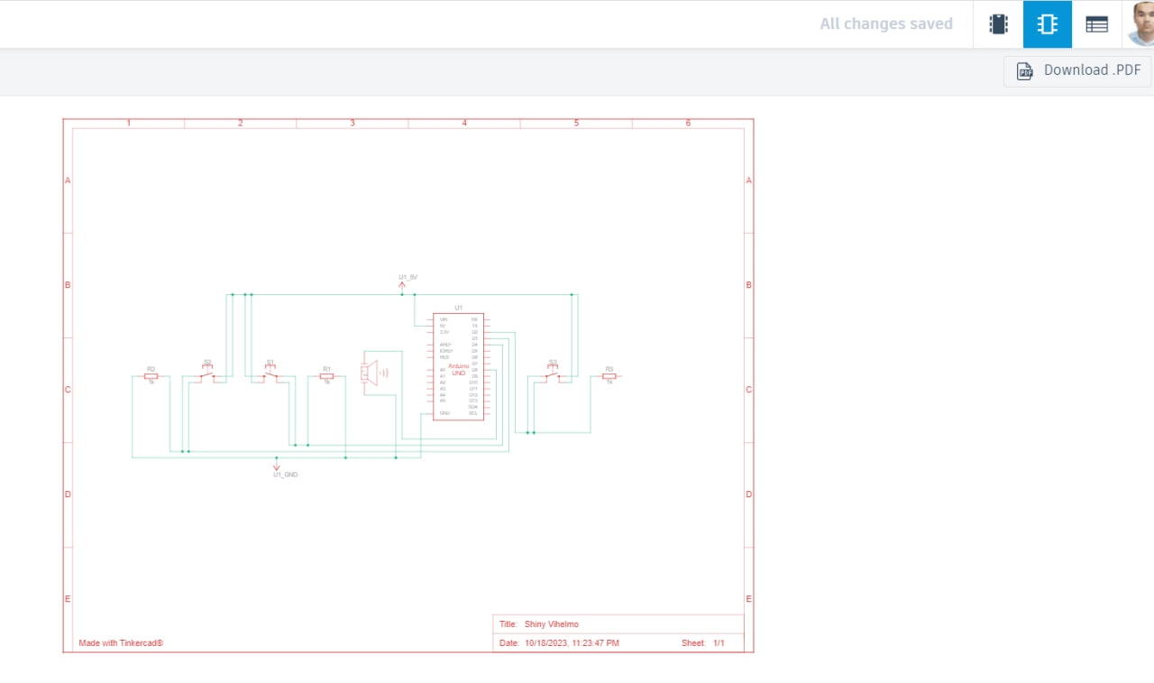

Slide 4
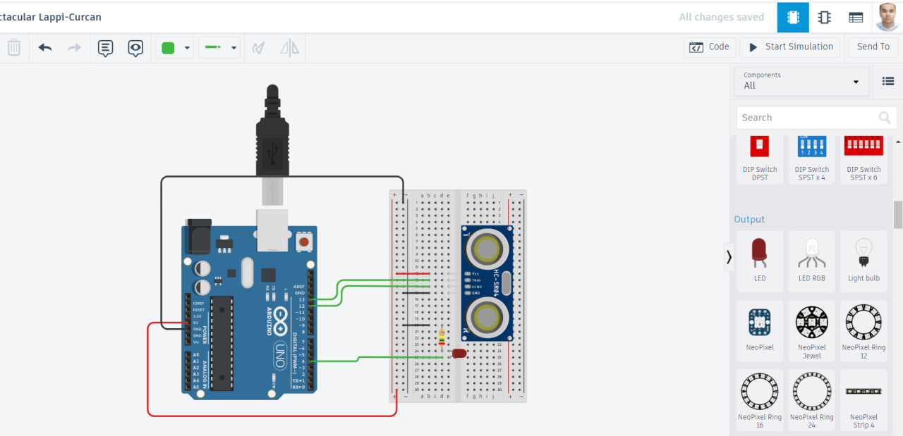

Slide 5
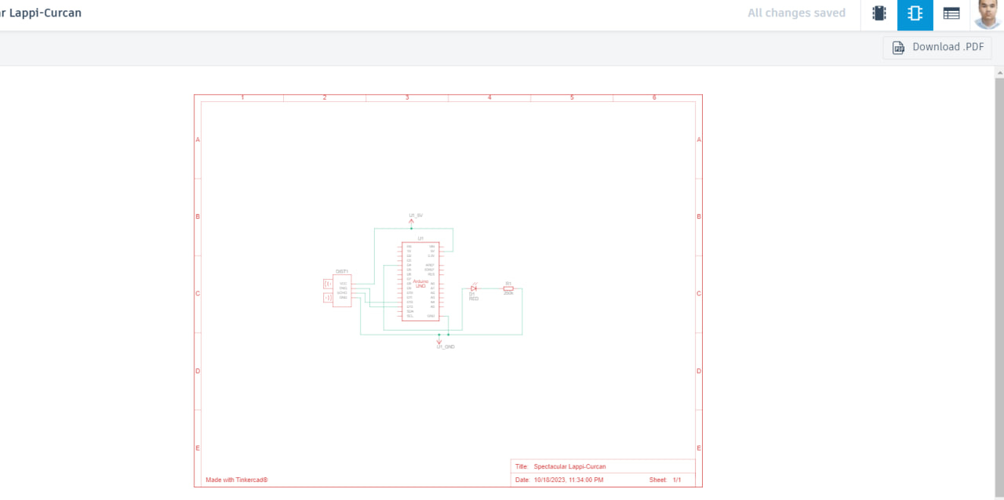

Slide 6
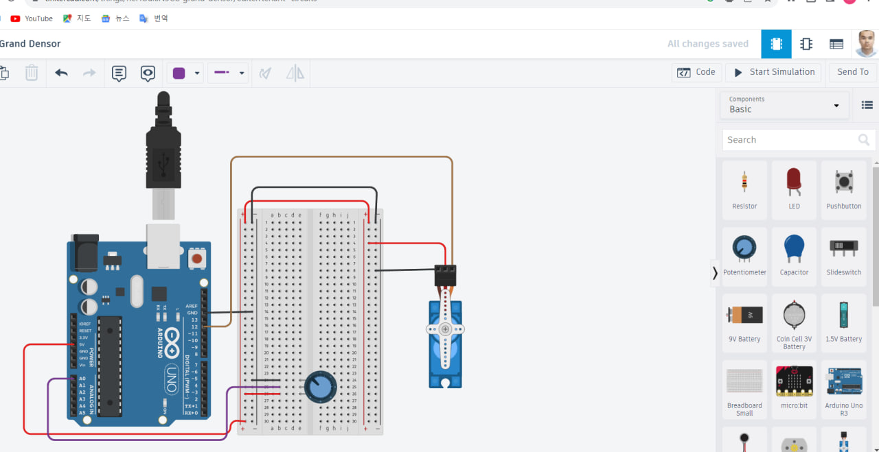

Slide 7
