Slide 1

Creative ISE Design
Week activity 5 Arduino
Done by Abdurasulov Mirsaid 12225253

Slide 2
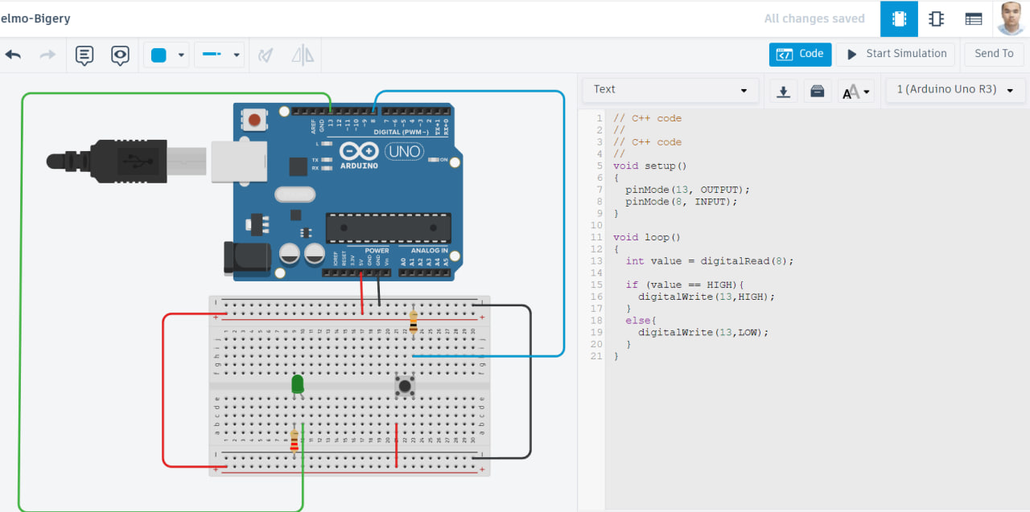
Activity 1 (Circuit and code)

Slide 3
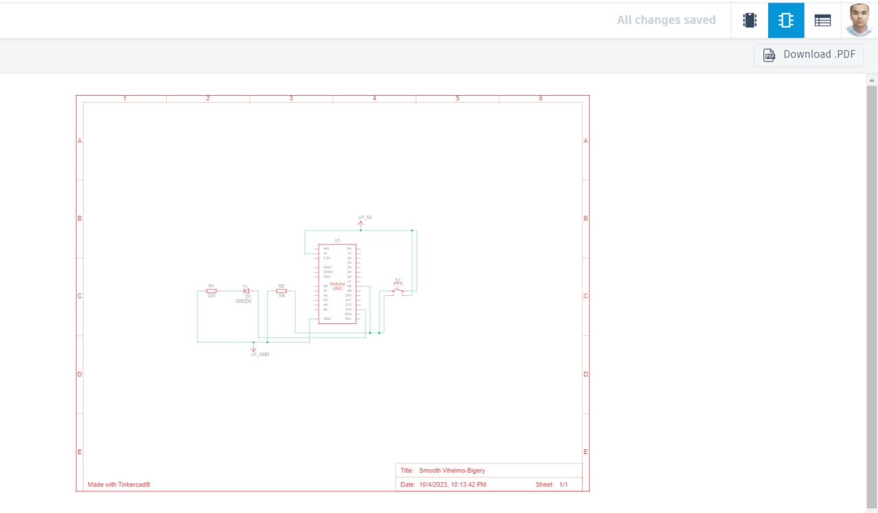
Graphic:

Slide 4
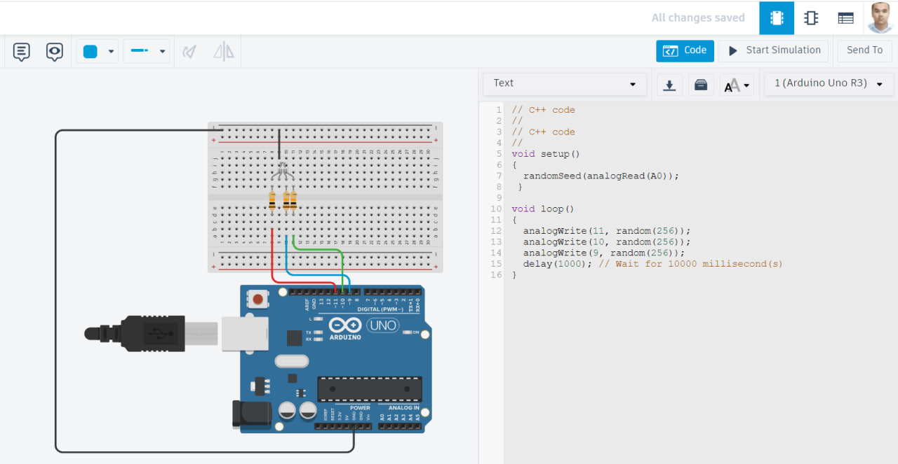
Activity 2 (circuit and code)

Slide 5
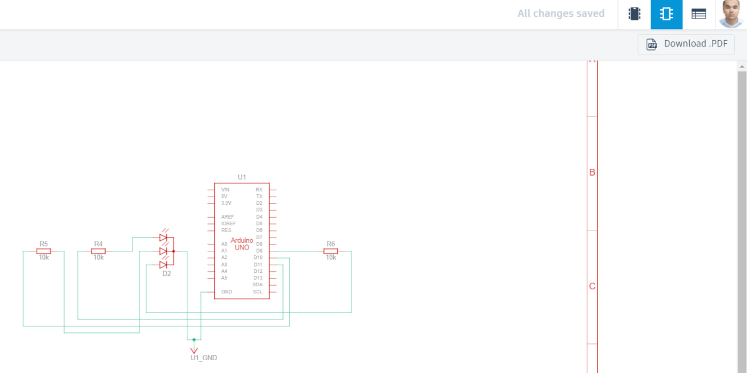
Graphic:

Slide 6

Abdurasulov Mirsaid Thank you

