Slide 1
PROGRESS PRESENTATION 1 · J26-IT-363 · COMPONENT 4
Forecasting trail bottlenecks and
controlling crowds with a Spatio-Temporal GNN
Horton Plains National Park · Adam's Peak (Sri Pada)
Weerasekera J.V. · IT23343948
Decentralized Hiking AI
Notes:
Introduce yourself and the component in one sentence: I forecast where and when trails get crowded, a day to 90 days ahead, and turn that forecast into crowd control – at two very different sites. (~20 s)

Slide 2
PROBLEM DEFINITION
Crowding is managed with a fixed daily number
• Horton Plains today: a static daily permit quota (DWC). It cannot tell 300 people on a dry Poya morning from 50 in the rain, or where they bunch up – World's End fills up between 08:00 and 10:00.
• Adam's Peak today: no limit and no tickets. On Poya nights thousands queue for hours on the steep final steps below the summit – a safety risk.
• Data gap: authorities publish only park-level visitor totals. There are no counts per trail section, and no sensors on the trails.
• Missing tool: nothing forecasts where and when a bottleneck will form, or turns that into a decision (how many to let in, when to start, when to hold groups).
Research question
Can a Spatio-Temporal GNN, using only the trail graph, terrain, weather and calendar, forecast segment-level crowding and drive crowd control that replaces a static quota?
Component 4 · IT23343948 · 2
Notes:
Current implementation: Horton Plains uses a daily permit cap; Adam's Peak has no limit at all and relies on police on the night. Neither knows WHERE on the trail or WHEN the crowd will be. Stress the gap: no segment-level data exists, and nobody installs sensors – so it has to work from open data. (~60 s)

Slide 3
PROVEN GAP / CREATIVE SOLUTION
Objectives, novelty and where each one stands
Objective | What was built | Status
1 Trail graph + features from open data | OSM graph, Copernicus DEM, Open-Meteo, Sri Lankan calendar; 2 parks | Done
2 Synthetic occupancy target | Group-based walking simulator (Tobler, stairs, rain, queues) | Done – field calibration pending
3 ST-GNN vs baselines | HA, ARIMA, LSTM, GRU-no-graph; spatial CV; paired t-tests | Done (Horton 3 seeds)
4 Dynamic carrying capacity | Cifuentes PCC→RCC→ECC with a forecast crowding factor | Done
5 From forecast to control (extension) | Slot tickets (LP) · start times + halfway checks | Done, evaluated
6 Prototype for users | FastAPI + Flutter app, staff roles, 2 parks | Working prototype
Novelty 1
ST-GNN on a tiny (48–57 node), sensor-free trail graph – tested against baselines, not assumed
Novelty 2
Forecast judged by the decision it improves (crowd control), not only by its error
Novelty 3
One pipeline, two kinds of site: ticketed park and no-ticket pilgrimage
Component 4 · IT23343948 · 3
Notes:
Walk through the table quickly; the status column is the progress claim for PP1. Novelty: ST-GNNs are proven on city traffic with hundreds of sensors; here 48-57 nodes and no sensors. And the forecast is evaluated by the decisions it improves, not only by accuracy. (~60 s)

Slide 4
DESIGN
System overview
Open data
OSM · DEM · weather
calendar · Poya
Trail graph
300–500 m segments
terrain features
Simulator
groups walk the graph
→ occupancy target
Forecasting
ST-GNN (day ahead)
planning model (90 d)
Capacity & control
Cifuentes · slot LP
start times · holds
Service
FastAPI per park
gateway · Flutter app
• Per park: one YAML file (configs/parks/*.yaml) – adding a destination needs no code or app change
• Two horizons: day-ahead hourly occupancy per segment (ST-GNN) and a 2–90 day outlook with a P10–P90 range
• Two control styles: Horton Plains – timed tickets per trail and 30-min slot; Adam's Peak – advice only (recommended start times + officer holds at halfway rest stops)
• Users: visitors / pilgrims (plan, book, start times), rangers (gate, halfway counts), officers (season plan, closures), admin (audit)
Component 4 · IT23343948 · 4
Notes:
Left to right: open data becomes a graph; the simulator makes the training target; two forecasters (day-ahead ST-GNN, 2-90 day planning model); capacity and control turn forecasts into decisions; the API serves the app. Every park is one config file. (~60 s)

Slide 5
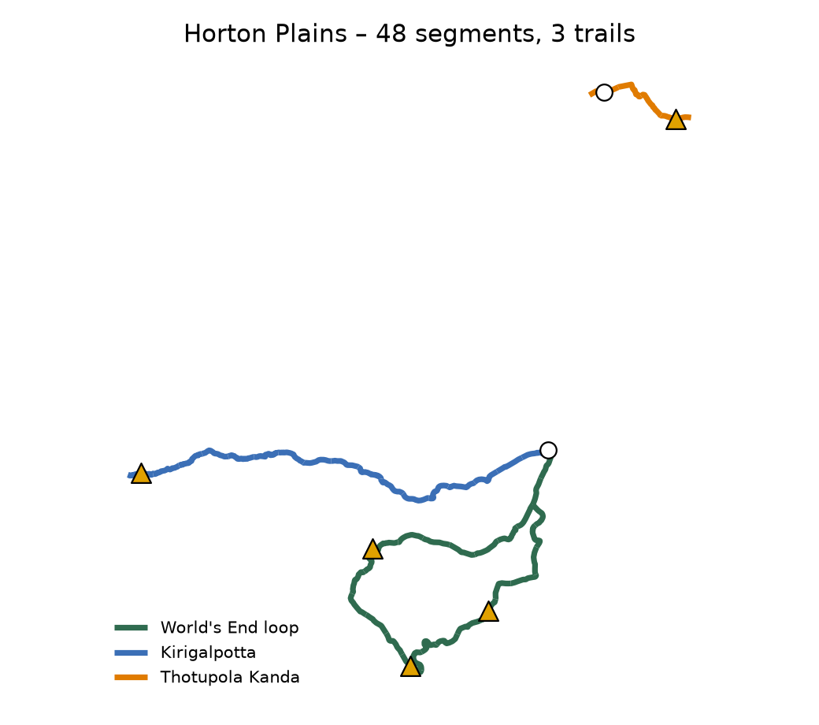
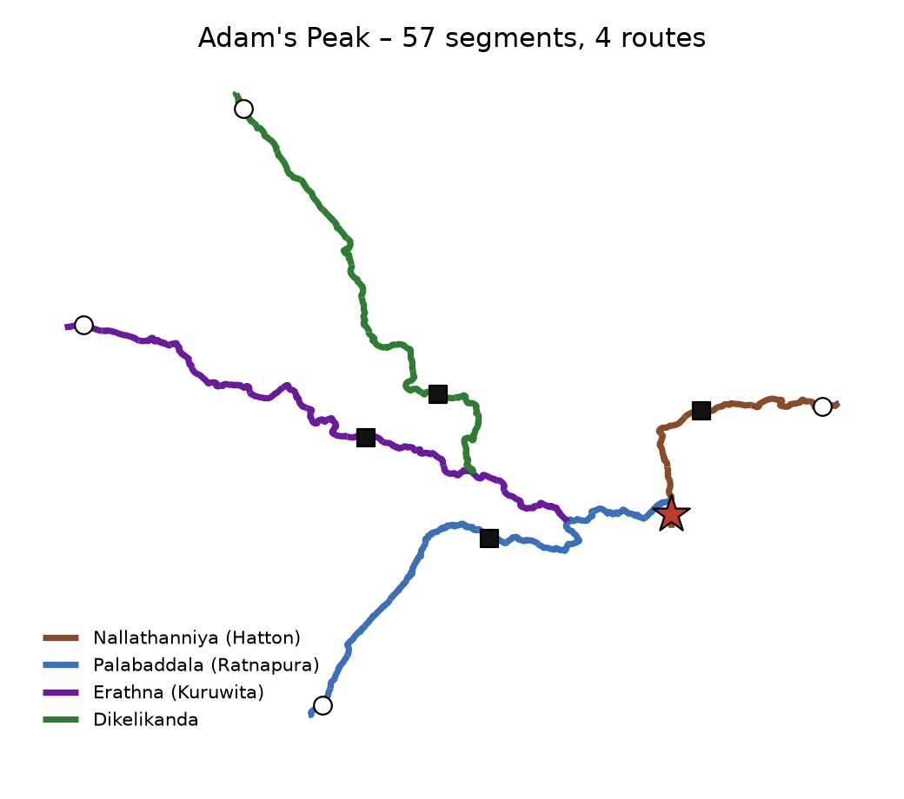
APPLICATION OF KNOWLEDGE
Two study sites, built from open data only
• Graph: OpenStreetMap paths split into ~300 m (Horton) / ~500 m (Adam's Peak) segments
• Terrain: Copernicus 30 m DEM – slope, TWI, Tobler walking time, stairs
• Weather: Open-Meteo archive + 16-day forecast
• Calendar: public holidays, Poya days (estimated after 2026), school holidays, pilgrimage season
• No personal data: counts only
▲ viewpoint ★ summit ■ halfway checkpoint ○ start
Component 4 · IT23343948 · 5
Notes:
Horton: three trails sharing an entrance, day visits. Adam's Peak: four OSM-mapped routes that meet at one summit, climbed at night – the bottleneck is a queue, not a crowded viewpoint. The last ~350 m to the summit is missing from OSM and is approximated (stated as a limitation). (~45 s)

Slide 6
APPLICATION OF TECHNOLOGIES
The ST-GNN and the technologies behind it
Last 24 h
counts + weather
+ calendar
GCN × 2
neighbouring
segments
GRU
over time
GCN
spread state
Decoder
next 24 h weather
+ calendar
Occupancy
per segment
per hour
Area | Technology | Why
Graph learning | PyTorch 2 + PyTorch Geometric (DenseGCNConv) | small dense graph: fast, exact
Baselines | statsmodels SARIMAX, historical average, LSTM/GRU | mandatory comparison
Planning (90 d) | scikit-learn gradient boosting, conformal P10–P90 | inputs exist weeks ahead
Optimisation | SciPy linprog (HiGHS) | tickets per slot under capacity
Geo / terrain | OSMnx, GeoPandas, Rasterio | graph + DEM features
Service / app | FastAPI, SQLite, Flutter (Android / web) | offline-capable visitor app
• Missing counts: unsensed segments send no messages in the first GCN layer
• Transferable inputs: segments described, not named (13 features)
• Loss: masked L1, early stopping on the 2024 year
Component 4 · IT23343948 · 6
Notes:
Explain the architecture: per hour, a GCN mixes neighbouring segments, a GRU runs over the last 24 h, a decoder uses the known future weather and calendar. Key design choice: segments without counts send no messages in the first graph layer, so missing data is not read as 'empty'. Segments are described (viewpoint? minutes from trailhead? share of visitors?) instead of named, so the same model shape fits any park. (~75 s)

Slide 7
STANDARDS / BEST PRACTICES
Evaluation protocol and best practices
• No leakage: train 2022–23 · validate 2024 · test 2025; scalers fitted on training data only
• Spatial block CV: 4 contiguous blocks of segments held out – no history and no training loss there
• Fair statistics: paired t-test + Wilcoxon over forecast days (not hours), Holm-corrected, effect size d_z
• Clean ablation: the same network with the graph removed (GRU-no-graph) isolates what the graph adds
• Decision-focused: forecasts also judged by the waiting / overcrowding they prevent (RQ3)
• Reproducible: seeds logged; every run = results/<time>_<tag>/ with config + git hash; 56 Python + 16 Flutter tests
• Secure & ethical: roles checked on the server, hashed passwords, lockout, audit log; no personal visitor data
Component 4 · IT23343948 · 7
Notes:
This slide answers 'how do you know it works'. Time split avoids leakage; spatial block CV tests the real deployment case (segments with no counts); pairs are forecast days because hourly errors are correlated; Holm correction for several baselines. Every run saves config, seed and git hash. (~45 s)

Slide 8
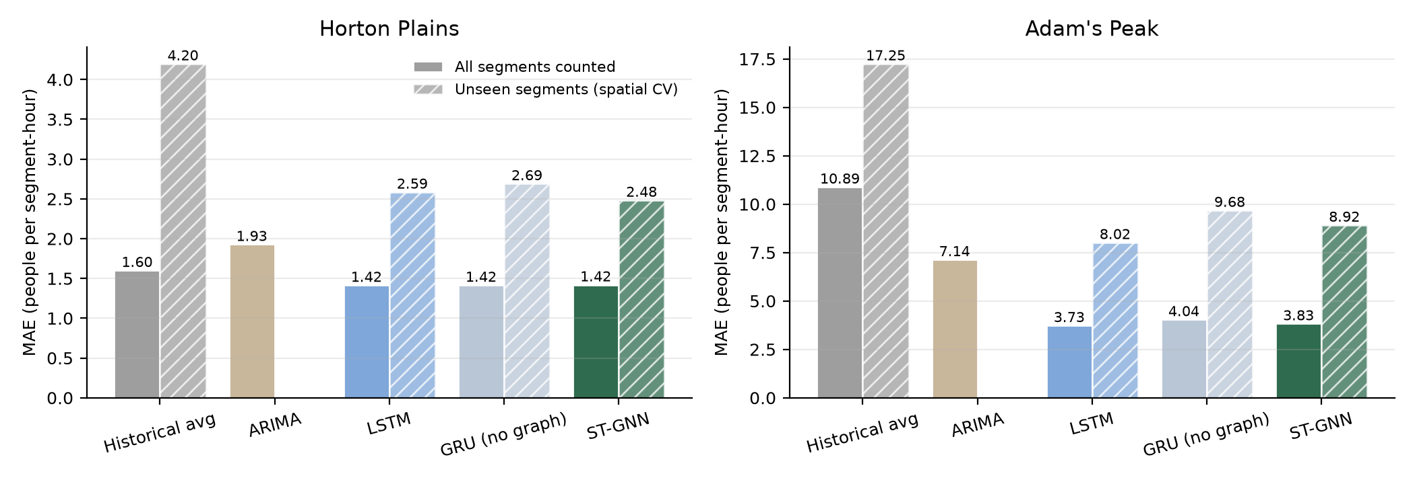
PROOF OF CONCEPT
RQ1 – Does the graph help? Yes, where there are no counts
• Horton, unseen segments: ST-GNN 2.48 · LSTM 2.59 · GRU without graph 2.69 · historical average 4.20
• Adam's Peak: the graph beats the same network without it (p < 0.001); a plain LSTM is best (3.73 vs 3.83)
• Every network: at least 40 % lower error than ARIMA and the historical average at Adam's Peak
Component 4 · IT23343948 · 8
Notes:
Hatched bars are the deployment case: segments with no counts. At Horton the ST-GNN is best there (2.48 vs 2.59 LSTM vs 4.20 historical average). With counts everywhere, the networks tie. At Adam's Peak the graph beats the same network without it, but a plain LSTM wins – honest result, and next step is an ST-GNN with an LSTM cell. (~60 s)

Slide 9
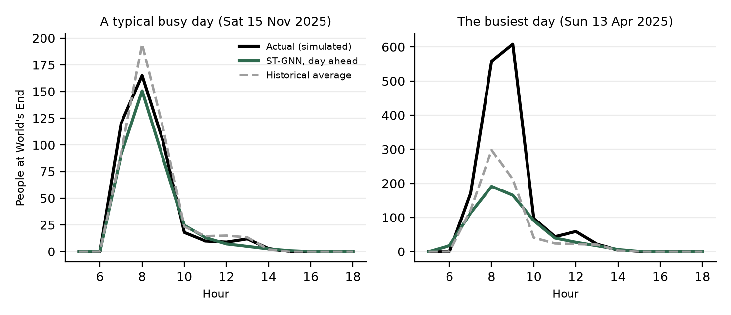
PROOF OF CONCEPT
What a day-ahead forecast looks like
• Typical busy day: ST-GNN off by 5.7 people/h at World's End, historical average by 6.3
• Busiest day: peak 608 people, forecast 191 – extremes are underpredicted
• Consequence: decisions use the forecast's busy case (P90), not its middle (RQ3)
• Input: yesterday's counts, tomorrow's weather forecast and the calendar – no sensors on the trail
Component 4 · IT23343948 · 9
Notes:
Left: a typical busy day – the ST-GNN error at World's End is 6 people per hour vs 6 for the historical average. Right: the busiest day of 2025 – the actual peak is 608, the forecast only 191. Rare extreme days are underpredicted; that is exactly why the control side plans on the busy case (P90), see RQ3. (~45 s)

Slide 10
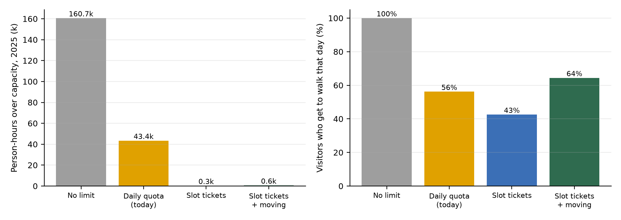
PROOF OF CONCEPT
From forecast to control – Horton Plains
• Capacity: Cifuentes PCC → RCC → ECC; the forecast adds a crowding factor next to rain
• Tickets: per trail and 30-min slot from a linear programme (SciPy HiGHS)
• Full slot: later slot, another trail, or another day – booked up to 90 days ahead
• Result: over-capacity time −73 % (quota) vs −99.6 % (slot tickets)
Component 4 · IT23343948 · 10
Notes:
A ticket fixes a trail and an entry time, so the simulator tells us where its holder will be. A linear programme sells tickets only while every segment stays under its Cifuentes capacity in every half hour. Replaying 2025: the current daily quota removes 73 % of over-capacity person-hours; slot tickets with moving remove 99.6 %, and let more people walk. (~45 s)

Slide 11
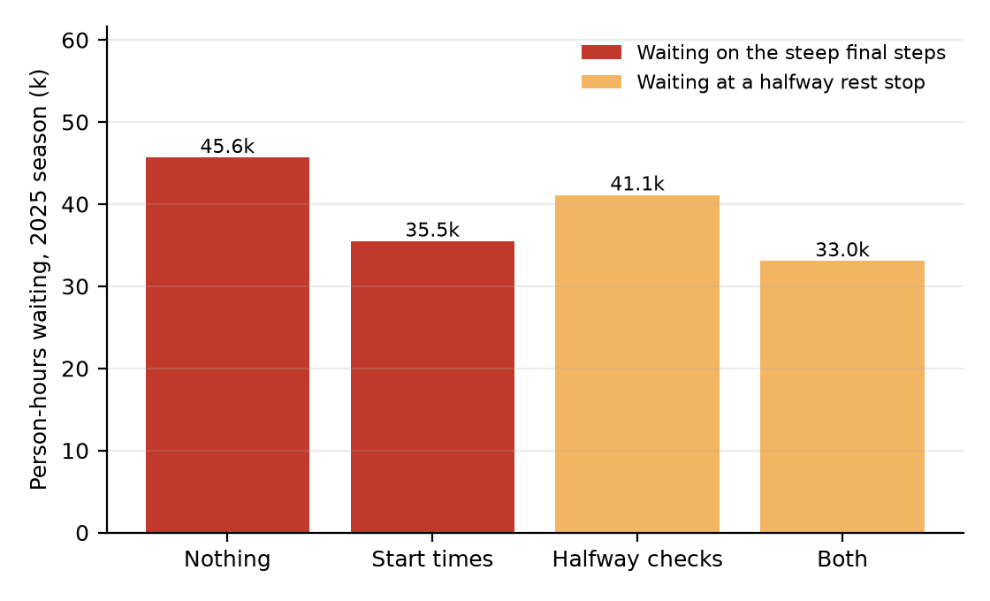
CREATIVE SOLUTION
Adam's Peak – no tickets, so advise and hold
• Recommended start times: per route, wait ≤ 20 min and summit before sunrise
• Herding-aware: movers spread batch by batch – naive advice made the queue 22 % worse
• Halfway checks: rangers enter counts; the app says HOLD and how many to release per 10 min
• Result (2025 season): start times −22 % waiting; both together move all waiting off the final steps and cut it by 28 %
Component 4 · IT23343948 · 11
Notes:
Turning pilgrims away is not acceptable. The danger is the queue on the steep final steps. Two measures: recommended start times per route (spread so the advice does not create a new peak – we found naive advice made queues 22 % worse), and officers at halfway rest stops who count passers and hold groups. Start times alone: −22 %. Both: no waiting on the final steps and −28 % waiting overall. (~60 s)

Slide 12
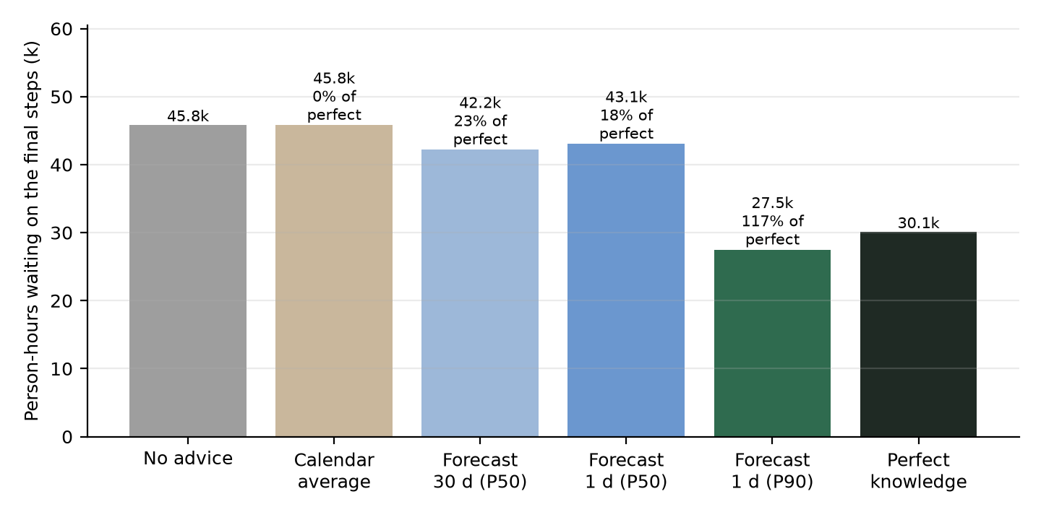
KEY FINDING
RQ3 – Better forecasts help only with the right decision rule
Median forecast →
18 % of the possible benefit
Busy-case (P90) forecast →
117 % of it,
moving 6.4 % of pilgrims
Forecasts should be evaluated by the decisions they drive, not only by their error.
Over 100 % is possible: 'perfect knowledge' means the true number of climbers, not the exact time each group starts; the cautious P90 advice also covers that uncertainty.
Component 4 · IT23343948 · 12
Notes:
Same 132 nights, advice computed before each night from different forecasts. The median forecast gets only 18 % of what perfect knowledge would, because it is too low on exactly the rare peak nights. Planning on the busy case (P90) gets all of it. Bootstrap 95 % interval of P90 vs P50 advice: -34,178 to -2,107 person-hours. This is why the officer console plans halfway checks on the busy case. (~60 s)

Slide 13
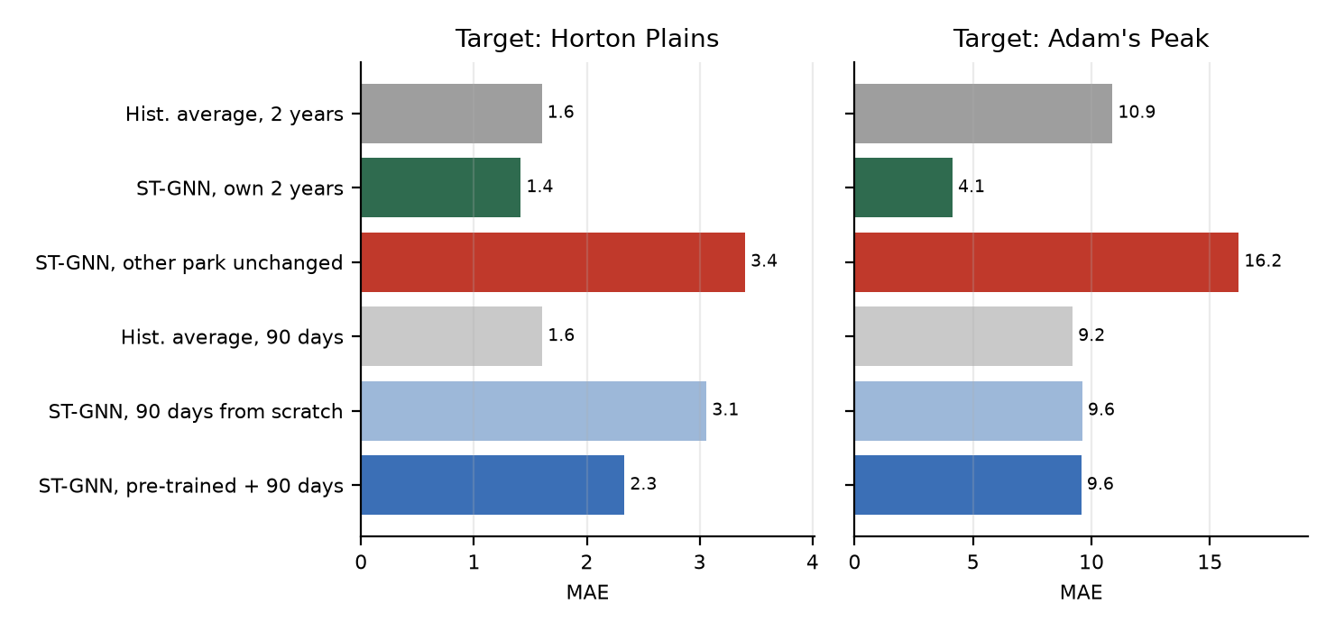
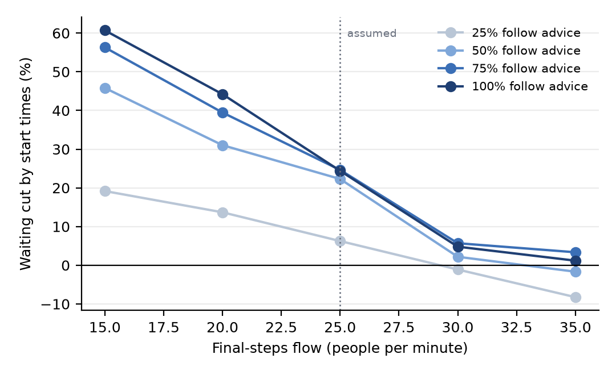
PROOF OF CONCEPT – LIMITS
RQ2 transfer · RQ4 robustness
• Transfer: unchanged → worse than the average; pre-trained + a few days beats scratch (7/8, p < 0.05)
• Robustness: halfway checks clear the final steps at every flow (15–35/min); start times help at ≤ 25/min
• Most important unknown: final-steps flow – waiting changes 26-fold between 15 and 35 people/min
Component 4 · IT23343948 · 13
Notes:
RQ2: a model from one park used unchanged at the other fails – the parks differ too much (day hike vs night pilgrimage). Pre-training does help a new park learn from little data (7 of 8 settings), but with under 90 days a historical average is as good: start a new park on the average and switch later. RQ4: start-time advice works when the final steps really are a bottleneck (≤ 25 people/min) and fades above 30; the flow is the number to measure in the field. (~60 s)

Slide 14
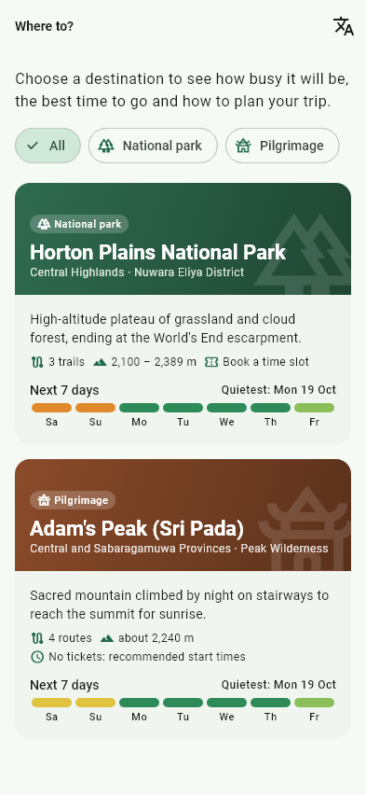
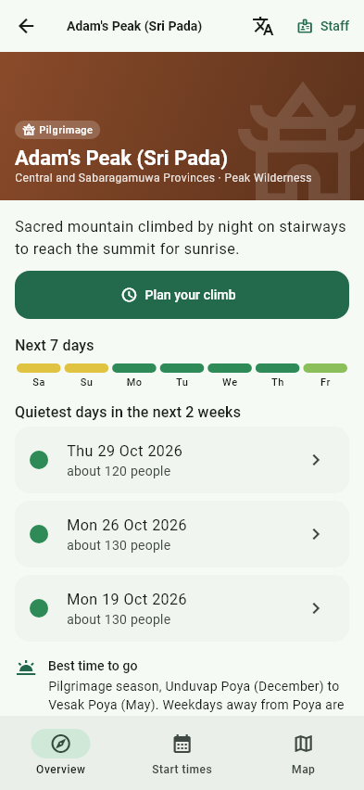
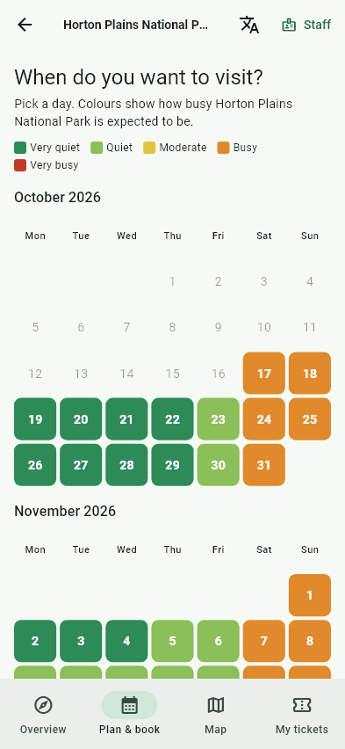
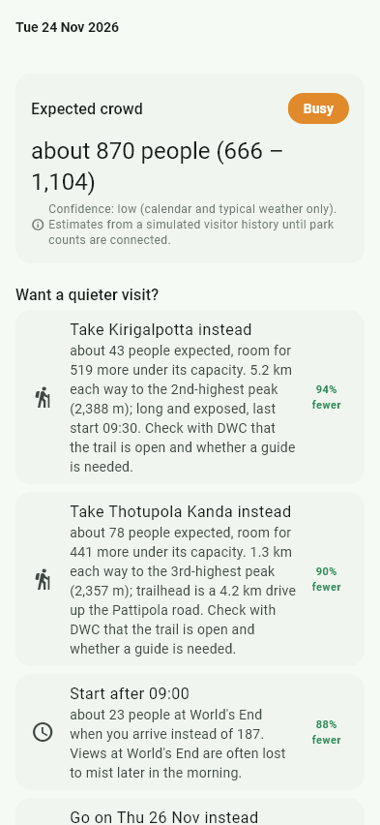
COMPLETION OF PROTOTYPE
Working prototype – visitors plan a trip
• Offline: outlook and tickets cached on the phone
• Booking: slot ticket with QR code; full slot → later slot, other trail, other day
• Languages: English · සිංහල · தமிழ் (drafts under native review)
• Map: OpenStreetMap trails, starts, checkpoints
Where to? – every destination,
its next 7 days
Destination overview,
quietest days, how to get there
90-day crowd calendar
One day: expected crowd
+ how to avoid it
Component 4 · IT23343948 · 14
Notes:
Screens rendered from the real API output. Trip planner: any number of destinations, read from config. Overview: week ahead and the quietest days. Calendar: 90-day crowd outlook. Day: expected crowd with a range and suggestions (other trail, later start, other day). Show the live demo if time allows – RUN_APP.md. (~45 s)

Slide 15
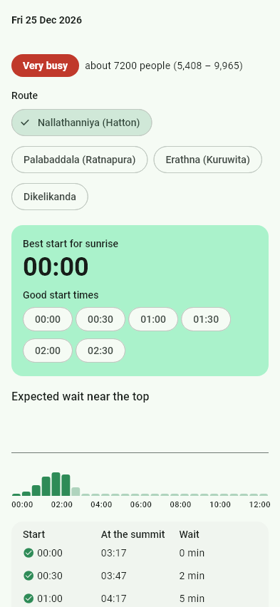
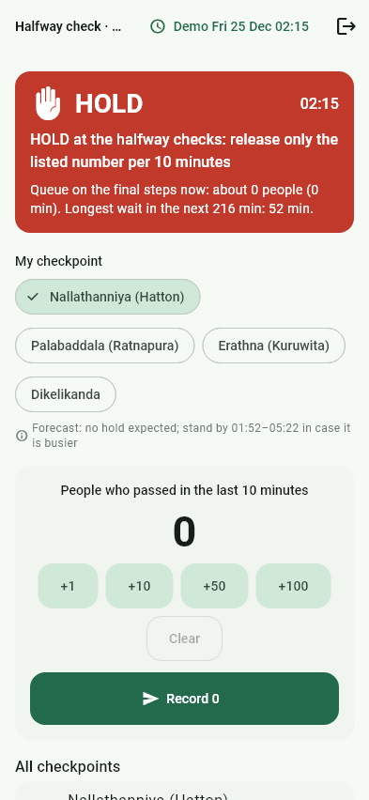
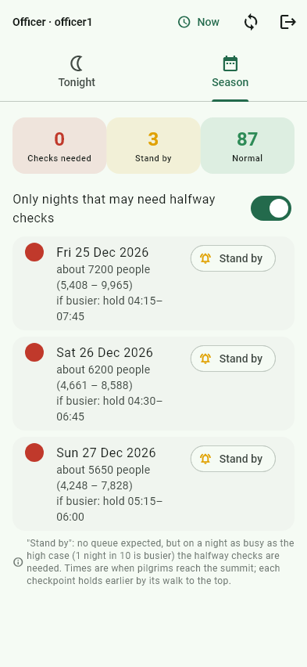
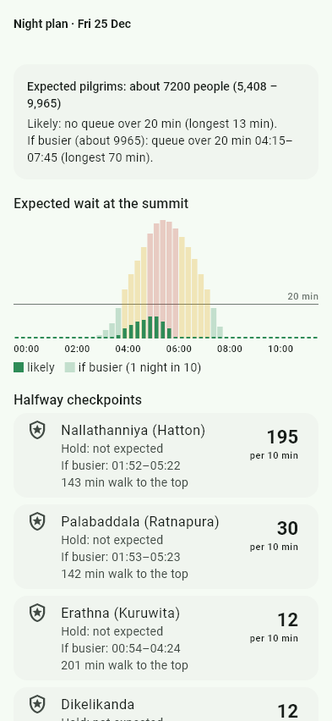
COMPLETION OF PROTOTYPE
Working prototype – pilgrims and staff at Adam's Peak
• Backend: FastAPI per park + gateway, 25+ endpoints
• Security: roles ranger < officer < admin checked on the server; hashed passwords, lockout, audit log
• Quality: 56 Python tests · 16 Flutter widget tests · analyzer clean
Pilgrim: best start times
and wait near the top
Ranger: halfway count →
HOLD + release rate
Officer: nights that may
need halfway checks
Officer: night plan,
hold windows per checkpoint
Component 4 · IT23343948 · 15
Notes:
Start times per route with the expected wait. Ranger at a halfway rest stop enters counts; the app turns red (HOLD) and gives the release rate. The officer sees which nights may need checks (here: Christmas, stand by) and a night plan with hold windows. (~45 s)

Slide 16
USER & FUNCTIONAL REQUIREMENTS
Requirements and their status
ID | Requirement | Status | Evidence
FR1 | Build the trail graph with terrain/weather features from open data | Done | 2 parks, 48 / 57 segments
FR2 | Forecast occupancy per segment for the next 24 h | Done | ST-GNN, RQ1
FR3 | Benchmark against HA, ARIMA, LSTM with significance tests | Done | paired t-tests, Holm
FR4 | Dynamic carrying capacity per trail / segment | Done | Cifuentes + crowding factor
FR5 | Visitors plan up to 90 days ahead and see alternatives | Done | planning model, suggestions
FR6 | Prevent overcrowding (tickets / advice / holds) | Done | −99.6 % Horton, final steps cleared AP
FR7 | Staff tools with roles | Done | ranger, officer, admin + audit
NFR1 | Works without trail sensors | Done | counts only from tickets / halfway counts
NFR2 | Fallback when the model is unavailable | Done | historical-average fallback
NFR3 | Other OSM-mapped parks without architectural change | Done (pipeline) | Adam's Peak = 1 config file; RQ2
NFR4 | Validated against real counts | Pending | field counts planned (risk R1)
NFR5 | No personal visitor data | Done | booking code only, no names
Component 4 · IT23343948 · 16
Notes:
Map each requirement to evidence. Partial items are honest: real counts and field validation come after PP1. (~45 s)

Slide 17
RISK MITIGATION
Risks and mitigation
# | Risk | Impact | Mitigation (status)
R1 | No real segment-level counts: the target is synthetic | High | Assumptions listed and parameterised; RQ4 sensitivity; field counts at World's End and one Poya night (planned)
R2 | ST-GNN not better than simpler models | Medium | Mandatory baselines + ablation; result reported either way; LSTM-cell ST-GNN next (in progress)
R3 | Last part of the Adam's Peak trail missing in OSM | Medium | Approximate link flagged; replace with a GPS track
R4 | Authorities do not adopt tickets / advice | Medium | Advice-only mode for pilgrim sites; decisions to confirm with DWC and Sri Pada Trust
R5 | Holiday calendar not published for 2027 | Low | Estimated Poya days (62/62 within 1 day); swap in gazette
R6 | CPU-only training time | Low | Small graph, early stopping; seeds run overnight
R7 | Translations inaccurate | Low | Marked as drafts; native-speaker review
Component 4 · IT23343948 · 17
Notes:
Lead with R1 – it is the question examiners will ask. The mitigation is already in motion: every assumption is listed and parameterised, sensitivity analysis shows which ones matter, and field counts are planned. (~45 s)

Slide 18
COMMERCIALISATION
Who would use it, and why they would pay
User | Benefit
DWC / park management | Dynamic quotas and slot plans instead of a fixed number; season staffing plan
Sri Pada Trust / police | Which nights need halfway checks, when to hold, how many to release
Visitors and pilgrims | Know before travelling: quiet days, start times, guaranteed entry slot
Tour operators / SLTDA | Plan groups on quiet days; tourism statistics per site
• Model: licence per site (authority) + small booking fee per ticket
• Scales: a new destination = one config file + open data – no sensors to buy or maintain
• Next sites: Ella Rock, Knuckles, Sigiriya, Sinharaja, Adam's Peak minor routes
• Low cost: open data, CPU-only, offline-capable app
Component 4 · IT23343948 · 18
Notes:
Benefits are concrete: fewer dangerous queues, fairer access, revenue protected by booking instead of turning people away at the gate, data for planning staff. Business model: a per-site licence to the authority, small booking fee, and the same engine for other sites (Ella Rock, Knuckles, Sigiriya, Sinharaja) by adding a config. (~45 s)

Slide 19
COMPLETION & PLAN
Progress and next steps
Done (PP1) | Next (to PP2)
Graph + features for 2 parks; simulator; dataset | Field counts: World's End (2–3 days), final-steps flow (1 Poya night)
ST-GNN + 4 baselines, spatial CV, tests (RQ1) | ST-GNN with LSTM cell; 3 seeds at Adam's Peak
Cifuentes capacity; slot tickets; start times + holds | Learning curve: days of counts a new park needs (RQ2)
Transfer, forecast value, sensitivity (RQ2–RQ4) | Calibrate the simulator with DWC totals; re-run RQ1–RQ4
API, gateway, Flutter app, 3 languages | Usability study (SUS, 10–15 users) + ranger / officer interviews
Planning model 2–90 days (P10–P90 ≈ 78 % coverage) | Research paper draft; integration with the team app
Component 4 · IT23343948 · 19
Notes:
About 60-65 % of the research work is done, on schedule; the remaining work is validation and depth, not new features. (~45 s)

Slide 20
Thank you
Questions?
Weerasekera J.V. · IT23343948 · Component 4
Notes:
Backup slides follow: limitations, planning model.

Slide 21
BACKUP
Backup – Limitations (stated before you are asked)
• Synthetic target: all results test the method on a simulator, not the real parks; every assumption is in docs/assumptions*.md with what would replace it
• Same simulator: the control results (RQ3, RQ4) use the simulator that made the data
• Seeds: Adam's Peak and transfer results use one seed; Horton temporal uses three
• Weather: the day-ahead test uses observed weather (a perfect forecast) – an upper bound
• OSM gaps: the last ~350 m to the Adam's Peak summit is an approximate link; minor routes not mapped
• Planning model: daily totals no better than the calendar average (MAE ≈ 110 vs 108); segment-hour occupancy better (1.44 vs 1.65)
Component 4 · IT23343948 · 21
Notes:
Use if asked about the synthetic data or validity.

