Slide 1
4
Your photo
(keep the one in the team deck)
MODULE 4
Spatio-Temporal Bottleneck Forecasting &
Dynamic Carrying Capacity
Forecasts where and when trail sections overload, a day ahead, from open data only - and turns it into a safe number per trail instead of one fixed daily quota.
CONTRIBUTION TO THE OVERALL SOLUTION
Supplies the crowd and capacity signal of the framework: a per-section forecast and safe numbers that the safety assistant (Module 3) and the authority dashboard read offline through a versioned data contract.
SPECIALIZATION Information Technology
IT23343948 | Weerasekera J.V | J26-IT-363

Slide 2
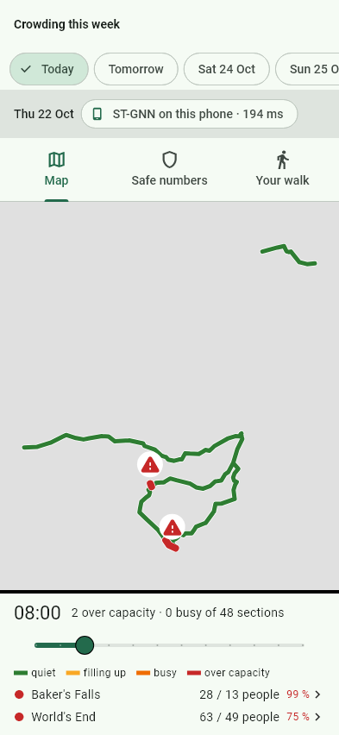
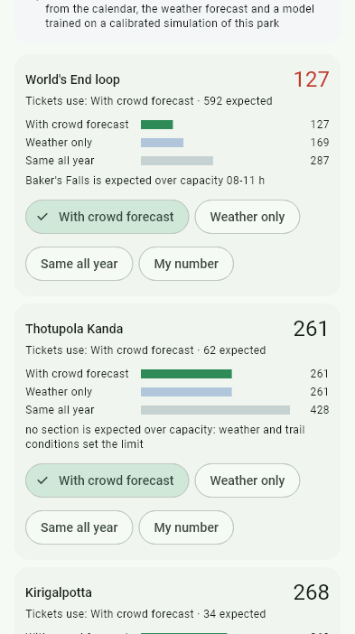
MODULE 4 · CROWD & CAPACITY FORECASTING
How the solution addresses the sub-problem / prototype
Working prototype at three parks (Horton Plains, Adam's Peak, Yala). Results: 2025 replay, simulation.
SUB-PROBLEM
PROTOTYPE FLOW
−27%
over-capacity
vs fixed quota
(Horton)
One fixed daily quota per park cannot say when or where a trail section overloads - and no section counts exist.
OpenStreetMap trail graph
35-57 sections of ~300 m - 1.2 km
Terrain + weather + calendar
Copernicus DEM, Open-Meteo, Poya days
−24%
same, at
Adam's Peak
USER REQUIREMENTS MET
✓ Section-level forecast, next 24 h (FR2)
✓ Condition-aware capacity, Cifuentes (FR3)
✓ Runs offline on the phone < 2 s (NFR1)
✓ One number + 'why' for officials (NFR4)
✓ Feed for Module 3 + dashboard (FR4)
✓ Tested against simple baselines
ST-GNN: GCN + GRU
people per section per hour, on the phone
−99.6%
with timed
entry slots
Cifuentes PCC → RCC → ECC
forecast enters the real-capacity step
Tomorrow, section by section (offline)
Officer: forecast vs fixed quota
<2 s
forecast on
the phone
Decisions
safe numbers · entry slots · gate advice
Same visitors admitted in every comparison. Slot tickets fix a trail + entry time, so no section goes over its safe number in any half hour.
16

Slide 3
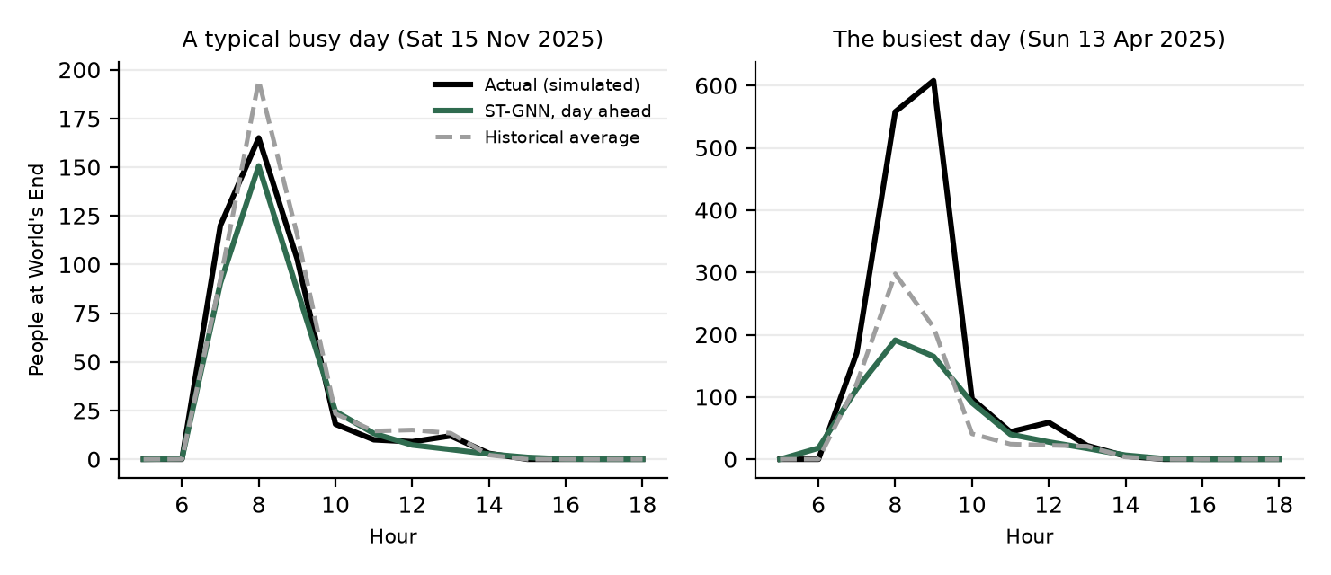
MODULE 4 · CROWD & CAPACITY FORECASTING
Design excellence / contribution + user feedback
Tested, not assumed: the graph model is compared with simpler models, and the parts that did not work are reported.
Graph structure
Transfer strategy
Management value
USER FEEDBACK
Tiny trail graphs (35-57 sections) built from OpenStreetMap - not dense city traffic. One config file per park: Horton Plains, Adam's Peak, Yala.
Pretrained on METR-LA → PEMS-BAY, adapted to each trail. Honest result: helps only with 30-90 days of data; traffic weights alone fail.
Forecast enters Cifuentes RCC → a safe number per trail that changes with weather and crowding: −27% / −24% over-capacity time vs a fixed quota.
Fill with real answers before presenting:
• Hiker: would you change your visit if a section shows red at 08:00?
• Guide / tour operator: is the safe number + reason clear?
• Ranger / DWC contact: would the counting + gate advice fit the job?
• Changed because of it: …
Validation · baseline comparison
MAE (people / section-hour) | Hist. avg | ARIMA | LSTM | GRU, no graph | ST-GNN
Every section counted | 1.60 | 1.93 | 1.42 | 1.42 | 1.42
Sections without counts | 4.20 | – | 2.59 | 2.61 | 2.54
Horton Plains, 2025 test year, 3 seeds, paired tests over days. Graph helps on uncounted sections (p < 0.001, ~2 %); a tie when every section is counted. Spatial block CV; no leakage.
Day-ahead forecast vs actual at World's End: right on typical days, low on the rare busiest day → decisions use the busy case.
Next Field counts in December (criteria fixed in advance) to validate the simulated target; surveys with DWC, rangers and hikers.
17

