Slide 1
IT2070 – Data Structures and Algorithms
Lecture 02
Introduction to Queue

Slide 2
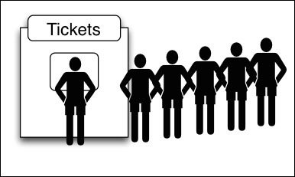
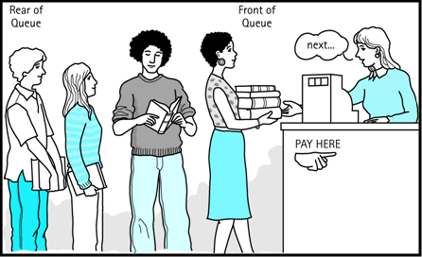
Queues
Imagine a queue in real life
The first item inserted is the first item to be removed

Slide 3
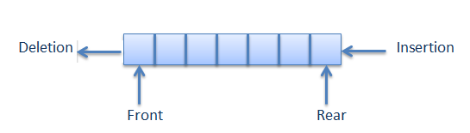
Queues
In a queue all insertions are made at the Rear end and deletions are made at the Front end.
Insertions and deletions are restricted from the Middle of the Queue.
Adding an item is called insert
Removing an item is called remove
The elements are inserted and removed according to the First-In-First-Out (FIFO) principle.

Slide 4
Queue - Insert
0
1
2
3
4
5
0
1
2
3
4
5
0
1
2
3
4
5
 | 15 | 27 | 39 | 23
 | 15 | 27 | 39 | 23
 | 15 | 27 | 39 | 23 | 45
Front
Rear
Front
Rear
45
Front
Rear
New Element
(Insert)
Before inserting
Item 45 is inserted to the rear
After inserting

Slide 5
Queue - Remove
0
1
2
3
4
5
0
1
2
3
4
5
0
1
2
3
4
5
 | 15 | 27 | 39 | 23
 | 15 | 27 | 39 | 23
 |  | 27 | 39 | 23
Front
Rear
Front
Rear
Front
Rear
15
Before removing
Front item is removed
After removing

Slide 6
Queue - PeekFront
0
1
2
3
4
5
0
1
2
3
4
5
 | 15 | 27 | 39 | 23
 | 15 | 27 | 39 | 23
Peek → 15
Front
Rear
Front
Rear
Queue remains the same
Peek is used to read the value from the Front of the queue without removing it. You can peek only the Front item, all the other items are invisible to the queue user.

Slide 7
Question 01
Draw the Queue frame after performing the below operations to the queue given below.
60 | 47 | 99 | 67 | 24
0
1
2
3
4
5
6
60 | 47 | 99 | 67 | 24
Front
Rear
Insert item 33
Insert item 53
peekFront
remove
remove
remove
remove
remove

Slide 8
Uses of Queue
There are various queues quietly doing their job in a computer’s operating system.
printer queue
stores keystroke data as you type at the keyboard
pipeline

Slide 9
Queue - Implementation
Queue implementation using an array with restricted access
Constructor creates a new Queue
of a size specified in its argument.
Variable front, which stores the
index of the item on the front of the
queue.
Variable rear, which stores the
index of the item on the end of the
queue.
Variable nItems, which stores the
total number of the items in the
queue.
class QueueX {
private int maxSize; // size of queue array
private int [] queArray;
private int front; //front of the queue
private int rear; //rear of the queue
private int nItems; //no of items of the queue
public QueueX (int s) {// constructor
maxSize = s; // set array size
queArray = new int[maxSize];
front = 0;
rear = -1;
nItems = 0; // no items
}
…………………….
…………………….
}

Slide 10
Queue – Implementation - insert
class QueueX {
private int maxSize; // size of queue array
private int [] queArray;
private int front; //front of the queue
private int rear; //rear of the queue
private int nItems; //no of items of the queue
publc QueueX(int s) { // constructor
maxSize = s; // set array size
queArray = new int [maxSize];
front = 0;
rear = -1;
nItems = 0; // no items
}
public void insert(int j) {
// increment rear
// insert an item
}
}

Slide 11
Queue – Implementation - insert
class QueueX {
private int maxSize; // size of queue array
private int [] queArray;
private int front; //front of the queue
private int rear; //rear of the queue
private int nItems; //no of items of the queue
publc QueueX(int s) { // constructor
maxSize = s; // set array size
queArray = new int [maxSize];
front = 0;
rear = -1;
nItems = 0; // no items
}
public void insert(int j) {
// increment rear and insert an item
queArray[++rear] = j;
nItems++;
}
}
What if the queue is full ?

Slide 12
Queue – Implementation - insert
class QueueX {
private int maxSize; // size of queue array
private int [] queArray;
private int front; //front of the queue
private int rear; //rear of the queue
private int nItems; //no of items of the queue
publc QueueX(int s) {// constructor
maxSize = s; // set array size
queArray = new int [maxSize];
front = 0;
rear = -1;
nItems = 0; // no items
}
public void insert(int j) {
// check whether queue is full
if (rear == maxSize – 1)
System.out.println(“Queue is full”);
else {
queArray[++rear] = j;
nItems++;
}
}
}

Slide 13
Queue – Implementation – remove/peekFront
class QueueX {
private int maxSize; // size of queue array
private int [] queArray;
private int front; //front of the queue
private int rear; //rear of the queue
private int nItems; //no of items of the queue
publc QueueX(int s) { // constructor
maxSize = s; // set array size
queArray = new int [maxSize];
front = 0;
rear = -1;
nItems = 0; // no items
}
public void insert(int j) {
// check whether queue is full
if (rear == maxSize – 1)
System.out.println(“Queue is full”);
else {
queArray[++rear] = j;
nItems++;
}
}
}
public int remove() {
// check whether queue is empty
// if not
// access item and increment front
}
public int peekFront() {
// check whether queue is empty
// if not
// access item
}

Slide 14
Queue – Implementation – remove
class QueueX{
private int maxSize; // size of queue array
private int [] queArray;
private int front; //front of the queue
private int rear; //rear of the queue
private int nItems; //no of items of the queue
publc QueueX(int s) {// constructor
maxSize = s; // set array size
queArray = new int [maxSize];
front = 0;
rear = -1;
nItems = 0; // no items
}
public void insert(int j) {
// check whether queue is full
if (rear == maxSize – 1)
System.out.println(“Queue is full”);
else {
queArray[++rear] = j;
nItems++;
}
}
}
public int remove() {
if (nItems == 0) {
System.out.println(“Queue is empty”);
return -99;
}
else {
nItems--;
return queArray[front++];
}
}

Slide 15
Queue – Implementation – peekFront
class QueueX{
private int maxSize; // size of queue array
private int [] queArray;
private int front; //front of the queue
private int rear; //rear of the queue
private int nItems; //no of items of the queue
publc QueueX(int s) {// constructor
maxSize = s; // set array size
queArray = new int [maxSize];
front = 0;
rear = -1;
nItems = 0; // no items
}
public void insert(int j) {
// check whether queue is full
if (rear == maxSize – 1)
System.out.println(“Queue is full”);
else {
queArray[++rear] = j;
nItems++;
}
}
}
public int peekFront() {
if (nItems == 0) {
System.out.println(“Queue is empty”);
return -99;
}
else {
return queArray[front];
}
}

Slide 16
Question 02
isEmpty() method of the Queue class returns true if the Queue is empty and
isFull() method returns true if the Queue is full.
Implement isEmpty() and isFull() methods of the Queue class.

Slide 17
Question 03
Draw the Queue frame after performing the below operations to the queue given below.
0
1
2
3
4
5
6
67 | 12 | 22 | 55 | 34 | 70 | 60
Front
Rear
remove
remove
remove
Insert item 88

Slide 18
Question 03 Contd..
Draw the Queue frame after performing the below operations to the queue given below.
0
1
2
3
4
5
6
0
1
2
3
4
5
6
77 | 67 | 12 | 22 | 55 | 34 | 70 | 60
77 | 67 | 12 | 22 | 55 | 34 | 70 | 60
 |  |  | 55 | 34 | 70 | 60
67 | 12 | 22 | 55 | 34 | 70 | 60
Front
Rear
Front
Rear
Although the queue is not full we cannot insert more elements.
Any Suggestions?
remove
remove
remove
Insert item 88

Slide 19
How to overcome this situation??
We can use a Circular Queue
0
0
1
2
3
4
5
6
77 | 67 | 12 | 22 | 55 | 34 | 70 | 60
Rear
 |  |  | 55 | 34 | 70 | 60
6
60
1
Front
Rear
70
5
2
34
55
Front
4
3

Slide 20
Circular Queue
Circular queues are queues that wrap around themselves.
These are also called ring buffers.
The problem in using the linear queue can be overcome by using circular queue.
When we want to insert a new element we can insert it at the beginning of the queue.
i.e. if the queue is not full we can make the rear start from the beginning by wrapping around
If rear was 3 then the next element should be stored in index 4
If rear was 7 then the next element should be stored in index 0

Slide 21
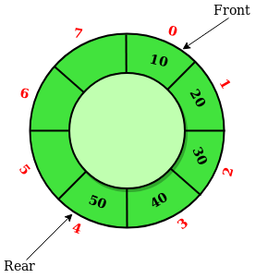
Question 04
Draw the Queue frame after performing the below operations to the circular queue
given below.
insert(14);
insert(29);
insert(33);
insert(88);
peekFront();
remove();
remove();
insert(90);
insert(100);
peekFront();

Slide 22
Inserting an element to Linear Queue
Inserting an element to Circular Queue
public void insert(int j) {
// check whether queue is full
if ( rear == maxSize - 1)
System.out.println(“Queue is full”);
else {
queArray[++rear] = j;
nItems++;
}
}
public void insert(int j) {
// check whether queue is full
if (nItems == maxSize)
System.out.println(“Queue is full”);
else {
if(rear == maxSize - 1)
rear = -1;
queArray[++rear] = j;
nItems++;
}
}

Slide 23
Removing an element from Linear Queue
Removing an element from Circular Queue
public int remove() {
// check whether queue is empty
if ( nItems == 0)
System.out.println(“Queue is empty”);
else {
nItems--;
return queArray[front++];
}
}
public int remove() {
// check whether queue is empty
if ( nItems == 0)
System.out.println(“Queue is empty”);
else {
int temp = queArray[front++];
if (front == maxSize)
front = 0;
nItems--;
return temp;
}
}

Slide 24
Question 05
Implement isFull(), isEmpty() and peekFront() methods of the
Circular Queue class.

Slide 25
Question 06 Creating a Queue
Using the implemented QueueX class, Write a program to create a queue with
maximum size 10 and insert the following items to the queue.
10 25 55 65 85
Delete all the items from the queue and display the deleted items.

Slide 26
Creating a Queue
class QueueApp {
public static void main(String[] args) {
QueueX theQueue = new QueueX(10); // create a queue with max size 10
theQueue. insert(10); // insert given items
theQueue. insert(25);
theQueue. insert(55);
theQueue. insert(65);
theQueue. insert(85);
while( !theQueue.isEmpty() ) { // until it is empty, delete item from queue
int val = theQueue.remove();
System.out.print(val);
System.out.print(“ “);
}
}
} // end of class

Slide 27
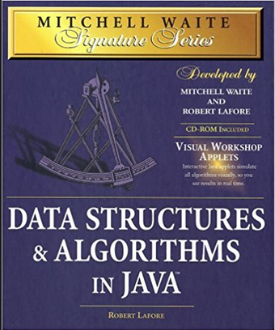
References
Mitchell Waite,Robert Lafore, Data Structures and Algorithms in Java,2nd Edition, Waite Group Press,1998.

