Slide 1
Beyond RBE=1.1 treatment planning for DWA protons
Mirta Dumancic, PhD
Seuntjens Lab
October 14th, 2026
DWA commissioning in matRad

Slide 2
Status Updates for the Seuntjens Lab
Community Events and Updates:
- undergrad MRI Crash Course Monday 1-3 PM
- Unit 8 visits for clinical radiotherapy
- FLASH workshop November 19
Research Progress with Particle Treatment Planning
- updated version of DWA commissioned in matRad
- added to REB protocol
- LET-based planning in collaboration with DKFZ (MATLAB or Python pyRadPlan)

Slide 3
Validation of DWA against a generic proton machine in a water phantom
Starting with TOPAS output:
- 58 Bragg curves (energies) in water, 580 lateral spot profiles in air
- RayStation beam model unknown
AI Disclosure for this work
Claude (Anthropic, Opus 5.5), an AI assistant, was used to help write and debug the MATLAB scripts that converted the TOPAS/RayStation exports into the matRad machine file (including the double-Gaussian lateral fit and energy-layer interpolation), to design the validation and DWA-vs-Generic comparison analyses, and to draft the accompanying documentation, while all code was run, checked and validated, and all results interpreted, by the author, who takes full responsibility for the work.

Slide 4
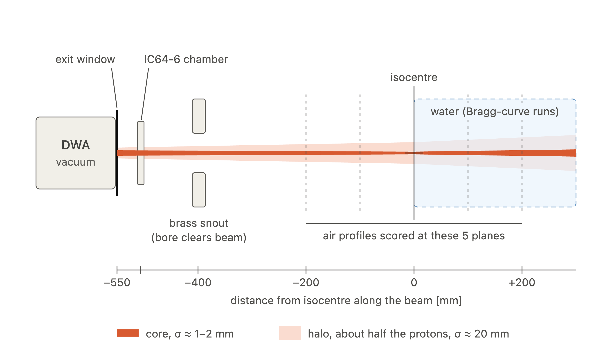
Commissioning the machine

Slide 5
Beam Model in matRad
Modeling the beam:
1) "DWA_proton": had a single Gaussian for the lateral profile but that turned to inflate the width: at 149 MeV σ ≈ 5.0 mm, when the real core is 1.3 mm
2) "DWA_proton_doubleGauss_interp": Gauss+halo
σ_core(z)² = σ_air,core² + σ_Highland(z)²
σ_halo(z)² = σ_air,core² + σ_air,halo,extra² + σ_Highland(z)²

Slide 6

SOBP check
1) "DWA_proton": had a single Gaussian for the lateral profile but that turned to inflate the width: at 149 MeV σ ≈ 5.0 mm, when the real core is 1.3 mm

Slide 7
Comparison with a generic proton machine (not a real machine = synchrotron!)

Slide 8
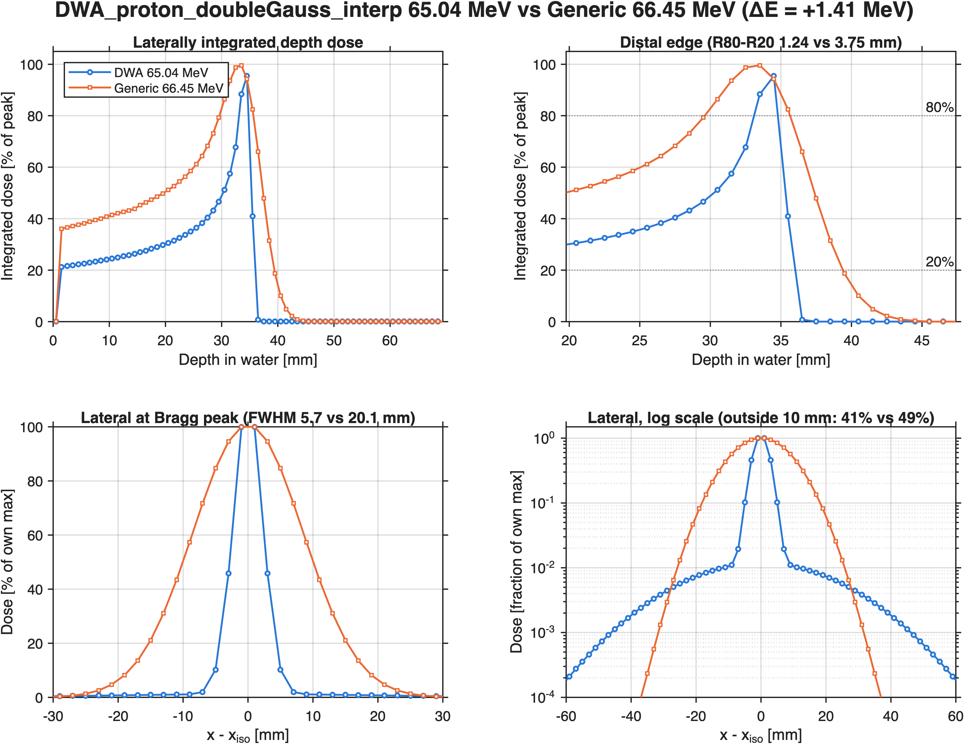
Latest version

Slide 9
Latest version

Slide 10
Update for Oct 14: Alaina & Remo
Where we are
DWA_proton_doubleGauss_interp in matRad: depth-dose is validated (Bragg peak within 1 mm of TOPAS at all 58 energies)
Remo's SOBP check: the depth is good, the lateral penumbra is too shallow
Today
1. Why the current lateral model is questionable
2. What goes into TOPAS: Jamiel's TRANSOPTR beam optics
3. A proposal: re-score in TOPAS for matRad, from scratch (dose, lateral profiles in water, LET)
4. Questions we need answered
Goal
One TOPAS data set that gives matRad everything: absolute IDD, depth-dependent σ1/σ2/weight and LETd
Decision needed
Agree on the scoring setup (A–D) before Alaina reruns, so one run serves matRad and RayStation

Slide 11
Open issues with the lateral beam model

Slide 12
Why the current lateral profile is questionable
matRad field | Where it comes from now | Problem
Z (IDD) | TOPAS Bragg curves in water | Good, but relative and scored to r < 60 mm
initFocus (core σ in air) | TOPAS lateral profiles in air | Fine; mirrored in Z (script bug)
sigma1 (core in water) | initFocus + Highland, computed | Not checked against MC in water
sigma2 (halo width) | Air profile at isocentre | Constant with depth
weight (halo) | Air profile at isocentre | Constant with depth; 0.5 or 0.05?
Nuclear halo in water | — | Missing
X vs Y | Averaged | matRad's double Gaussian is round
The key point
The Bragg curves are laterally integrated (IDD). Integrating over the plane removes all lateral information.
So everything lateral comes from runs in air. In air there is no nuclear scattering, so the halo there is only the in-air (beamline) halo.
In water the halo should grow with depth (secondary protons from nuclear reactions), and its weight should change. Our machine cannot do that.

Slide 13
Remo's SOBP check: penumbra too shallow
What Remo saw
Flat SOBP: more layers (interpolation) helped
Lateral profile: a ~20 % shoulder out to ±50 mm beyond the field edge
Why
Halo weight ≈ 0.4–0.5 is used at every depth
That weight describes the in-air halo at isocentre only
The physical nuclear halo (small at the surface, growing towards the Bragg peak) is missing
“The standard deviation and the relative weight of the two Gaussians can (and should) change as a function of depth.” (Remo)

Slide 14
Is the halo weight 0.5 or 0.05?
Alaina's lateral profiles are normalised to a maximum of 1, so we cannot tell what they are:
a central cut through the 2D spot, or
a projection (integrated over the other axis)
The same fitted a₁, σ₁, a₂, σ₂ give a 10× different matRad weight:
We used the cut (≈ 0.5).
A projection would give a halo 10× weaker, much closer to what a real spot looks like.
If the profile is… | matRad weight | Range (58 energies)
a central cut | a₂σ₂² / (a₁σ₁² + a₂σ₂²) | 0.38 – 0.51
a projection | a₂σ₂ / (a₁σ₁ + a₂σ₂) | 0.04 – 0.07
Question for Alaina
How were the profiles scored? A line through the centre, or a sum over the full width?
Either way, the weight comes from air and stays constant with depth. The fix needs dose in water (scoring C, below).

Slide 15
Two more issues in the current machine
1. initFocus is mirrored in Z
matRad's initFocus.dist is the distance from the source (increasing downstream). Alaina's Z is positive downstream.
Correct: dist = SAD + Z. Script has SAD − Z (inherited from the first DWA machine).
The convergence/divergence is reversed. Effect at the phantom surface:
20 MeV: σ ≈ 6.6 mm (now) vs ≈ 4.1 mm (correct)
149 MeV: σ ≈ 1.1 mm (now) vs ≈ 1.5 mm (correct)
Depth-dose is not affected. The fix is ready, as v2 (new machine name).
2. The spot is not round
TRANSOPTR focuses X and Y differently (next section).
Air profiles at isocentre, 149 MeV: X ≈ 1.0 mm, Y ≈ 1.3 mm.
matRad's double Gaussian is round, so we use the average of X and Y.
Effect: small for fields (spots overlap), visible for single spots.
Neither issue explains Remo's penumbra. That comes from the halo weight.

Slide 16
Jamiel's beam optics
TRANSOPTR beam input to TOPAS

Slide 17
What TOPAS gets from TRANSOPTR
One row per energy (58 rows, 20 → 228.7 MeV), at the nozzle exit window, 550 mm upstream of isocentre
Achieved energy: what the DWA delivers (≈ requested + 0.01–0.14 MeV)
ε (1-rms emittance) in X and Y: the area of the beam in position–angle space
Twiss α, β, γ: the shape and tilt of that area. σ = √(εβ), σ′ = √(εγ). α > 0 means converging
dE/E: energy spread (1-rms)
σ at isocentre in X and Y: 1.000 mm for every energy (the design target)
TOPAS samples a pure Gaussian beam from these numbers. There is no halo in the input, so any halo in Alaina's profiles is made in the nozzle and air.
Check (our propagation) | Result
σ(z) = √(ε(β − 2αz + γz²)), z = 550 mm | σ at iso = 1.000 mm (X and Y, all energies)
εₙ = βγ·ε (normalised) | ≈ 0.078 mm·mrad, constant (adiabatic damping)
Air cores upstream vs vacuum propagation | Agree: confirms +Z = downstream

Slide 18
Emittance and Twiss parameters vs energy
Geometric emittance falls with energy, normalised emittance is flat (≈ 0.078 mm·mrad): textbook adiabatic damping
Large α in X (190–300): X is strongly converging at the exit window
Step between 35 and 38 MeV: the optics were retuned there

Slide 19
Spot size, divergence and waist position
σ = 1.000 mm at isocentre in both planes, by design
X waist 80–180 mm past isocentre; Y waist 0.4–0.9 m past isocentre
So X and Y spots change differently with depth: the spot is not round off isocentre

Slide 20
Phase-space ellipses at 149 MeV
Ellipse at the exit window and at isocentre, X and Y
Tilted ellipse = converging beam (α > 0)
This is exactly what TOPAS samples: a Gaussian in position and angle, no halo

Slide 21
Achieved energy and energy spread
Achieved energy ≈ requested (Δ ≤ 0.14 MeV); matRad uses the achieved value
dE/E = 0.044–0.060 % (1-rms): very narrow. Range straggling dominates the Bragg peak width, not the beam
Compare with energySpectrum (σ in %) in the matRad machine file

Slide 22
Beam envelope from the exit window to isocentre
σ(z) in X and Y for selected energies, vacuum propagation of the TRANSOPTR beam
Dots: cores fitted to Alaina's air profiles (DWA_SpotProfiles.csv)
Upstream cores follow the vacuum envelope: confirms the sign of Z and that the core is optics, not scatter

Slide 23
A proposal, from scratch
Scoring in TOPAS for matRad

Slide 24
Where the DWA beam goes: nozzle, snout, isocentre
Snout: the last piece of the nozzle (brass, bore radius 50 mm). matRad's BAMStoIsoDist is measured from here
550 mm exit window → isocentre; 400 mm snout → isocentre
Alaina's current runs: profiles in air around isocentre, Bragg curves in water at isocentre
matRad needs the lateral profile in water, at each depth

Slide 25
Proposed scoring: air runs and water runs
Air runs
A phase space after the snout (Z ≈ −375 mm): reusable source for every later run
B 2D x–y fluence maps every 50 mm, snout to +300 mm: gives initFocus in X and Y, and tells cut vs projection
Water runs
C dose in r–z bins, water cylinder, surface at isocentre, r ≥ 150 mm, absolute per primary: gives Z, σ1(z), σ2(z), weight(z)
D dose-averaged LET on the same bins: gives machine.data.LET

Slide 26
Scoring details
 | What | Where | Binning | Gives matRad
A | Phase space (x, y, x′, y′, E, particle) | Plane after the snout, Z ≈ −375 mm | — | Re-usable source; check of the beamline
B | Fluence: primary protons and all particles | x–y planes every 50 mm, snout → +300 mm | 0.25–0.5 mm, ±80 mm | initFocus (X, Y separately); halo in air
C | Dose to water, absolute (Gy per primary) | Water cylinder, surface at iso, r ≥ 150 mm | r: 0.5 mm; z: 1 mm (0.5 mm below 80 MeV) | Z(z); σ1, σ2, weight vs depth
D | Dose-averaged LET, protons | Same cylinder and bins as C | Same as C | machine.data.LET (keV/µm)
Energies: all 58 for C and D; 10–15 spread over the range for A and B. Histories: ~1e7 primaries per energy for the lateral fits
Priority: C > B > D > A. C alone fixes Remo's penumbra; B fixes initFocus and X/Y; D is needed for LET planning

Slide 27
From TOPAS output to the matRad machine file
Depth dose (from C)
Sum dose over r in each z slice: ∫D dA [Gy·cm²/primary]
Z [MeV·cm²/g per primary] = ∫D dA × 6.2415e9
Absolute: no more relative curves; r ≥ 150 mm catches the halo
Lateral (from C, then B)
Fit D(r) at each depth with two Gaussians: σ1(z), σ2(z), weight(z)
Store as sigma1, sigma2, weight (vectors over depths), as in matRad's generic machine
B gives initFocus (σ in air vs distance) for X and Y
What changes for matRad
weight becomes small at the surface and grows towards the Bragg peak, as Remo expects. The penumbra steepens, and the 20 % shoulder goes away.
Naming
New physics = new machine name (e.g. DWA_proton_TOPASwater_v1). Old machine stays for comparison.

Slide 28
LET scoring (D)
In TOPAS
Scorer: ProtonLET, weighted by dose (LETd)
Same r–z cylinder and bins as the dose scorer C, so dose and LET line up voxel by voxel
Score protons only (primary + secondary). Keep the dose map, it is needed for averaging
Output in MeV/mm (in water, 1 MeV/mm = 1 keV/µm)
Into matRad
Plane average per depth: LETd(z) = Σ D·LET / Σ D
Store as machine.data(i).LET in keV/µm, on the same depths as Z
Why it matters
LET-based planning with Remo | matRad needs machine.data.LET to compute LET and variable-RBE dose
Generic machine has LET | DWA must have it too, for a fair comparison
Same run as C | No extra simulation: add one scorer
Check: LETd at the Bragg peak should rise steeply towards the distal edge (lowest at the entrance, ≈ 0.5–3 keV/µm depending on energy).

Slide 29
Questions for Alaina & Remo
For Alaina
Are the lateral profiles a central cut or a projection?
Exit window: material and thickness (the file lists Air under a Mylar comment)
Which lateral model did RayStation fit (single, double Gaussian)?
Can you rerun with scorers A–D? Can the dose be absolute per primary?
Is BAMStoIsoDist 400 mm (snout) or 550 mm (exit window)?
For Remo
Depth-dependent sigma1/sigma2/weight: same format as the generic machine?
LET: what depth and energy resolution does matRad need?
Should we thin the energy layers in the steering file (stf)?
OK to release the initFocus fix now as v2, before the new TOPAS data?

