Slide 1
SUPERSTORE DATASET
CAPSTONE

Slide 2
DATASET DESCRIPTION
The dataset is a Superstore sales dataset containing 9,994 rows and 20 columns. It includes various attributes related to retail transactions, such as order details (Order ID, Order Date, Ship Date, Ship Mode), customer information (Customer Name, City, State, Region, Country), product details (Category, Sub-Category, Manufacturer, Product Name), and transaction metrics (Sales, Profit, Discount, Quantity, Postal Code). It also captures the customer segment and the number of records. This data is useful for analyzing sales performance, customer behavior, and product trends.

Slide 3
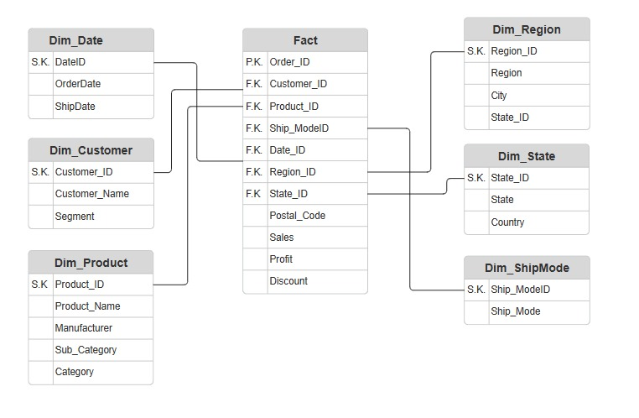
STAR - DIAGRAM

Slide 4
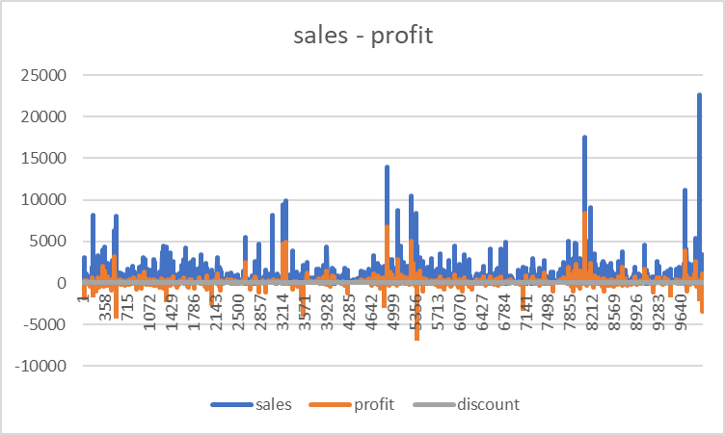
GRAPHICAL ANALYSIS
ANALYSIS
GRAPH
The graph shows that sales (blue) are consistently higher than profit (orange), with occasional spikes. Profit dips below zero at certain points, indicating losses, possibly influenced by costs or discounts. Discounts (gray) are minimal overall but may contribute to some losses. High sales don’t always guarantee profits, highlighting the need to optimize discounts and costs.

Slide 5
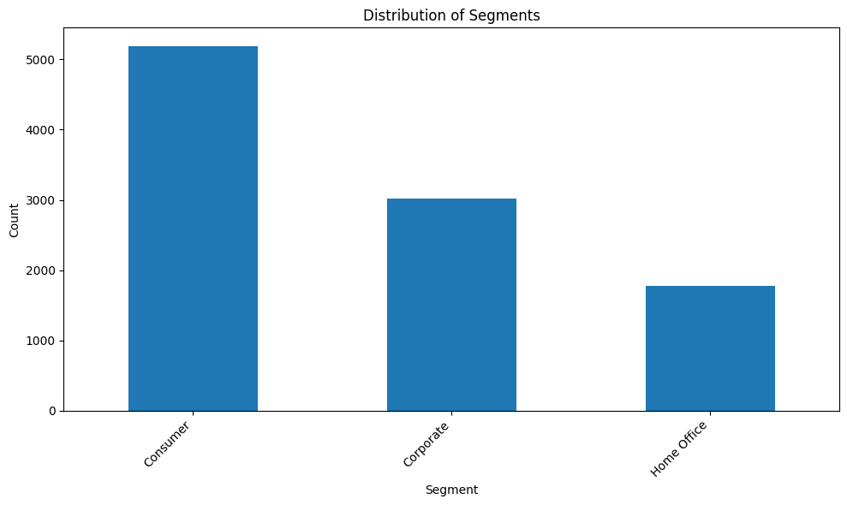
GRAPHICAL ANALYSIS
Analysis
Graph
Plot that shows major segments of the costumers

Slide 6
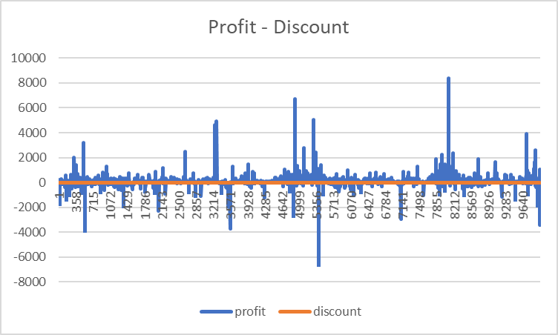
GRAPHICAL ANALYSIS
ANALYSIS
GRAPH
The graph compares profit (blue) and discount (orange). Profits show significant fluctuations, with occasional peaks and multiple dips below zero, indicating losses. Discounts remain consistently low, suggesting they are not the primary driver of profit variability. High losses, such as near index 4999, may require further investigation.

Slide 7
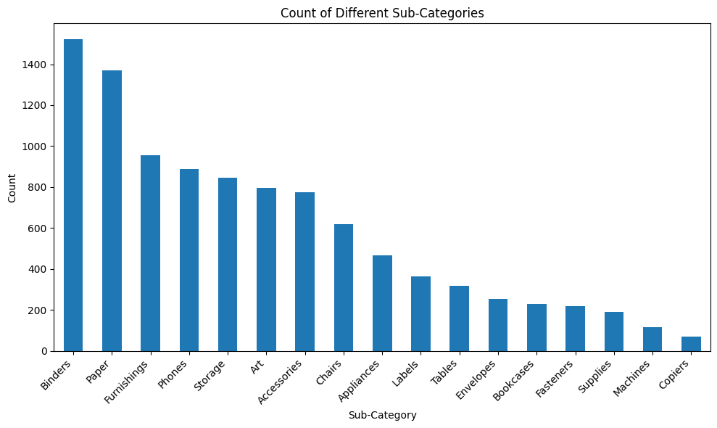
GRAPHICAL ANALYSIS
Analysis
Graph
Plot that shows which product sells more

Slide 8
SCREENSHOTS

Slide 9
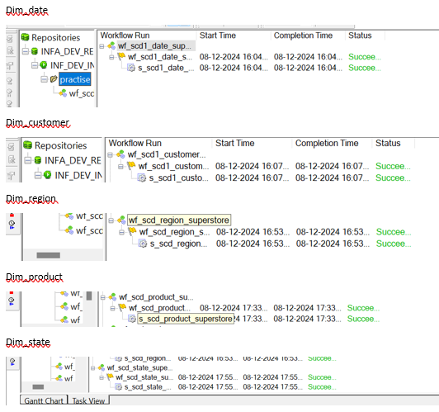

Slide 10
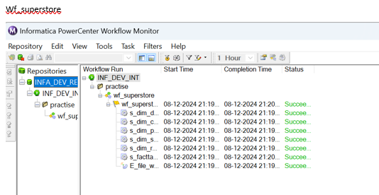

Slide 11
CONCLUSION
Using fact tables and dimension tables enhances data analysis by organizing information into a structured schema that supports efficient querying and insightful reporting. Fact tables store measurable metrics, such as sales, profit, or quantity, while dimension tables provide descriptive attributes like customer details, product categories, and regional data. This separation allows for clear relationships and easier aggregation of data across different dimensions. By leveraging this design, businesses can perform more precise, scalable, and multidimensional analyses, enabling better decision-making and deeper insights into performance trends.

Slide 12
THANKYOU
Mirudhula L

