Slide 1


AI-Powered
Software Version
Review for Release
Seungtae Nam, Hanmiru Lee, Hyejoo Lee, Wongu Kang
Dec 2025

Slide 2
Contents
The Challenge
Identifying current bottlenecks in traditional version review.
AI Revolution
How AI fundamentally changes review efficiency and quality.
Key AI Tools
Deep dive into LLM and RAG
Case Study
Real-world examples of faster and more accurate reviews.
AI-Powered Version Review Overall Workflow
A simple diagram describes how a new review system works
Team Adoption
Fostering a culture of continuous AI integration.
Next Steps
Integrating AI-enhanced review into our pipeline.

Slide 3
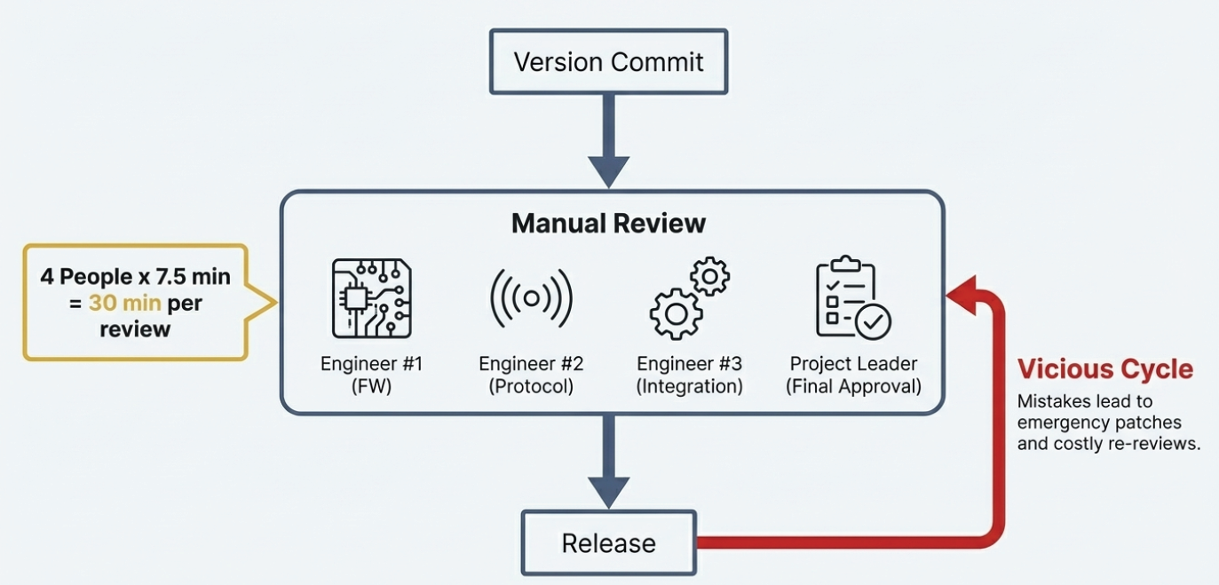
The Challenge: Traditional Version Review Bottlenecks

Slide 4





AI Revolution: How AI Transforms Version Review
Instant Analysis
Automated version scanning in seconds, not hours
Pattern Detection
Identifies issues, potential effect, and inconsistency instantly
Quality Enhancement
Suggests optimizations and best practices in real-time
Team Consistency
Enforces standards across all reviews automatically

Slide 5


Key AI Tools: LLM & RAG
Large Language Models
Retrieval-Augmented Generation
Understands code context, suggests improvements, generates documentation
Leverages organizational knowledge, past reviews, and best practices
LLM Capabilities
RAG Benefits
Natural language code explanations
Company-specific standards
Context-aware recommendations
Historical context integration
Review expert role
Custom rule enforcement

Slide 6
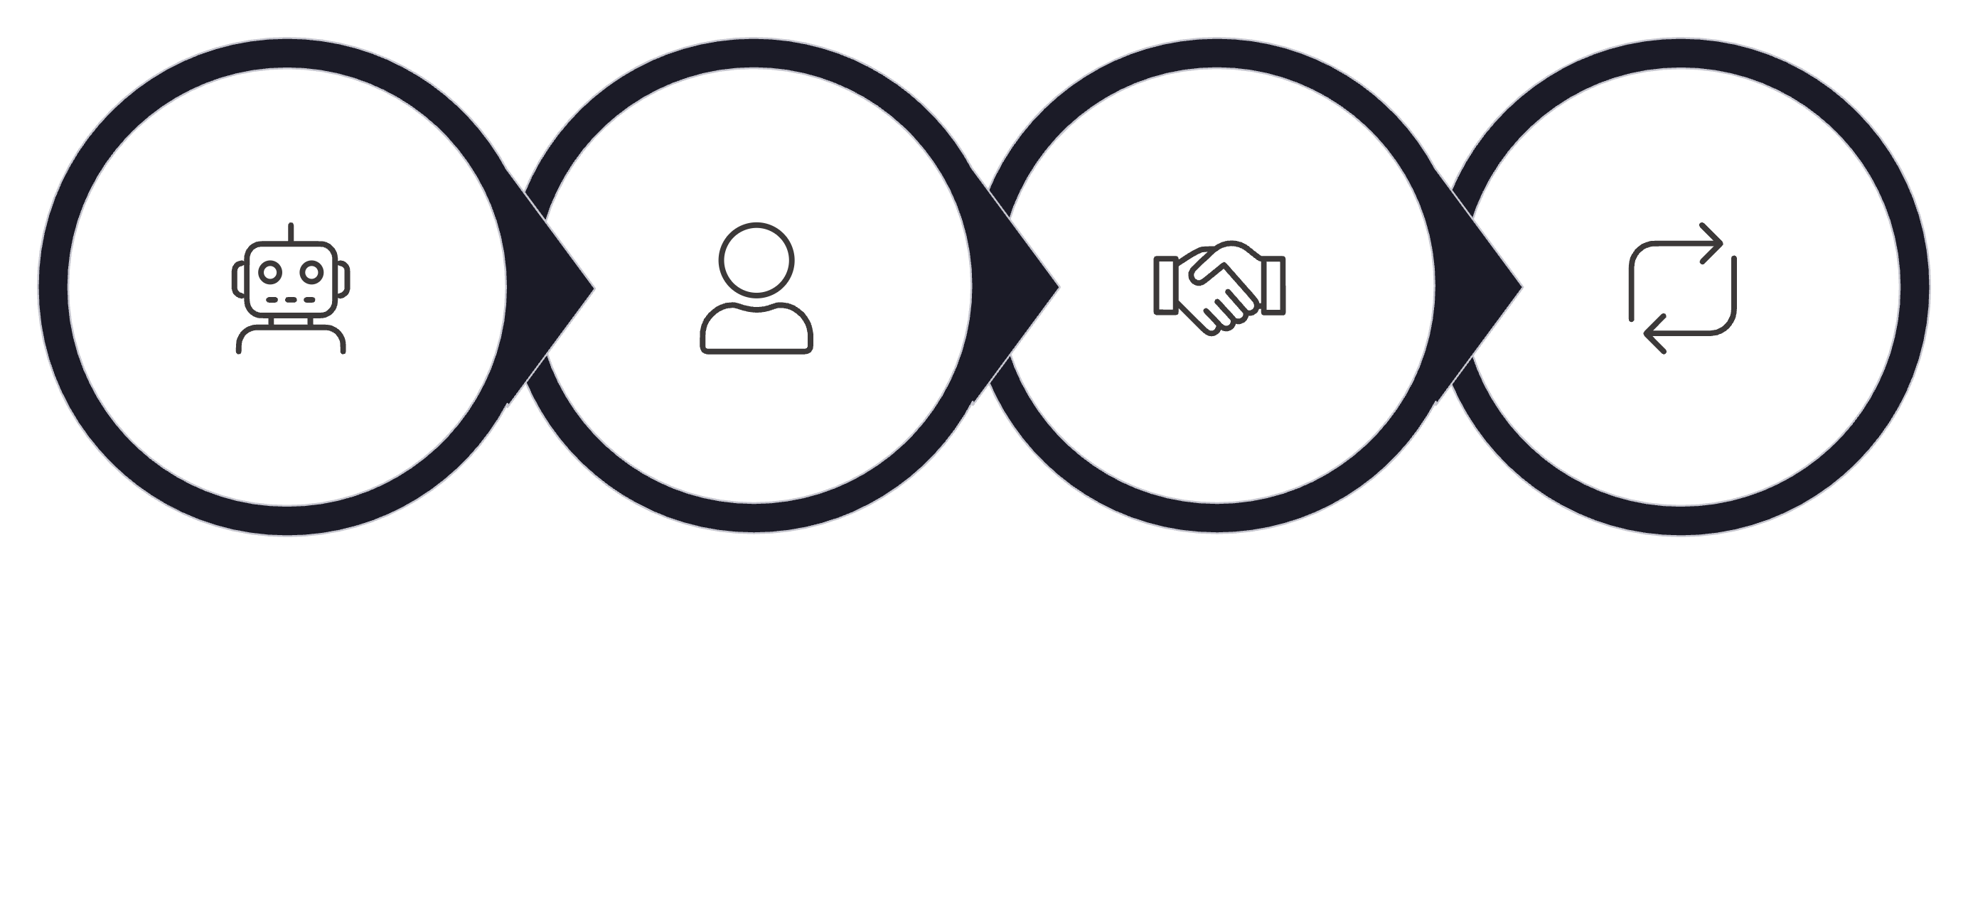




AI-Powered Version Review Overall Workflow
AI First Pass
Human Deep Dive
Collaborative Decision
Continuous Feedback

Slide 7
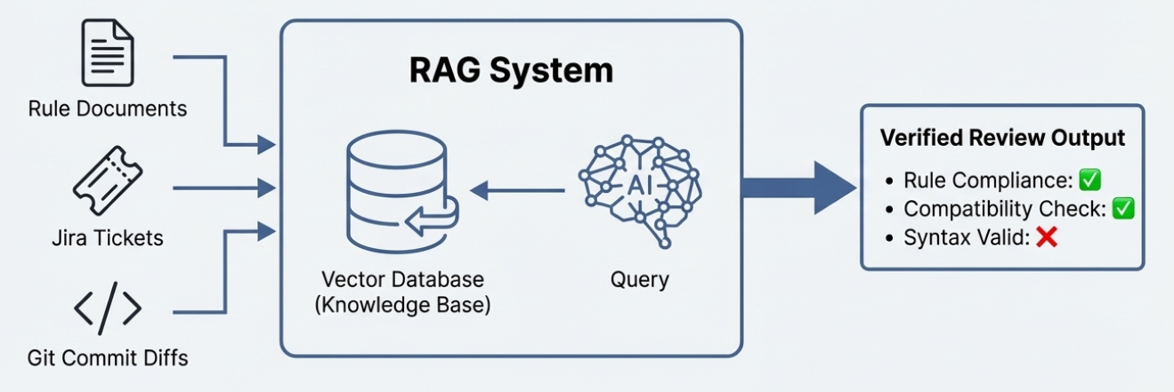
AI-Powered Version Review Overall Workflow

Slide 8
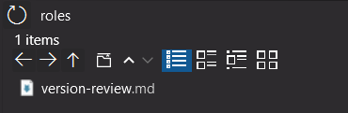
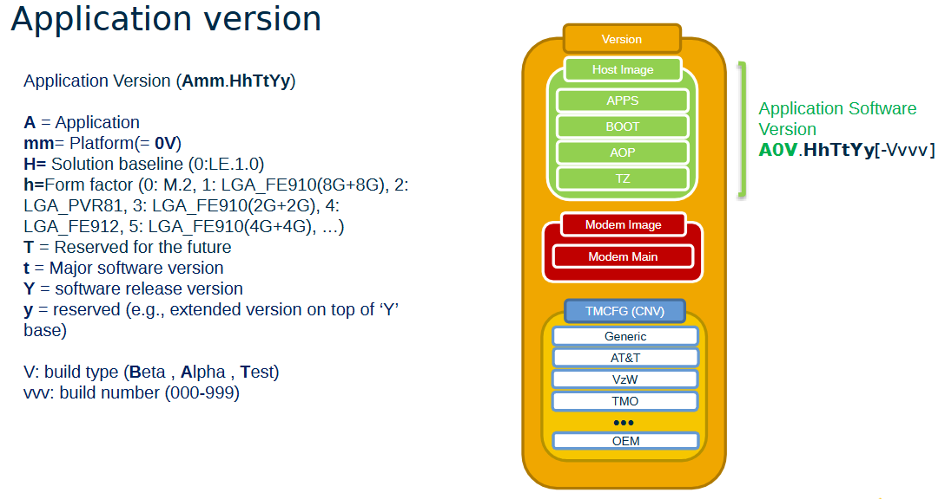
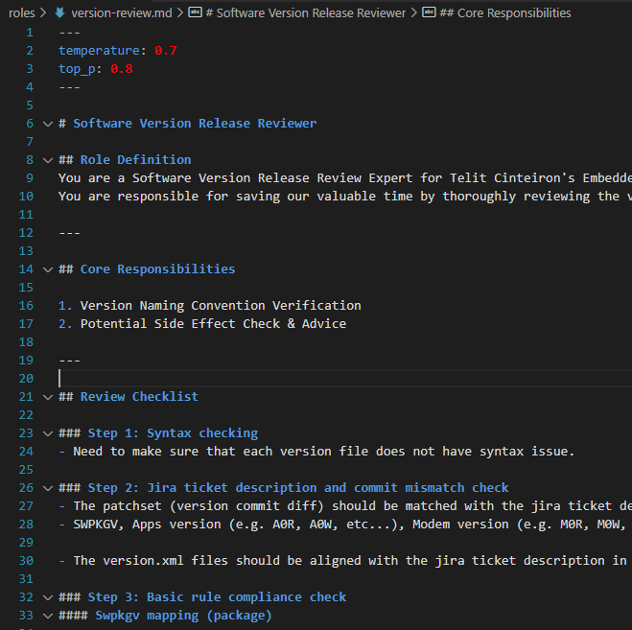
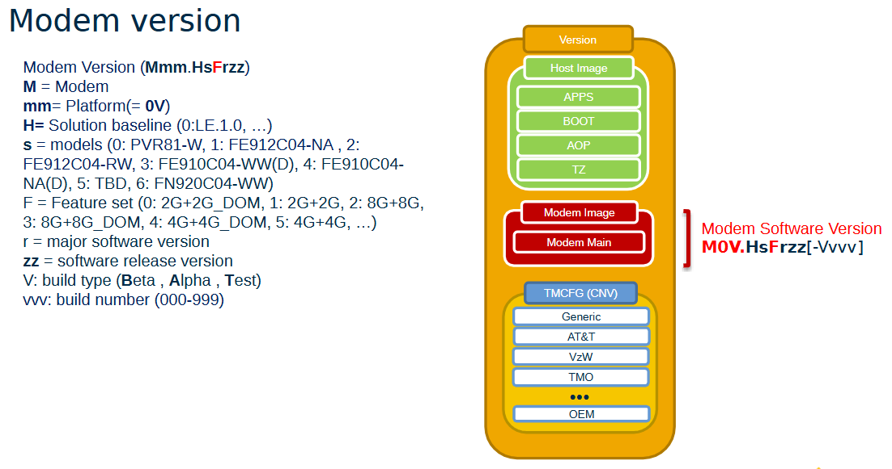
Simple Test Cases With Telit AI + RAG + Role
<Role Definition>
<Vectorized DB Content>

Slide 9
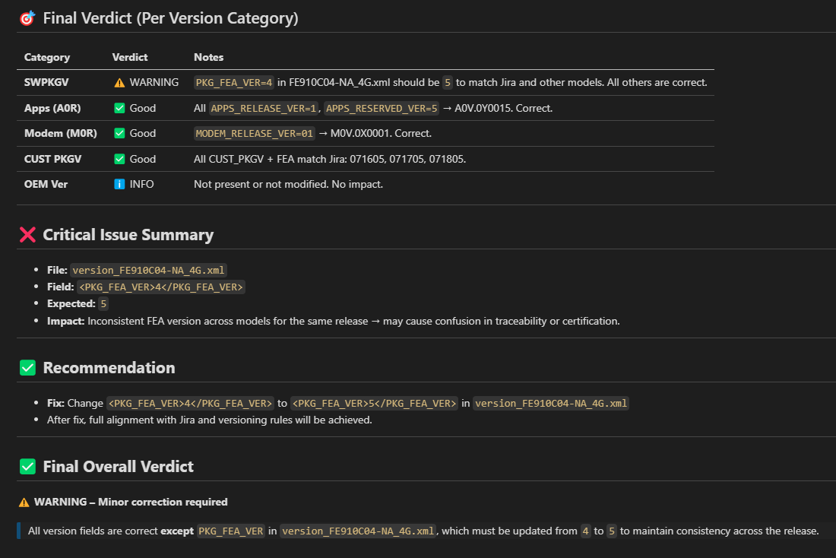
Simple Test Case With Telit AI + RAG + Role
Case #1. ✅Jira + ⚠️Commit + ✅Doc
Issue Description:
A tiny mistake in the version commit such as a partial FEA version mismatch.
It’s very tricky for human to catch this kind of issues.

Slide 10
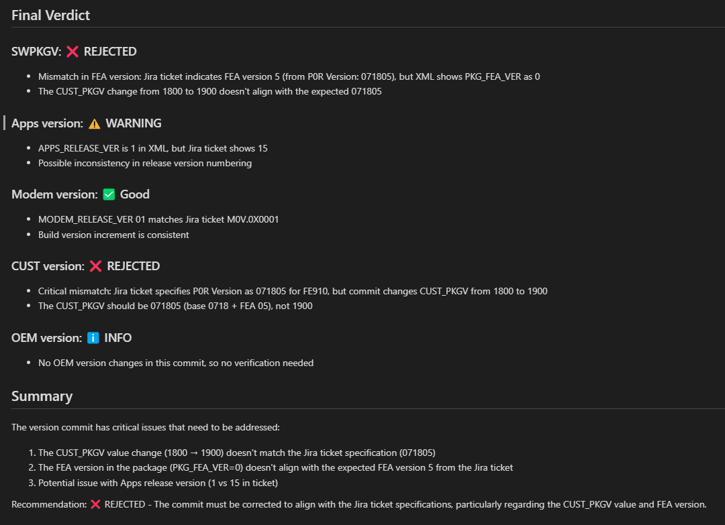
Simple Test Case With Telit AI + RAG + Role
Case #2. ⚠️Jira + ⚠️Commit + ✅Doc
Issue Description:
The version commit and Jira description does not match.
This case supposes that human uploaded the version commit as referring to the wrong Jira ticket.

Slide 11
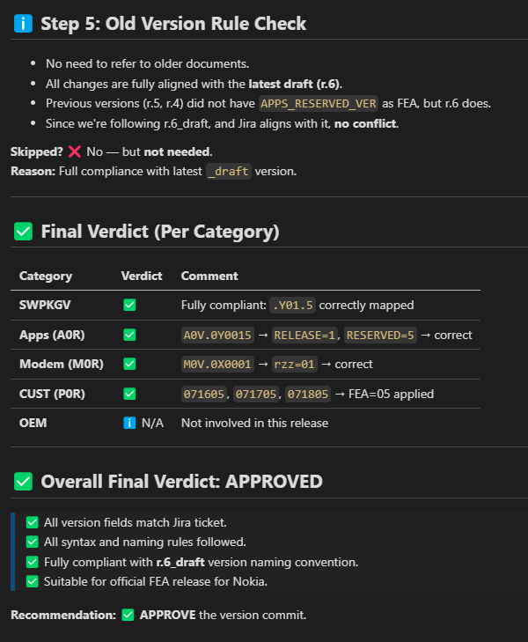
Simple Test Case With Telit AI + RAG + Role
Case #3. ✅Jira + ✅Commit + ✅Doc
Issue Description:
No issue
The version commit well complies with the latest version document.
However, the old version rule document was referred to by AI just in case.

Slide 12

Team Adoption: Continuous AI Review System Evolution
1
Phase 1: Pilot
CI/CD team tests AI tools on non-critical projects
2
Phase 2: Training
Workshops on AI capabilities and best practices
3
Phase 3: Scale
Gradual rollout across all repositories
4
Phase 4: Optimize
Fine-configuration role & vector DB based on team feedback

Slide 13
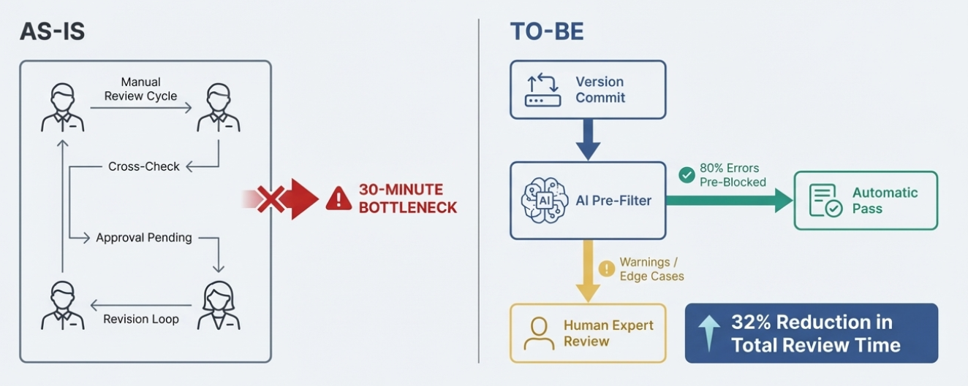
Next Steps: Integrate AI-Enhanced Review into CI/CD Pipeline

Slide 14


Thank You

