Slide 1
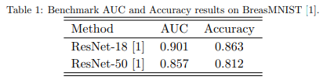
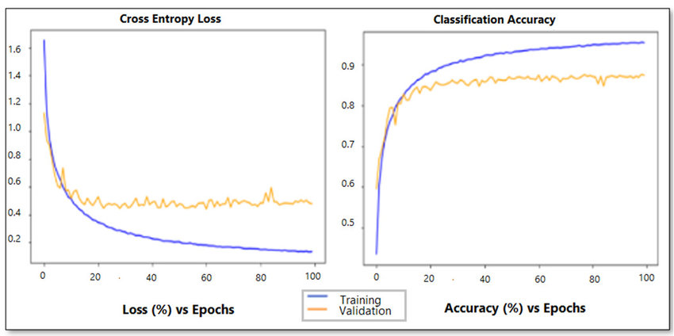
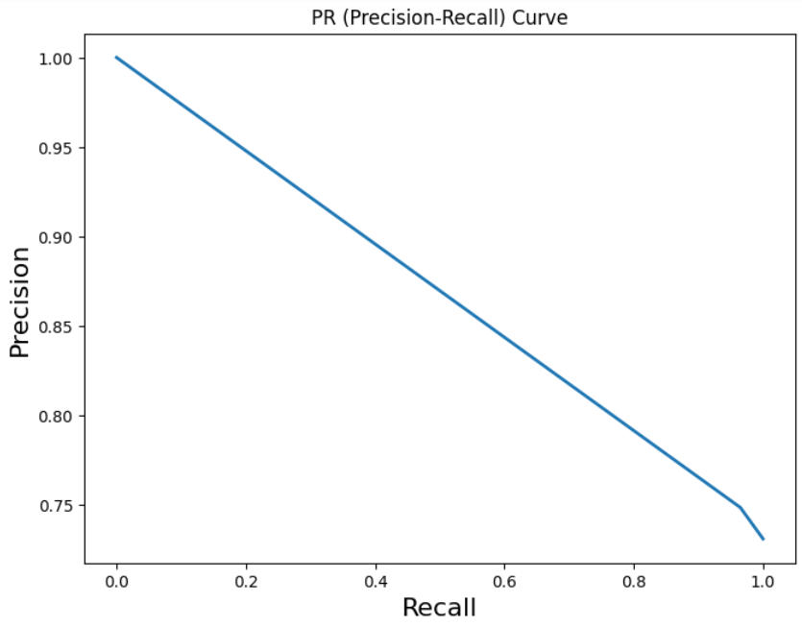
Coursework 2028, mk02172
Mirusa Kamalanathan
University of Surrey
INTRODUCTION
TECHNICAL DETAILS
RESULTS
REFERENCES
This project involves classifying images of breast ultrasounds from the dataset, BreastMNIST, into two classes: {‘0’: ‘malignant’} or {‘1’: ‘normal, benign’} via automation.
BreastMNIST dataset include Breast Ultrasound images of 28x28x1 pixels. The dataset has been split into 546 training images, 78 validation images and 156 testing images. Additional information can be found in the original dataset citation [1].
The proposed model is based on ResNet18. By using ResNet18 as a framework, this benefits the model from its pre-trained weights, allowing a significantly more accurate performance in image classification.
In the model, ResNet18 is used until the final fully connected layer. It has been replaced with two custom layers. One fully connected layer with ReLU activation function and a layer which allows an output of 2 labels. This is due to the model being a binary classifier.
The loss function used is cross-entropy. Cross-entropy is well suited for binary classification, making this loss function suitable for the proposed model. The loss function also encourages accurate predictions when training neural networks.
Regarding the number of epochs, learning rate and optimizer for the proposed model, the student has effectively used the validation set to select these hyperparameters (using grid search).
Between 10, 20, 30 and 40 epochs, 20 epochs was chosen.
Between learning rates of 0.1, 0.01, 0.001 and 0.0001, 0.1 was chosen.
Between Adam and SGD optimisers, SGD was chosen.
Cross-Entropy Graphic Illustration [2]:
Results of student’s proposed model in the specific train/val/test split:
Train → AUC : 0.997, Accuracy : 0.971
Test → AUC : 0.774, Accuracy: 0.756
Comparing with the baseline results, model had performed significantly better on the training data. However, the model had performed worse on the testing data.
This indicates overfitting. The proposed model has learned to capture noise in the training data, instead of underlying patterns. This prevents the model from generalising the correct patterns on unseen data, leading to poor results.
Experimenting with a different model architecture or selecting hyperparameters that will generalise better to unseen data can lead to better results.
Implementing early stopping when monitoring the model’s performance during the validation set can help avoid worse results.
We will compare the model’s metrics with 5-fold cross validation:
5-fold CV → Average Accuracy : 0.779 (3sf), Average AUC : 0.690 (3sf)
The average accuracy and AUC in 5-fold cross-validation are slightly than in the train/val/test split on the testing data. This is expected as cross-validation offers a more reliable evaluation as performance is examined across different folds. The proposed model’s accuracy and AUC on each fold has remained consistent, indicating the model is unbiased and stable.
We will compare the model’s AUPR and F1 score: AUPR: 0.892 (3sf)
F1 Score: 0.748 (3sf)
The proposed model’s high AUPR is states the model has high precision and recall. Thus, the model can classify positive instances, while minimizing TFP and TFN. The model’s F1 score is slightly lower. This is expected as F1 is a single metric, however, AUPR evaluates precision-recall trade-off curve. Proposed model’s Precision-Curve model:
[1]
Jiancheng Yang, Rui Shi, Donglai Wei, Zequan Liu, Lin Zhao, Bilian Ke, Hanspeter Pfister, and Bingbing Ni. Medmnist v2-a large-scale lightweight benchmark for 2d and 3d biomedical image classification. Scientific Data, 10(1):41, 2023.
[2]
https://www.researchgate.net/figure/Cross-entropy-loss-and-classification-accuracy-with-dropout-and-batch-normalization_fig1_359860179
[3]
https://www.sciencedirect.com/science/article/pii/S001048252030367X#bib29
[4] https://www.sciencedirect.com/science/article/pii/S001048252030367X#bib31
[5]
https://www.sciencedirect.com/science/article/pii/S001048252030367X#bib34
A new neural network model, based on ResNet18, must be proposed by the student that must surpass the benchmark results on the test set:
Model must be trained, visualised (via confusion matrix, ROC curve and PR curve) and evaluated using specific metrics (accuracy, AUC, AUPR, precision, recall and F1 score).
RESEARCH
This literature review will overview CNN methods for breast cancer detection in breast ultrasound images:
[3] Written by Wilfrido Gomez-Flores, the article studies pre-trained CNN for semantic segmentation of breast tumours in ultrasound, comparing Faster R-CNN with Inception-ResNet-v2 and comparing it to FCN-AlexNet. The results state Faster R-CNN performs significantly better with an F1 on 0.88.
[4] Written by Wilfrido Gomez-Flores, the article studies pre-trained CNN for semantic segmentation of breast tumours in ultrasound, using the PBAC method for M-Net model outputs. Results show a significantly high F1 score of 0.96.
[5] Authors: H. Tanaka, S.-W. Chiu, T. Watanabe, S. Kaoku, T. Yamaguchi. Follows up on the computer-aided diagnosis system for breast ultrasound images using deep learning. Two CNN models, VGG19 and ResNet152, were examined for heat to visualise data. Results were a detection percentage of 47.7 and 37.

