Slide 1

Digital Portfolio
STUDENT NAME: MIRUTHUBASHINI R
REGISTER NO AND NMID:2422k1453 AND asbru10210082422k1453
DEPARTMENT: COMPUTER SCIENCE
COLLEGE: COLLEGE/UNIVERSITY

Slide 2

PROJECT TITLE:
Digital Portfolio

Slide 3
AGENDA
Problem Statement
Project Overview
End Users
Tools and Technologies
Portfolio design and Layout
Features and Functionality
Results and Screenshots
Conclusion
Github Link

Slide 4

PROBLEM STATEMENT
In today’s digital era, professionals and students alike need an effective way to showcase their skills, experience, and projects. Traditional resumes often fail to highlight interactive elements like project demos, design creativity, or coding abilities. A Digital Portfolio provides a dynamic, accessible, and personalized way to present one's professional identity online.

Slide 5

PROJECT OVERVIEW
The Digital Portfolio is a web-based application that serves as an online resume and project showcase. It is designed to reflect an individual's professional persona and includes key sections such as About Me, Skills, Projects, Resume, Contact, and more. The aim is to create a responsive, user-friendly, and aesthetically pleasing platform to present personal and professional achievements.

Slide 6

END USERS
Students – to showcase academic projects, skills, and coursework. Job Seekers – to present resumes and portfolio pieces to potential employers. Freelancers – to highlight past work and attract new clients. Creative Professionals – like designers and developers who want to showcase their visual or technical work.

Slide 7
TOOLS AND TECHNIQUES
Category Tools/Technologies Frontend HTML5, CSS3, JavaScript Frameworks React.js / Vanilla JS (based on preference) Backend (opt.) Node.js, Express.js Database (opt.) MongoDB / Firebase Version Control Git, GitHub Deployment GitHub Pages, Netlify, Vercel Design Tools Figma, Adobe XD, Canva

Slide 8
POTFOLIO DESIGN AND LAYOUT
The design follows a clean, modern aesthetic with a mobile-responsive layout. The structure includes: Home Page: Brief introduction and call-to-action About Me: Background, education, and interests Skills: Technical and soft skills, displayed with icons or progress bars Projects: Interactive cards or modals for each project with links to GitHub/live demo Resume: Downloadable PDF resume or embedded view Contact: Contact form with email functionality and social media links Theme: Light/Dark mode toggle (optional)

Slide 9

FEATURES AND FUNCTIONALITY
✅ Responsive design for all screen sizes ✅ Smooth scroll and navigation ✅ Interactive project showcase with images, descriptions, and links ✅ Contact form integration (with services like EmailJS or Formspree) ✅ SEO optimized for visibility ✅ GitHub integration to pull recent projects (optional) ✅ Theme switching (optional)

Slide 10
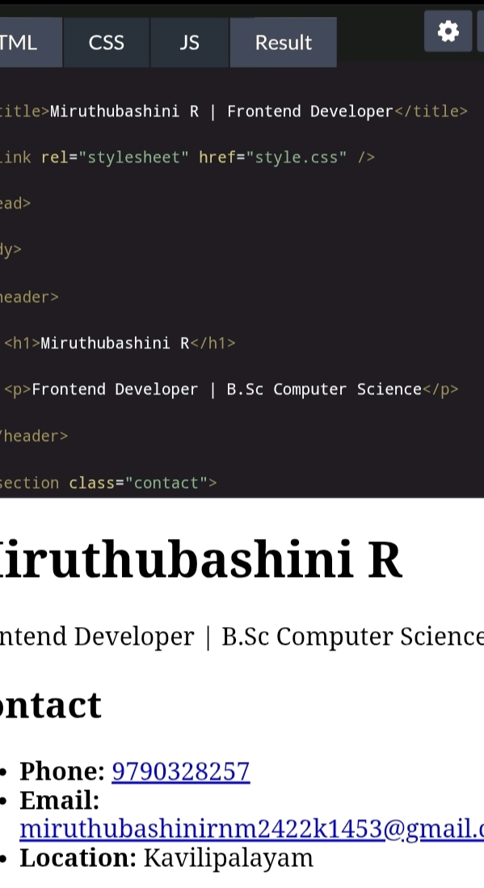
RESULTS AND SCREENSHOTS
HTML

Slide 11
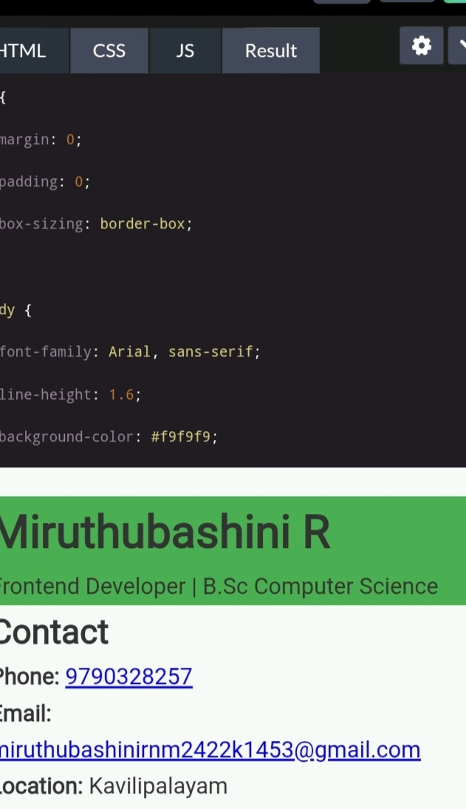
CSS

Slide 12

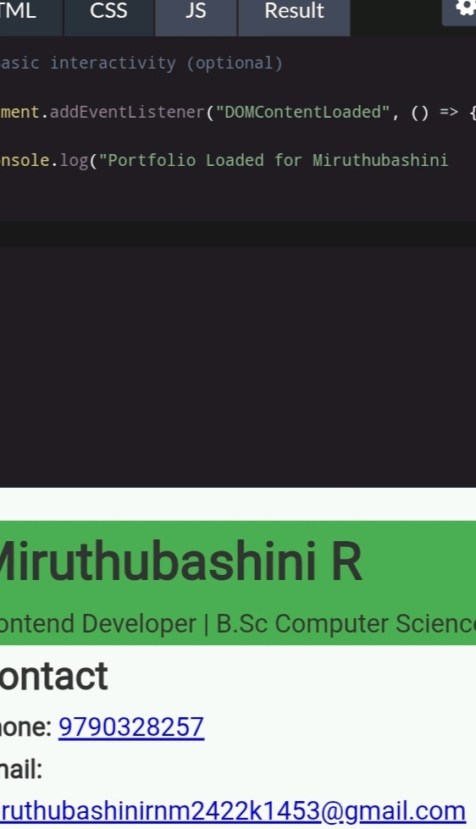
JS

Slide 13
CONCLUSION
The Digital Portfolio project successfully provides a clean, professional platform to showcase personal and professional accomplishments. It is easy to navigate, visually appealing, and highly customizable, making it suitable for a wide range of users. This portfolio not only enhances the personal brand of the user but also demonstrates front-end development skills effectively

Slide 14

GIT HUB LINK
https://github.com/signup?ref_cta=Sign+up&ref_loc=header+logged+out&ref_page=%2F&source=header-home

