Slide 1
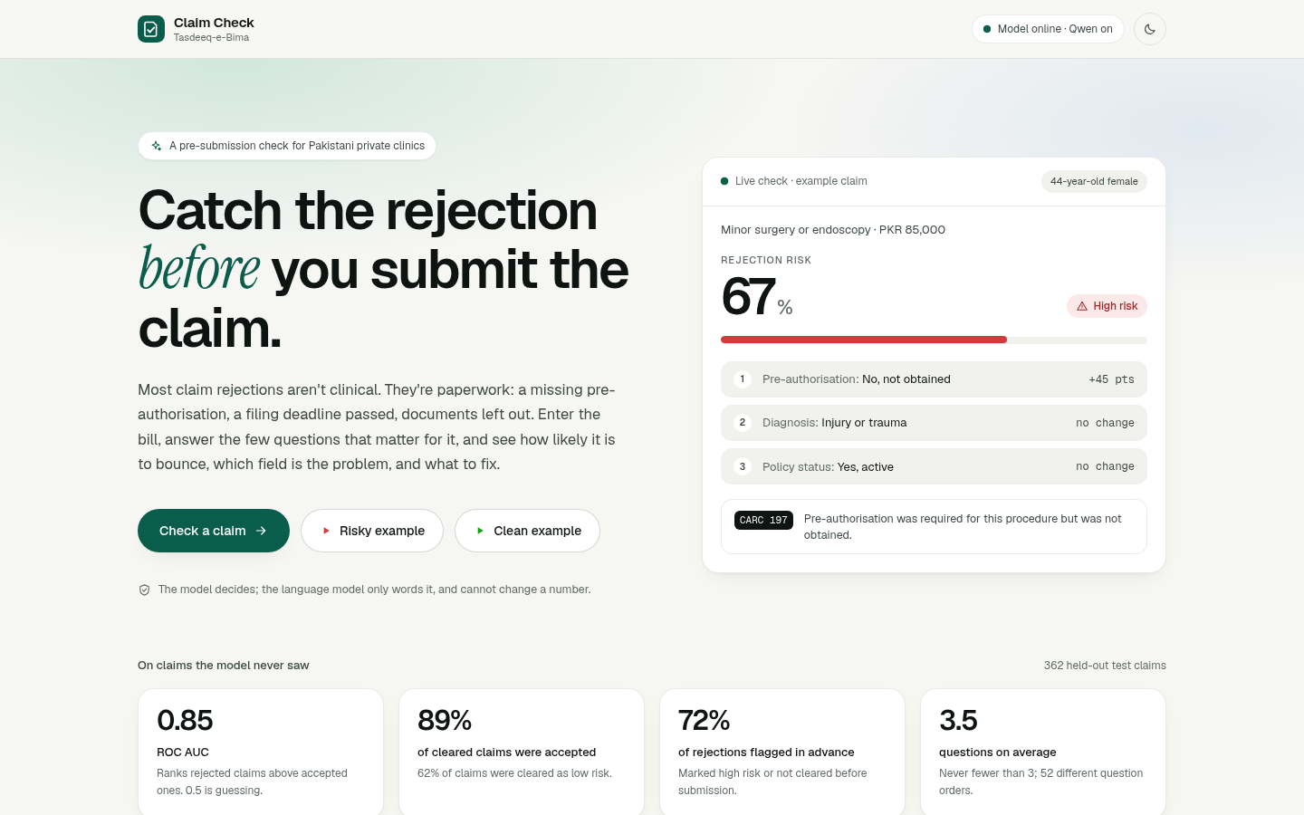
BANO QABIL AI HACKATHON
Claim Check
Catch the rejection before you submit the claim.
A pre-submission check for Pakistani private clinics: how likely a claim is to be rejected, which field is the problem, and what to fix.
Mirza Ahsan Baig and Safee Akmal · Tasdeeq-e-Bima
1

Slide 2
THE PROBLEM
Rejections are paperwork, not medicine
A clinic treats an insured patient, then bills the insurer or TPA. A large share of those claims come back rejected — for a missing pre-authorisation, a filing deadline passed, documents left out.
The clinic finds out weeks later. Small clinics have no billing specialist to catch it. Cash flow becomes unpredictable, and clinics eventually stop accepting insurance patients at all.
A financial-inclusion problem as much as a healthcare one
2

Slide 3
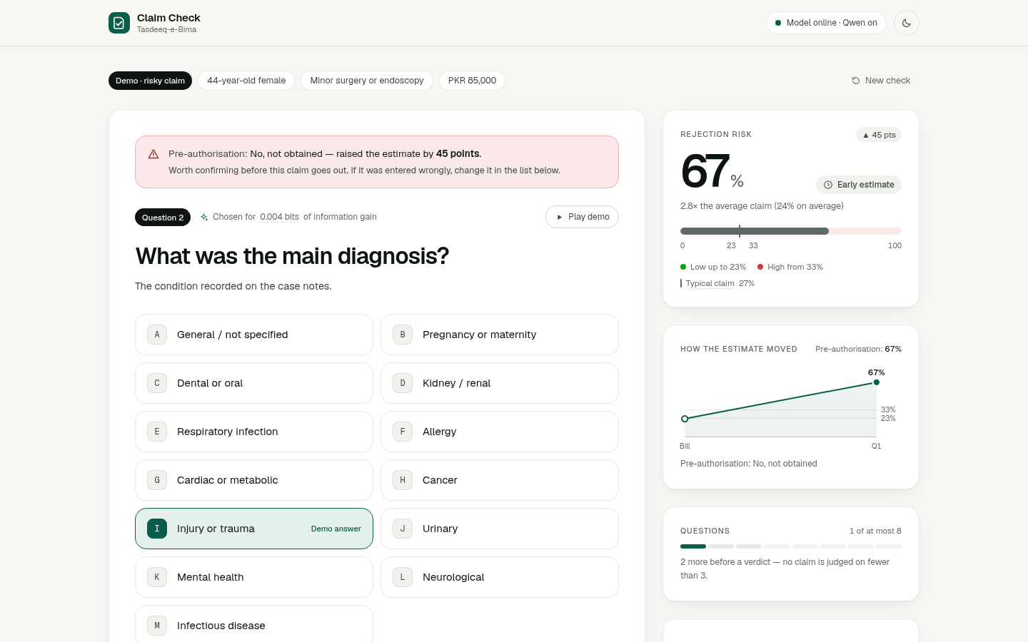
HOW IT WORKS
Enter the bill. Answer what matters.
1. The clerk enters the patient and the bill: procedure and amount.
2. The tool asks only the paperwork questions that matter for this claim, choosing each by expected information gain.
3. It returns the risk, the fields driving it, the likely X12 CARC reason code, and the one thing to do before submitting.
When the procedure needs pre-authorisation, that is always the first question — a claim that needed it is never cleared without it.
Calibrated LightGBM · exact Shapley attribution · Qwen on Alibaba Cloud DashScope
3

Slide 4
THE DIFFERENTIATOR
It asks, it doesn't just collect
Most tools here are a form with a model bolted on, or a fixed decision tree. This one computes, after every answer, how much each remaining question would reduce its uncertainty about this claim, and asks that one.
It stops as soon as the verdict is settled: never before 3 questions, never after 8.
52
question orders across 362 test claims
3.5
questions on average
6
insurer rules checked on every claim
4

Slide 5
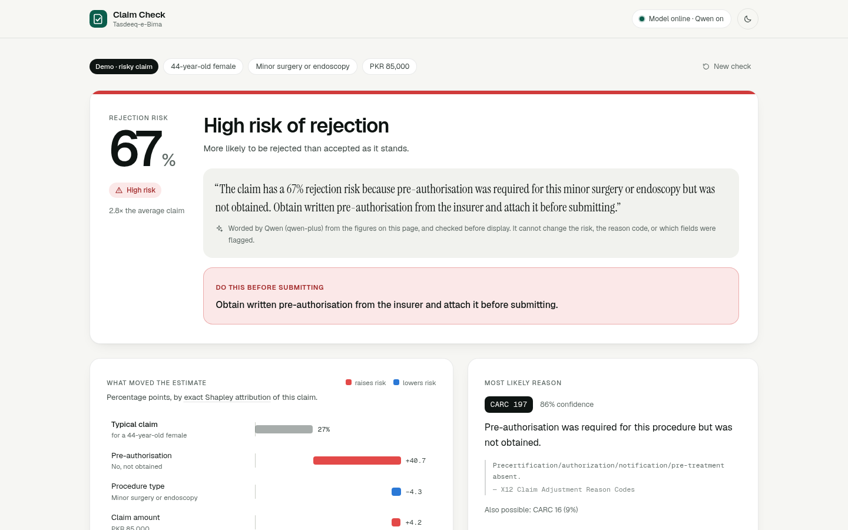
THE VERDICT
Every number traces back
The risk is a calibrated probability, with bands fitted by simulating the real question loop.
Shapley attribution names the fields driving it, and the points add up exactly from a typical claim to this one.
Rule checks say what the clerk may not know: whether pre-approval was needed, how much of the filing window is left.
Qwen only words the result. Any reply with a number it was not given is rejected and replaced by a template.
5

Slide 6
RESULTS
On claims the model never saw
Only 24% of claims are rejected, so blindly approving everything already scores 76%. AUC and verdict quality are the honest headline.
Claims cleared as low risk: 62% of all, 89% of them accepted. Claims flagged high: 26% of all, 56% of them rejected. Accuracy at the high-risk line: 81.8%. Reason code: 88% top-1 across 12 real codes.
0.85
ROC AUC, fully answered
89%
of cleared claims accepted
72%
of rejections flagged in advance
Held-out test split, used once · low ≤ 23%, high ≥ 33%
6

Slide 7
THE DATA
No, the data is not real. It cannot be.
No public dataset exists anywhere of real clinic claims paired with their outcomes. Insurers treat that as private business information.
So we built ours from two real pieces:
Synthea — open clinical simulator, real SNOMED CT codes
X12 CARC — the real industry rejection-reason standard
Only the labelling logic is ours, and it is written down. A near-perfect score on self-generated data would only prove the model had memorised our rules.
docs/data-provenance.md · docs/model-card.md
7

Slide 8
BUILT TO BE CHECKED
Reproducible, and audited
The dataset builds byte-for-byte from a checksum-pinned Synthea bundle; CI rebuilds it weekly and fails on any drift.
Hyperparameters chosen by cross-validation, bands on validation, the test split reported once — as the verdicts users would get.
An independent audit's findings are fixed and pinned by tests: input validation, verdict gating, attribution that adds up, and an explanation layer that cannot state a number it was not given.
When staff disagree, one click logs a labelled correction. Nothing retrains live.
8

Slide 9
WHAT'S NEXT
What production would need
1. Real historical claims with real adjudication outcomes, from a partner clinic or TPA
2. Parsed 835 remittance advice, for the codes insurers actually sent
3. Retraining as outcomes accumulate, with human corrections as labels
4. Per-insurer models and rule tables — they differ by payer
The system supports all four. It cannot access the data they need.
Python · LightGBM · FastAPI · Next.js · Qwen on DashScope · containerised
9

