Slide 1

x86 Processor Architecture

Slide 2
Lecture Overview
General Concepts
IA-32 Processor Architecture
IA-32 Memory Management
64-bit Processors
Components of an IA-32 Microcomputer

Slide 3
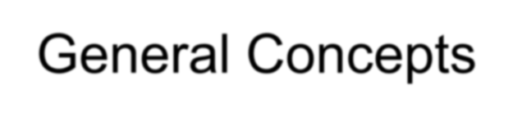
General Concepts
Basic microcomputer design
Instruction execution cycle
Reading from memory
How programs run

Slide 4
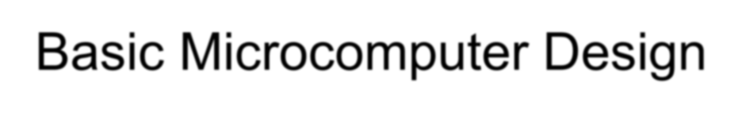
Basic Microcomputer Design
clock synchronizes CPU operations
control unit (CU) coordinates sequence of execution steps
ALU performs arithmetic and bitwise processing
data bus
registers
Memory Storage Unit
I/O Device #1
I/O Device #2
Central Processor Unit (CPU)
ALU | CU | clock
control bus
address bus

Slide 5
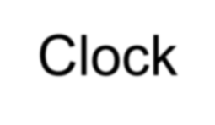
Clock
synchronizes all CPU and BUS operations
machine (clock) cycle measures time of a single operation
clock is used to trigger events
one cycle
1
0

Slide 6
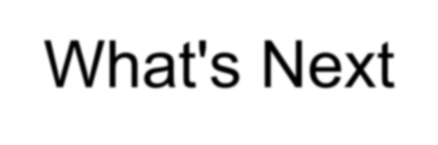
What's Next
General Concepts
IA-32 Processor Architecture
IA-32 Memory Management
64-Bit Processors
Components of an IA-32 Microcomputer

Slide 7
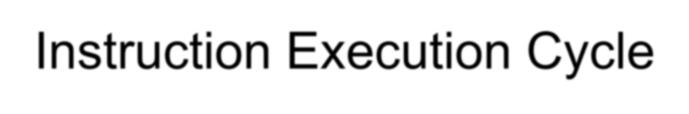
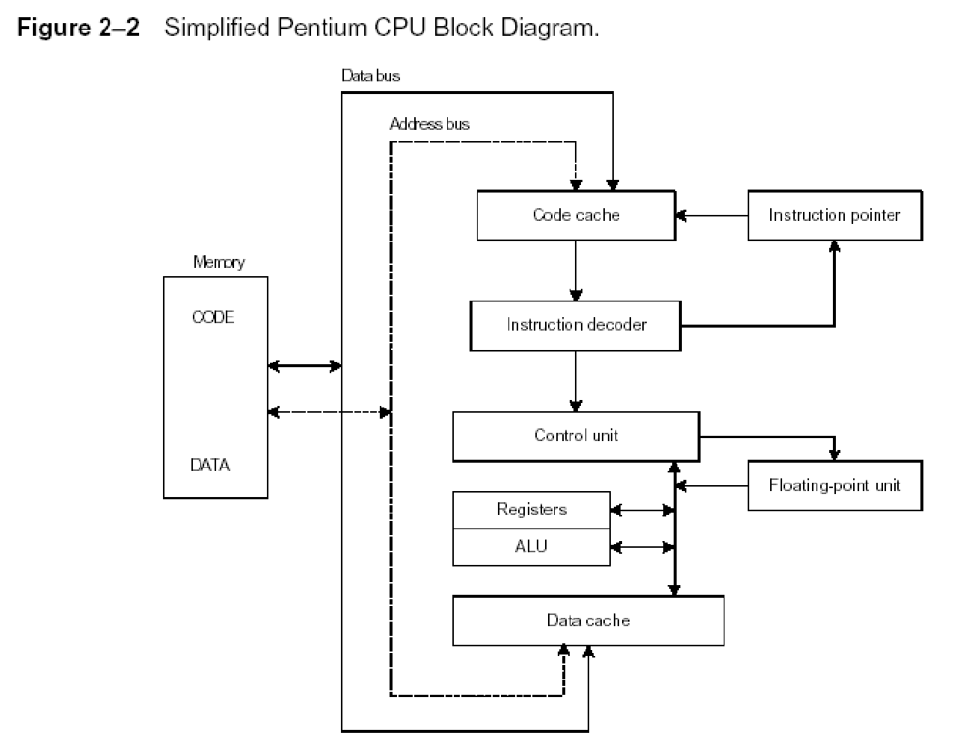
Instruction Execution Cycle
Fetch
Decode
Fetch operands
Execute
Store output

Slide 8
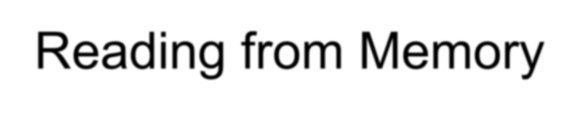
Reading from Memory
Multiple machine cycles are required when reading from memory, because it responds much more slowly than the CPU. The steps are:
Place the address of the value you want to read on the address bus.
Assert (changing the value of) the processor’s RD (read) pin.
Wait one clock cycle for the memory chips to respond.
Copy the data from the data bus into the destination operand

Slide 9
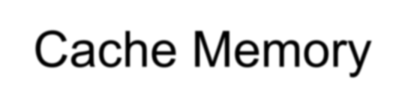
Cache Memory
High-speed expensive static RAM both inside and outside the CPU.
  Level-1 cache: inside the CPU
  Level-2 cache: outside the CPU
Cache hit: when data to be read is already in cache memory
Cache miss: when data to be read is not in cache memory.

Slide 10
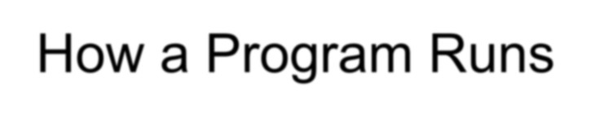

How a Program Runs
User
sends program name to
Operating searches for system program in
Current directory
gets starting cluster from
returns to
System path
loads and starts
Directory entry
Program

Slide 11


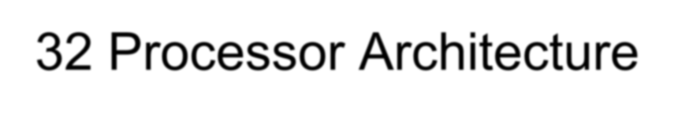
IA-32 Processor Architecture
Modes of operation
Basic execution environment
Floating-point unit

Slide 12
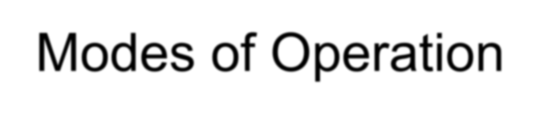
Modes of Operation
Protected mode
  native mode (Windows, Linux)
Real-address mode
  native MS-DOS
System management mode
  power management, system security, diagnostics
Virtual-8086 mode
  hybrid of Protected
  each program has its own 8086 computer

Slide 13
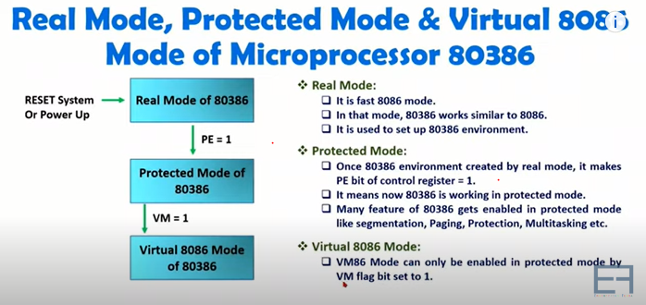
Real mode, Protected mode, virtual mode

Slide 14
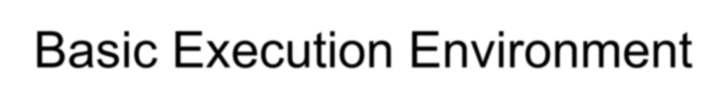
Basic Execution Environment
Addressable memory
General-purpose registers
Index and base registers
Specialized register uses
Status flags
Floating-point, MMX, XMM registers

Slide 15
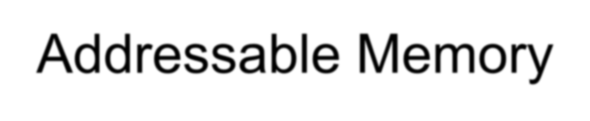
Addressable Memory
Protected mode
  4 GB
  32-bit address
Real-address and Virtual-8086 modes
  1 MB space
  20-bit address

Slide 16
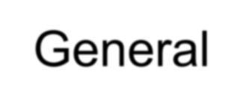

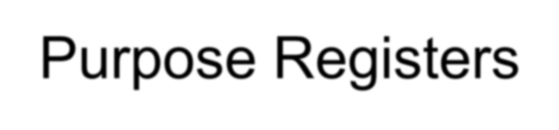
General-Purpose Registers
Named storage locations inside the CPU, optimized for speed.
32-bit General-Purpose Registers
EAX
EBP
EBX
ESP
ECX
ESI
EDX
EDI
16-bit Segment Registers
EFLAGS
CS
ES
SS
FS
EIP
DS
GS

Slide 17
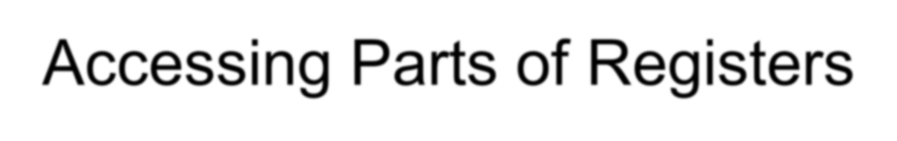
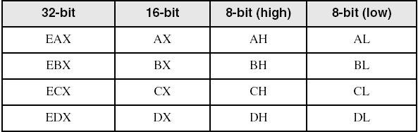
Accessing Parts of Registers
Use 8-bit name, 16-bit name, or 32-bit name
Applies to EAX, EBX, ECX, and EDX
8
AH
8
AL
8 bits + 8 bits
AX
16 bits
EAX
32 bits

Slide 18
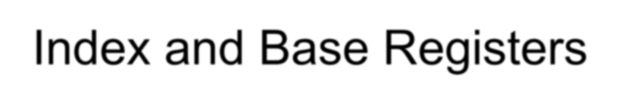
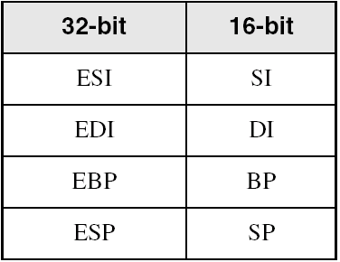
Index and Base Registers
Some registers have only a 16-bit name for their lower half:

Slide 19
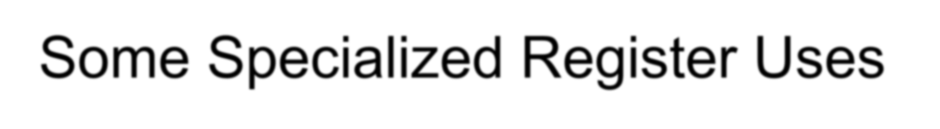
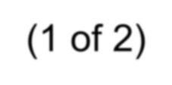
Some Specialized Register Uses (1 of 2)
General-Purpose
  EAX – accumulator
  ECX – loop counter
  ESP – stack pointer
  ESI, EDI – index registers
  EBP – extended frame pointer (stack)
Segment
  CS – code segment
  DS – data segment
  SS – stack segment
  ES, FS, GS - additional segments

Slide 20
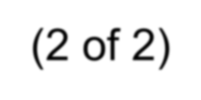
Some Specialized Register Uses (2 of 2)
EIP – instruction pointer
EFLAGS
  status and control flags
  each flag is a single binary bit

Slide 21
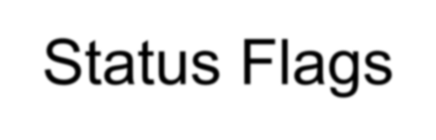
Status Flags
Carry
  unsigned arithmetic out of range
Overflow
  signed arithmetic out of range
Sign
  result is negative
Zero
  result is zero
Auxiliary Carry
  carry from bit 3 to bit 4
Parity
  sum of 1 bits is an even number

Slide 22
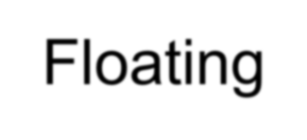
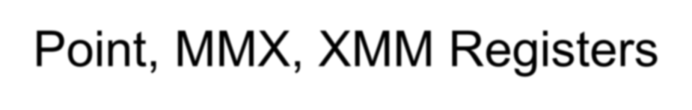
Floating-Point, MMX, XMM Registers
Eight 80-bit floating-point data registers
  ST(0), ST(1), . . . , ST(7)
  arranged in a stack
  used for all floating-point arithmetic
Eight 64-bit MMX registers
Eight 128-bit XMM registers for single- instruction multiple-data (SIMD) operations
ST(0)
ST(1)
ST(2)
ST(3)
ST(4)
ST(5)
ST(6)
ST(7)

Slide 23
What's Next
General Concepts
IA-32 Processor Architecture
IA-32 Memory Management
64-Bit Processors
Components of an IA-32 Microcomputer

Slide 24

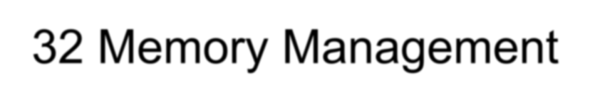
IA-32 Memory Management
Real-address mode
Calculating linear addresses
Protected mode
Paging

Slide 25
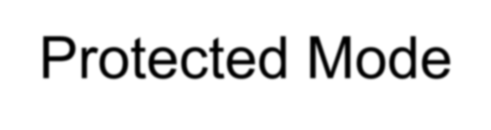
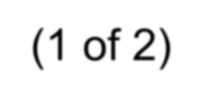
Protected Mode (1 of 2)
4 GB addressable RAM
  (00000000 to FFFFFFFFh)
Each program assigned a memory partition which is protected from other programs
Designed for multitasking
Supported by Linux & MS-Windows

Slide 26
What's Next
General Concepts
IA-32 Processor Architecture
IA-32 Memory Management
64-Bit Processors
Components of an IA-32 Microcomputer

Slide 27
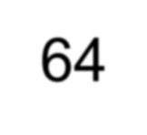
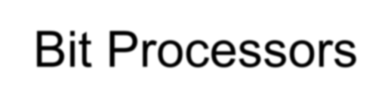
64-Bit Processors
64-Bit Operation Modes
  Compatibility mode – can run existing 16-bit and 32-bit applications (Windows supports only 32-bit apps in this mode)
  64-bit mode – Windows 64 uses this
Basic Execution Environment
  addresses can be 64 bits (48 bits, in practice)
  16 64-bit general purpose registers
  64-bit instruction pointer named RIP

Slide 28
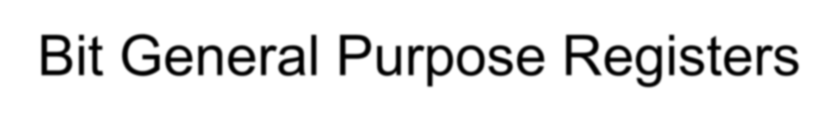
64-Bit General Purpose Registers
32-bit general purpose registers:
  EAX, EBX, ECX, EDX, EDI, ESI, EBP, ESP, R8D, R9D, R10D, R11D, R12D, R13D, R14D, R15D
64-bit general purpose registers:
  RAX, RBX, RCX, RDX, RDI, RSI, RBP, RSP, R8, R9, R10, R11, R12, R13, R14, R15

Slide 29
What's Next
General Concepts
IA-32 Processor Architecture
IA-32 Memory Management
64-Bit Processors
Components of an IA-32 Microcomputer

Slide 30
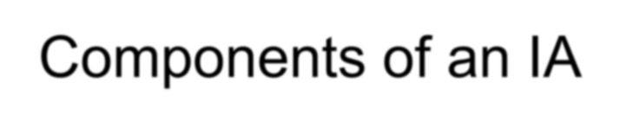
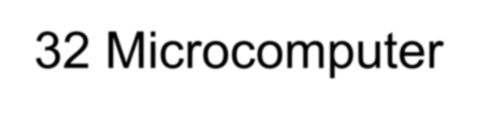
Components of an IA-32 Microcomputer
Motherboard
Video output
Memory
Input-output ports

Slide 31
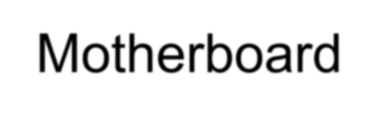
Motherboard
CPU socket
External cache memory slots
Main memory slots
BIOS chips
Sound synthesizer chip (optional)
Video controller chip (optional)
IDE, parallel, serial, USB, video, keyboard, joystick, network, and mouse connectors
PCI bus connectors (expansion cards)

Slide 32
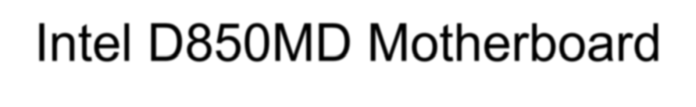
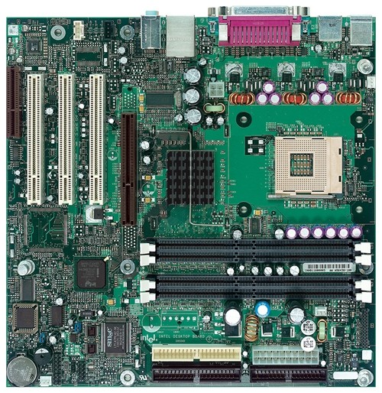
Intel D850MD Motherboard
mouse, keyboard, parallel, serial, and USB connectors
Video
Audio chip
PCI slots
memory controller hub
Pentium 4 socket
AGP slot
dynamic RAM
Firmware hub
I/O Controller
Speaker
Power connector
Battery
Diskette connector
Source: Intel® Desktop Board D850MD/D850MV Technical Product Specification
IDE drive connectors

Slide 33
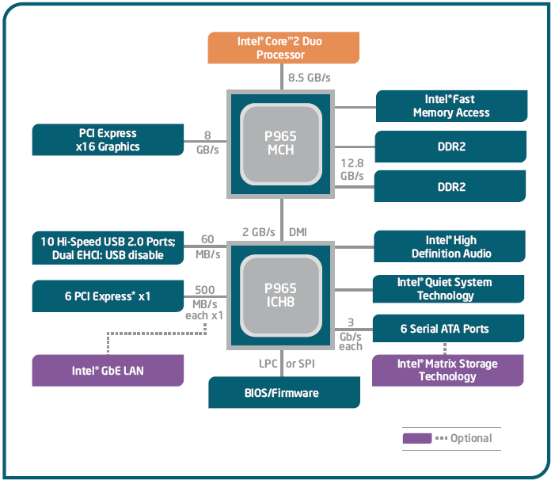
Intel 965 Express Chipset

Slide 34
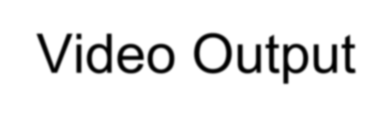
Video Output
Video controller
  on motherboard, or on expansion card
  AGP
  Video memory (VRAM)
Video CRT Display
  uses raster scanning
  horizontal retrace
  vertical retrace
Direct digital LCD monitors
  no raster scanning required

Slide 35
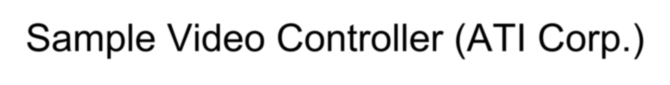
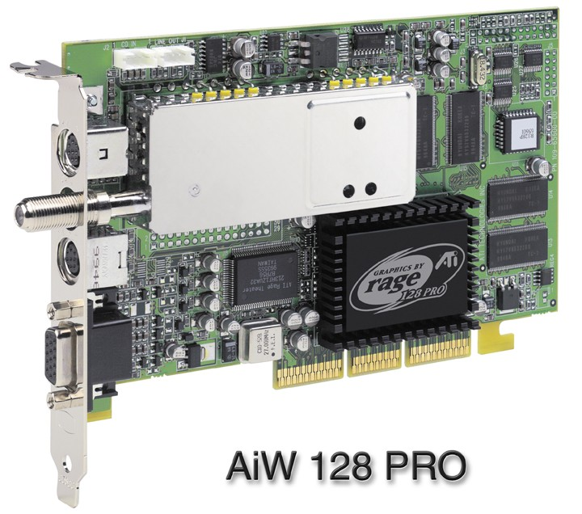
Sample Video Controller (ATI Corp.)
128-bit 3D graphics performance powered by RAGE™ 128 PRO
3D graphics performance
Intelligent TV-Tuner with Digital VCR
TV-ON-DEMAND™
Interactive Program Guide
Still image and MPEG-2 motion video capture
Video editing
Hardware DVD video playback
Video output to TV or VCR

Slide 36
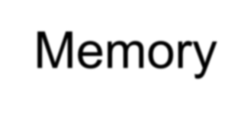
Memory
ROM
  read-only memory
EPROM
  erasable programmable read-only memory
Dynamic RAM (DRAM)
  inexpensive; must be refreshed constantly
Static RAM (SRAM)
  expensive; used for cache memory; no refresh required
Video RAM (VRAM)
  dual ported; optimized for constant video refresh
CMOS RAM
  complimentary metal-oxide semiconductor
  system setup information
See: Intel platform memory (Intel technology brief: link address may change)

Slide 37
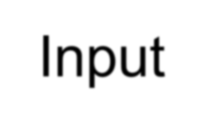
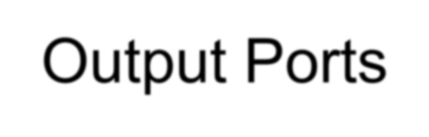
Input-Output Ports
USB (universal serial bus)
  intelligent high-speed connection to devices
  up to 12 megabits/second
  USB hub connects multiple devices
  enumeration: computer queries devices
  supports hot connections
Parallel
  short cable, high speed
  common for printers
  bidirectional, parallel data transfer
  Intel 8255 controller chip

Slide 38
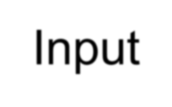
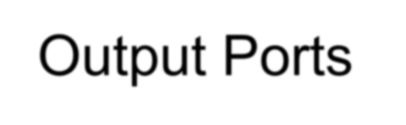
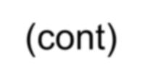
Input-Output Ports (cont)
Serial
  RS-232 serial port
  one bit at a time
  uses long cables and modems
  16550 UART (universal asynchronous receiver transmitter)
  programmable in assembly language

Slide 39
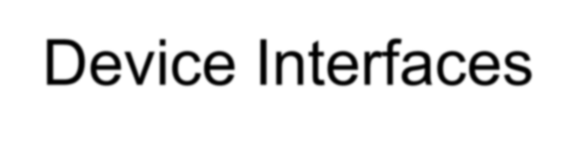
Device Interfaces
ATA host adapters
  intelligent drive electronics (hard drive, CDROM)
SATA (Serial ATA)
  inexpensive, fast, bidirectional
FireWire
  high speed (800 MB/sec), many devices at once
Bluetooth
  small amounts of data, short distances, low power usage
Wi-Fi (wireless Ethernet)
  IEEE 802.11 standard, faster than Bluetooth

Slide 40
What's Next
General Concepts
IA-32 Processor Architecture
IA-32 Memory Management
Components of an IA-32 Microcomputer

