Slide 1


SESSION 10
Prepare for Your Event
I can work with my team to reflect on our BIOGLOWTM experience.
I can work with my team to create a plan and practice what we will share at the festival.
Students will work together to prepare for their presentation of team model and team poster for the festival.

Slide 2

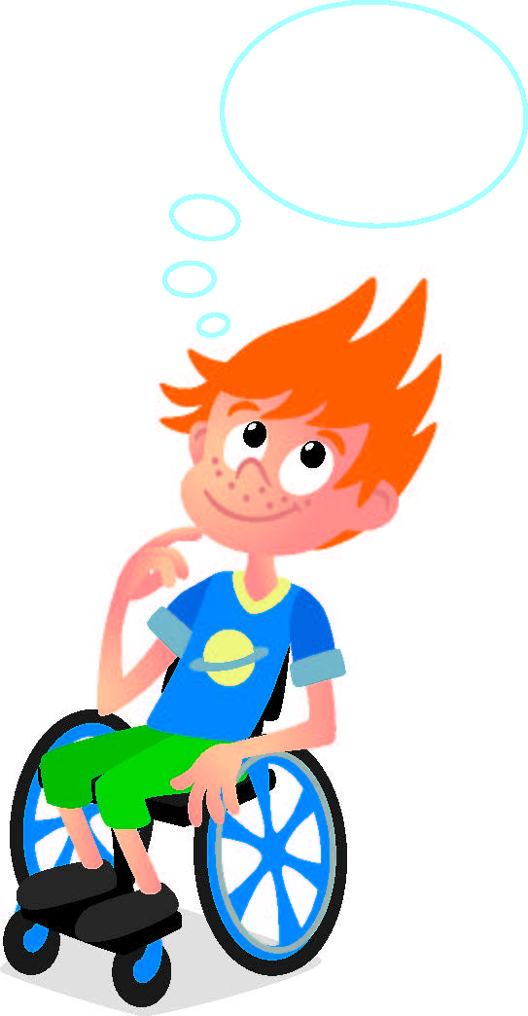
Discussion
What did we do last session?
Notes:
Discuss with students the poster they made in the last session.

Slide 3

Introduction
How has your team used impact throughout the sessions?
We apply what we learn to improve our world.
Notes:
Introduction – Model Impact (5-10 minutes)
• Introduce the FIRST® Core Values.
• Read the definition for impact to the team. (see TMG page 5)
• Talk about what impact is. Have the team provide examples of these Core Value throughout the sessions.
• Have the team build something using the prototyping pieces representing these Core Value.

Slide 4
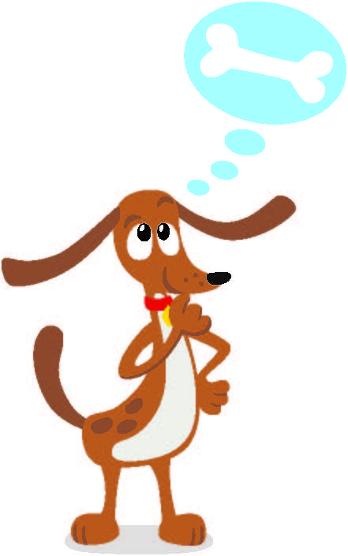
Guiding Questions
How has the team demonstrated Core Values?
How will you present your poster and model at the festival?
Notes:
Each session has Guiding Questions that can be shared to frame the session.
Talk through each of these questions with the students. Have them start to think about these questions and later their will share their thoughts with their team.

Slide 5

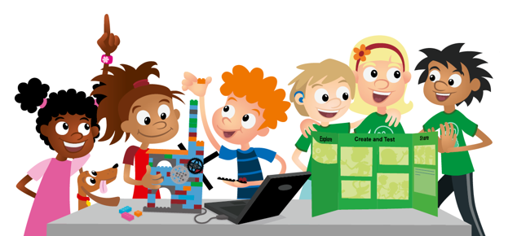
Session Tasks
Get your completed team model and team poster.
I will describe the team model.
We will show how the poster captures our team journey!
Decide who on the team will share about certain parts of the model and post.
I’m going to share what we explored.
I will explain the program and how it motorizes the team model.
I can reflect on how our team used Core Values.
Notes:
Session Tasks
Gather your completed team model and team poster.
Talk about how your team will share what you learned with the reviewers.
Complete the next page.
Session Tips
Go over the reviewing sheet and explain the reviewing process with your team.
Ask the team the reviewing questions and practice the responses they would give.
A festival is a critical part of the FIRST® LEGO® League Explore experience. If you are unable to attend, plan a celebration of your own. Class Pack teachers can use the Class Pack Guide to plan their event.
The team doesn’t need to answer every question on this page. These are meant to help the team feel ready for the event.
You could have the team practice their presentation by presenting to others before their event.
Your team could register for an Explore festival or you can run your own. Whichever you decide, be sure to celebrate what the children have learned and accomplished during their Explore experience.

Slide 6
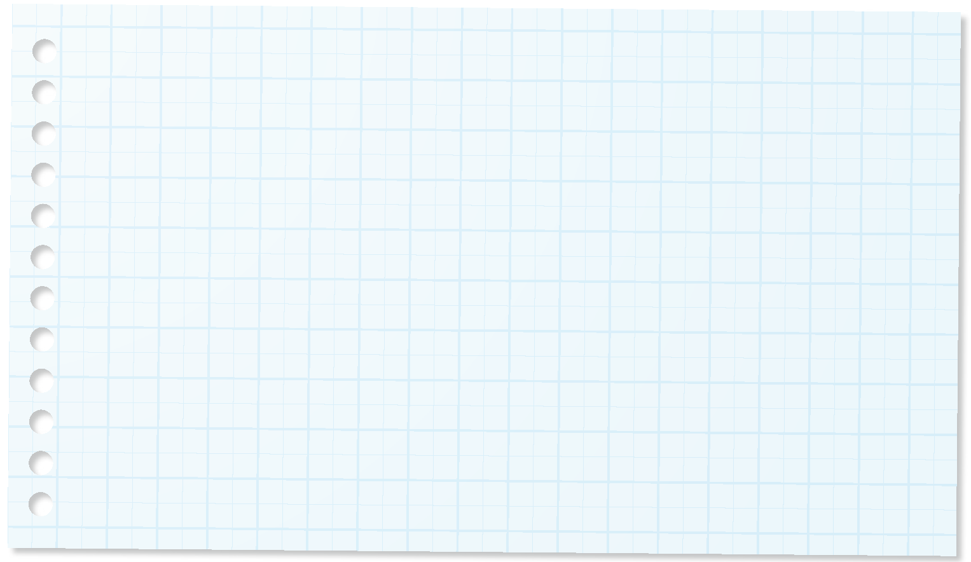
Session Tasks
Fill in page 27 of your Engineering Notebook.
Can you describe your team model?
Explain how your team used innovation and creativity to explore archaeology.
What did you learn about the season challenge?
How did you use Core Values?
Notes:
Session Tasks
Gather your completed team model and team poster.
Talk about how your team will share what you learned with the reviewers.
Complete the next page.
Session Tips
Go over the reviewing sheet and explain the reviewing process with your team.
Ask the team the reviewing questions and practice the responses they would give.
A festival is a critical part of the FIRST® LEGO® League Explore experience. If you are unable to attend, plan a celebration of your own. Class Pack teachers can use the Class Pack Guide to plan their event.
The team doesn’t need to answer every question on this page. These are meant to help the team feel ready for the event.
You could have the team practice their presentation by presenting to others before their event.
Your team could register for an Explore festival or you can run your own. Whichever you decide, be sure to celebrate what the children have learned and accomplished during their Explore experience.

Slide 7
Session Tasks
Fill in page 27 of your Engineering Notebook.
What part of your team model is motorized?
How did you code your motorized part?
What did you include in your team poster?
How does the poster show your team journey?
Notes:
Session Tasks
Gather your completed team model and team poster.
Talk about how your team will share what you learned with the reviewers.
Complete the next page.
Session Tips
Go over the reviewing sheet and explain the reviewing process with your team.
Ask the team the reviewing questions and practice the responses they would give.
A festival is a critical part of the FIRST® LEGO® League Explore experience. If you are unable to attend, plan a celebration of your own. Class Pack teachers can use the Class Pack Guide to plan their event.
The team doesn’t need to answer every question on this page. These are meant to help the team feel ready for the event.
You could have the team practice their presentation by presenting to others before their event.
Your team could register for an Explore festival or you can run your own. Whichever you decide, be sure to celebrate what the children have learned and accomplished during their Explore experience.

Slide 8
Guiding Questions
What else does your team need before the event?
How does the team model relate to the season theme?
Notes:
Each session has Guiding Questions that can be shared to frame the session.
Talk through each of these questions with the students. Have them start to think about these questions and later their will share their thoughts with their team.

Slide 9
Guiding Questions
Can you explain the program you coded for the motorized model?
How will your team show your team spirit at events?
Notes:
Each session has Guiding Questions that can be shared to frame the session.
Talk through each of these questions with the students. Have them start to think about these questions and later their will share their thoughts with their team.

Slide 10
Share
Practice in front of everyone.
Showing off the team poster & team model.
Notes:
Share
Have the team share with the whole room:
Practice their team poster presentation.
Practice their team model presentation.

Slide 11
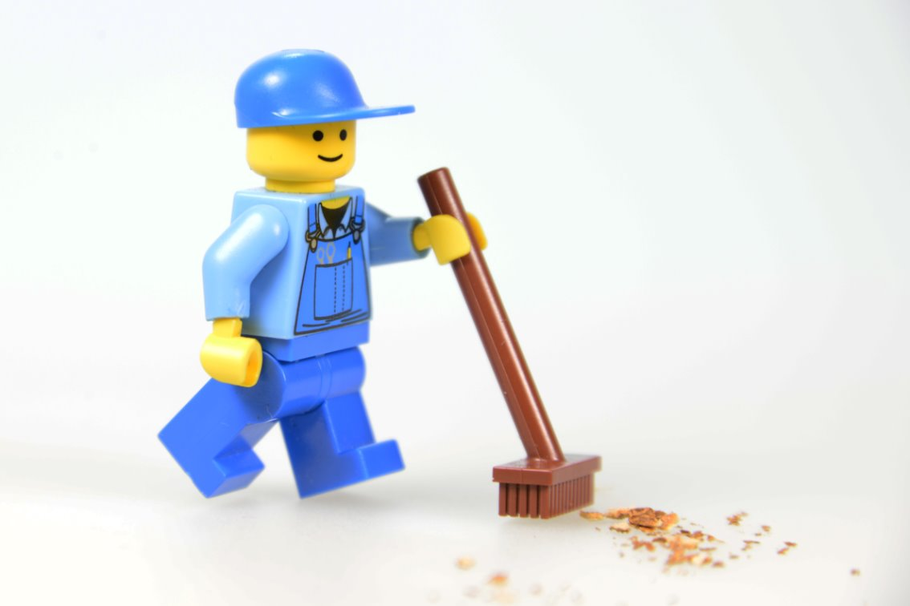
Clean Up
Notes:
Cleanup Pointers
Make sure the team model and team poster are stored and ready to be transported to the festival.
Check that you have the device, charging cord, and fully charged battery for the event.
You may wish to play a video or song during clean up time Link on
GoNoodle:. https://family.gonoodle.com/activities/clean-up
Link on YouTube Kids: https://www.youtubekids.com/watch?v=ZJFk87ZsHn0
Link on Youtube: https://youtu.be/ZJFk87ZsHn0

Slide 12


LEGO, the LEGO logo, the Minifigure, LEGO Education, the LEGO Education logo, and the SPIKE logo are trademarks of the/sont des marques de commerce du/son marcas registradas de LEGO Group. ©2026 The LEGO Group. All rights reserved/Tous droits réservés/Todos los derechos reservados. FIRST®, the FIRST® logo, and FIRST® CANOPY™ are trademarks of For Inspiration and Recognition of Science and Technology (FIRST). LEGO® is a registered trademark of the LEGO Group. FIRST® LEGO® League and BIOGLOW™ are jointly held trademarks of FIRST and the LEGO Group. ©2026 FIRST and the LEGO Group. All rights reserved.

