Slide 1


SESSION 2
Creature Creators
Students will build the different animal models and learn about their different body parts and where they live in the rainforest.
I can work with my team to build the animals from the Explore Set.
I can work with my team to create new animals.

Slide 2

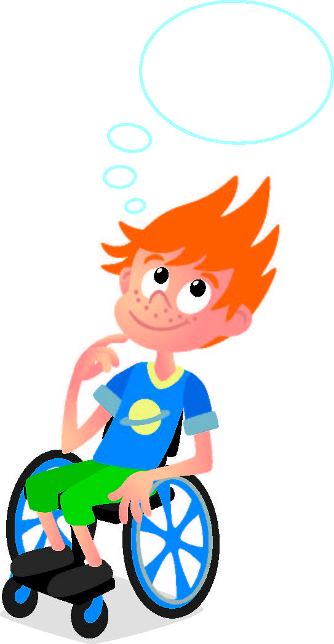
Discussion
What did we do last session?
Notes:
Discuss with students the term biodiversity & habitat and review what wildlife biologists do. ​

Slide 3
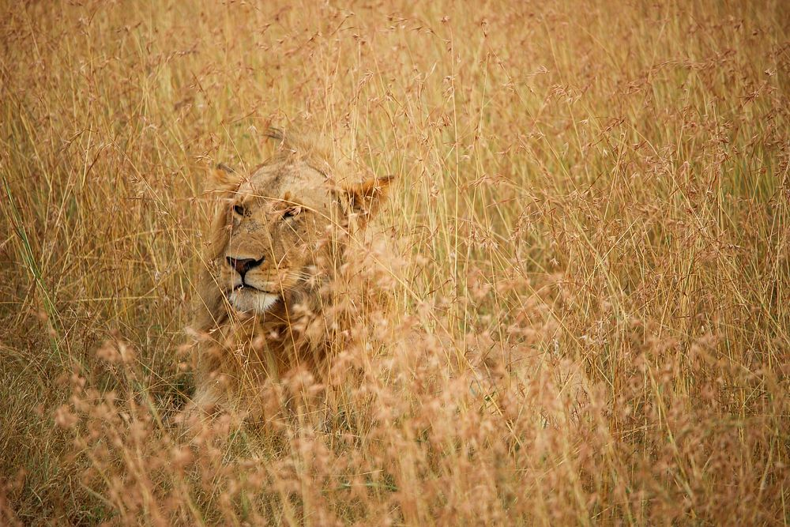
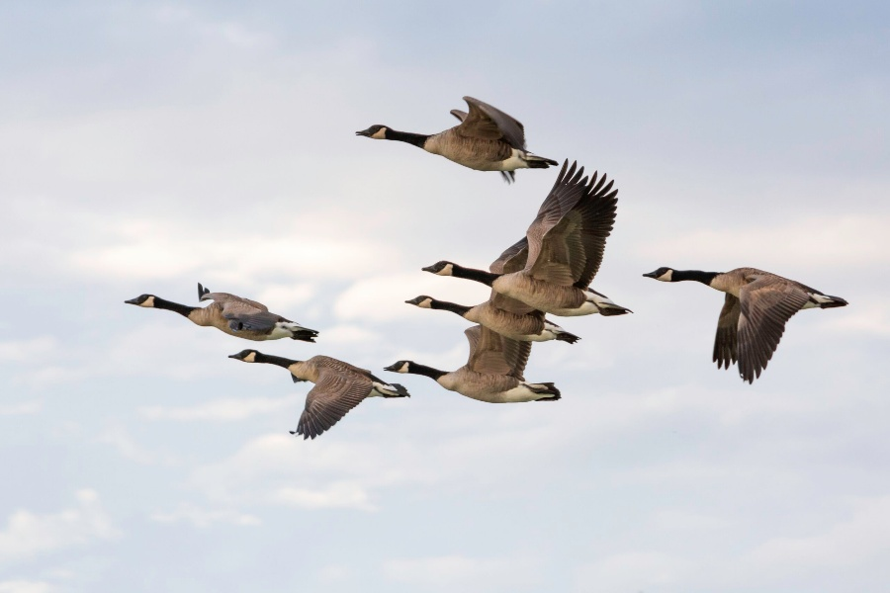
Key Vocabulary
Camouflage: a special way that animals use their colors, patterns, or body shapes to blend right into their surroundings
Behaviors: the way an animal or plant acts or behaves
Notes:
Session specific vocab

Slide 4

Guiding Questions
What colors and patterns do you notice on the animals?
How do the animal’s body parts help it survive in the rainforest?
Where in the rainforest do these animals live?
Notes:
Each session has Guiding Questions that can be shared to frame the session.
Talk through each of these questions with the students. Have them start to think about these questions and later their will share their thoughts with their team.

Slide 5
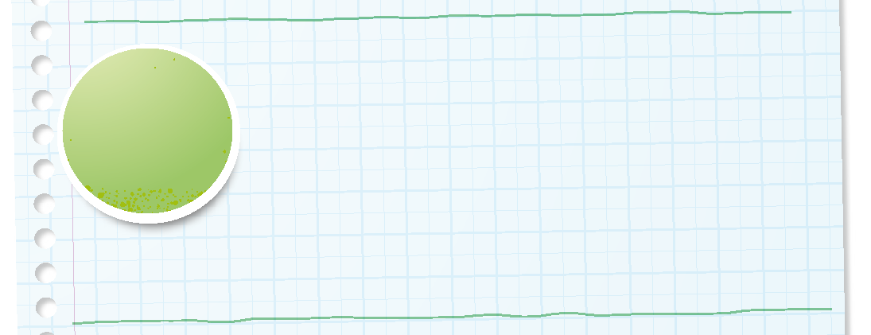

Introduction
Can your team provide examples of how they have used impact?
We apply what we learn to improve our world.
Notes:
Introduction – Make an Impact (5-10 minutes)
• Introduce the FIRST® Core Values.
• Read the definition for impact to the team. (see TMG page 5)
• Talk about what impact is. Have the team provide examples of this Core Value.
• Have everyone draw a picture of an example of impact on the Core Values page in their Engineering Notebook.

Slide 6
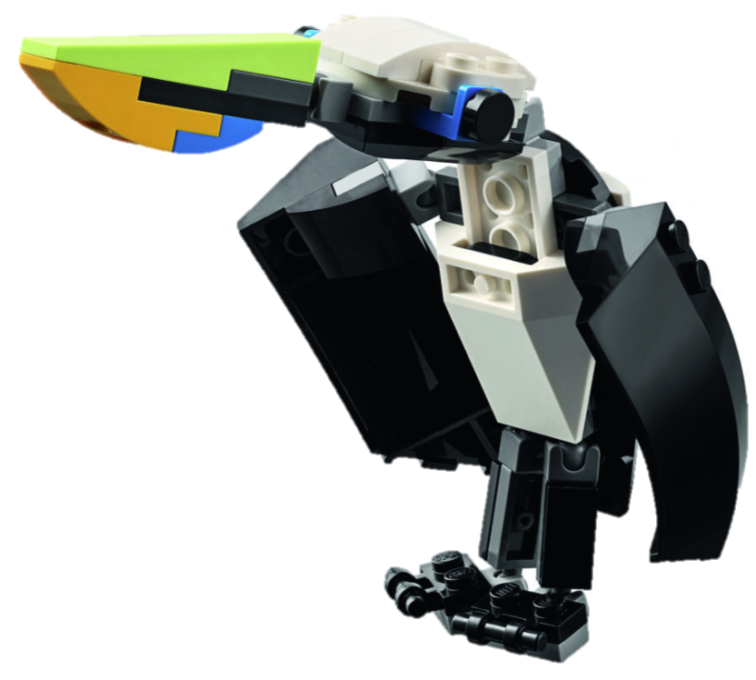
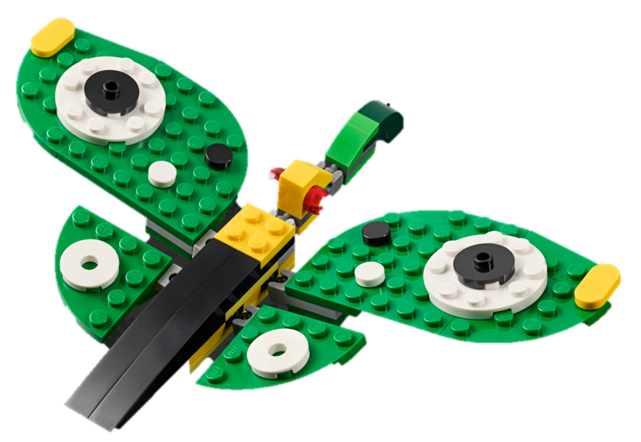
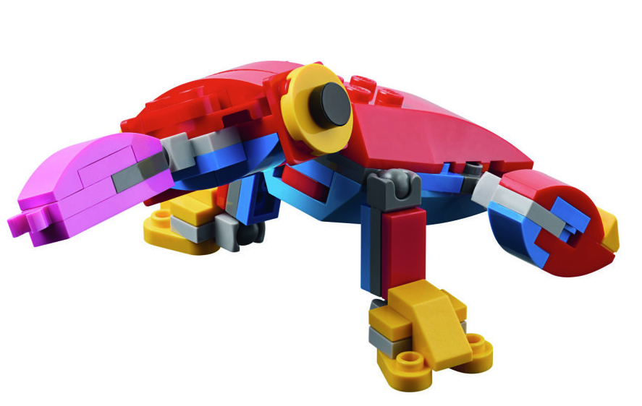
Activity 1 Tasks
Divide up into groups of two. Using Bags 4-6 and Book 2, build the animals.
Notes:
Activity 1 Tasks
Use book 2 and bags 4-6 to build the animals in the Explore Set.
Talk to your team about the animals you built.
Can you describe them?
What makes them different from each other?
Talk to your team about where these animals live in the rainforest.
Label the parts of the animals below in your Engineering Notebook.
Session Tips
Use bags 4-6 and book 2 to build the animals.
You could divide the team into pairs so each can build a different animal.
Lead a discussion about each of the animals and what makes them different.

Slide 7
Activity 1 Tasks
What do you notice about the animals you built?
Can you describe them?
What makes them different from each other?
Where do these animals live in the rainforest?
Notes:
Activity 1 Tasks
Use book 2 and bags 4-6 to build the animals in the Explore Set.
Talk to your team about the animals you built.
Can you describe them?
What makes them different from each other?
Talk to your team about where these animals live in the rainforest.
Label the parts of the animals below in your Engineering Notebook.
Session Tips
Use bags 4-6 and book 2 to build the animals.
You could divide the team into pairs so each can build a different animal.
Lead a discussion about each of the animals and what makes them different.

Slide 8
Activity 1 Tasks
Label the parts of the animals.
Wings
Eyes
Legs
What else?
Notes:
Activity 1 Tasks
Use book 2 and bags 4-6 to build the animals in the Explore Set.
Talk to your team about the animals you built.
Can you describe them?
What makes them different from each other?
Talk to your team about where these animals live in the rainforest.
Label the parts of the animals below in your Engineering Notebook.
Session Tips
Use bags 4-6 and book 2 to build the animals.
You could divide the team into pairs so each can build a different animal.
Lead a discussion about each of the animals and what makes them different.

Slide 9
Guiding Questions
Where would your new animal live on the mat?
What behaviors does your new animal have?
What area of the mat would be the best place for your animal to live?
Notes:
Each session has Guiding Questions that can be shared to frame the session.
Talk through each of these questions with the students. Have them start to think about these questions and later their will share their thoughts with their team.

Slide 10
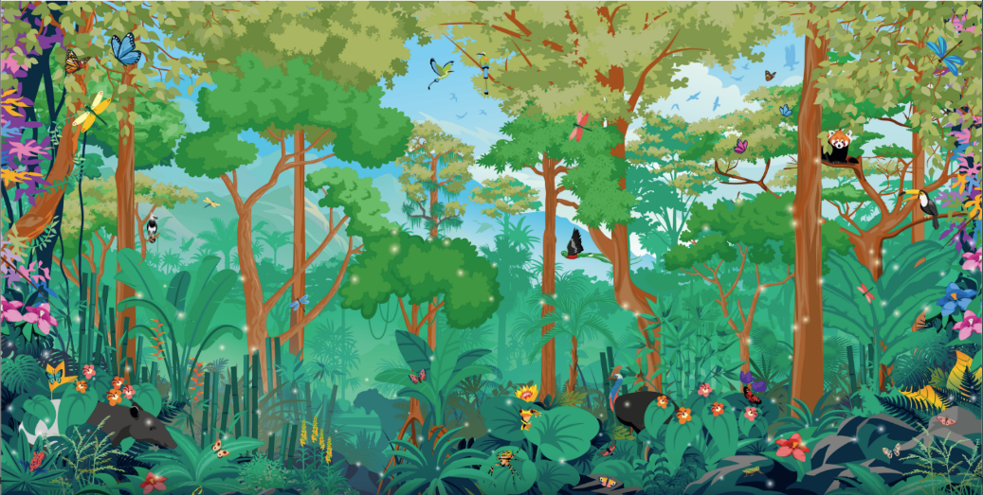
Activity 2 Tasks
Look at the Explore mat. Talk about the different areas on the mat.
Where would each animal live?
You Need…
Notes:
Activity 2 Tasks
Place the Explore mat on a flat surface.
Look at the mat and decide with your team where each of the animals might live.
Tell a story with your team about one of the animals.
Session Tips
The team can build on the Explore Mat during any of the sessions.
You can also use the back of the box to create a more immersive play experience.
Encourage the team to explain why they chose a specific area of the mat for their animal to live.
There are no wrong ways to design a new animal. Have the team be as creative as they want when building.

Slide 11
Challenge
Take apart your animal, trade some pieces with another animal to make a new animal.
Where would this new animal live on the mat?
What would you call this animal?
What does it like to eat?
How does it move?
Is it friendly to other animals?
Notes:
Challenge
Change one of the animals you built by swapping its pieces with other animals’ pieces.
Think about where this new kind of animal would live on the mat.
Tell a story about the new kind of animal you created.
That would you call this animal?
What does it like to eat?
How does it move?
Is it friendly to other animals?
Label the mat to show where this animal would live.
Session Tips
The team can build on the Explore Mat during any of the sessions.
You can also use the back of the box to create a more immersive play experience.
Encourage the team to explain why they chose a specific area of the mat for their animal to live.
There are no wrong ways to design a new animal. Have the team be as creative as they want when building.

Slide 12

Share
Share what you learned.
What was different about each animal?
Why do they live in different places?
Notes:
Share
Have the team share with the whole room:
Talk about the animals.
Share what they learned the different parts of animals and where they live in their Engineering Notebooks.

Slide 13
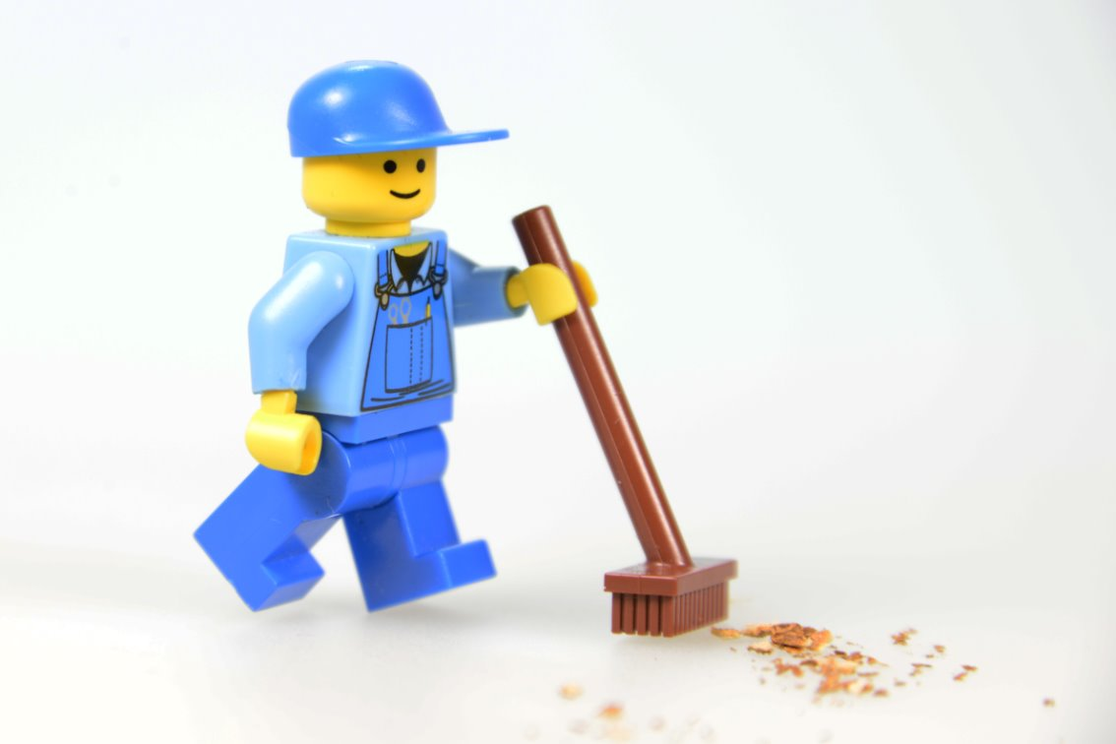
Clean Up
Notes:
Cleanup Pointers
• Fold the mat and store it to keep it from being damaged.
• The animal models can be restored to their original design or kept in their new form
Charge your LEGO Education set for the next session.
You may wish to play a video or song during clean up time Link on
GoNoodle:. https://family.gonoodle.com/activities/clean-up
Link on YouTube Kids: https://www.youtubekids.com/watch?v=ZJFk87ZsHn0
Link on Youtube: https://youtu.be/ZJFk87ZsHn0

Slide 14


LEGO, the LEGO logo, the Minifigure, LEGO Education, the LEGO Education logo, and the SPIKE logo are trademarks of the/sont des marques de commerce du/son marcas registradas de LEGO Group. ©2026 The LEGO Group. All rights reserved/Tous droits réservés/Todos los derechos reservados. FIRST®, the FIRST® logo, and FIRST® CANOPY™ are trademarks of For Inspiration and Recognition of Science and Technology (FIRST). LEGO® is a registered trademark of the LEGO Group. FIRST® LEGO® League and BIOGLOW™ are jointly held trademarks of FIRST and the LEGO Group. ©2026 FIRST and the LEGO Group. All rights reserved.

