Slide 1


SESSION 3
Animal Alarm
I can work with my team to build the LEGO® model from the lesson and explore sensor blocks.
I can work with my team to learn about how biologists detect animals in the rainforest.
Students will build a model that could be used by biologists to detect animals in the rainforest and write code to test it.

Slide 2


Discussion
What did we do last session?
Notes:
Discuss with students the animals, their habitats and behaviors they learned about last session. ​

Slide 3


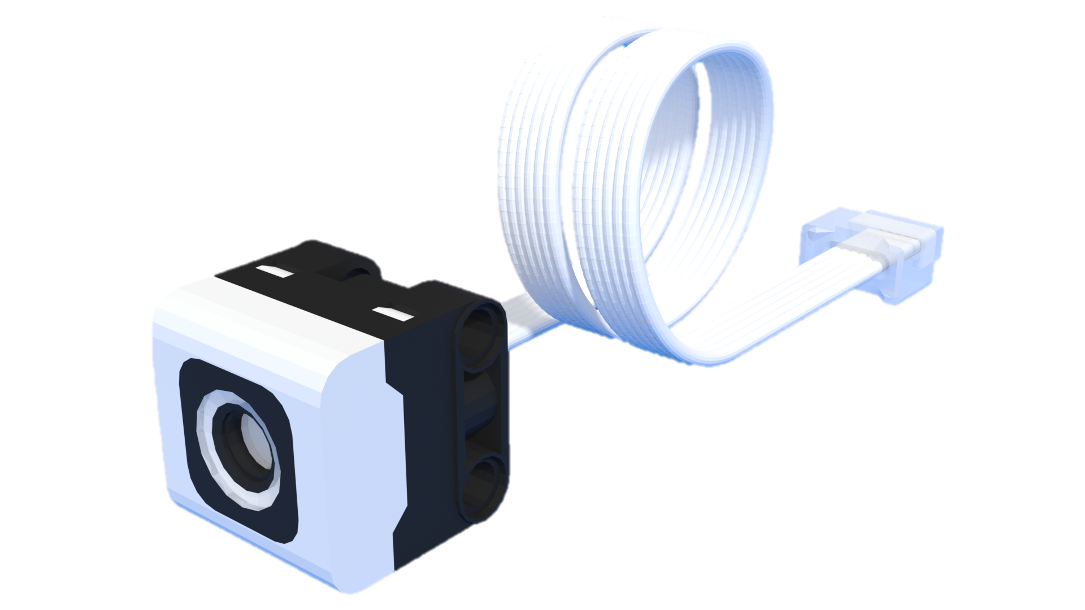
Key Vocabulary
Detect: to notice, discover, or find something that is hidden or hard to see
Program: to direct the thinking or behavior of
Sensor: a special tool or device that detects changes like light, temperature, or movement
Notes:
Session specific vocab

Slide 4


Introduction
Can your team provide examples of how they have used teamwork?
We are stronger when we work together.
Notes:
Introduction – Teamwork makes the dream work! (5-10 minutes)
• Introduce the FIRST® Core Values.
• Read the definition for teamwork to the team. (see TMG page 5)
• Talk about what teamwork is. Have the team provide examples of this Core Value.
• Have everyone draw a picture of an example of teamwork on the Core Values page in their Engineering Notebook.

Slide 5

Guiding Questions
Which blocks can you use to code the LEGO model?
How do you change the program so the model shows a different color?
Notes:
Each session has Guiding Questions that can be shared to frame the session.
Talk through each of these questions with the students. Have them start to think about these questions and later their will share their thoughts with their team.

Slide 6
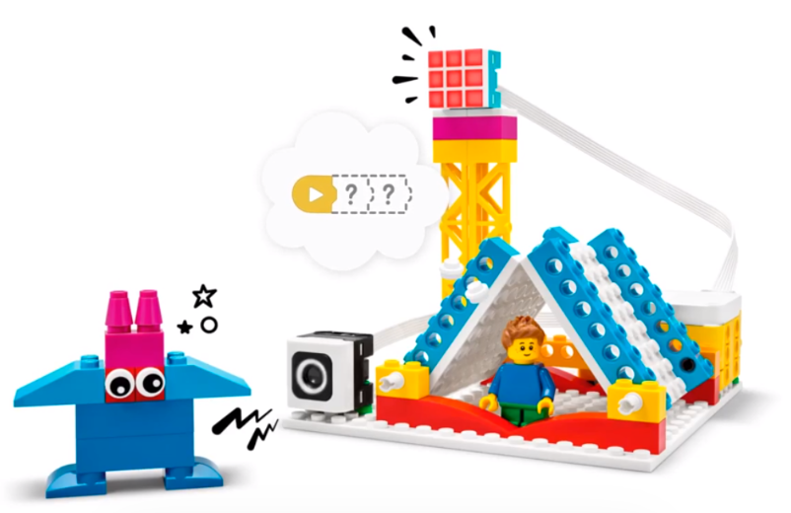


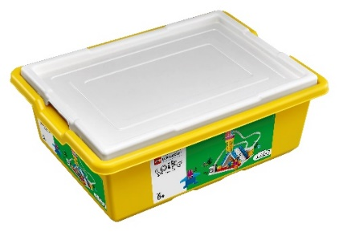
Activity 1 Tasks
In the SPIKE App, complete the Animal Alarm lesson.
This lesson is in the FIRST® LEGO® League Explore Unit.
You Need…
Notes:
Activity 1 Tasks
Open the SPIKE App on your team’s device.
Complete Coding Lesson 1 in the FIRST®LEGO® League Explore Unit – Animal Alarm.
Change the program so the color changes when one of the animals from the Explore Set moves in front of the sensor.
Write your ideas below.
Session Tips
- The team will only use their SPIKE Essential set for Activity 1.
- If your team is new to coding, you could have them complete the Tutorial Activities in the app.
- Lessons can be found in the FIRST® LEGO® League Explore Unit. Show the team how to access the Animal Alarm lesson in the app.

Slide 7

Code
Change the program so the color changes when one of the animals moves in front of the sensor.
Write your ideas on page 12 of your Engineering Notebook.
Notes:
Activity 1 Tasks
Open the SPIKE App on your team’s device.
Complete Coding Lesson 1 in the FIRST®LEGO® League Explore Unit – Animal Alarm.
Change the program so the color changes when one of the animals from the Explore Set moves in front of the sensor.
Write your ideas below.
Session Tips
- The team will only use their SPIKE Essential set for Activity 1.
- If your team is new to coding, you could have them complete the Tutorial Activities in the app.
- Lessons can be found in the FIRST® LEGO® League Explore Unit. Show the team how to access the Animal Alarm lesson in the app.

Slide 8
Guiding Questions
What kinds of sounds might you hear in the rainforest?
How can you test your program to make sure the sound plays at the right time?
Notes:
Each session has Guiding Questions that can be shared to frame the session.
Talk through each of these questions with the students. Have them start to think about these questions and later their will share their thoughts with their team.

Slide 9


Activity 2 Tasks
Record a new animal sound and change the program so it plays when the animal moves by the sensor.
You Need…
What animal sounds could you hear in the rainforest?
Notes:
Activity 2 Tasks
Try the other sound blocks for the Animal Alarm.
Record a new animal sound using the microphone icon
Change the program so our new sound plays when the animals moves by the sensor.
Session Tips
- The team should focus on using the sound blocks in this activity.
- The team should determine how to record sounds using their device. If recording is not possible, try the sounds provided in the app.
- The team can use the creatures they designed to test the Animal Alarm.

Slide 10
Challenge
Create a new sound for each animal you built.
Share about your animal and why is makes that sound.
Notes:
Challenge
Create a sound for each new animal you built.
Place the Animal Alarm and the animals you built on the mat.
Change the program so the model will play a sound when the animal is detected by the sensor.
Tell a story about the new animal.
Why does it make that sound?

Slide 11

Share
Share what you learned.
What coding blocks did you learn?
What sounds do these animals make?
Notes:
Share
Have the team share with the whole room:
Share the motor-coding skills they learned.
Talk about the sounds each animals makes.

Slide 12

Clean Up
Notes:
Cleanup Pointers
- Everything built in this session should be taken apart and returned to storage.
- Make sure to charge your LEGO Education set for the next session.
You may wish to play a video or song during clean up time Link on
GoNoodle:. https://family.gonoodle.com/activities/clean-up
Link on YouTube Kids: https://www.youtubekids.com/watch?v=ZJFk87ZsHn0
Link on Youtube: https://youtu.be/ZJFk87ZsHn0

Slide 13


LEGO, the LEGO logo, the Minifigure, LEGO Education, the LEGO Education logo, and the SPIKE logo are trademarks of the/sont des marques de commerce du/son marcas registradas de LEGO Group. ©2026 The LEGO Group. All rights reserved/Tous droits réservés/Todos los derechos reservados. FIRST®, the FIRST® logo, and FIRST® CANOPY™ are trademarks of For Inspiration and Recognition of Science and Technology (FIRST). LEGO® is a registered trademark of the LEGO Group. FIRST® LEGO® League and BIOGLOW™ are jointly held trademarks of FIRST and the LEGO Group. ©2026 FIRST and the LEGO Group. All rights reserved.

