Slide 1


SESSION 4
Treehouse Camp
I can work with my team to build the LEGO® model from the lesson and explore motor-coding blocks.
I can work with my team to discuss how scientists can observe and learn about wildlife from treehouses.
Students will learn about motors, build a model and write code to show how treehouses can be used to observe wildlife.

Slide 2


Discussion
What did we do last session?
Notes:
Discuss with students the coding and sensors used by biologists they learned about last session. ​

Slide 3
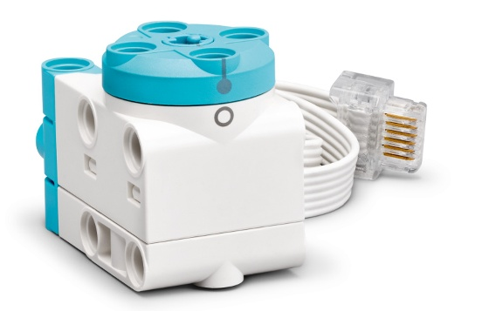


Key Vocabulary
Motor: a device that creates movement
Observe: to look closely at something
Treehouse: a shelter built high up in the branches of a tree
Notes:
Session specific vocab

Slide 4
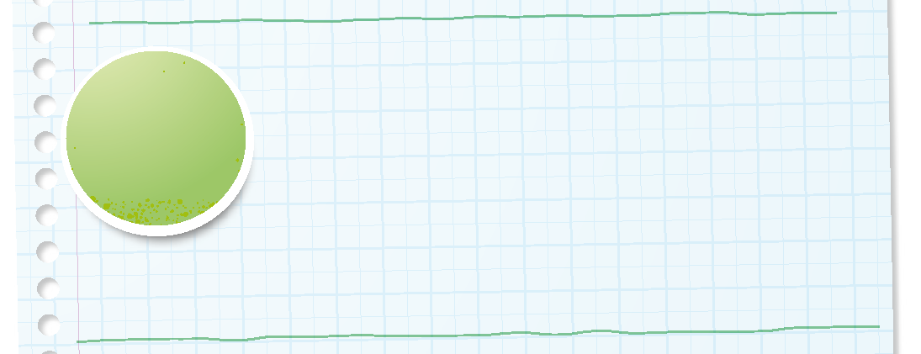
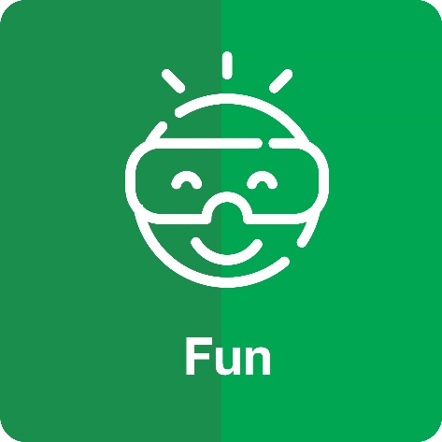
Introduction
Can your team provide examples of how they have used fun?
We enjoy and celebrate what we do.
Notes:
Introduction – Have Fun (5-10 minutes)
• Introduce the FIRST® Core Values.
• Read the definition for fun to the team. (see TMG page 5)
• Talk about what fun is. Have the team provide examples of this Core Value.
• Have everyone draw a picture of an example of fun on the Core Values page in their Engineering Notebook.

Slide 5

Guiding Questions
How can you change the program so the LEGO model opens slowly?
How can you code the model to make a sound?
What kind of animals could you watch from a treehouse?
Notes:
Each session has Guiding Questions that can be shared to frame the session.
Talk through each of these questions with the students. Have them start to think about these questions and later their will share their thoughts with their team.

Slide 6


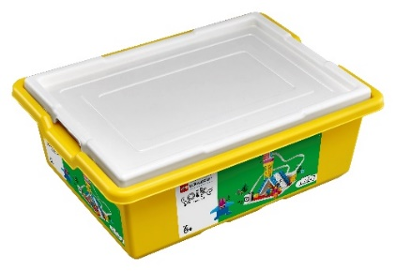
Activity 1 Tasks
In the SPIKE App, complete the Treehouse Camp lesson.
This lesson is in the FIRST® LEGO® League Explore Unit.
You Need…
Notes:
Activity 1 Tasks
Open the SPIKE app on your team’s device.
Complete Coding Lesson 2 in the FIRST LEGO League Explore Unit – Treehouse Camp
Change the program so the treehouse roof can open slowly.
Talk with your team about how this model could help a scientist in the rainforest.
Write your ideas below.
Session Tips
- The team should focus on using the motor blocks in this activity.
- Questions and tips in the Engineering Notebook are meant to start a discussion and generate ideas.
- Give the team time to experiment with the program and different coding options.

Slide 7

Code
Change the program so the treehouse roof can open slowly.
How could this model help a scientist in the rainforest?
Write your ideas on page 14 of your Engineering Notebook.
Notes:
Activity 1 Tasks
Open the SPIKE app on your team’s device.
Complete Coding Lesson 2 in the FIRST LEGO League Explore Unit – Treehouse Camp
Change the program so the treehouse roof can open slowly.
Talk with your team about how this model could help a scientist in the rainforest.
Write your ideas below.
Session Tips
- The team should focus on using the motor blocks in this activity.
- Questions and tips in the Engineering Notebook are meant to start a discussion and generate ideas.
- Give the team time to experiment with the program and different coding options.

Slide 8
Guiding Questions
How can you change the model so it can be hidden in the rainforest?
Where could you observe the most animals on the mat?
How did you include your team members’ ideas?
Notes:
Each session has Guiding Questions that can be shared to frame the session.
Talk through each of these questions with the students. Have them start to think about these questions and later their will share their thoughts with their team.

Slide 9

Activity 2 Tasks
Use the SPIKE Essential set to change the Treehouse Camp model to blend into the rainforest.
You Need…
Describe how you camouflaged the model to blend in.
Notes:
Activity 2 Tasks
Use the SPIKE Essential set to change the Treehouse Camp model so that it can blend into the rainforest.
Place the model on the Explore Mat.
Session Tips
- Use the SPIKE Essential set to modify the model.
- Try to keep the Explore Set separate from the other materials.
- You could challenge the team to change the amount of time the model will stay open or closed.

Slide 10
Challenge
Change the program so the roof will open for 5 seconds and then close, repeat 3 times.
Share what built and explain how you coded the model.
Notes:
Challenge
Change the program so the model will open for 5 seconds and then close for 5 seconds.
Make the program repeat two or three times.
Share what you built and explain how you coded the model.

Slide 11

Share
Share what you learned.
What did you learn about motors?
What did you learn about coding
motors?
How do biologists use treehouses to study animals in the rainforest?
Notes:
Share
Have the team share with the whole room:
Share the motor-coding skills they learned.
- How do biologists use treehouses to study animals in the rainforest?

Slide 12
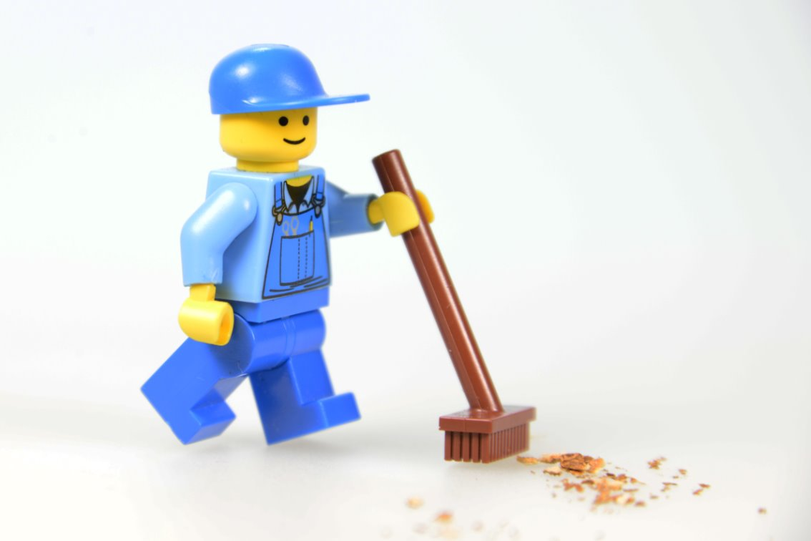
Clean Up
Notes:
Cleanup Pointers
- Everything built in this session should be taken apart and returned to storage.
- Make sure to charge your LEGO Education set for the next session.
You may wish to play a video or song during clean up time Link on
GoNoodle:. https://family.gonoodle.com/activities/clean-up
Link on YouTube Kids: https://www.youtubekids.com/watch?v=ZJFk87ZsHn0
Link on Youtube: https://youtu.be/ZJFk87ZsHn0

Slide 13


LEGO, the LEGO logo, the Minifigure, LEGO Education, the LEGO Education logo, and the SPIKE logo are trademarks of the/sont des marques de commerce du/son marcas registradas de LEGO Group. ©2026 The LEGO Group. All rights reserved/Tous droits réservés/Todos los derechos reservados. FIRST®, the FIRST® logo, and FIRST® CANOPY™ are trademarks of For Inspiration and Recognition of Science and Technology (FIRST). LEGO® is a registered trademark of the LEGO Group. FIRST® LEGO® League and BIOGLOW™ are jointly held trademarks of FIRST and the LEGO Group. ©2026 FIRST and the LEGO Group. All rights reserved.

