Slide 1


SESSION 5
Science Helpers
I can work with my team to build the lift platform model and use the provided code.
I can work with my team to talk about how people collaborate to study the rainforest.
Students will build and program a lift to move scientists up and down. Students will learn how people collaborate to study the rainforest.

Slide 2

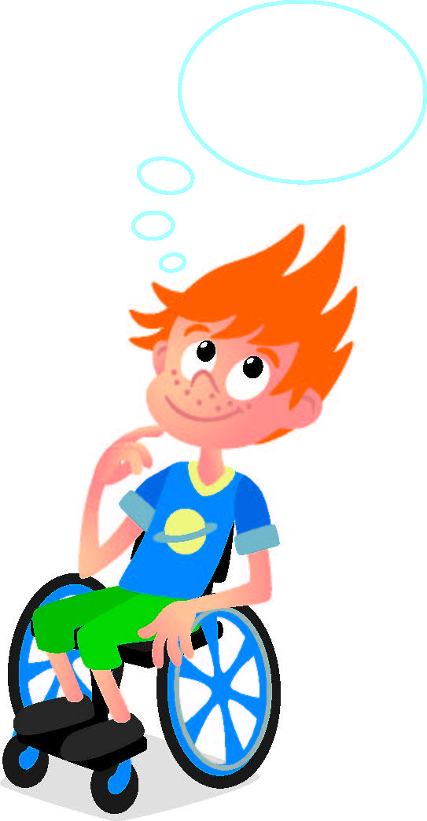
Discussion
What did we do last session?
Notes:
Discuss with students the coding and motors used in the treehouse they learned about last session. ​

Slide 3
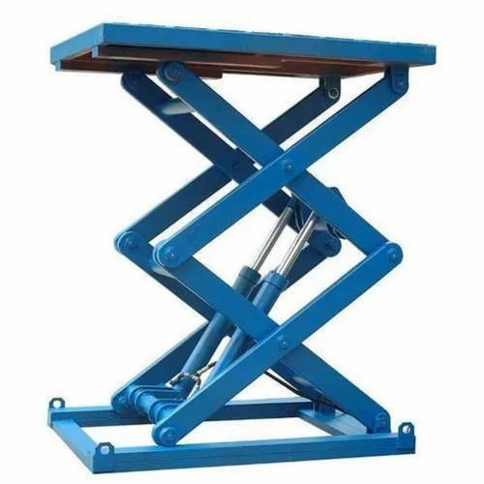

Key Vocabulary
Platform: any raised surface used as a place to stand
Protect: keep safe from danger
Notes:
Session specific vocab

Slide 4
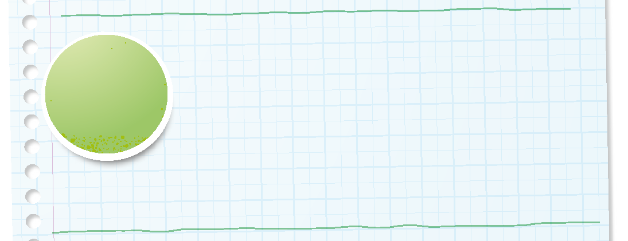

Introduction
Can your team provide examples of how they have used innovation?
We use creativity and persistence to solve problems.
Notes:
Introduction – Let’s Innovate (5-10 minutes)
• Introduce the FIRST® Core Values.
• Read the definition for innovation to the team. (see TMG page 5)
• Talk about what innovation is. Have the team provide examples of this Core Value.
• Have everyone draw a picture of an example of innovation on the Core Values page in their Engineering Notebook.

Slide 5
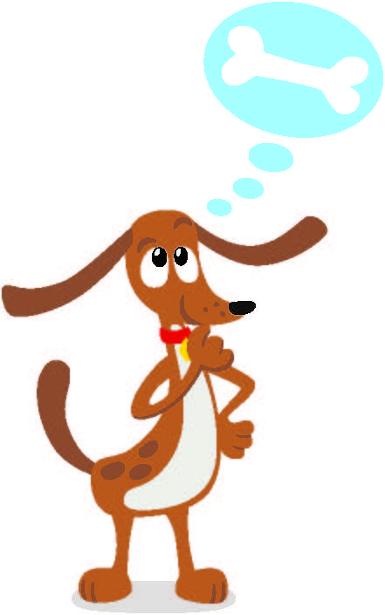
Guiding Questions
Can you describe what will happen to the lift if you use the provided code?
How could a scientist use a lift to learn more about biodiversity in the rainforest?
What other tools could be used to study the rainforest?
Notes:
Each session has Guiding Questions that can be shared to frame the session.
Talk through each of these questions with the students. Have them start to think about these questions and later their will share their thoughts with their team.

Slide 6
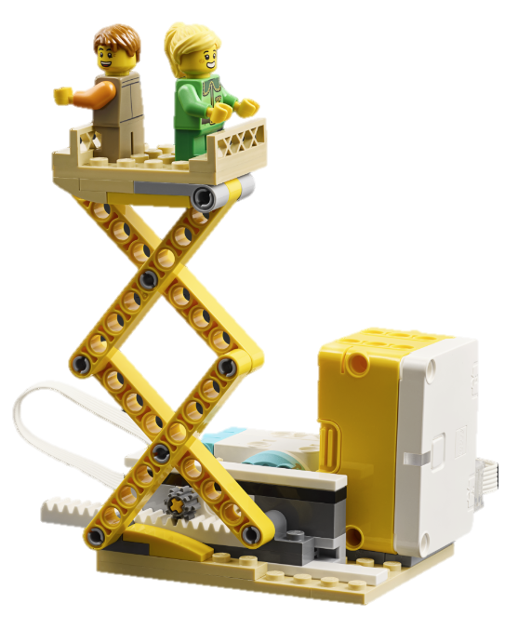


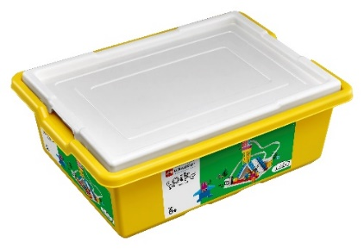
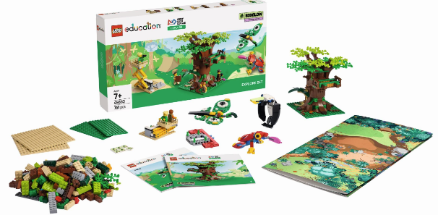
Activity 1 Tasks
Using Bag 2 & 7, build the lifting platform and add a scientist on top.
You Need…
Notes:
Activity 1 Tasks
Use the building instructions in Book 2 and Bag 7 to build the lifting platform.
Add a scientist to the platform.
Open the SPIKE app on your team’s device.
Try the program provided in the box below to activate the lift and raise the scientist.
Talk with your team about how this model could help a scientist in the rainforest.
Write your ideas below.
Session Tips
- Tell the team to watch their robot so that it does not fall off the table.
- The team should take turns making changes to the program.
- The team will use only their SPIKE Essential set for this activity.

Slide 7
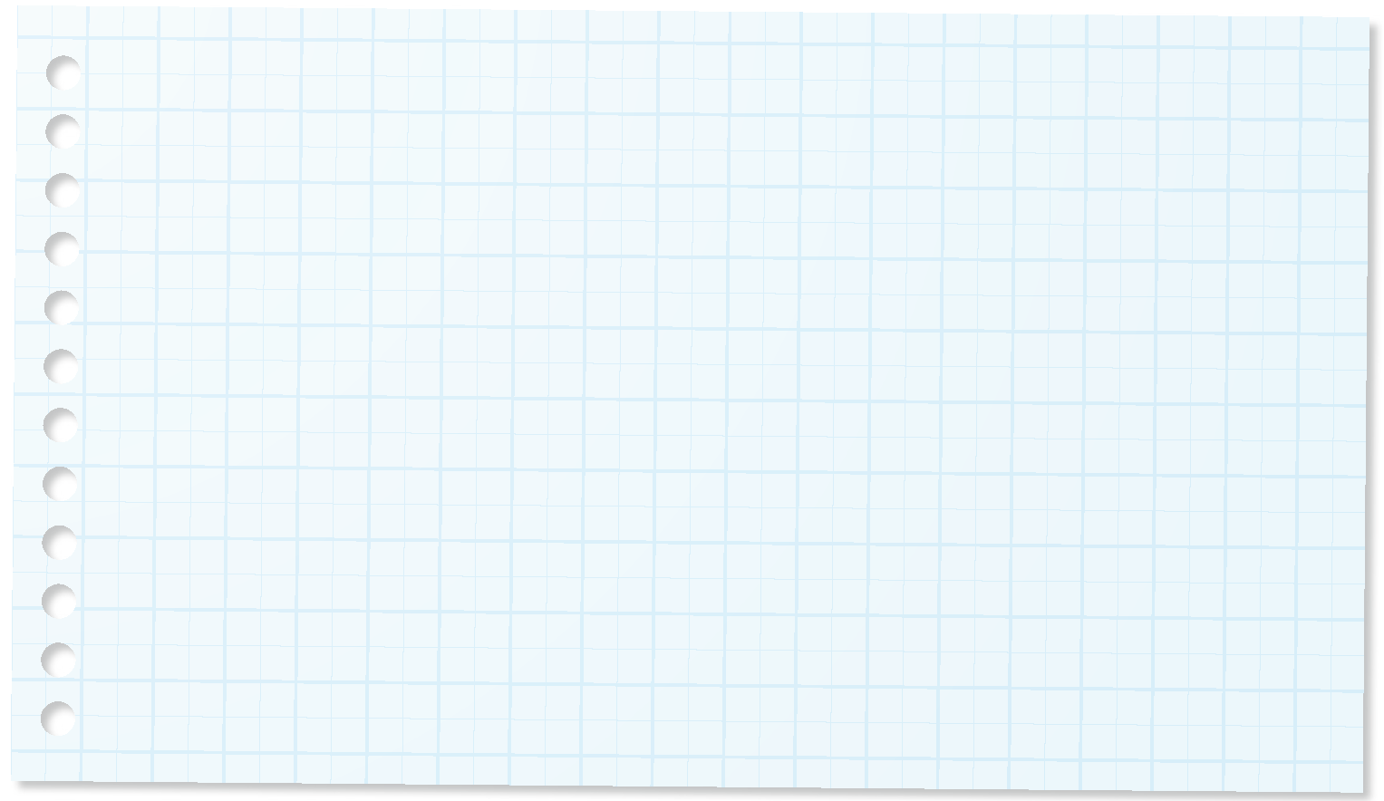
Code
Try the program provided to move the lift.
How could this lift help a scientist in the rainforest?
Write your ideas on page 16 of your Engineering Notebook.
Notes:
Activity 1 Tasks
Use the building instructions in Book 2 and Bag 7 to build the lifting platform.
Add a scientist to the platform.
Open the SPIKE app on your team’s device.
Try the program provided in the box below to activate the lift and raise the scientist.
Talk with your team about how this model could help a scientist in the rainforest.
Write your ideas below.
Session Tips
- Tell the team to watch their robot so that it does not fall off the table.
- The team should take turns making changes to the program.
- The team will use only their SPIKE Essential set for this activity.

Slide 8
Guiding Questions
What are some other ways a lifting platform could be used in the rainforest?
Why is it important for scientists to share their knowledge and skills with each other?
How can you code the model to raise it to a different height?
Notes:
Each session has Guiding Questions that can be shared to frame the session.
Talk through each of these questions with the students. Have them start to think about these questions and later their will share their thoughts with their team.

Slide 9
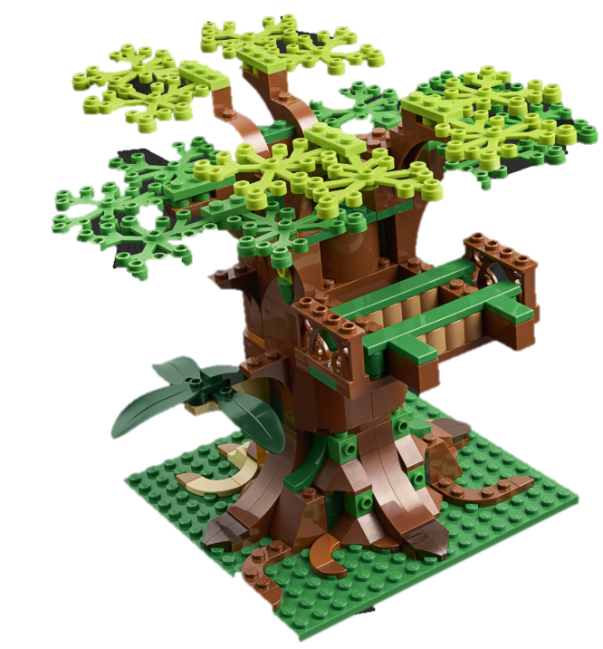
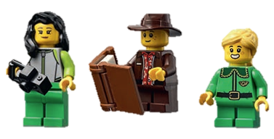
Activity 2 Tasks
Change the lift model so that it can be used with the tree model.
Can it reach all areas of the tree?
Notes:
Activity 2 Tasks
Find or rebuild the tree model from Session 1.
Change the lifting platform so that it can be used in the rainforest.
Session Tips
- If the tree model built in Session 1 was disassembled, ask the team to rebuild it before proceeding to the next task.
- Use the Multimedia Resources to find example photos, websites, and other activities related to the sessions.
- The team should practice positioning the lifting platform to reach different areas of the tree.

Slide 10
Challenge
Change the program so the model will raise and lower the scientists safely.
Share what built and explain how you coded the model.
Notes:
Challenge
Place the tree model and lifting platform on the mat.
Add two scientists to the platform.
Decide with your team what the scientists want to research in the tree.
Change the program for your lifting platform so it can raise and lower the scientists safely.
Share what you built and explain how you coded the model.

Slide 11
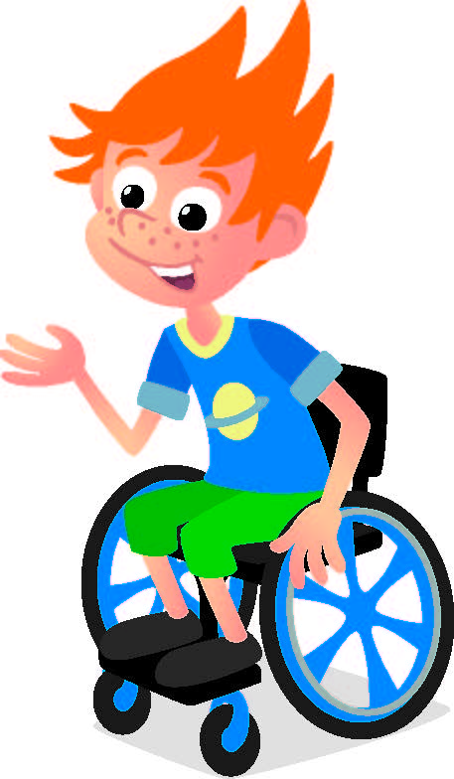
Share
Share what you learned.
What did you learn about coding?
Share how scientists collaborate and share their knowledge with each other.
Notes:
Share
Have the team share with the whole room:
- Share how they applied coding skills in this session.
- Share how scientists collaborate and share their knowledge with each other.

Slide 12
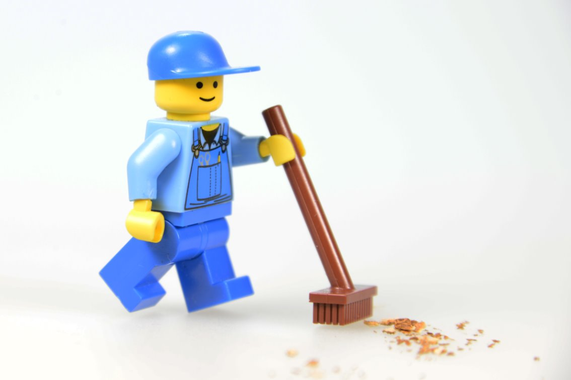
Clean Up
Notes:
Cleanup Pointers
Keep the tree and the lifting models assembled for use in later sessions.
Make sure to charge your LEGO® Education set for the next session.
You may wish to play a video or song during clean up time Link on
GoNoodle:. https://family.gonoodle.com/activities/clean-up
Link on YouTube Kids: https://www.youtubekids.com/watch?v=ZJFk87ZsHn0
Link on Youtube: https://youtu.be/ZJFk87ZsHn0

Slide 13


LEGO, the LEGO logo, the Minifigure, LEGO Education, the LEGO Education logo, and the SPIKE logo are trademarks of the/sont des marques de commerce du/son marcas registradas de LEGO Group. ©2026 The LEGO Group. All rights reserved/Tous droits réservés/Todos los derechos reservados. FIRST®, the FIRST® logo, and FIRST® CANOPY™ are trademarks of For Inspiration and Recognition of Science and Technology (FIRST). LEGO® is a registered trademark of the LEGO Group. FIRST® LEGO® League and BIOGLOW™ are jointly held trademarks of FIRST and the LEGO Group. ©2026 FIRST and the LEGO Group. All rights reserved.

