Slide 1


SESSION 8
Team Model
I can work with my team to draw our team model and label different parts.
I can work with my team to create a team model to share what we learned about biodiversity.
Students will work together to build their team model and prepare to share what they have learned with the reviewers at their festival.

Slide 2

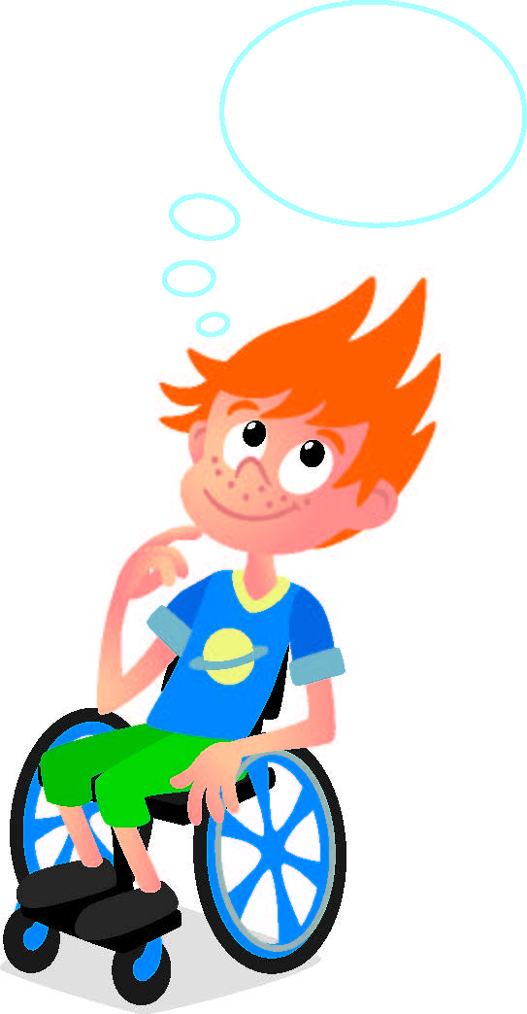
Discussion
What did we do last session?
Notes:
Discuss with students the jobs and tools of people who work in a rainforest they learned about last session.

Slide 3
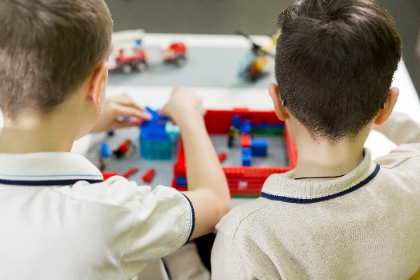

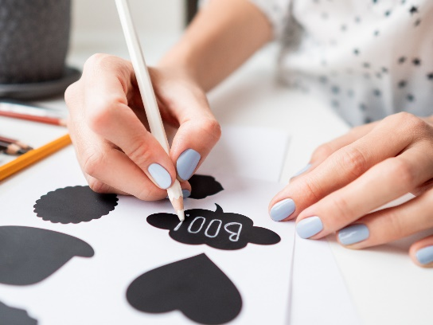
Key Vocabulary
Model: construction used to help represent something
Design: to think up and plan out in the mind
Label: to name or describe with
Notes:
Session specific vocab

Slide 4

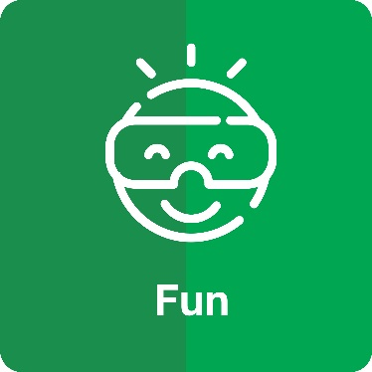
Introduction
How has your team used fun and teamwork throughout the sessions?
We are stronger when we work together.
We enjoy and celebrate what we do.
Notes:
Introduction – Model Teamwork & Fun (5-10 minutes)
• Introduce the FIRST® Core Values.
• Read the definition for teamwork and fun to the team. (see TMG page 5)
• Talk about what teamwork and fun is. Have the team provide examples of these Core Value throughout the sessions.
• Have the team build something using the prototyping pieces representing these Core Value.

Slide 5
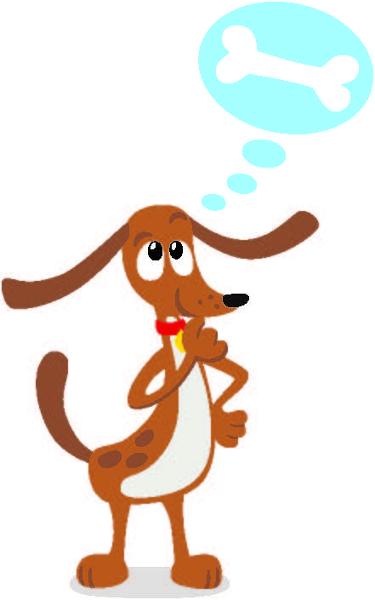
Guiding Questions
How will you plan your design for your team model?
What do you think is the most important part for your team model and why?
Notes:
Each session has Guiding Questions that can be shared to frame the session.
Talk through each of these questions with the students. Have them start to think about these questions and later their will share their thoughts with their team.

Slide 6
Activity 1 Tasks
Review the requirements for the team model.
Include:
A plant or animal that your team designed
A job related to the rainforest
A tool or piece of technology used to study biodiversity
All parts of the Explore Set and mat
Use SPIKE Essential to motorize a part of your model
Use only LEGO elements
Notes:
Activity 1 Tasks
Talk to your team about what you have learned about biodiversity.
Check the required parts of the team model on the next page.
Draw your ideas for your team model below.
Label the different parts.
Session Tips
The team will need all parts of the Explore Set (radar and excavation site models) and the mat.
Each member could build part of the team model and work as a group to put them together on the mat.
The team model can only be made of LEGO® bricks, minifigures, baseplates, and other LEGO elements.
Create the team model over two meetings and allow the children to be creative!

Slide 7

Activity 1 Tasks
Design your team model.
Draw your ideas for your team model on page 22 and 23 of your
Engineering
Notebook.
Make sure to label the different parts.
Notes:
Activity 1 Tasks
Talk to your team about what you have learned about biodiversity.
Check the required parts of the team model on the next page.
Draw your ideas for your team model below.
Label the different parts.
Session Tips
The team will need all parts of the Explore Set (radar and excavation site models) and the mat.
Each member could build part of the team model and work as a group to put them together on the mat.
The team model can only be made of LEGO® bricks, minifigures, baseplates, and other LEGO elements.
Create the team model over two meetings and allow the children to be creative!

Slide 8
Guiding Questions
What are the strengths of your design?
What part of the model will you motorize and code?
Notes:
Each session has Guiding Questions that can be shared to frame the session.
Talk through each of these questions with the students. Have them start to think about these questions and later their will share their thoughts with their team.

Slide 9
Activity 2 Tasks
Work together to build your team model.
Make sure to include everyone’s ideas!
Do you have all the required parts?
Notes:
Activity 2 Tasks
Create your team model together on the Explore mat.
Talk about the different parts of your model.
Session Tips
The team model should be able to fit on a table and be easy to move.
The team should apply the coding concepts learned throughout the sessions to activate their model.
The team can choose to motorize any part of their team model.

Slide 10
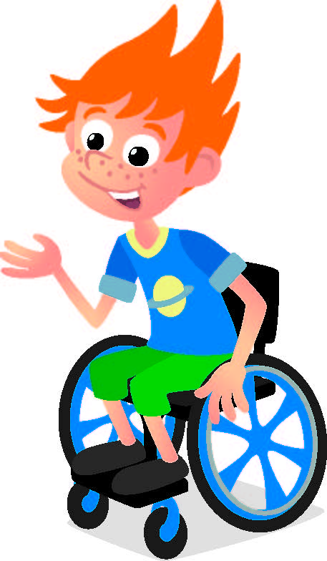
Share
Share what you learned.
Demonstrate the moving part of your model.
Can you point to each part of the team model and explain it?
Notes:
Share
Have the team share with the whole room:
- Review the list of required parts and identify them on the team model.
- Demonstrate and explain their team model.

Slide 11
Guiding Questions
What part of your team model are you most proud of?
What will you share with the reviewers at the festival?
Notes:
Each session has Guiding Questions that can be shared to frame the session.
Talk through each of these questions with the students. Have them start to think about these questions and later their will share their thoughts with their team.

Slide 12
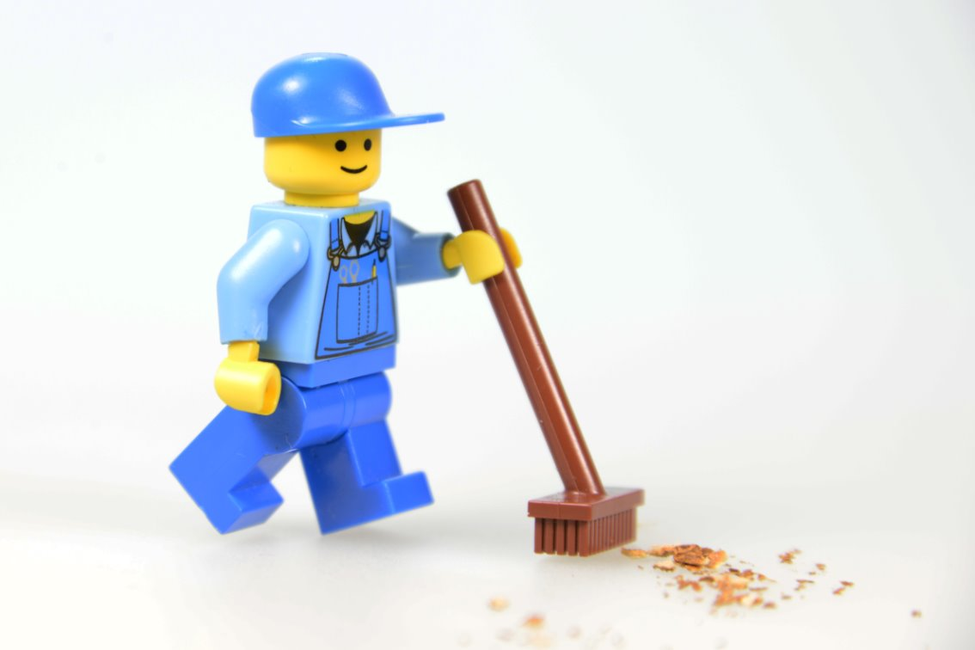
Clean Up
Notes:
Cleanup Pointers
- The team model should stay assembled for the festival.
- Organize unused pieces of the SPIKE™ Essential set and Explore Set and return them to storage.
You may wish to play a video or song during clean up time Link on
GoNoodle:. https://family.gonoodle.com/activities/clean-up
Link on YouTube Kids: https://www.youtubekids.com/watch?v=ZJFk87ZsHn0
Link on Youtube: https://youtu.be/ZJFk87ZsHn0

Slide 13


LEGO, the LEGO logo, the Minifigure, LEGO Education, the LEGO Education logo, and the SPIKE logo are trademarks of the/sont des marques de commerce du/son marcas registradas de LEGO Group. ©2026 The LEGO Group. All rights reserved/Tous droits réservés/Todos los derechos reservados. FIRST®, the FIRST® logo, and FIRST® CANOPY™ are trademarks of For Inspiration and Recognition of Science and Technology (FIRST). LEGO® is a registered trademark of the LEGO Group. FIRST® LEGO® League and BIOGLOW™ are jointly held trademarks of FIRST and the LEGO Group. ©2026 FIRST and the LEGO Group. All rights reserved.

