Slide 1


SESSION 9
Team Poster
I can work with my team to create a plan for what they will include on their team poster.
I can work with my team to design and create their team poster.
I can work with my team to practice presenting their poster.
Students will work together to design their team poster and prepare for their festival.

Slide 2


Discussion
What did we do last session?
Notes:
Discuss with students the models they built in the last few sessions.

Slide 3
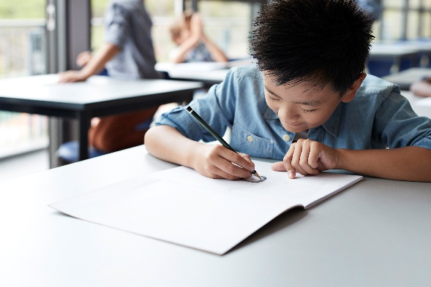
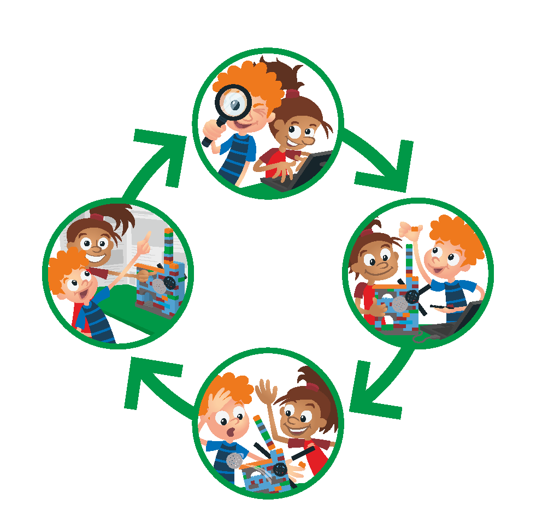
Key Vocabulary
Draft: to put into written form
Team Journey: experience through FIRST LEGO League Explore
Notes:
Session specific vocab

Slide 4


Introduction
How has your team used innovation and inclusion throughout the sessions?
We use creativity and persistence to solve problems.
We respect each other and embrace our differences.
Notes:
Introduction – Model Innovation & Inclusion (5-10 minutes)
• Introduce the FIRST® Core Values.
• Read the definition for innovation and inclusion to the team. (see TMG page 5)
• Talk about what innovation and inclusion is. Have the team provide examples of these Core Value throughout the sessions.
• Have the team build something using the prototyping pieces representing these Core Value.

Slide 5

Guiding Questions
What topics do you want to include on the team poster?
What pictures could you draw or add to your poster?
Notes:
Each session has Guiding Questions that can be shared to frame the session.
Talk through each of these questions with the students. Have them start to think about these questions and later their will share their thoughts with their team.

Slide 6


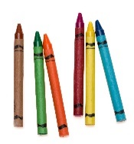
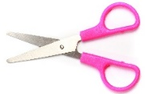
Activity 1 Tasks
Talk with your team about what to include on your poster.
What did you learn that you want to share?
Think about your team’s journey.
Write or draw your ideas on page 25 of your Engineering Notebook.
You Need…
Notes:
Activity 1 Tasks
Talk to your team about what you will include on your team poster.
Use the next page to draft your ideas.
Session Tips
You will need to provide a large poster board and various art supplies. A trifold poster board works well.
The team should create the poster themselves. You can support them and provide insight.
The team can look back at the Team Journey and Core Values pages in their Engineering Notebooks for ideas.
Create the team poster over two meetings and allow the children to be creative.

Slide 7
Activity 2 Tasks
Create your team poster.
Look through your Engineering Notebook and team model for ideas.
Make sure everyone on your team helps!
You Need…
Notes:
Activity 2 Tasks
Decide how your team will create the poster and determine what supplies you will need.
Gather your poster board and supplies.
Create your team poster. The whole team should help create it.
Session Tips
Sample topics for the poster are provided for the students. However, they can choose to include anything they feel is necessary.
Provide extra paper for the team to draw and write their ideas for their team poster.
Look ahead to Session 10 to see what the reviewers will be asking the team.

Slide 8
Guiding Questions
How will each person talk about the poster?
What do you want the reviewers to know about your poster?
Notes:
Each session has Guiding Questions that can be shared to frame the session.
Talk through each of these questions with the students. Have them start to think about these questions and later their will share their thoughts with their team.

Slide 9

Share
Share what you made.
Show off your team poster design.
How will you share what is on your poster?
Notes:
Share
Have the team share with the whole room:
Share their team poster design and contents.
Demonstrate how they will share their poster and model with the reviewers.

Slide 10
Guiding Questions
What part of your team poster are you most proud of?
What will you share with the reviewers at the festival?
Notes:
Each session has Guiding Questions that can be shared to frame the session.
Talk through each of these questions with the students. Have them start to think about these questions and later their will share their thoughts with their team.

Slide 11
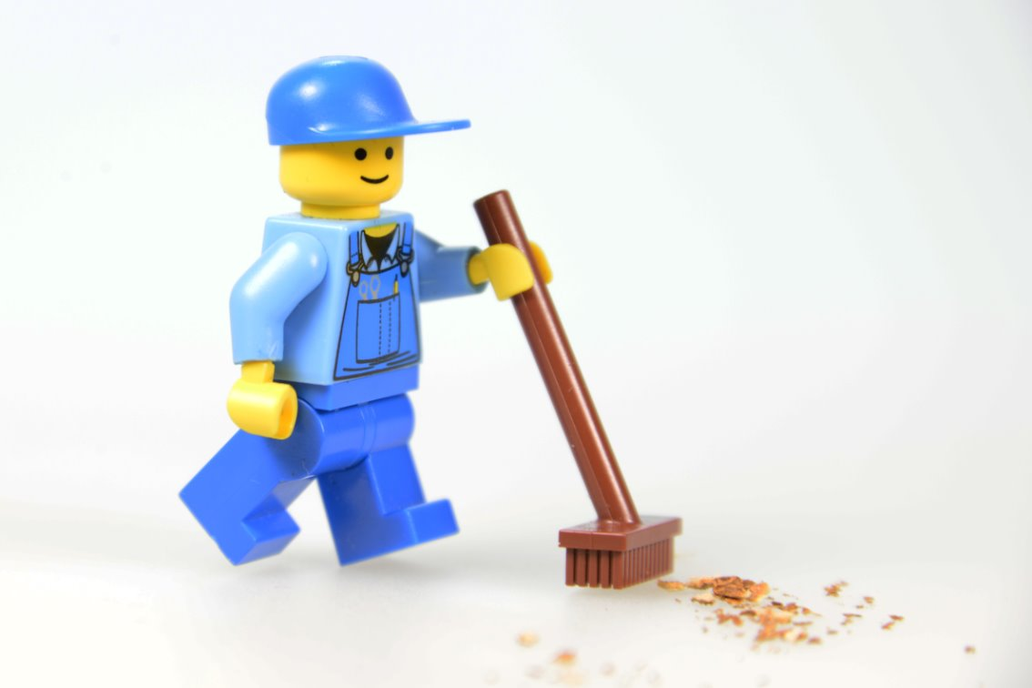
Clean Up
Notes:
Cleanup Pointers
Find a safe place to store the poster.
You may need extra time at the end of each session to clean up the art supplies.
You may wish to play a video or song during clean up time Link on
GoNoodle:. https://family.gonoodle.com/activities/clean-up
Link on YouTube Kids: https://www.youtubekids.com/watch?v=ZJFk87ZsHn0
Link on Youtube: https://youtu.be/ZJFk87ZsHn0

Slide 12


LEGO, the LEGO logo, the Minifigure, LEGO Education, the LEGO Education logo, and the SPIKE logo are trademarks of the/sont des marques de commerce du/son marcas registradas de LEGO Group. ©2026 The LEGO Group. All rights reserved/Tous droits réservés/Todos los derechos reservados. FIRST®, the FIRST® logo, and FIRST® CANOPY™ are trademarks of For Inspiration and Recognition of Science and Technology (FIRST). LEGO® is a registered trademark of the LEGO Group. FIRST® LEGO® League and BIOGLOW™ are jointly held trademarks of FIRST and the LEGO Group. ©2026 FIRST and the LEGO Group. All rights reserved.

