Slide 1


SESSION 1
I can explore the BIOGLOW™ season theme and get to know others on my team.
I can work with my team to build the mission models and make connections to the Challenge story and Project Sparks.
Students will get to know one another, build the mission models, and review the Project Sparks.

Slide 2
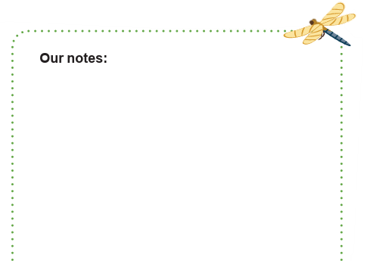
Introduction
Get to know your team.
Record information about your team here.
Select a team name.
Notes:
Introduction:
- Get to know your team members and select your team name.
Watch season videos and read pages 3-9 to learn how FIRST® LEGO® League Challenge works and about the BIOGLOWTM robot game and innovation project.
Session Tips:
- Have the team watch the season videos on the FIRST® LEGO® League YouTube channel and read pages 3-9 in their Engineering Notebooks.

Slide 3
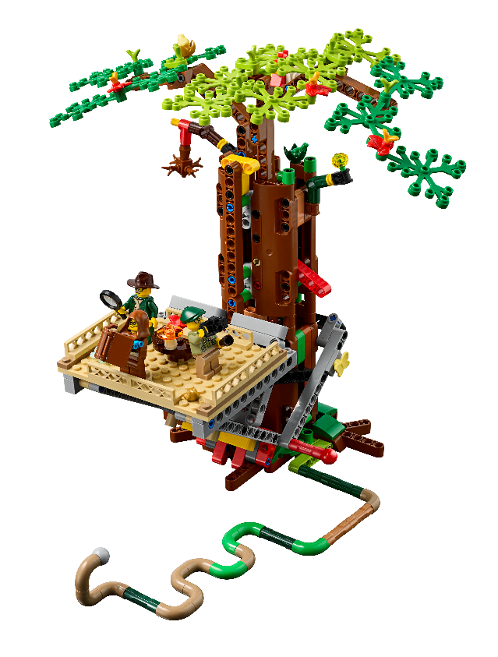
Key Vocabulary
mission model: The LEGO models placed on the field, designed to represent a real-world concept or challenge.
project spark: provide guidance on selection of project problem
innovation project: identify a problem and develop a solution to solve it
Notes:
Session specific vocab

Slide 4
Tasks
Build the robot game mission models.
Place models on the Challenge mat.
Pages 7-8 of the Robot Game Rulebook show how to set up the table.
Notes:
Tasks ​
Use the building instructions to build the robot game mission models.
Set up the game field.
Read page 7 of the Robot Game Rulebook to learn how to set up the mat.
Explore how the models work and how they connect to the Project Sparks on page 6.
Discuss the reflection questions and record your progress.
​
Session Tips​
Have the team watch the season videos on the FIRST® LEGO® League YouTube channel and read pages 3-9 in their Engineering Notebooks.
Provide the model building instructions and show the field setup video to the team.
The team can work together or as individuals to build the models. Be sure to inspect and test the models to ensure they function correctly.
Use the Robot Game Rulebook and mission video to understand how the models work.
Encourage the team to investigate the mat and the mission models to inspire them.
Lead a discussion about the Project Sparks and Challenge story and how they relate to the mission models.

Slide 5
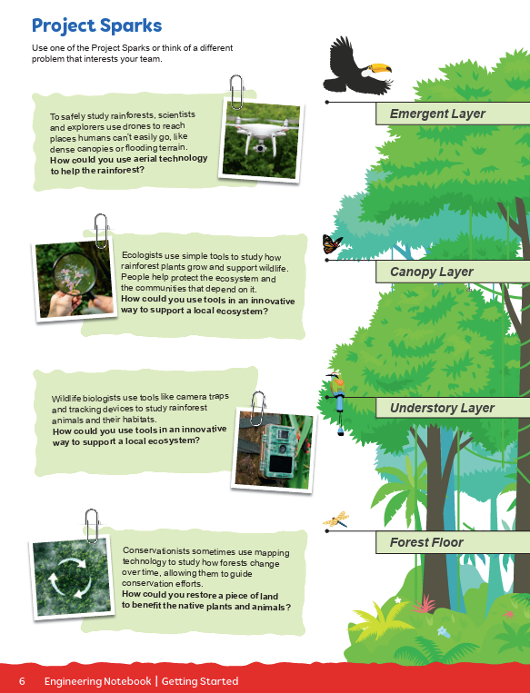
Tasks
Explore how the models work.
Connect them to the Project Sparks.
Page 6 of the Engineering Notebook has the Project Sparks.
Notes:
Tasks ​
Use the building instructions to build the robot game mission models.
Set up the game field.
Read page 7 of the Robot Game Rulebook to learn how to set up the mat.
Explore how the models work and how they connect to the Project Sparks on page 6.
Discuss the reflection questions and record your progress.
​
Session Tips​
Have the team watch the season videos on the FIRST® LEGO® League YouTube channel and read pages 3-9 in their Engineering Notebooks.
Provide the model building instructions and show the field setup video to the team.
The team can work together or as individuals to build the models. Be sure to inspect and test the models to ensure they function correctly.
Use the Robot Game Rulebook and mission video to understand how the models work.
Encourage the team to investigate the mat and the mission models to inspire them.
Lead a discussion about the Project Sparks and Challenge story and how they relate to the mission models.

Slide 6

Tasks
On page 10 of your Engineering Notebook, write notes about the mission models.
Answer the reflection questions.
Page 6 of the Engineering Notebook has the Project Sparks.
Notes:
Tasks ​
Use the building instructions to build the robot game mission models.
Set up the game field.
Read page 7 of the Robot Game Rulebook to learn how to set up the mat.
Explore how the models work and how they connect to the Project Sparks on page 6.
Discuss the reflection questions and record your progress.
​
Session Tips​
Have the team watch the season videos on the FIRST® LEGO® League YouTube channel and read pages 3-9 in their Engineering Notebooks.
Provide the model building instructions and show the field setup video to the team.
The team can work together or as individuals to build the models. Be sure to inspect and test the models to ensure they function correctly.
Use the Robot Game Rulebook and mission video to understand how the models work.
Encourage the team to investigate the mat and the mission models to inspire them.
Lead a discussion about the Project Sparks and Challenge story and how they relate to the mission models.

Slide 7

Reflect
How do the mission models relate to the Project Sparks?
Which mission models look interesting to you?
How does your team plan to have fun while working on the game and project?

Slide 8



Share
How do the mission models connect with the BIOGLOWTM theme?
Notes:
Share ​
Discuss the reflection questions
Get together at the mat. Talk about how the mission models connect to the BIOGLOW theme.
Clean up your space.
​
Session Tips​
Lead a discussion about the Project Sparks and Challenge story and how they relate to the mission models.

Slide 9

Clean Up

Slide 10

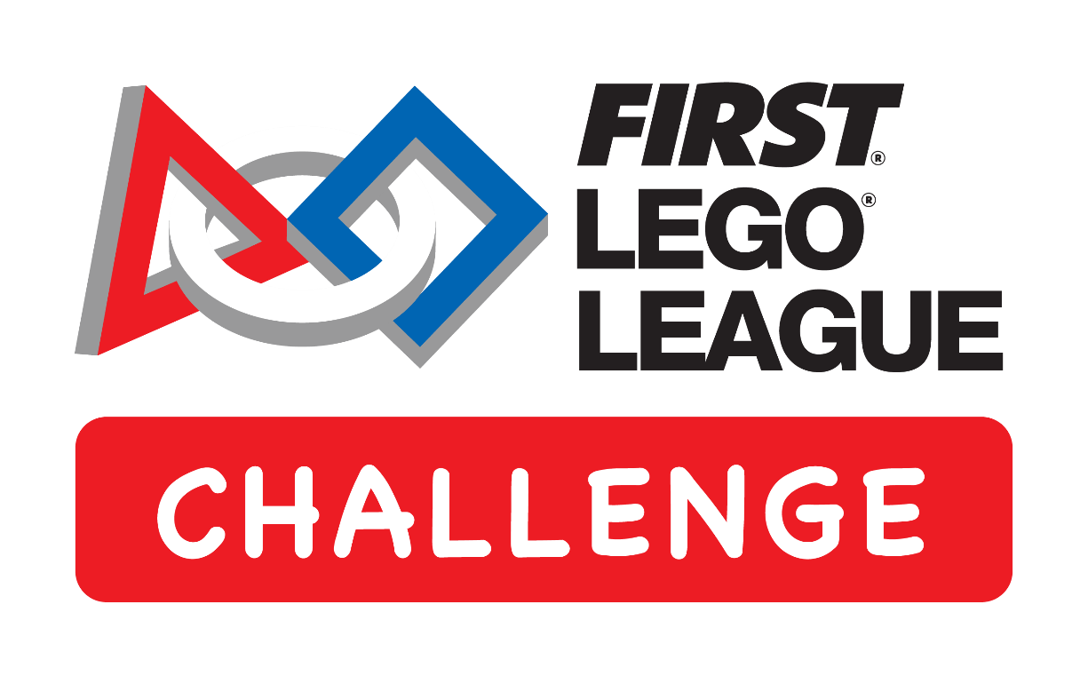
LEGO, the LEGO logo, the Minifigure, LEGO Education, the LEGO Education logo, and the SPIKE logo are trademarks of the/sont des marques de commerce du/son marcas registradas de LEGO Group. ©2026 The LEGO Group. All rights reserved/Tous droits réservés/Todos los derechos reservados. FIRST®, the FIRST® logo, and FIRST® CANOPY™ are trademarks of For Inspiration and Recognition of Science and Technology (FIRST). LEGO® is a registered trademark of the LEGO Group. FIRST® LEGO® League and BIOGLOW™ are jointly held trademarks of FIRST and the LEGO Group. ©2026 FIRST and the LEGO Group. All rights reserved.

