Slide 1


SESSION 10
I can work with my team to iterate and improve our innovation project solution based on testing and feedback.
I can work with my team to code our robot and test our mission strategy.
Students will prepare for their innovation project presentation and practice a timed robot game to see where they might need to improve. ​

Slide 2
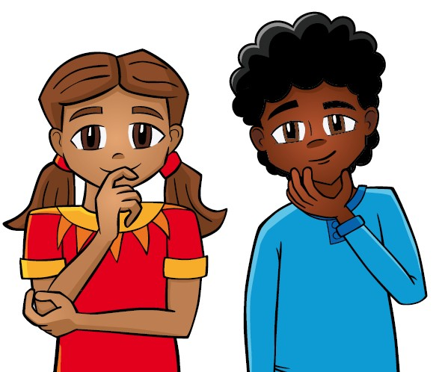
Discussion
What did we do last session?
Notes:
Discuss with students the progress made on their innovation project solution and missions in the previous session. ​​

Slide 3
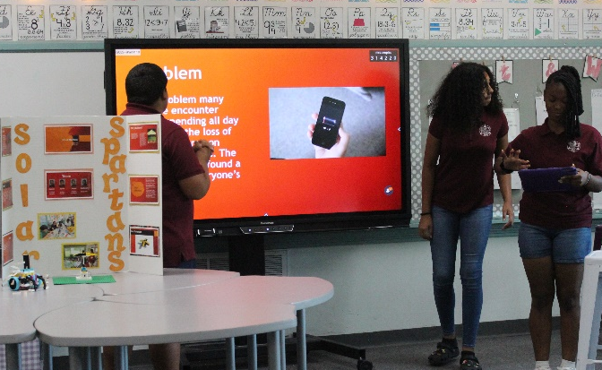
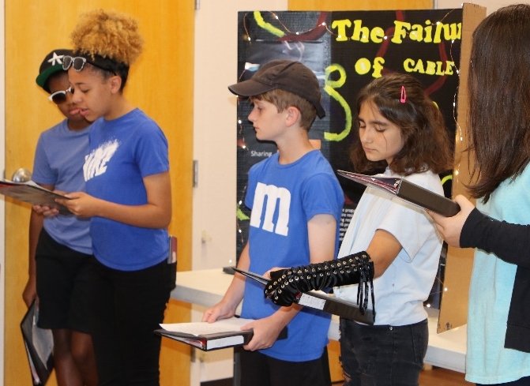
Key Vocabulary
presentation: the act of bringing information before another
script: written text for a presentation
Notes:
Session specific vocab

Slide 4

Introduction
What are some ways your team has demonstrated Coopertition®?
Write these on page 23 of your Engineering Notebook.
Coopertition®: Teams help and cooperate with each other, even as they compete.
Notes:
Introduction:
Talk about Coopertition® and the ways your team will demonstrate it when competing with other teams.

Slide 5

Tasks
Using the innovation project rubric, plan your project presentation.
Write a script to help remember key points.
Are there any props or costumes you want for your presentation?
Notes:
Tasks ​
Look at the innovation project rubric for what to include in your five-minute presentation.
Plan your project presentation by writing an outline or script.
Create any visual displays you need.
Engaging your audience can help ensure they remember your key points.
Continue to create, test, and iterate on your robot solution.
Continue practicing 2.5-minute robot games with all the missions you have worked on.
Discuss the reflection questions and record your progress.
Session Tips​
Provide the team with the innovation project rubric.
The presentation can have a slideshow, poster, play, or even a skit.
Props can be used, such as costumes, shirts, or hats.
Make sure teams have a drawing or model that represents their solution to show to judges.
The team can use a script for their judging session presentation.
Provide copies for each team member.
The team might need more space to store all their materials for the presentation.
Use the scoresheet at the end of each 2.5-minute match so the team knows their score.

Slide 6
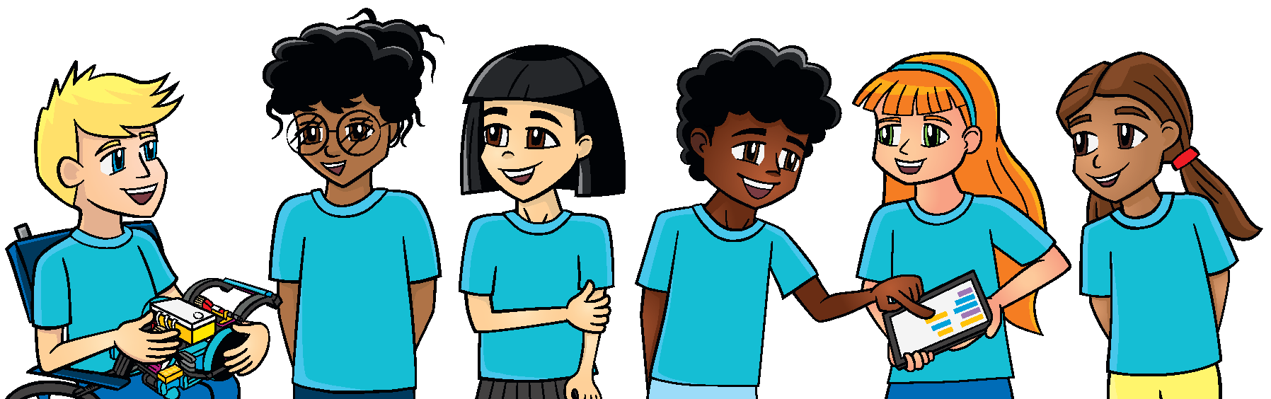
Tasks
Practice the 2 minute 30 second robot game and see how many missions you can complete.
Do you have all your attachments easy to grab during a match?
Does everyone get to participate in the robot game?
Notes:
Tasks ​
Look at the innovation project rubric for what to include in your five-minute presentation.
Plan your project presentation by writing an outline or script.
Create any visual displays you need.
Engaging your audience can help ensure they remember your key points.
Continue to create, test, and iterate on your robot solution.
Continue practicing 2.5-minute robot games with all the missions you have worked on.
Discuss the reflection questions and record your progress.
Session Tips​
Provide the team with the innovation project rubric.
The presentation can have a slideshow, poster, play, or even a skit.
Props can be used, such as costumes, shirts, or hats.
Make sure teams have a drawing or model that represents their solution to show to judges.
The team can use a script for their judging session presentation.
Provide copies for each team member.
The team might need more space to store all their materials for the presentation.
Use the scoresheet at the end of each 2.5-minute match so the team knows their score.

Slide 7
Reflect
How will you know if your solution is going to make a positive impact on others?
What is your team most proud of in your work on the project and robot design?
What skills have you developed throughout your FIRST ® LEGO® League experience?

Slide 8



Share
Share the robot skills practiced, and project on your solution in this session.
Notes:
Share ​
Discuss the reflection questions.
Get together at the mat. Share the robot skills you practiced in this session and the work completed on the innovation project.
Clean up your space.
​

Slide 9
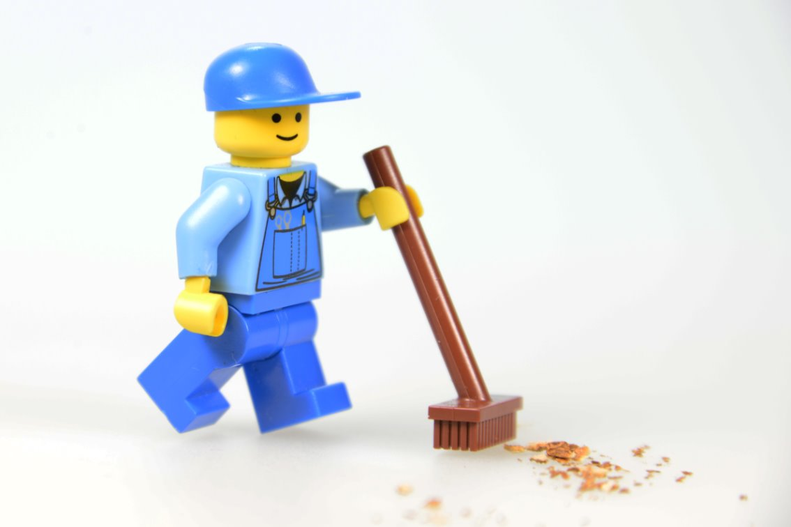
Clean Up

Slide 10


LEGO, the LEGO logo, the Minifigure, LEGO Education, the LEGO Education logo, and the SPIKE logo are trademarks of the/sont des marques de commerce du/son marcas registradas de LEGO Group. ©2026 The LEGO Group. All rights reserved/Tous droits réservés/Todos los derechos reservados. FIRST®, the FIRST® logo, and FIRST® CANOPY™ are trademarks of For Inspiration and Recognition of Science and Technology (FIRST). LEGO® is a registered trademark of the LEGO Group. FIRST® LEGO® League and BIOGLOW™ are jointly held trademarks of FIRST and the LEGO Group. ©2026 FIRST and the LEGO Group. All rights reserved.

