Slide 1


SESSION 11
I can work with my team to finalize our innovation project presentation.
I can work with my team to finalize our robot game and prepare our robot design explanation.
Students will finalize their innovation project presentation and outline their robot design presentation. ​

Slide 2

Discussion
What did we do last session?
Notes:
Discuss with students the progress made on their innovation project solution and missions in the previous session. ​​

Slide 3
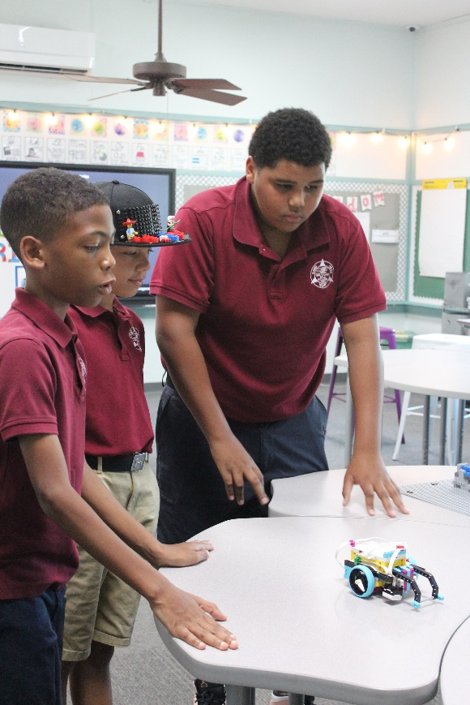
Key Vocabulary
explanation: a statement that makes something clear
robot design: process used to build and code robot
Notes:
Session specific vocab

Slide 4

Introduction
What are some ways your team had fun this season?
Complete the “Event Time” section on page 8 of your Engineering Notebook.
Fun: We enjoy and celebrate what we do!
Notes:
Introduction:
Talk about how your team has had fun while exploring the season theme and share examples of how your team has celebrated your hard work.
Complete the “Event Time” section of the Team Progress sheet on page 8

Slide 5

Tasks
Using the robot design rubric, plan your presentation.​
Write a script to help remember key points.​
​
Make sure to explain how everyone contributed to the robot design.
Notes:
Tasks ​
Look at the robot design rubric to learn about what to include in your five-minute explanation.
Plan your robot design explanation by creating an outline or script.
Make sure to share how each member of the team contributed to the project and robot design.
Continue to develop and practice your project presentation and collect feedback.
Discuss the reflection questions and record your progress.
Session Tips​
Provide the team with the robot design rubric. Have the team reflect on their progress and complete the final section of the Team Progress sheet on page 8 of the Engineering Notebook.
Build team confidence by having them practice communicating their innovation project and robot design solutions.
Every team member should participate in the presentation at the judging session.
If the team needs any accommodations, contact the organizer of the event.
As part of their mission strategy, the team should know who will run the robot during the matches.

Slide 6
Tasks
Continue working on and practicing your innovation project presentation.
Does everyone have a part in the presentation?
Notes:
Tasks ​
Look at the robot design rubric to learn about what to include in your five-minute explanation.
Plan your robot design explanation by creating an outline or script.
Make sure to share how each member of the team contributed to the project and robot design.
Continue to develop and practice your project presentation and collect feedback.
Discuss the reflection questions and record your progress.
Session Tips​
Provide the team with the robot design rubric. Have the team reflect on their progress and complete the final section of the Team Progress sheet on page 8 of the Engineering Notebook.
Build team confidence by having them practice communicating their innovation project and robot design solutions.
Every team member should participate in the presentation at the judging session.
If the team needs any accommodations, contact the organizer of the event.
As part of their mission strategy, the team should know who will run the robot during the matches.

Slide 7
Reflect
Which parts of you robot show how you used the Engineering Design process?
How are everyone’s contributions recognized in the presentation?
How has FIRST ® LEGO ® League made a difference for you?

Slide 8



Share
Practice your project presentation and collect feedback.
Notes:
Share ​
Discuss the reflection questions.
Practice your project presentation and collect feedback.
Clean up your space.
​

Slide 9
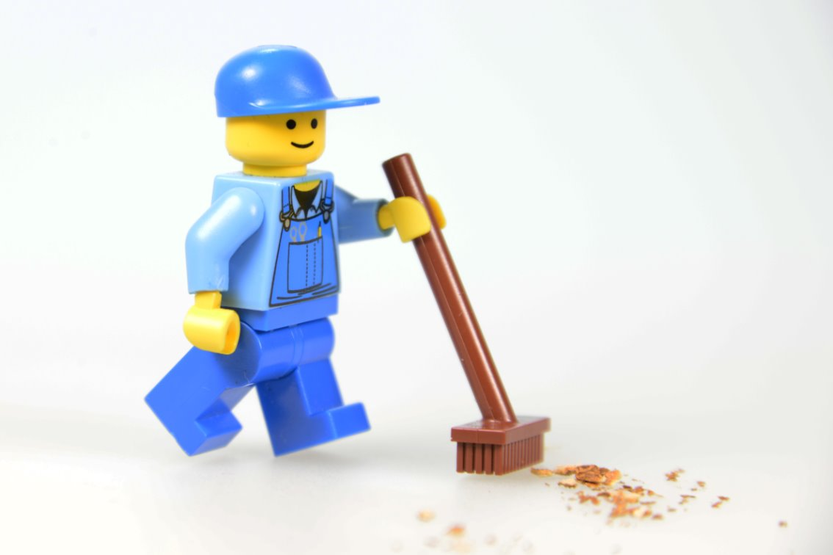
Clean Up

Slide 10


LEGO, the LEGO logo, the Minifigure, LEGO Education, the LEGO Education logo, and the SPIKE logo are trademarks of the/sont des marques de commerce du/son marcas registradas de LEGO Group. ©2026 The LEGO Group. All rights reserved/Tous droits réservés/Todos los derechos reservados. FIRST®, the FIRST® logo, and FIRST® CANOPY™ are trademarks of For Inspiration and Recognition of Science and Technology (FIRST). LEGO® is a registered trademark of the LEGO Group. FIRST® LEGO® League and BIOGLOW™ are jointly held trademarks of FIRST and the LEGO Group. ©2026 FIRST and the LEGO Group. All rights reserved.

