Slide 1


SESSION 12
I can work with my team to practice our presentation for our innovation project and robot solutions.
I can work with my team to run practice robot game matches.
Students will practice their presentations and practice robot game matches to prepare for their event. ​

Slide 2

Discussion
What did we do last session?
Notes:
Discuss with students the progress made on their presentations for robot design and innovation project in the previous session. ​​

Slide 3

Introduction
Look back at your team’s goals on page 8.
Take pride in what you’ve accomplished this season and enjoy the experience of sharing it with others.
Look back at your team’s goals on page 8 of the Engineering Notebook.
Did you achieve them?
Notes:
Introduction:
Look at your team’s goals listed on page 8. Did you achieve them?
Review page 26, Prepare for Your Event, and page 27, Rubrics & Scoresheets.

Slide 4

Tasks
Rehearse your full presentation for your innovation project and robot design.
Get feedback from your coach, a mentor, or another team.
Notes:
Tasks ​
Rehearse your judging presentation by communicating your innovation project and explaining your robot design.
Collect feedback on your presentation from your coach, mentor, or another team.
Practice multiple 2.5-minute robot game matches and calculate the points you score.
Practice your project presentation and your robot design explanation.
Make a list of everything you will need to bring to the event.
Discuss the reflection questions and record your progress.
Session Tips​
Try to split the time in this session equally between practicing the presentation and the robot game matches.
Encourage the team to practice their presentation before the event.
They can practice by sharing their solutions with others.
The judging session flowchart tells you how much time is allowed for the presentation.
Have the team run their 2.5-minute robot matches.
Make sure they practice running their programs in the right order.
The team should have a contingency plan for if things don’t go as planned during the robot game.
They could identify other missions to run. Remind the team about the Core Values and how they will demonstrate them throughout the event, including at every robot game match.

Slide 5
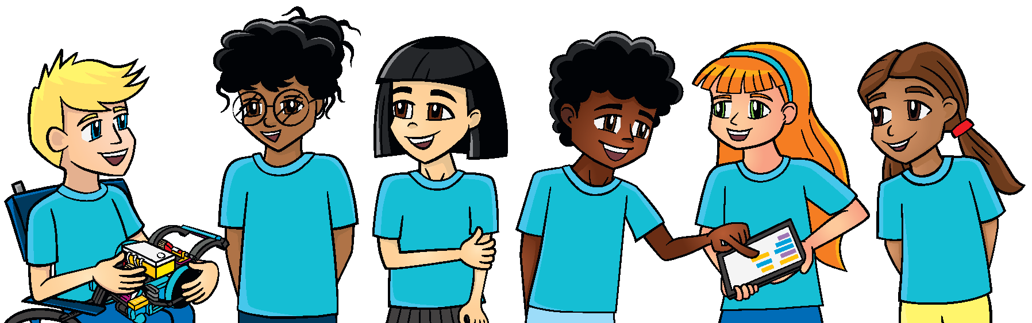
Tasks
Practice multiple 2 minute 30 second robot game matches.
Use the scoresheets on page 27 to calculate the points you score.
Notes:
Tasks ​
Rehearse your judging presentation by communicating your innovation project and explaining your robot design.
Collect feedback on your presentation from your coach, mentor, or another team.
Practice multiple 2.5-minute robot game matches and calculate the points you score.
Practice your project presentation and your robot design explanation.
Make a list of everything you will need to bring to the event.
Discuss the reflection questions and record your progress.
Session Tips​
Try to split the time in this session equally between practicing the presentation and the robot game matches.
Encourage the team to practice their presentation before the event.
They can practice by sharing their solutions with others.
The judging session flowchart tells you how much time is allowed for the presentation.
Have the team run their 2.5-minute robot matches.
Make sure they practice running their programs in the right order.
The team should have a contingency plan for if things don’t go as planned during the robot game.
They could identify other missions to run. Remind the team about the Core Values and how they will demonstrate them throughout the event, including at every robot game match.

Slide 6
Reflect
What is your plan for having your team’s robot attachments ready for the robot game?
What has your team accomplished?

Slide 7
Reflect
What will you do if a mission does not work during a match?
What else does your team need to work on before the event?

Slide 8



Share
Practice presenting your project and robot design presentations.
Notes:
Share ​
Discuss the reflection questions.
Review the judging rubrics and robot game scoresheet.
Practice presenting your project and robot design explanation.
Clean up your space​

Slide 9
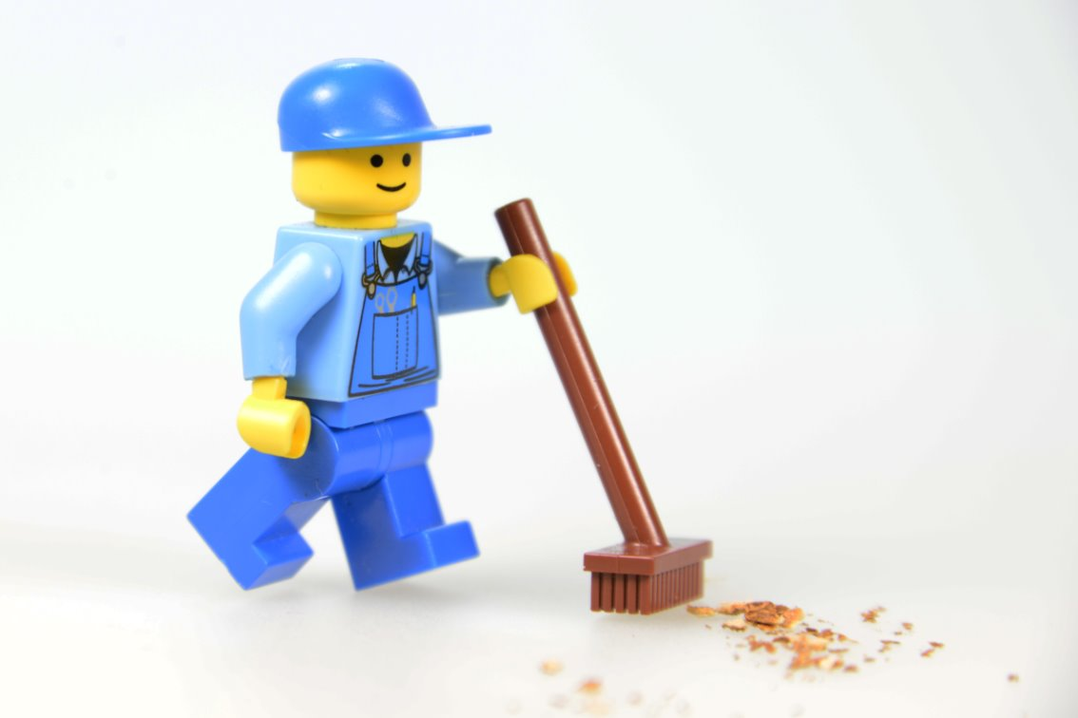
Clean Up

Slide 10

LEGO, the LEGO logo, the Minifigure, LEGO Education, the LEGO Education logo, and the SPIKE logo are trademarks of the/sont des marques de commerce du/son marcas registradas de LEGO Group. ©2026 The LEGO Group. All rights reserved/Tous droits réservés/Todos los derechos reservados. FIRST®, the FIRST® logo, and FIRST® CANOPY™ are trademarks of For Inspiration and Recognition of Science and Technology (FIRST). LEGO® is a registered trademark of the LEGO Group. FIRST® LEGO® League and BIOGLOW™ are jointly held trademarks of FIRST and the LEGO Group. ©2026 FIRST and the LEGO Group. All rights reserved.

