Slide 1


SESSION 4
I can work with my team to determine what kind of research is necessary to learn about the problem.
I can work with my team to code the driving base to detect a line using a sensor.
I can work with my team to think about strategy for the robot game.
Students will begin to do research for their Innovation Project and continue their coding skills using a sensor and developing their game strategy. ​

Slide 2

Discussion
What did we do last session?
Notes:
Discuss with students the coding and building skills they learned last session and ask them what innovation project problem statement they decided on. ​​

Slide 3
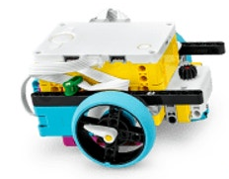
Key Vocabulary
mission strategy: plan for missions to attempt, order to complete them, attachments and programming needed
autonomous: ability to operate independently, without human intervention
match: timed period of 2.5 minutes during which the robot completes as many missions as possible to earn points
Notes:
Session specific vocab

Slide 4

Introduction
Identify what
kind of research is needed to learn about existing solutions to the problem.
What sources can you use to collect information?
Notes:
Introduction:
Work as a team to identify what kind of research is needed to learn about existing solutions.
Determine how your team will use the information collected to create your innovation project solution
Session Tips:
Source examples for research include websites, videos, books, magazines, personal stories, user experiences, and interviews.

Slide 5
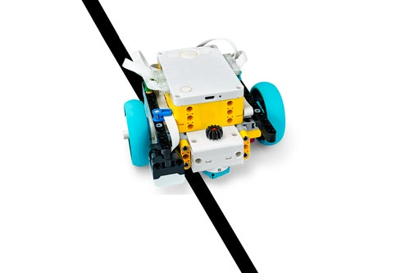

Tasks
In the SPIKETM app, complete the following lesson.
Competition Ready Unit Training Camp 3: Reacting to Lines
Notes:
Tasks ​
Open the SPIKE™ app. Find your lesson.
Competition Ready Unit Training Camp 3: Reacting to Lines
Talk about the skills you learned in this lesson and how they will help you in the robot game.
Try it out! See if you can use the skills you learned to attempt another mission.
Discuss the reflection questions and record your progress.
Session Tips​
Examples of research sources include websites, videos, books, magazines, personal stories, user experiences, and interviews.
Plug in the controller and open the app periodically to check for software and firmware updates.
Have the team follow the program on the screen to see how it matches the robot’s actions.
This will help them debug their programs.
Try to start the robot in the same or a very similar place each time in one of the launch areas.
Teams can use page 30 of the Engineering Notebook to take notes on the missions.
Make copies of this page as needed.

Slide 6
Tasks
Try to code your robot to attempt a different mission.
How does the sensor help with your robot’s success?
Notes:
Tasks ​
Open the SPIKE™ app. Find your lesson.
Competition Ready Unit Training Camp 3: Reacting to Lines
Talk about the skills you learned in this lesson and how they will help you in the robot game.
Try it out! See if you can use the skills you learned to attempt another mission.
Discuss the reflection questions and record your progress.
Session Tips​
Examples of research sources include websites, videos, books, magazines, personal stories, user experiences, and interviews.
Plug in the controller and open the app periodically to check for software and firmware updates.
Have the team follow the program on the screen to see how it matches the robot’s actions.
This will help them debug their programs.
Try to start the robot in the same or a very similar place each time in one of the launch areas.
Teams can use page 30 of the Engineering Notebook to take notes on the missions.
Make copies of this page as needed.

Slide 7
Tasks
Begin to think about your strategy for the robot game.
A mission strategy determines which missions to attempt and the order you will attempt them.
Notes:
Tasks ​
Open the SPIKE™ app. Find your lesson.
Competition Ready Unit Training Camp 3: Reacting to Lines
Talk about the skills you learned in this lesson and how they will help you in the robot game.
Try it out! See if you can use the skills you learned to attempt another mission.
Discuss the reflection questions and record your progress.
Session Tips​
Examples of research sources include websites, videos, books, magazines, personal stories, user experiences, and interviews.
Plug in the controller and open the app periodically to check for software and firmware updates.
Have the team follow the program on the screen to see how it matches the robot’s actions.
This will help them debug their programs.
Try to start the robot in the same or a very similar place each time in one of the launch areas.
Teams can use page 30 of the Engineering Notebook to take notes on the missions.
Make copies of this page as needed.

Slide 8

Reflect
How will your team record your research on your project problem?
How did testing your program help make your robot more accurate?
How could you use the lines on the mat in your mission strategy?

Slide 9



Share
Share the robot skills learned in this session.
Notes:
Share ​
Discuss the reflection questions
Get together at the mat. Share the robot skills you learned in this session.
Clean up your space.
​

Slide 10

Clean Up

Slide 11


LEGO, the LEGO logo, the Minifigure, LEGO Education, the LEGO Education logo, and the SPIKE logo are trademarks of the/sont des marques de commerce du/son marcas registradas de LEGO Group. ©2026 The LEGO Group. All rights reserved/Tous droits réservés/Todos los derechos reservados. FIRST®, the FIRST® logo, and FIRST® CANOPY™ are trademarks of For Inspiration and Recognition of Science and Technology (FIRST). LEGO® is a registered trademark of the LEGO Group. FIRST® LEGO® League and BIOGLOW™ are jointly held trademarks of FIRST and the LEGO Group. ©2026 FIRST and the LEGO Group. All rights reserved.

