Slide 1


SESSION 6
I can work with my team to begin developing the solution to their innovation project problem.
I can work with my team to create a mission strategy plan and write pseudocode for a mission.
Students will develop a solution to their innovation project, develop a mission strategy, and write pseudocode. ​

Slide 2

Discussion
What did we do last session?
Notes:
Discuss with students the guided mission and any others they complete as well as the research and sources they found related to their innovation project in the previous session. ​​

Slide 3

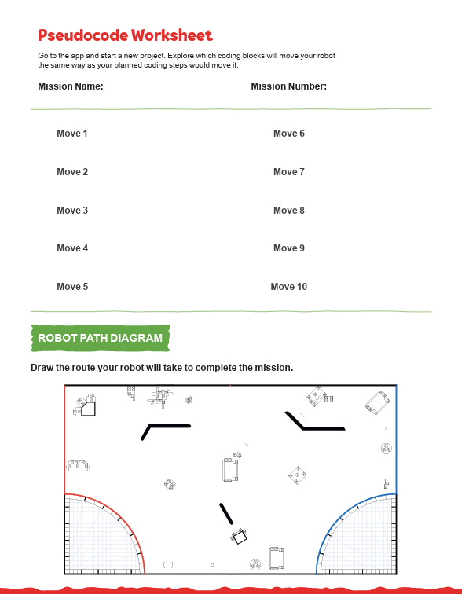
Key Vocabulary
prototype: serves as a model or inspiration for idea or solution
pseudocode: simple representation of a robot’s plan or simple diagrams instead of code
Notes:
Session specific vocab

Slide 4

Introduction
What have you learned so far and what you still want to explore?
Innovation: We use creativity and persistence to solve problems.
Complete the “Halfway There” section on page 8 of your Engineering Notebook.
Notes:
Introduction:
Talk about innovation and share examples of how your team has been creative while solving problems.
Complete the “Halfway There” section of the Team Progress sheet on page 8
Session Tips:
Provide extra paper or a shared digital file for the team to capture the process they use to create their robot and innovation project solutions.

Slide 5
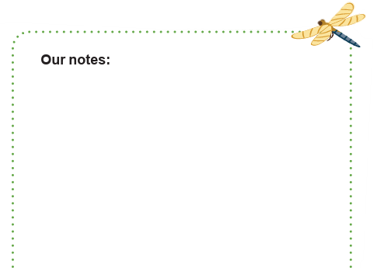
Tasks
How can you develop your solution?
PROCESS
Use the planning sheet on page 29 of your Engineering Notebook.
Determine what materials you might need to create a prototype.
Describe the process you followed to develop your innovative solution.
Notes:
Tasks ​
Plan how you will develop a solution to your problem.
Use the Innovation Project Planning sheet on page 29 to record your steps.
Use a variety of sources and keep track of them in this Engineering Notebook.
Determine what materials may be needed to create a prototype model or drawing of your solution
Session Tips​
Provide extra paper or a shared online file for the team to capture the process used to create their robot and innovation project solutions.
The team will be judged on the robot used in the game, their project solutions, and the Engineering Design Process.
Take some extra time with the team if needed to explore all the solution ideas and narrow it down to one.
The Innovation Project Planning page in the Engineering Notebook should be completed over multiple sessions to help the team document their process.
Let the team be creative when developing their prototype or drawing.
It’s important that they can explain it clearly and share details.

Slide 6

Tasks
Review the Robot Game Missions video and Robot Game Rulebook.
What missions have you completed so far?
Which missions do you still want to try?
Notes:
Tasks ​
Review the “Robot Game Missions” video and Robot Game Rulebook.
Complete the Pseudocode sheet for a selected mission on page 28.
Upload your program ideas to your robot using the SPIKE™ app and test them.
Continue to practice completing missions in the robot game.
Discuss the reflection questions and record your progress.
Session Tips​
The team should pause to reflect on the last few sessions. Ask the team what they feel most proud of so far. What are they excited about?
Provide sticky notes and planning cards for the team to place on the mat to map out their mission strategy.
Encourage the team to find the missions where points can be scored most easily and to do them first.
Allow the team to think about the reflection questions or write their answers before sharing. This leads to a deeper understanding of their strategy.
Tell the team that trial and error is part of the process and will ultimately lead to more success. The judges at the event will want to hear what they learned along the way.

Slide 7

Tasks
Complete the Pseudocode sheet on page 28 of your Engineering Notebook.
Put your program ideas in the SPIKETM app, test if they work with your robot on the mat.
Notes:
Tasks ​
Review the “Robot Game Missions” video and Robot Game Rulebook.
Complete the Pseudocode sheet for a selected mission on page 28.
Upload your program ideas to your robot using the SPIKE™ app and test them.
Continue to practice completing missions in the robot game.
Discuss the reflection questions and record your progress.
Session Tips​
The team should pause to reflect on the last few sessions. Ask the team what they feel most proud of so far. What are they excited about?
Provide sticky notes and planning cards for the team to place on the mat to map out their mission strategy.
Encourage the team to find the missions where points can be scored most easily and to do them first.
Allow the team to think about the reflection questions or write their answers before sharing. This leads to a deeper understanding of their strategy.
Tell the team that trial and error is part of the process and will ultimately lead to more success. The judges at the event will want to hear what they learned along the way.

Slide 8

Reflect
What is the next step in developing your innovation project solution?
How will documenting your progress on the innovation project help your team’s judging session at the event?

Slide 9
Reflect
How can your robot’s attachments and program support your team’s mission strategy?
How can you iterate and improve your robot design used in previous tasks?

Slide 10



Share
Share the robot skills learned in this session.
Notes:
Share ​
Discuss the reflection questions
Get together at the mat. Share the robot skills you learned in this session.
Clean up your space.
​

Slide 11

Clean Up

Slide 12


LEGO, the LEGO logo, the Minifigure, LEGO Education, the LEGO Education logo, and the SPIKE logo are trademarks of the/sont des marques de commerce du/son marcas registradas de LEGO Group. ©2026 The LEGO Group. All rights reserved/Tous droits réservés/Todos los derechos reservados. FIRST®, the FIRST® logo, and FIRST® CANOPY™ are trademarks of For Inspiration and Recognition of Science and Technology (FIRST). LEGO® is a registered trademark of the LEGO Group. FIRST® LEGO® League and BIOGLOW™ are jointly held trademarks of FIRST and the LEGO Group. ©2026 FIRST and the LEGO Group. All rights reserved.

