Slide 1


SESSION 8
I can work with my team to evaluate and improve on their innovation project solution.
I can work with my team to design robot attachments and create programs to solve missions.
Students will continue to develop their innovation project solution based on feedback from others and continue solving missions in the robot game. ​

Slide 2

Discussion
What did we do last session?
Notes:
Discuss with students their progress on their innovation project solution and their robot game missions in the previous session. ​​

Slide 3
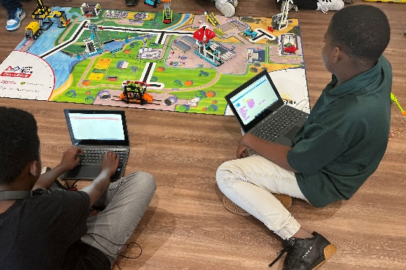
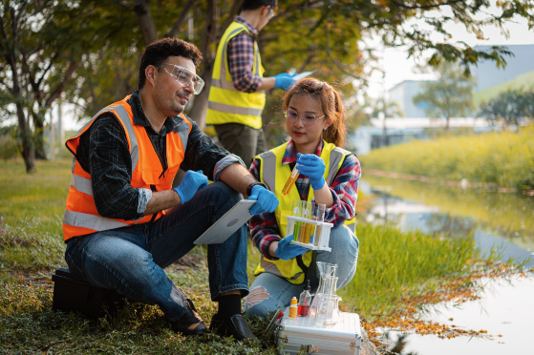
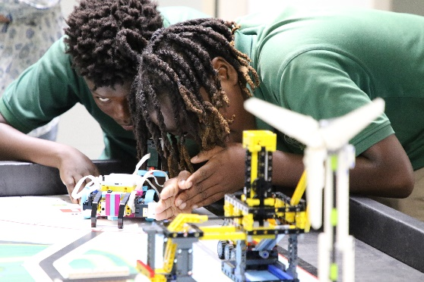
Key Vocabulary
evaluate: to decide the value or worth of after study
expert: a person with special skill in or knowledge of a subject
test: take measures to check the quality, performance, or reliability of something
Notes:
Session specific vocab

Slide 4

Introduction
How does your team demonstrate inclusion?
Share how your team makes sure everyone is respected and has their voices heard.
Inclusion: We respect each other and embrace our differences.
Notes:
Introduction:
Talk about inclusion and share examples of how your team makes sure everyone is respected and their voices are heard.
Session Tips:
The team can create a survey to evaluate their solution or ask for feedback from someone affected by the problem.

Slide 5

Tasks
Share your innovation project solution with others.
Collect their feedback and use it to iterate on your solution.
Can you test your solution to see if it works?
Notes:
Tasks ​
Share and collect feedback on your ideas. Use page 29 to record the feedback.
Decide what feedback to use to iterate on your solution.
Determine if you can do any testing of your solution
Session Tips​
The team can create a survey to evaluate their solution or ask for feedback from someone affected by the problem.
The team should iterate and improve their innovation project solution following feedback from others.
Consider joining a webinar or watching interviews to learn from experts.
The team should reference the project rubric so they can be prepared for judging at the event.
The team should think about who their innovative project solution is for.

Slide 6
Tasks
Complete another robot game mission.
How would that mission fit into your strategy?
Iterate your program until it completes the mission reliably.
Document your design and testing process for each mission.
Notes:
Tasks ​
Choose another robot game mission to work on.
Think about how each new mission fits into your mission strategy.
Iterate and refine your program so your robot completes the mission reliably.
Document your design and testing process for each mission.
Discuss the reflection questions and record your progress.
Session Tips​
The team should think about strategy when choosing missions to solve.
Multiple missions can be completed on the same run to save time.
Encourage the team to discuss how their program works. Break the program into blocks that control one movement.
Remind teams that simple, repeatable designs often outperform complicated ones.
Encourage them to test missions multiple times and change attachments or code until the robot is consistent.
The robot’s starting point in the launch area strongly influences where it ends up. Have the team keep good notes about where to place the robot.
The Pseudocode sheet in the Engineering Notebook can be used for this purpose.
Encourage the team to reference the robot design rubric and explain how building and coding techniques helped solve missions.
This will help build their confidence before the judging session.

Slide 7
Reflect
What changes will you make to your project solution after getting feedback?
How does your team decide which missions to attempt?

Slide 8
Reflect
How has your team used Core Values to develop your robot and project solution?
In what order will you run the missions in the robot game?

Slide 9



Share
Share the robot skills practiced, and work completed on the innovation project.
Notes:
Share ​
Discuss the reflection questions.
Get together at the mat. Share the robot skills you practiced in this session and the work completed on the innovation project.
Clean up your space.
​

Slide 10

Clean Up

Slide 11


LEGO, the LEGO logo, the Minifigure, LEGO Education, the LEGO Education logo, and the SPIKE logo are trademarks of the/sont des marques de commerce du/son marcas registradas de LEGO Group. ©2026 The LEGO Group. All rights reserved/Tous droits réservés/Todos los derechos reservados. FIRST®, the FIRST® logo, and FIRST® CANOPY™ are trademarks of For Inspiration and Recognition of Science and Technology (FIRST). LEGO® is a registered trademark of the LEGO Group. FIRST® LEGO® League and BIOGLOW™ are jointly held trademarks of FIRST and the LEGO Group. ©2026 FIRST and the LEGO Group. All rights reserved.

