Slide 1


SESSION 9
Students will continue running their robot on the mat and improving their code while also iterating on their innovation project solution. ​
I can work with my team to code our robot and test our mission strategy.
I can work with my team to iterate and improve our innovation project solution based on testing and feedback.

Slide 2

Discussion
What did we do last session?
Notes:
Discuss with students the progress made on their innovation project solution and missions in the previous session. ​​

Slide 3
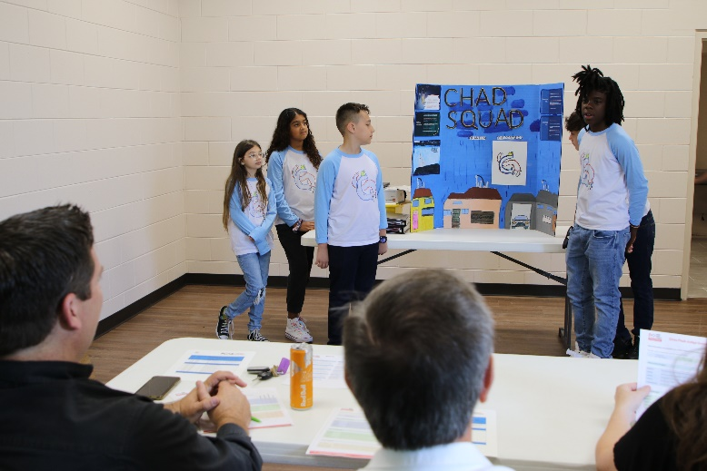
Key Vocabulary
judge: a person appointed to decide in an event
field: playing area defined by walls, including the mat, mission models, and home areas
Notes:
Session specific vocab

Slide 4

Introduction
How has your team had a positive influence on you and others?
Write these on page 22 of your Engineering Notebook.
Impact: We apply what we learn to improve our world.
Notes:
Introduction:
Think about impact and share examples of how your team has had a positive influence on you and others.
Session Tips:
Examples recorded here could be used for the innovation project presentation or robot design explanation.

Slide 5
Tasks
Does your mission strategy cover all the missions you wanted to try?
Try to add in one more mission if you can fit it in the 2 minute and 30 seconds of match time.
Continue iterating an improving your robot design and document your changes.
Notes:
Tasks ​
Think about your robot mission strategy on the mat and the missions you will solve.
Continue to practice missions.
Iterate and improve your robot and innovation project solutions.
Discuss the reflection questions and record your progress.
Session Tips​
Examples recorded here could be used for the innovation project presentation or robot design explanation.
The team should develop a clear strategy for which programs to run and the order in which to run them during the robot game.
The team should also have a backup of their programs on an external drive like a USB stick or online storage.
The reflection questions should be discussed together so the team is able to authentically describe their journey to the judges.
Core Values are evaluated throughout the judging session while teams present on their innovation project and robot design.
Review the rubrics to learn which criteria count toward the team’s Core Values score.

Slide 6

Reflect
How will your team demonstrate Core Values at the event?
How will your team explain what is innovative about your solution to the judges?

Slide 7
Reflect
What changes have you made to your innovation project and robot design based on feedback and testing?

Slide 8



Share
Share the robot skills practiced, and project on your solution in this session.
Notes:
Share ​
Discuss the reflection questions.
Get together at the mat. Share the robot skills you practiced in this session and the work completed on the innovation project.
Clean up your space​

Slide 9

Clean Up

Slide 10


LEGO, the LEGO logo, the Minifigure, LEGO Education, the LEGO Education logo, and the SPIKE logo are trademarks of the/sont des marques de commerce du/son marcas registradas de LEGO Group. ©2026 The LEGO Group. All rights reserved/Tous droits réservés/Todos los derechos reservados. FIRST®, the FIRST® logo, and FIRST® CANOPY™ are trademarks of For Inspiration and Recognition of Science and Technology (FIRST). LEGO® is a registered trademark of the LEGO Group. FIRST® LEGO® League and BIOGLOW™ are jointly held trademarks of FIRST and the LEGO Group. ©2026 FIRST and the LEGO Group. All rights reserved.

