Slide 1
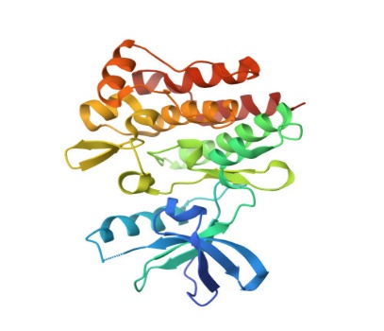

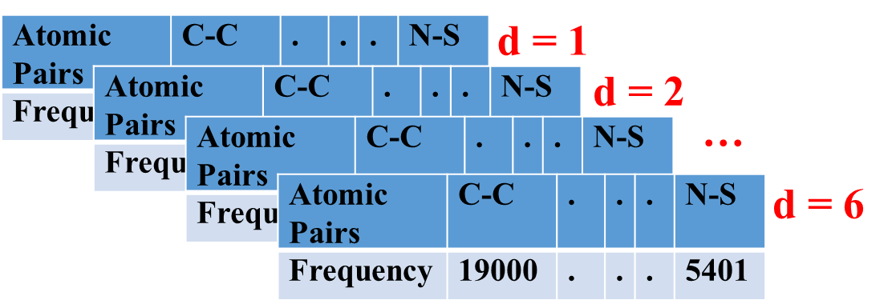
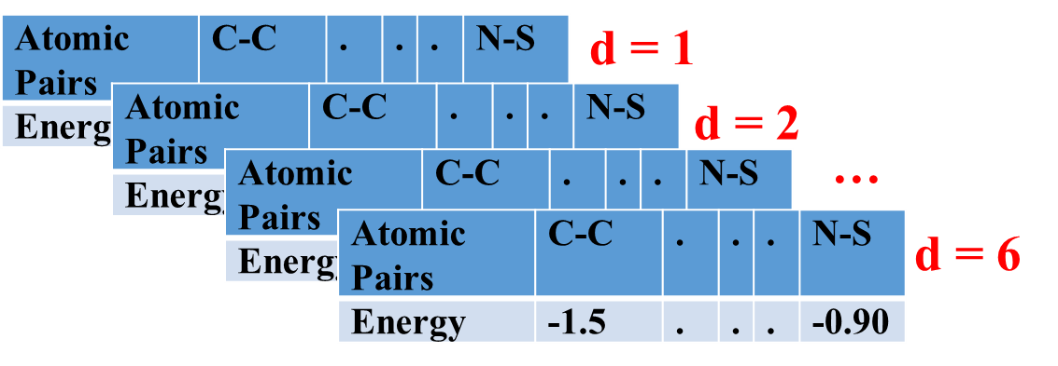
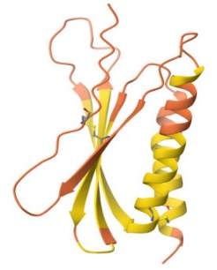
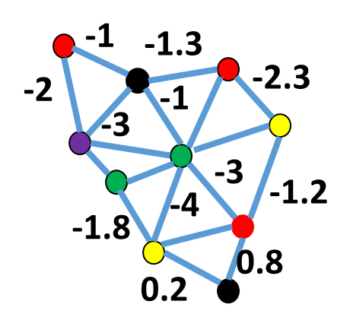

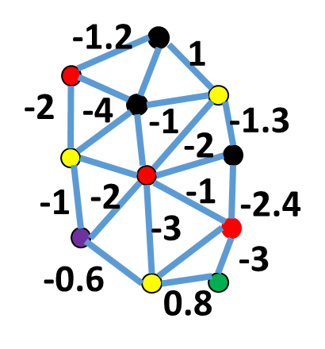


A
3D protein
structure
Data set
B
Amino Acid |  |  | . | .
Energy | -11 | -54 | . | . | -75
Estimate
the Predictor Matrix: P
3D protein
structure
Data set
Amino Acid |  |  | . | .
Energy | -23 | -65 | . | . | -64
C
D

