Slide 1
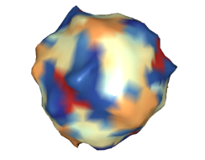
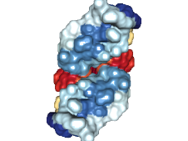

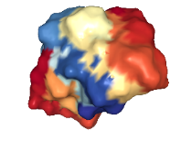
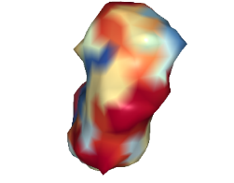
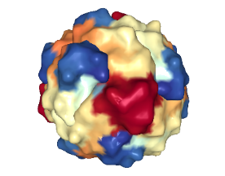
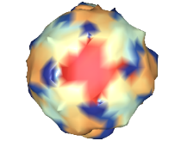
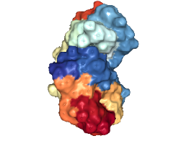
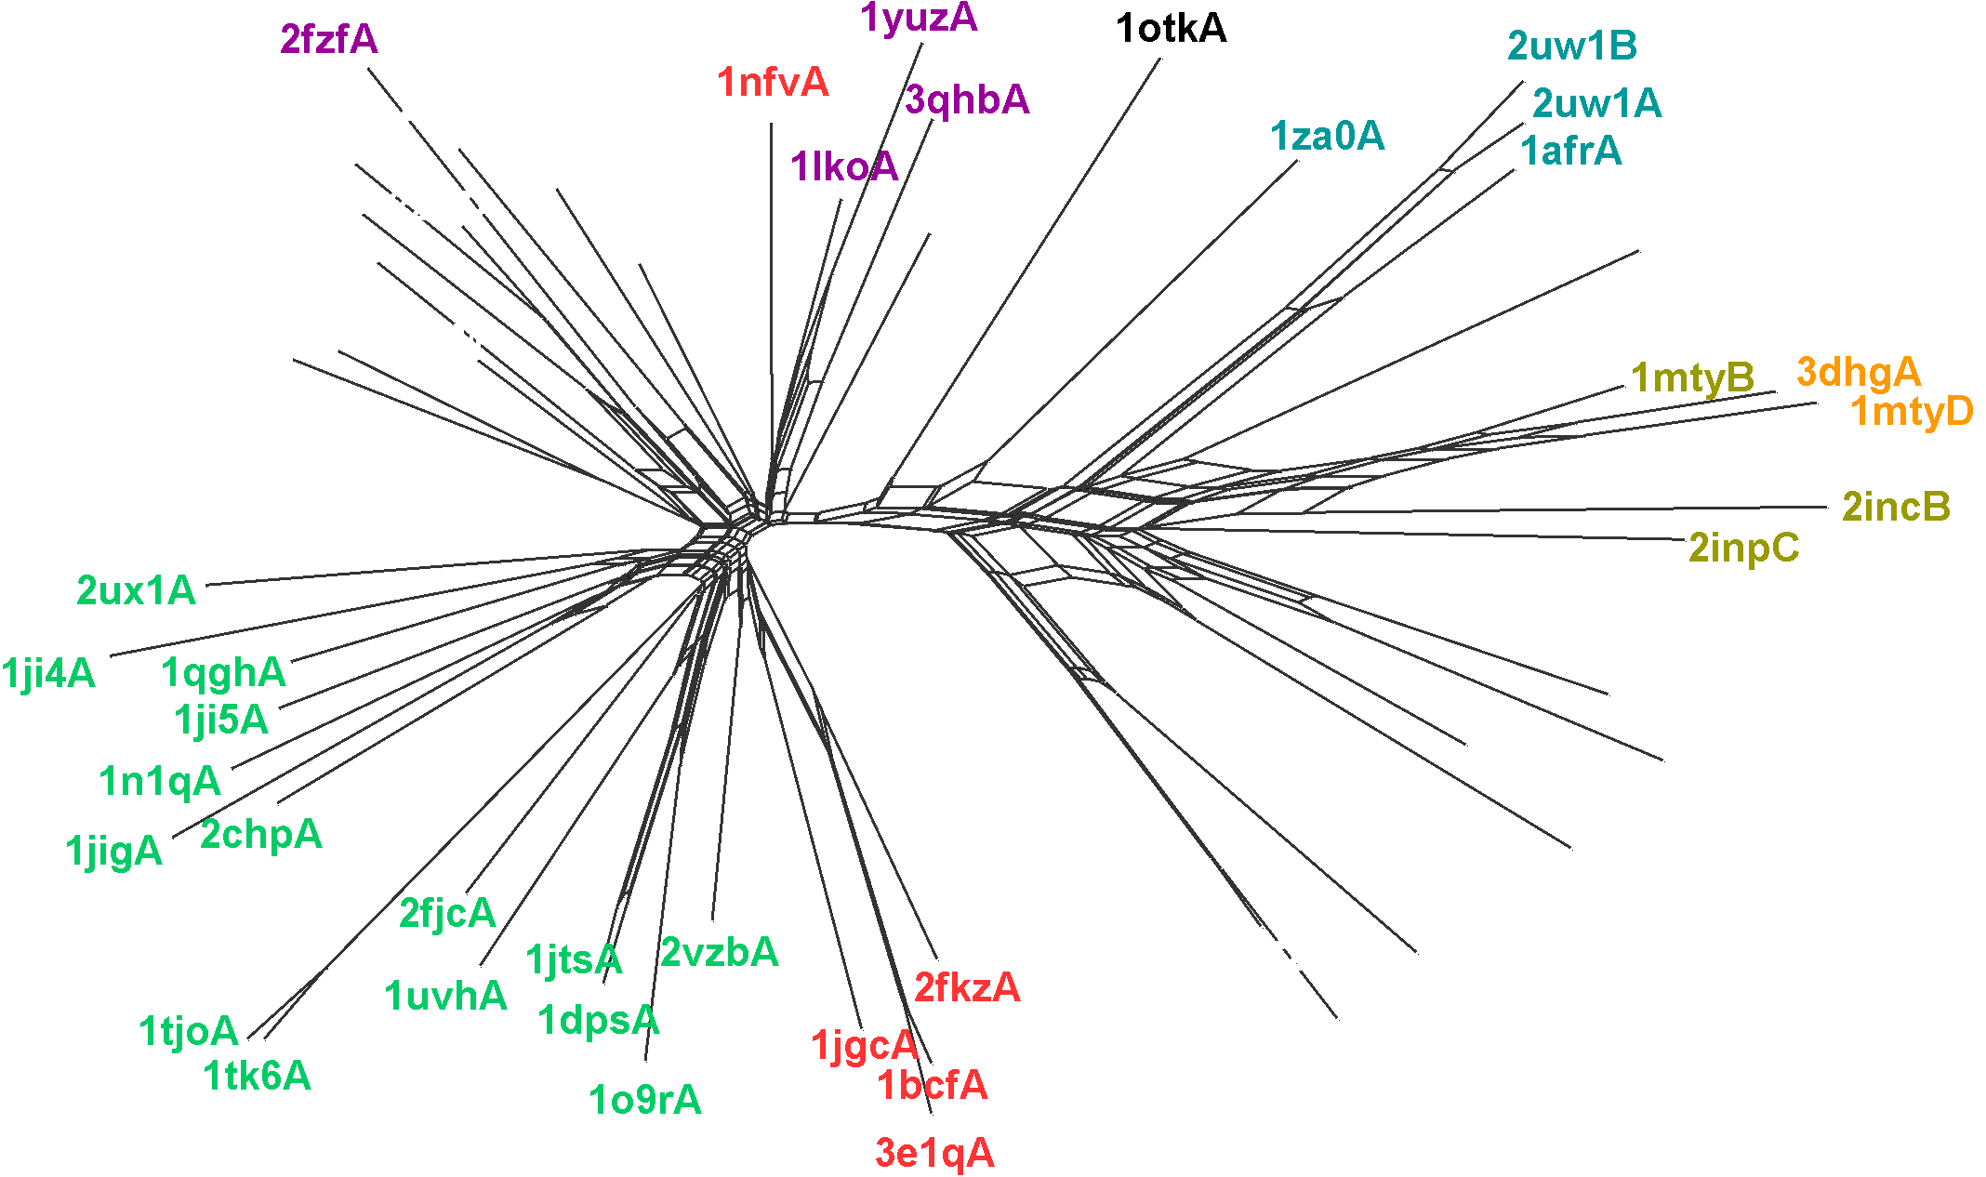
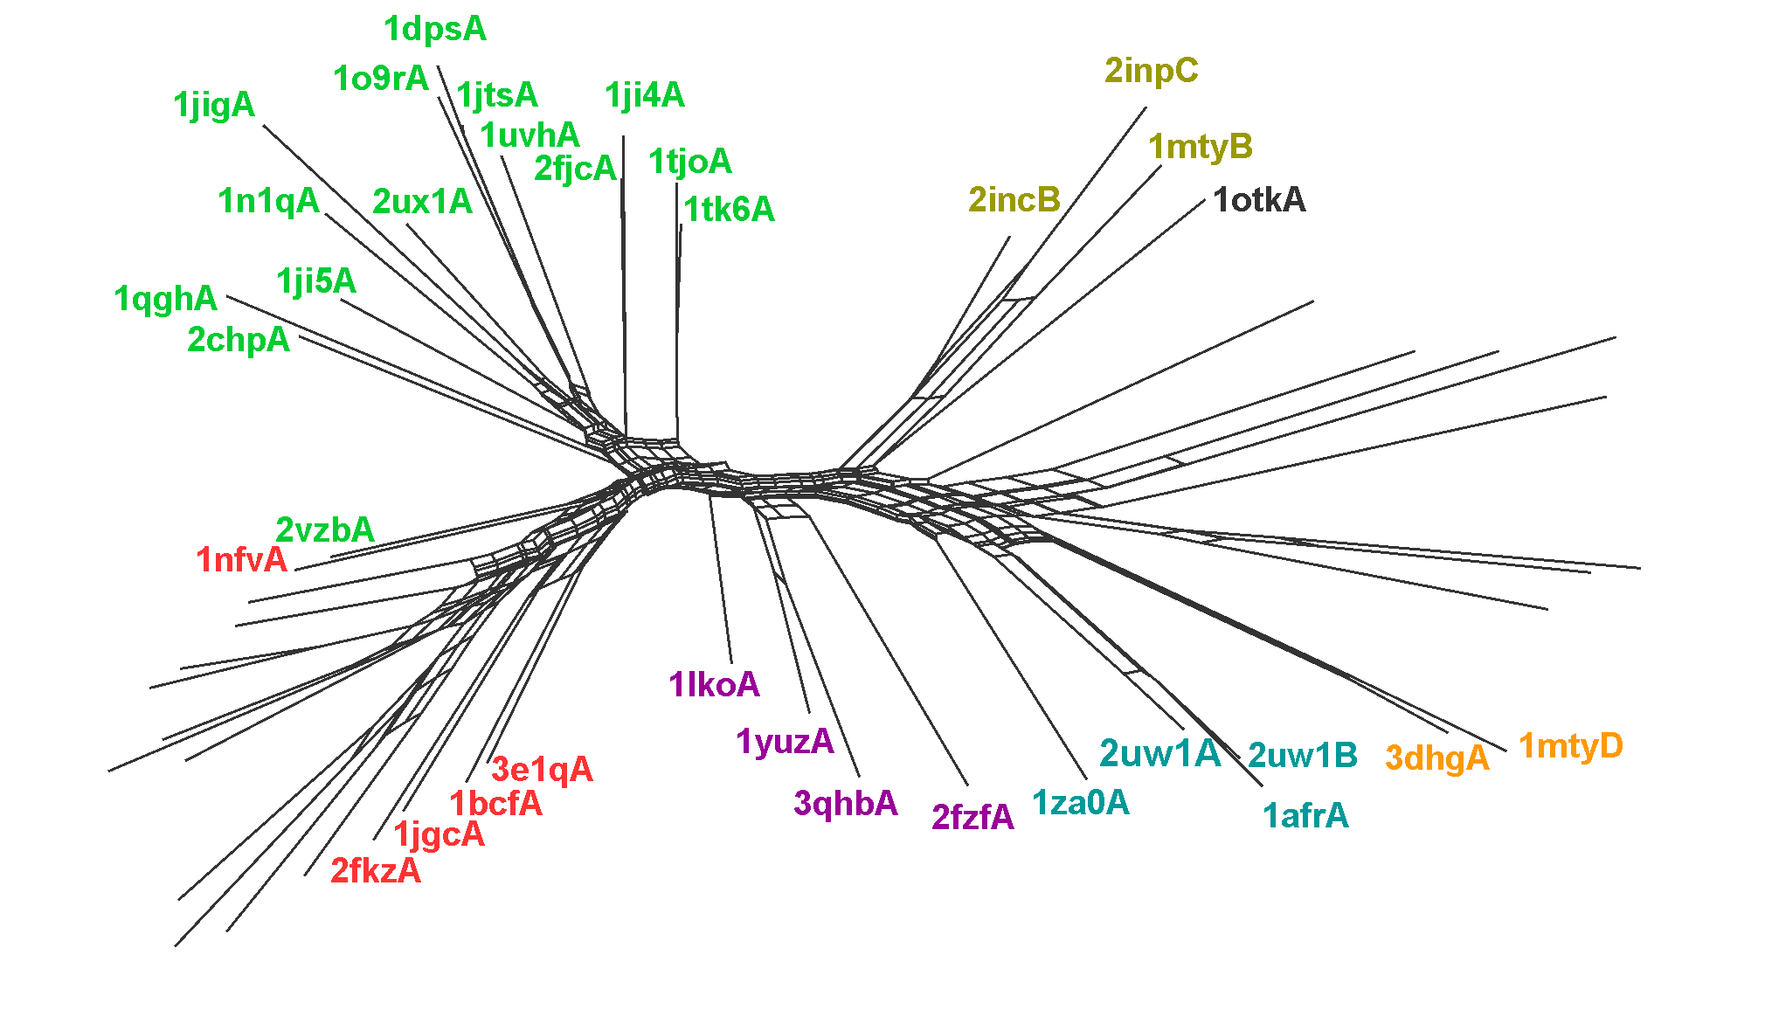
A
Manual Annotation
Subgroup | Pfam
Bacterioferirtin | 00210 Ferritin
Dps
Ferritin
BMM alpha | 02332 Phenol_hydrox
BMM beta
Fatty acid desaturase | 03405 FA_desaturase
RNR R2 | 00268 Ribonuc_red_sm
Rubrerythrins | 02915 Rubrerythrins
1tokA | 05138 PaaA_PaaC
Rubrerythrins
(1lko)
Ferritins
(1z6o)
Fatty acid desaturases
(2uw1)
alpha
BMM
(1mty)
beta
Dps
(2vzb)
Bacterioferritins
(1bcf)
RNR R2
(1w68)
B
SPE
D
Scope family | Manual | SPE | TM
a.25.1.1 | 1 | 1 | 1
 | 2 | 2 | 4
 | 3 | 3 | 3
 | 4 | 4 | 2
a.25.1.2 | 1 | 2 | 4
 | 2 | 1 | 2
 | 3 | 4 | 1
 | 4 | 3 | 3
SCOP: a.25.1.1 Ferritins
SCOP: a.25.1.2 Ribonucleotide reductase-like
C
TM-Vec

Slide 2
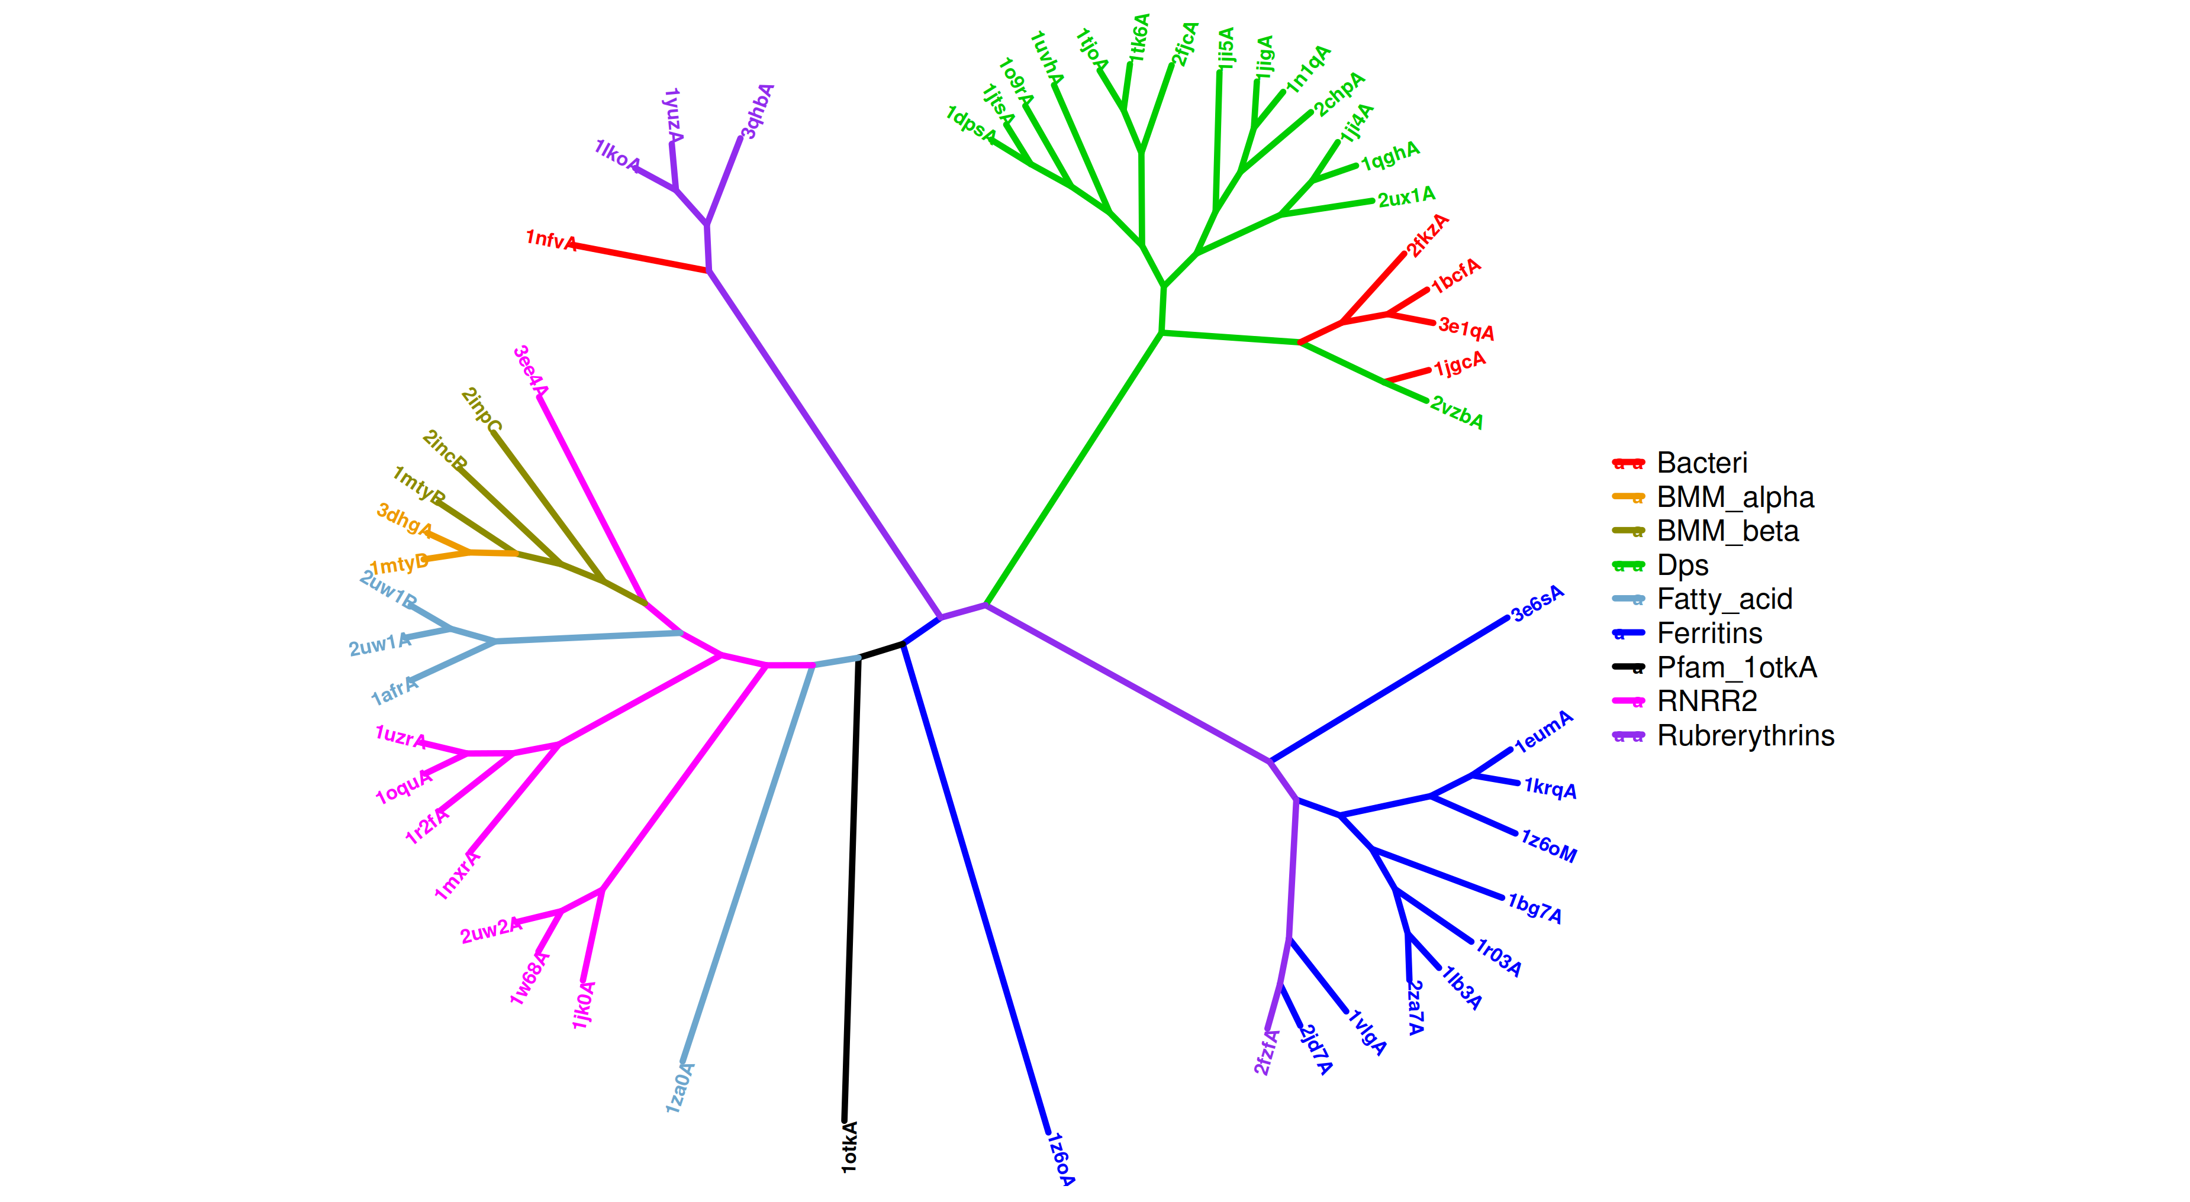
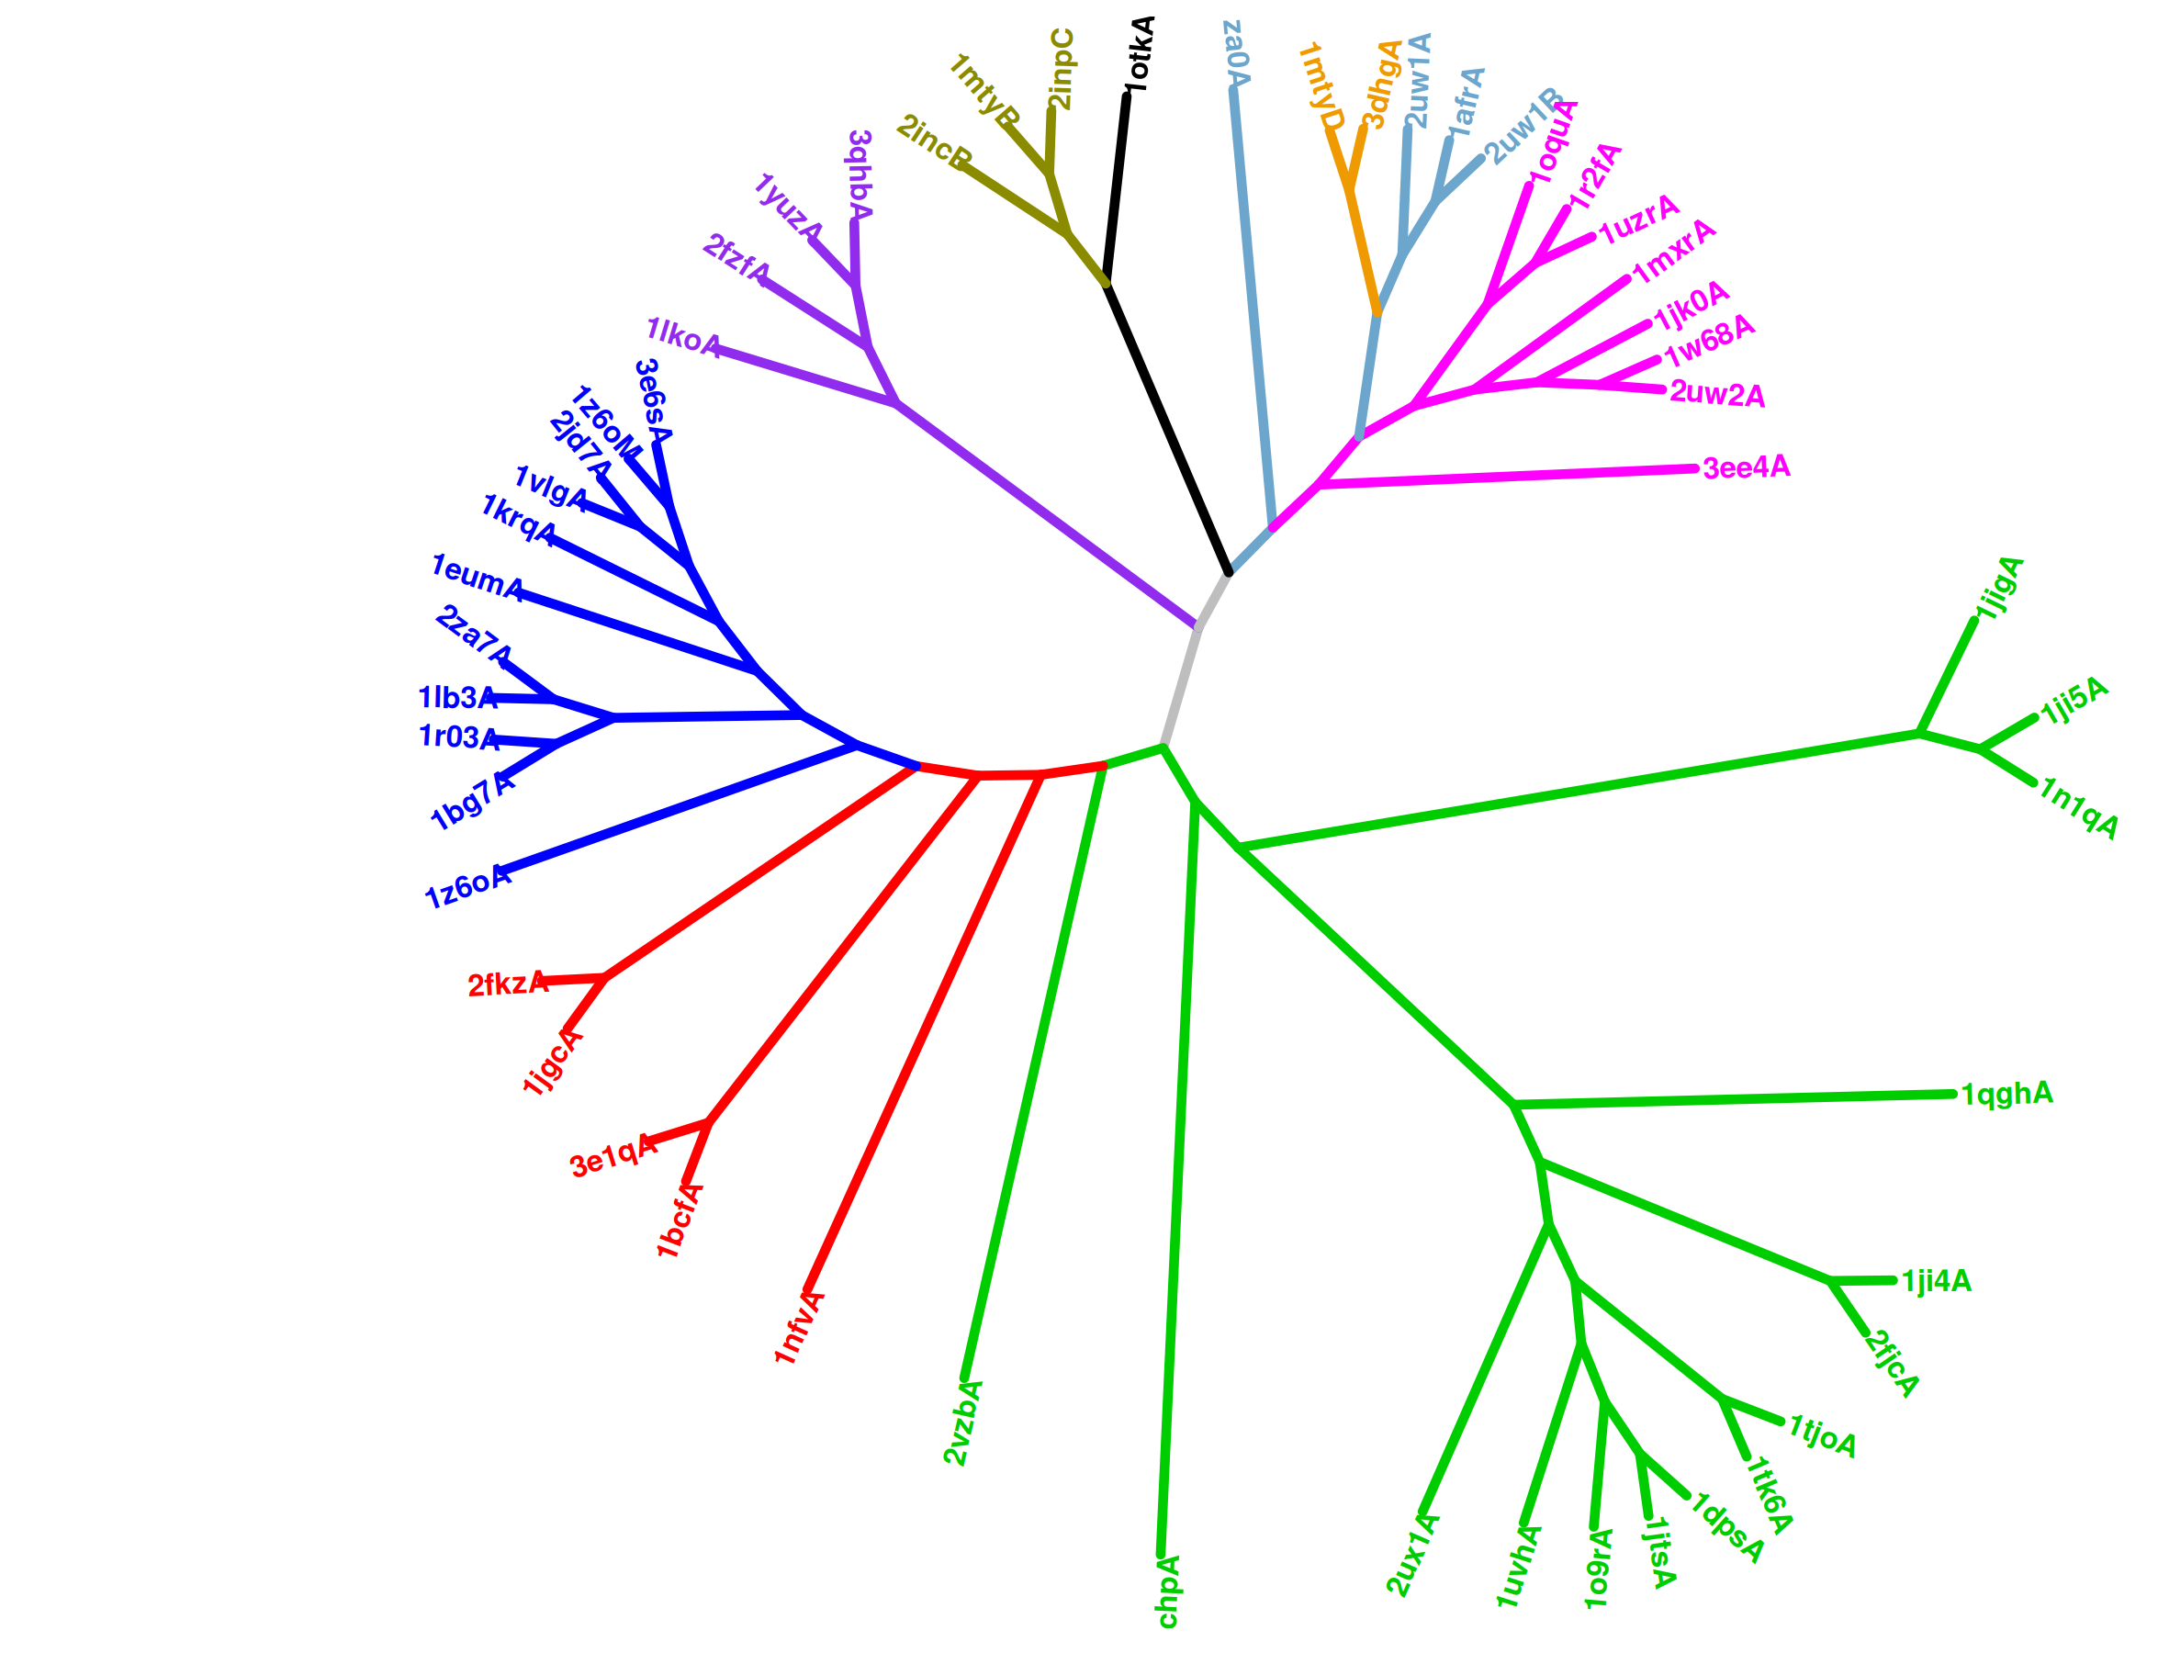
SPE
TM

Slide 3
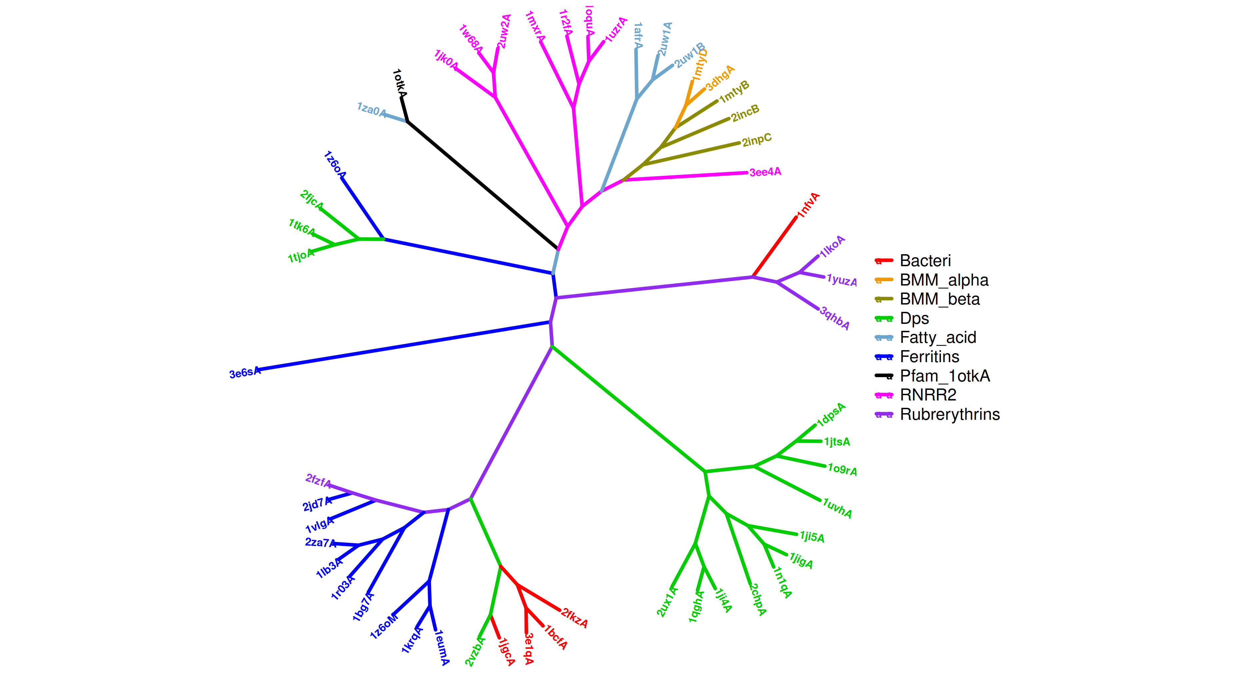
CPE

