Slide 1
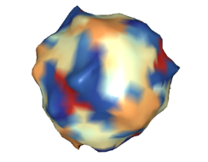
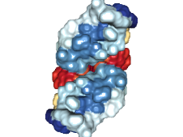

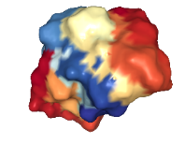
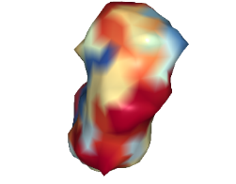
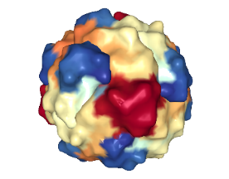
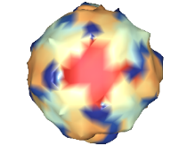
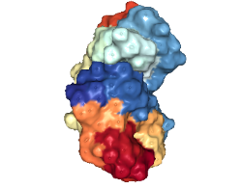
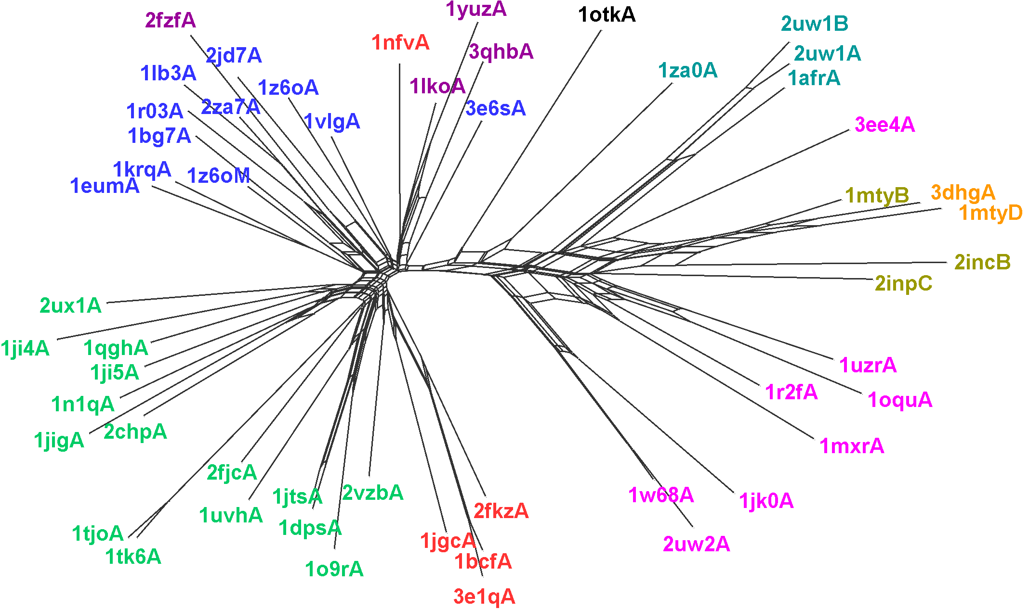

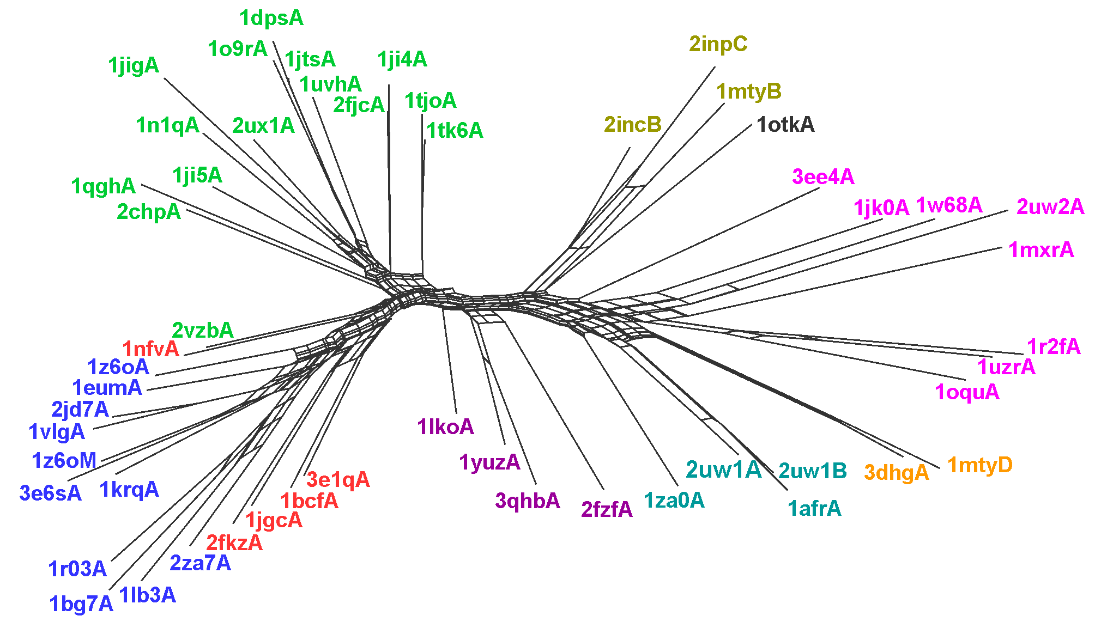
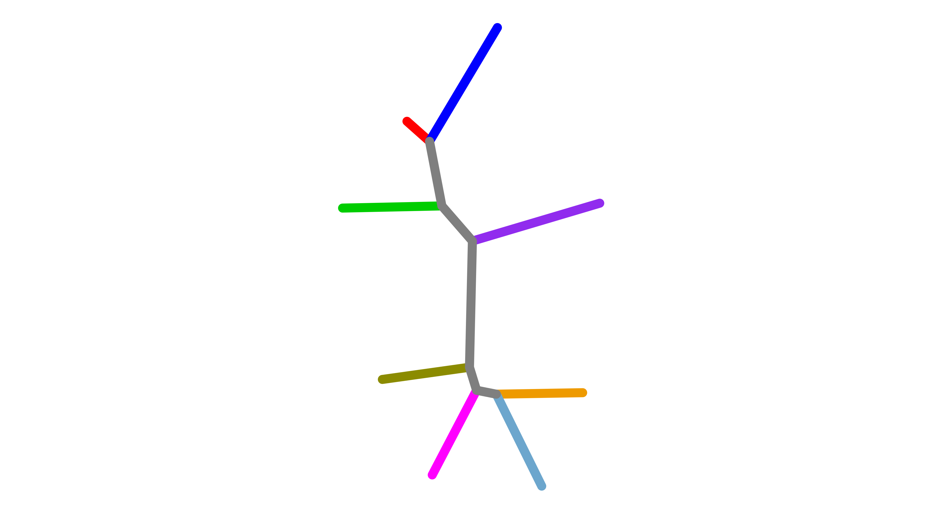
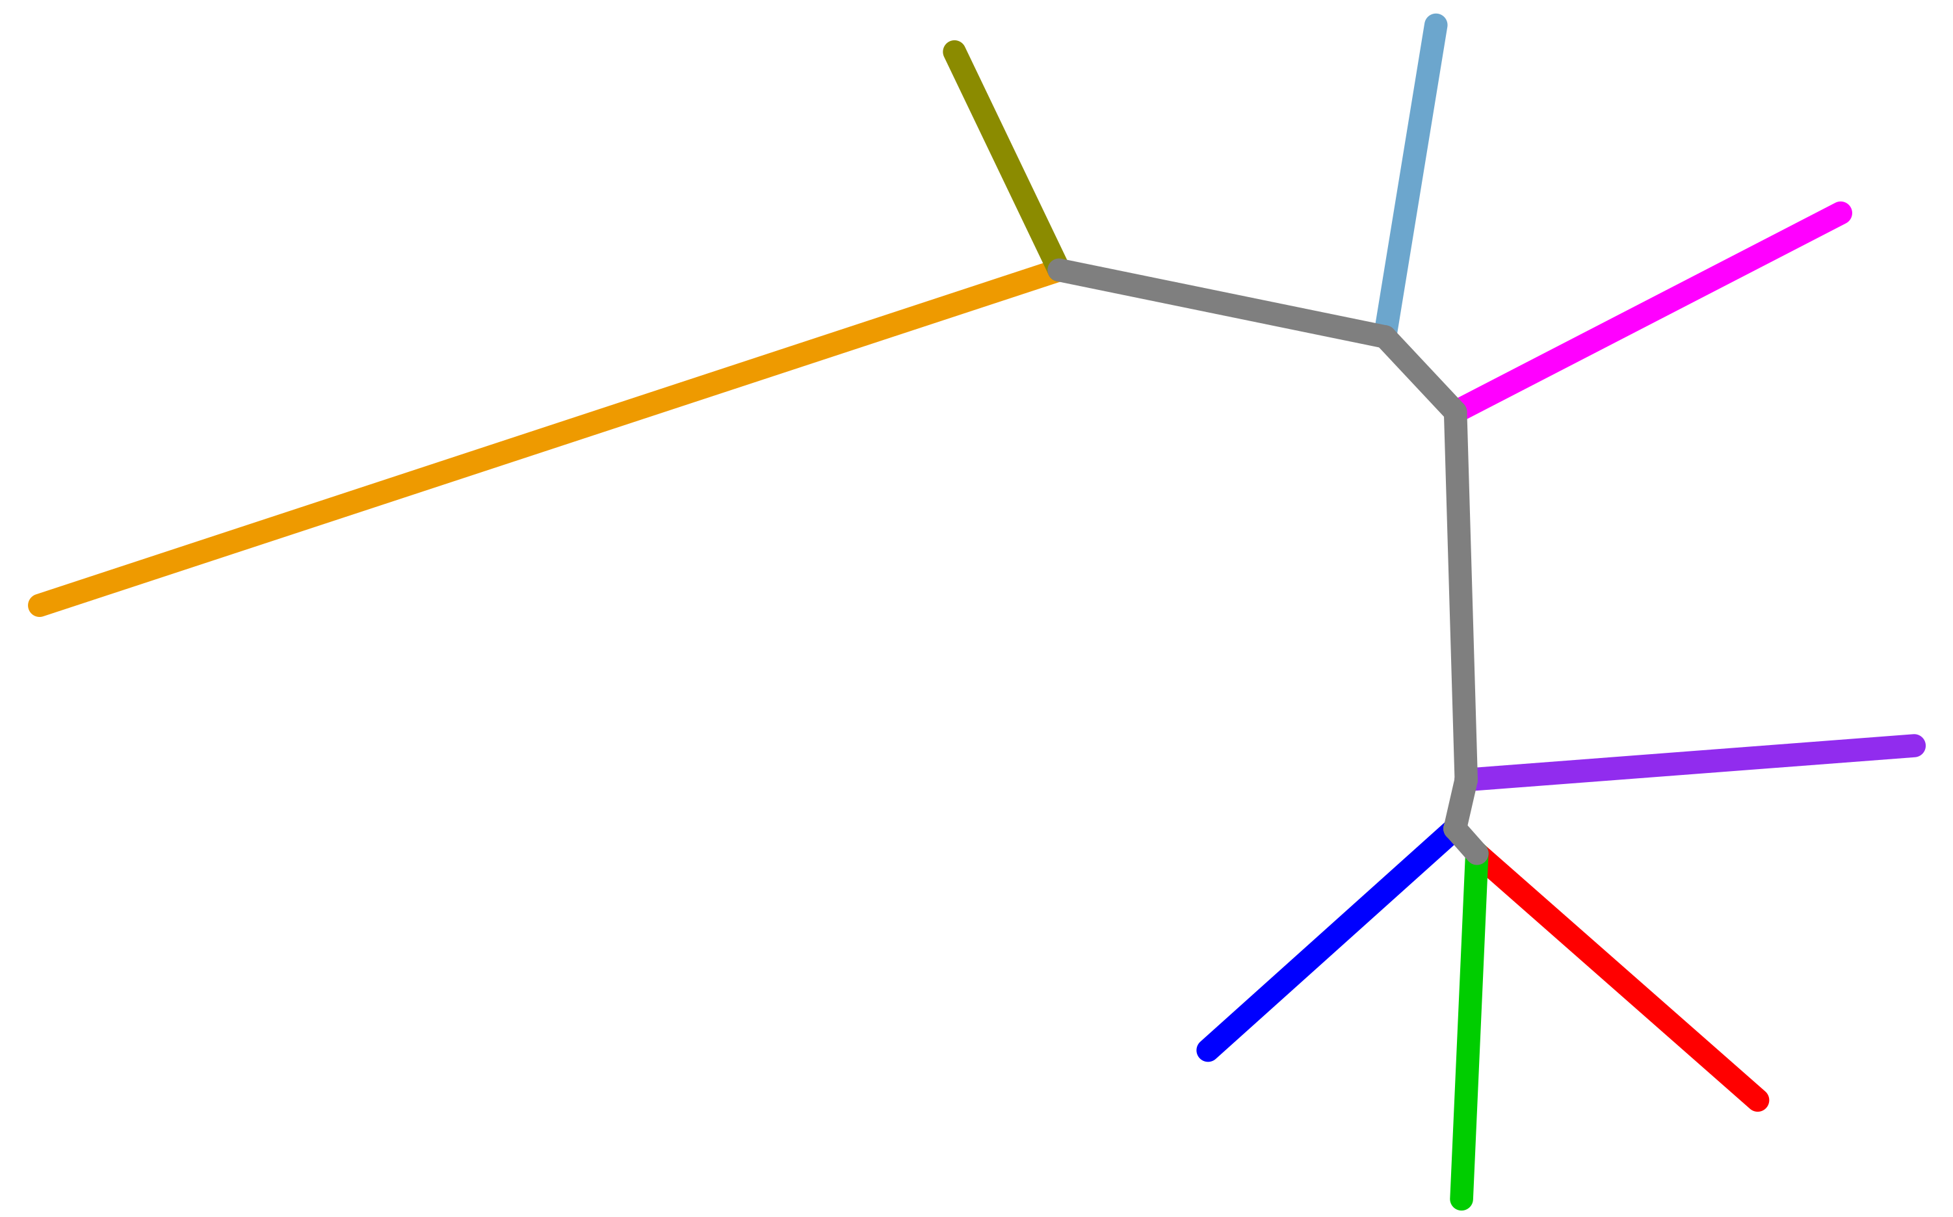
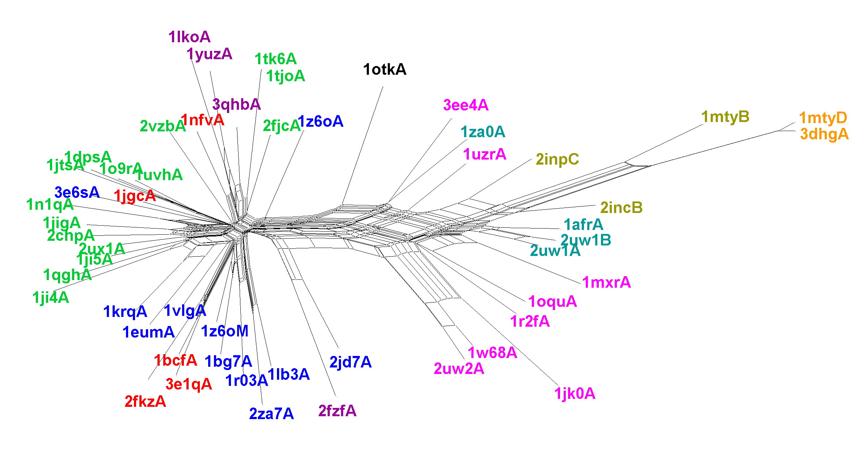
A
Manual Annotation
Subgroup | Scop ID
Rubrerythrins | a.25.1.1 Ferritins
Ferritin
Bacterioferirtin
Dps
Fatty acid desaturase | a.25.1.2 Ribo nucleotide reductase-like
RNR R2
BMM alpha
BMM beta
Ferritins
(1z6o)
Rubrerythrins
(1lko)
Fatty acid desaturases
(2uw1)
alpha
BMM
(1mty)
beta
a.25.1.1 |  |  |  |  | a.25.1.2
Dps
(2vzb)
Bacterioferritins
(1bcf)
RNR R2
(1w68)
B
SPE
C
SPE
a.25.1.1 |  |  |  |  | a.25.1.2
D
TM-Vec
E
TM-Vec
a.25.1.1 |  |  |  |  | a.25.1.2
F
CPE
CPE
G
a.25.1.1 |  |  |  |  | a.25.1.2

