Slide 1
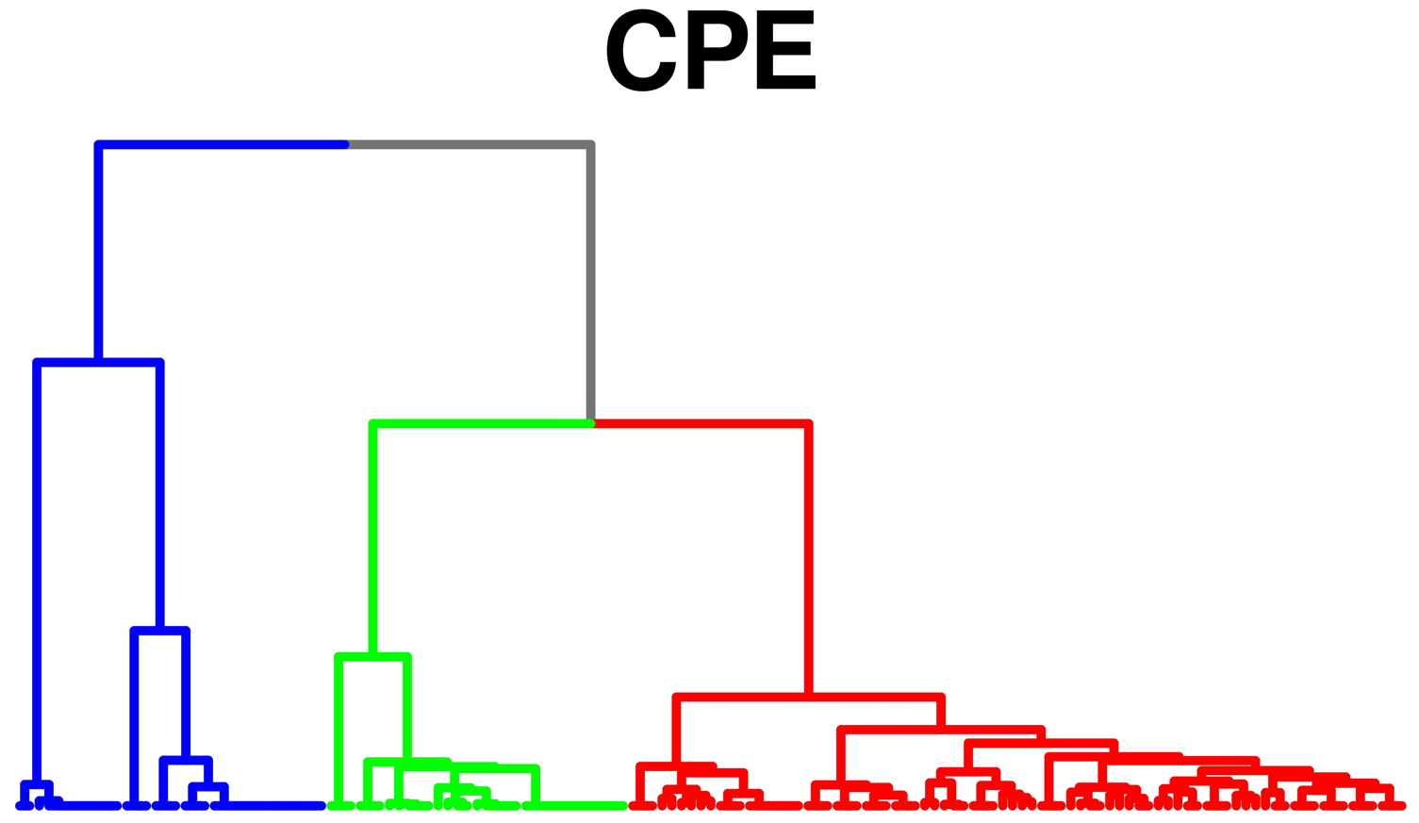
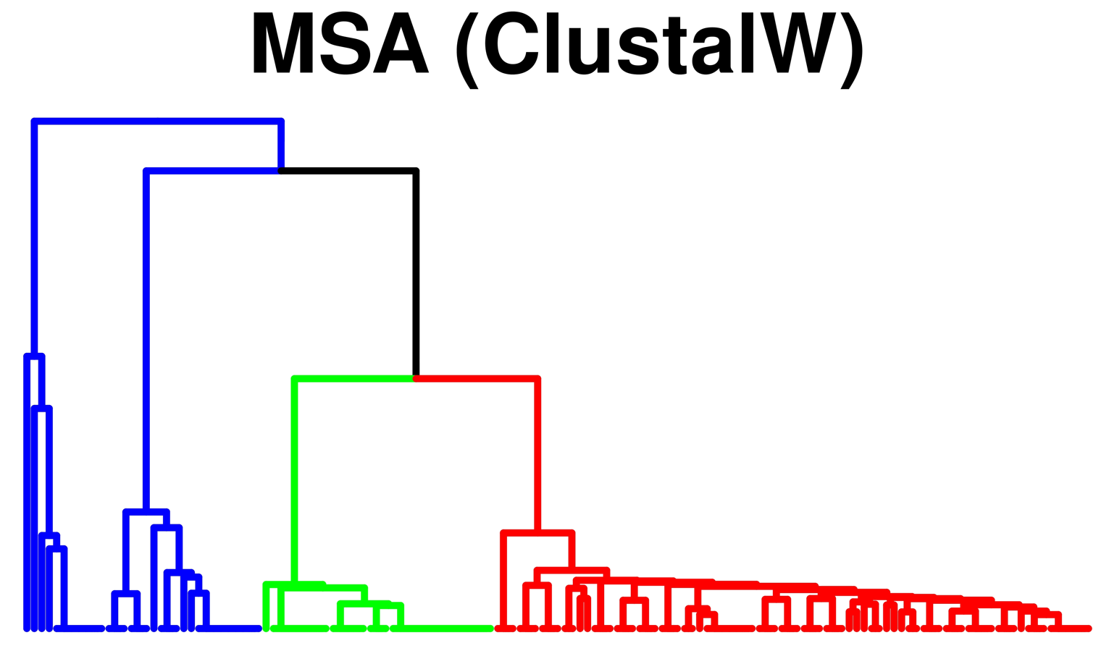
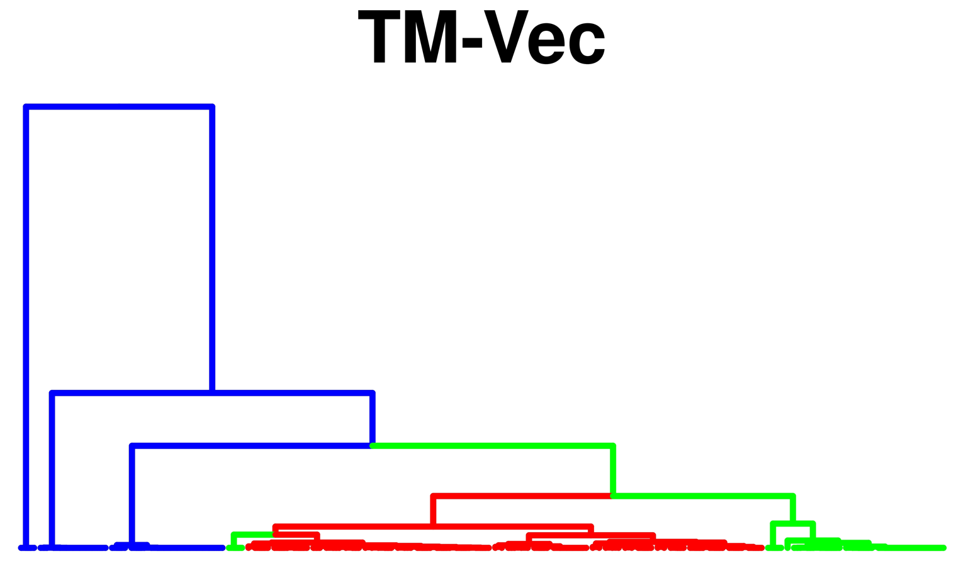

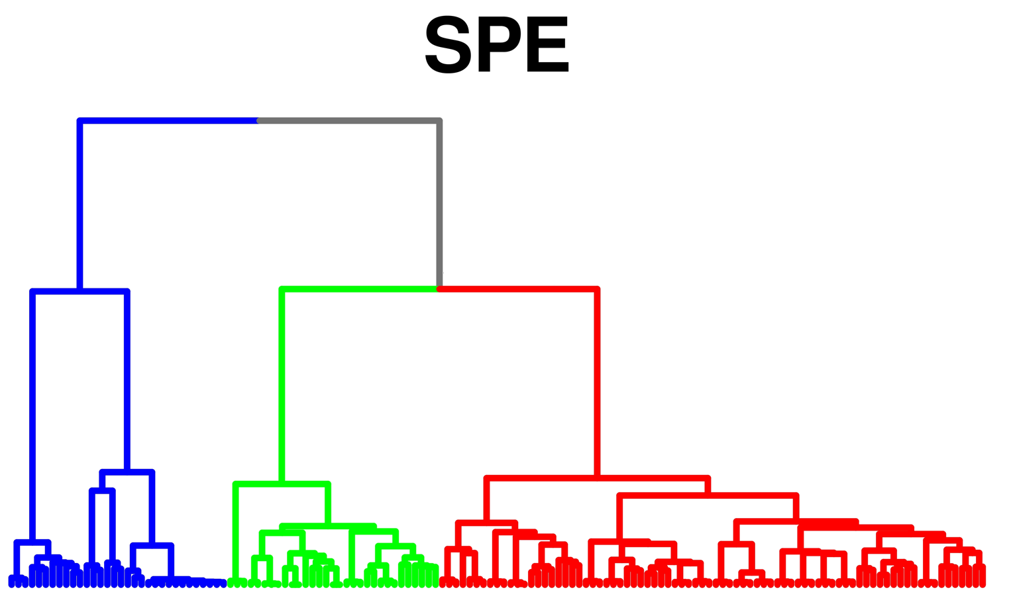
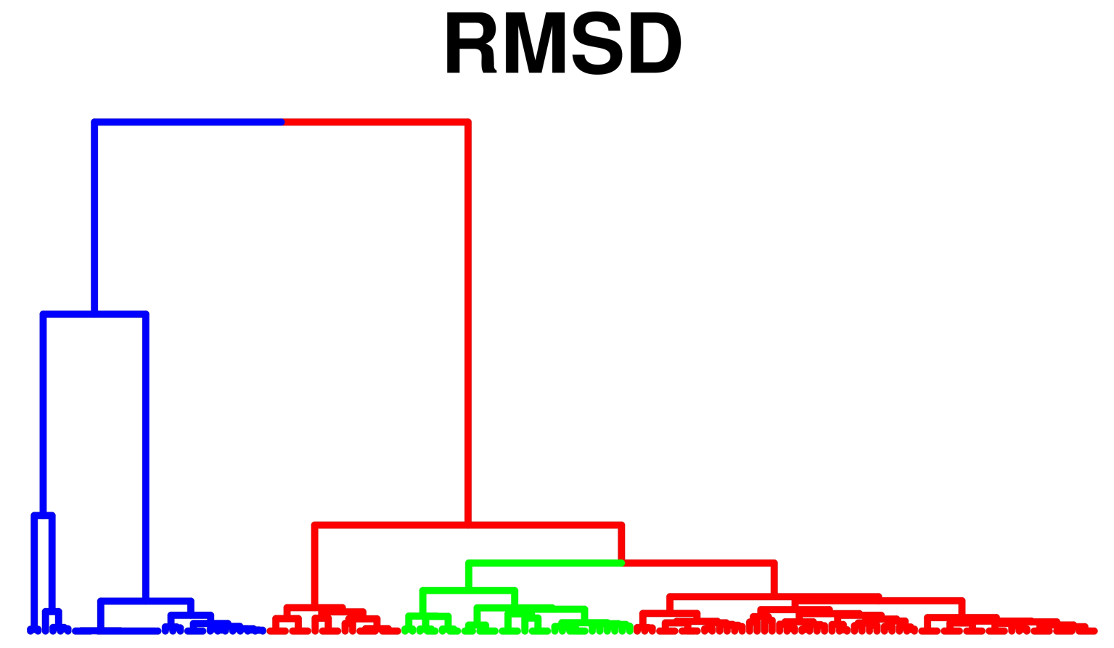
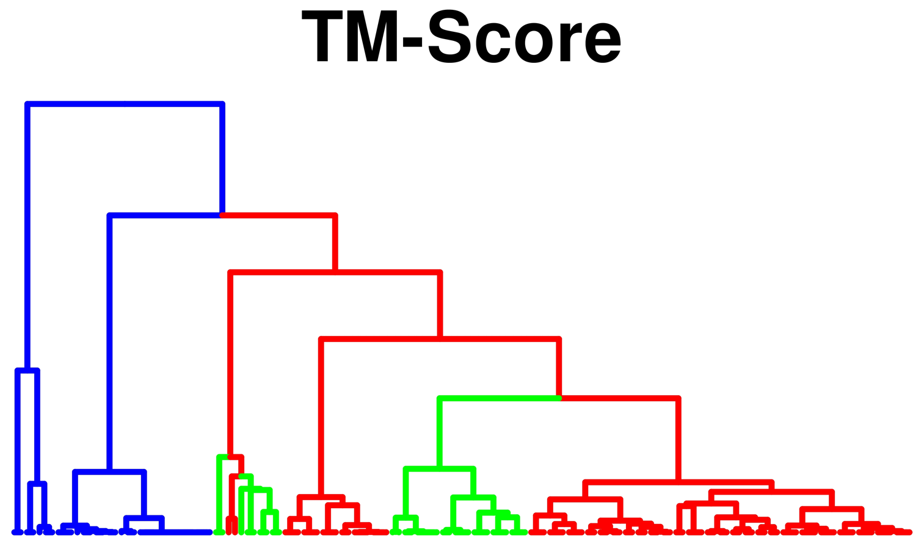
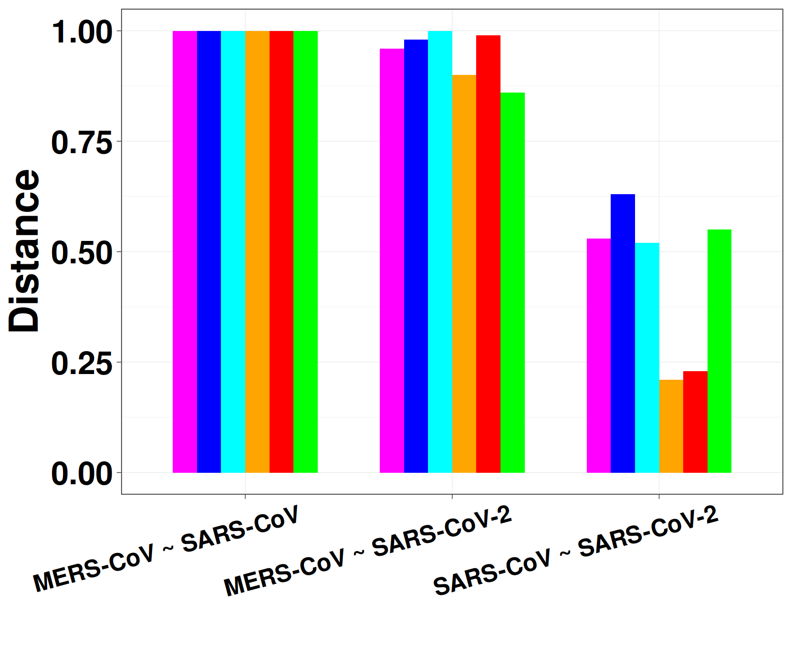
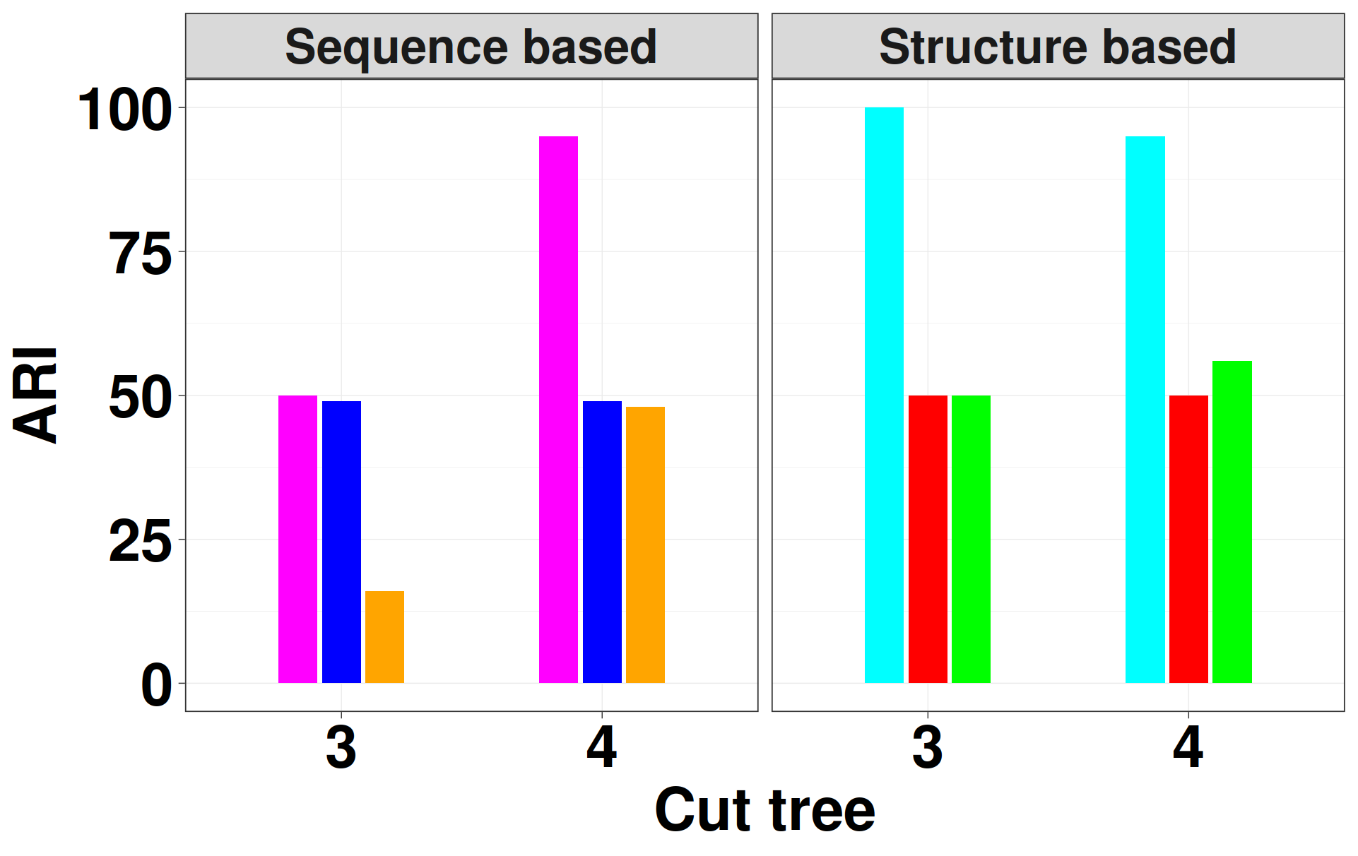
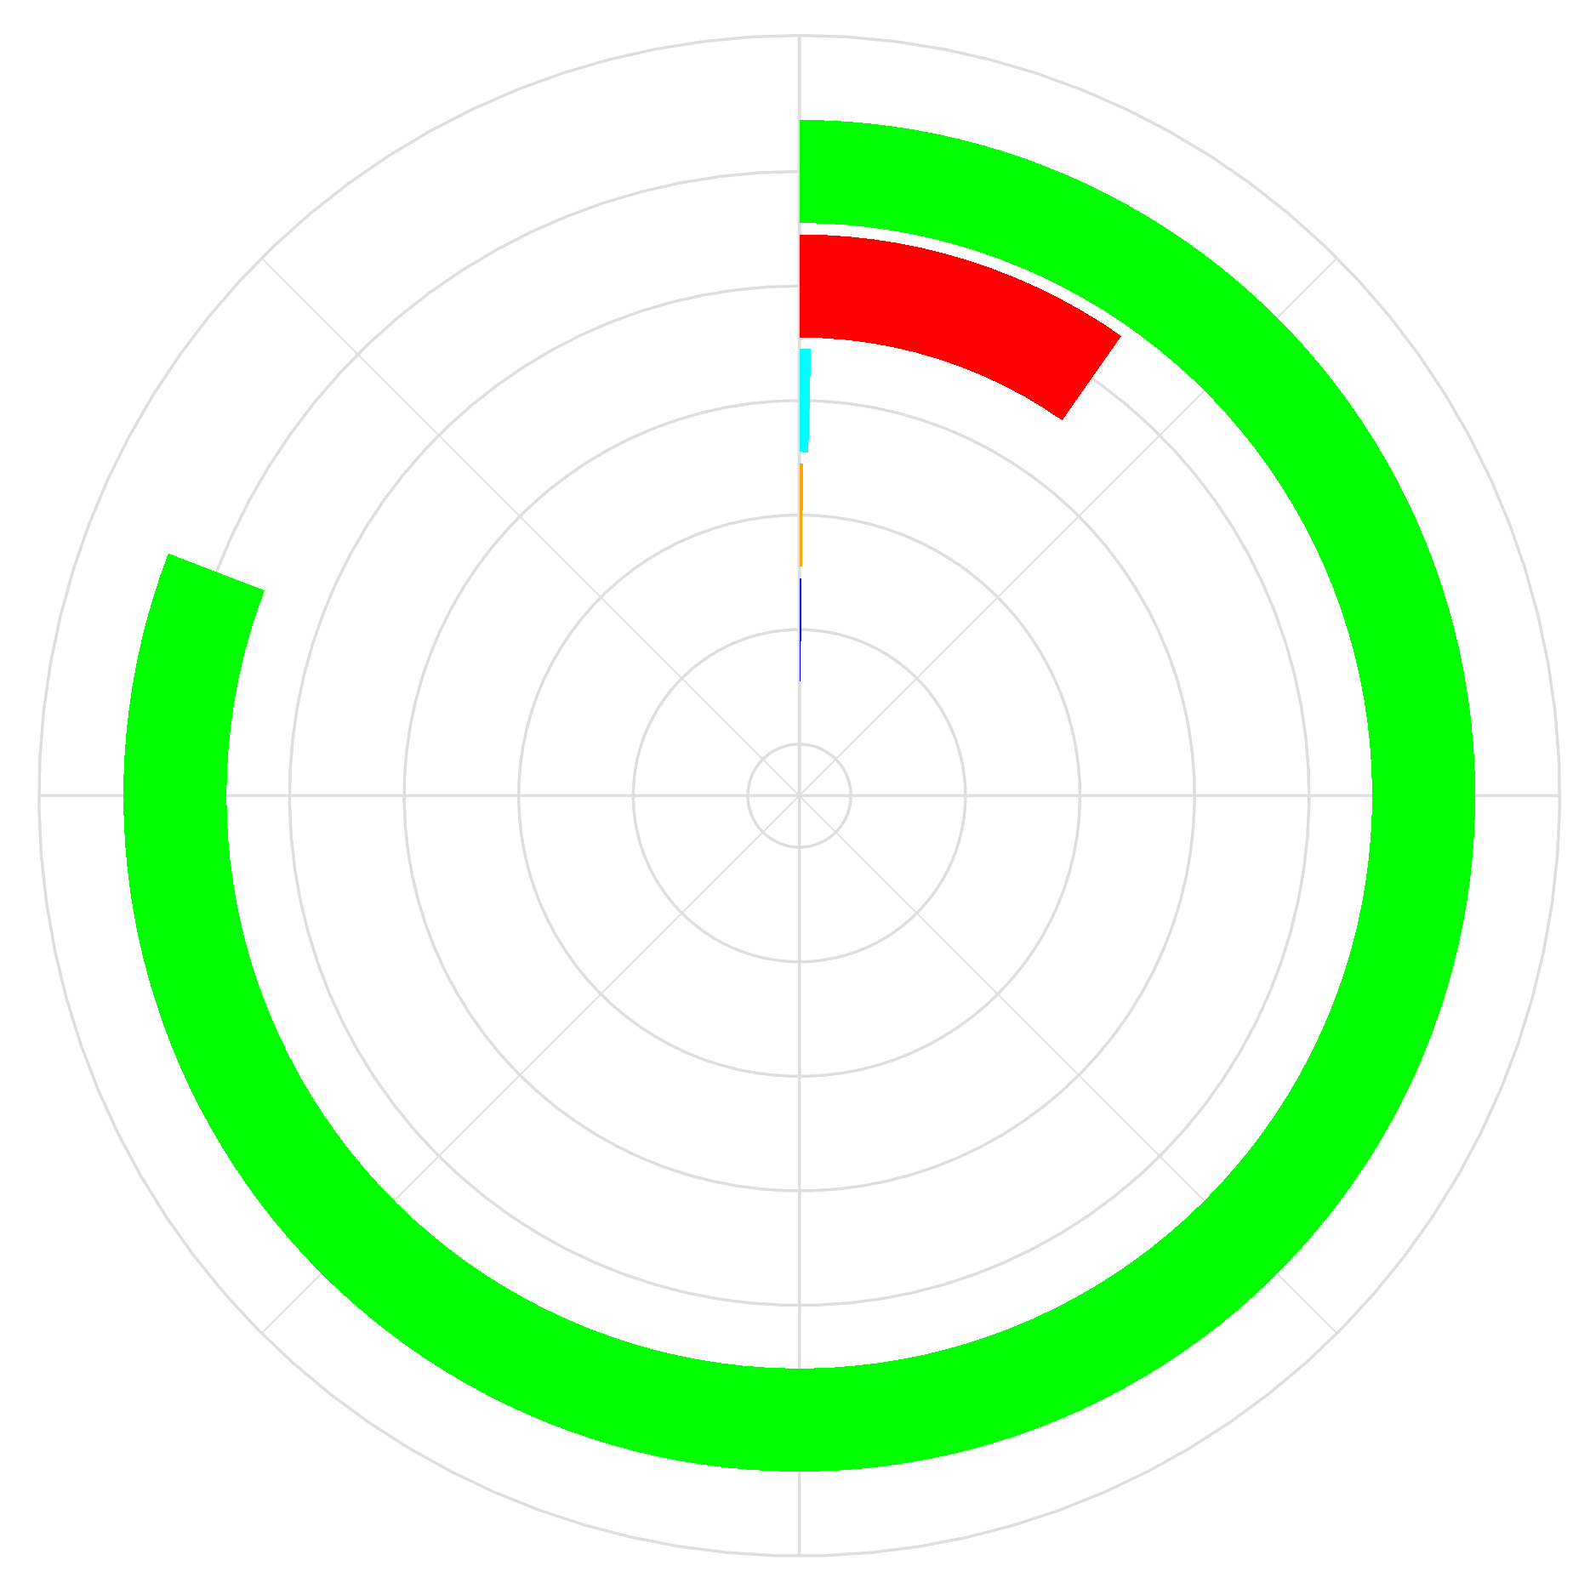
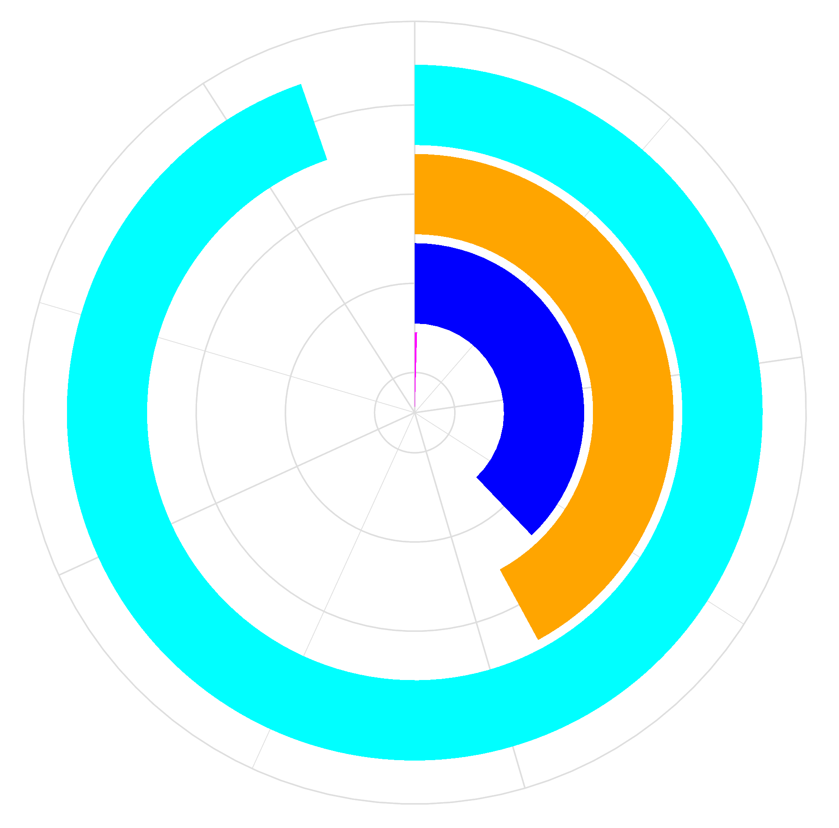
A
B
C
100 (96.4 - 100)
97 (91.5 - 99.4)
98 (93 - 99.8)
99 (94.6 - 100)
99 (94.6 - 100)
99 (94.6 - 100)
D
MERS-CoV
E
F
100 (96.4 - 100)
SARS-CoV
SARS-CoV-2
99 (94.6 - 100)
G
H
I
Performance
Running Time
CPE
MSA(ClustalW)
TM-Vec
SPE
RMSD
TM-Score
12h
190s

