Slide 1
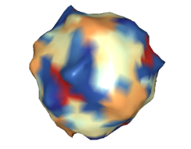
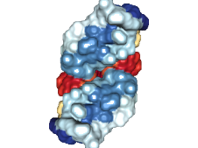

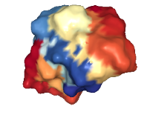
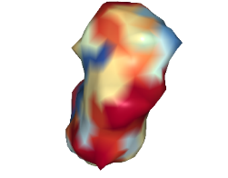
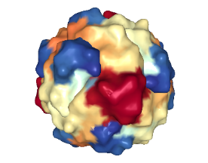
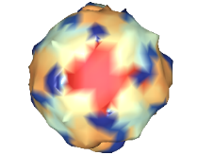
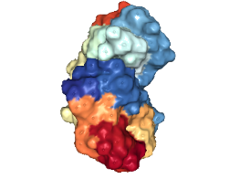
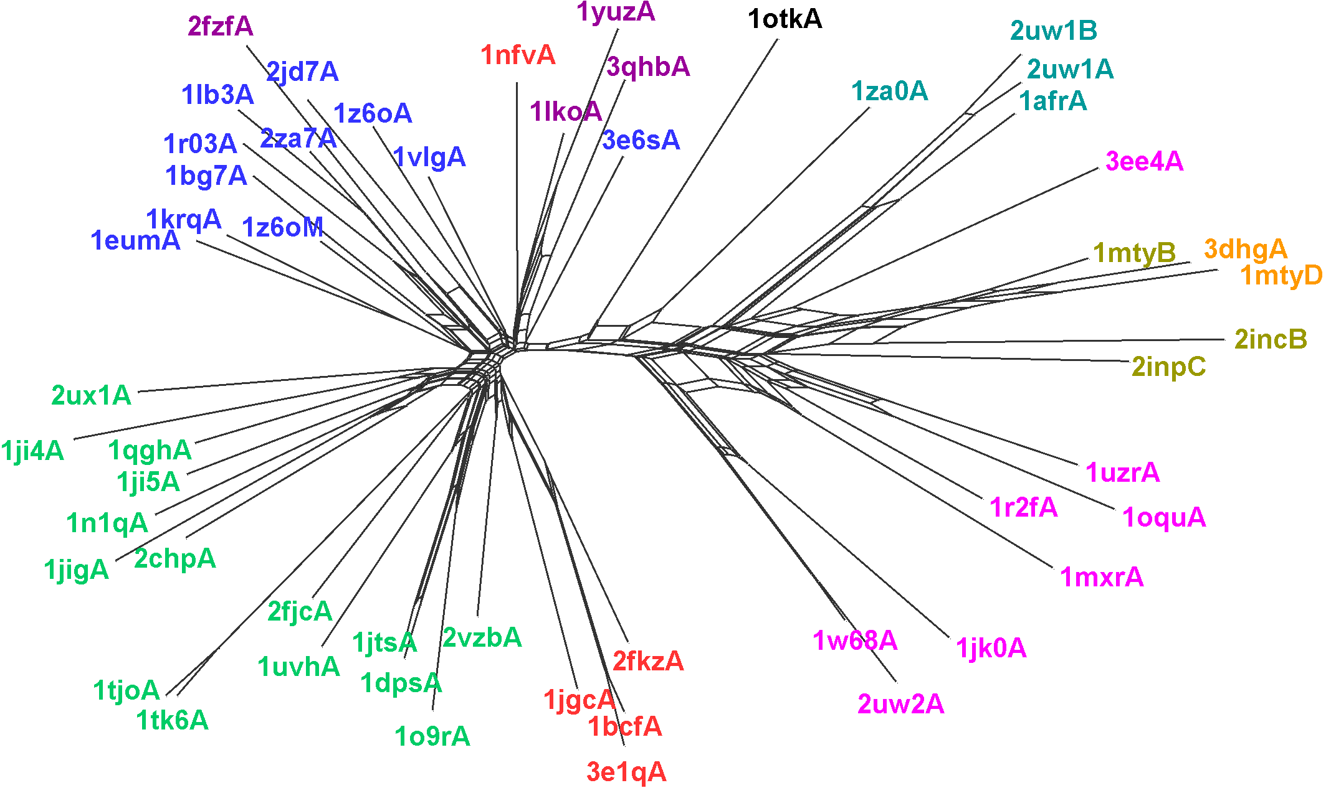

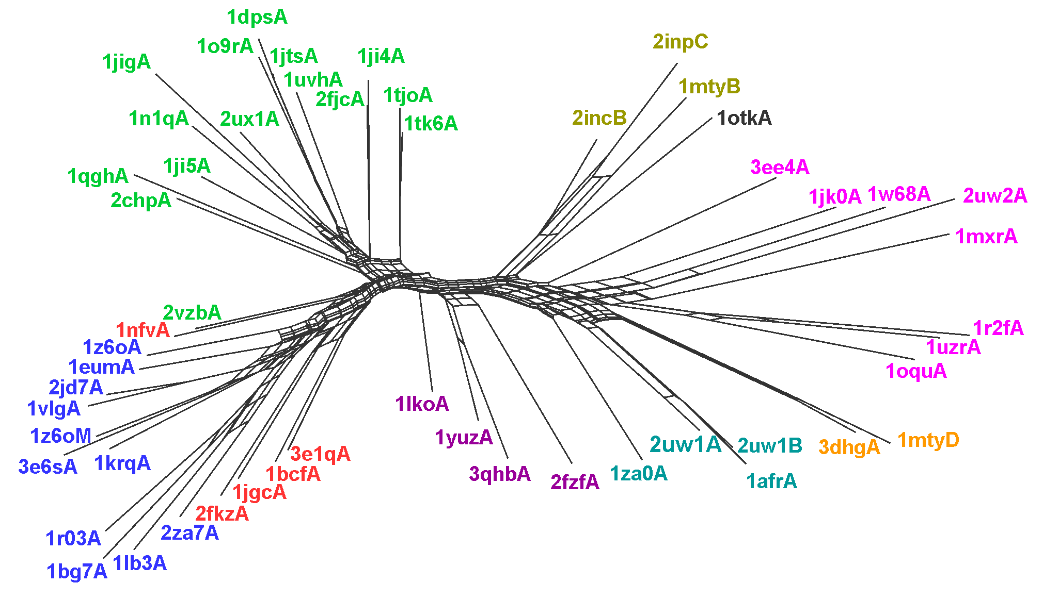
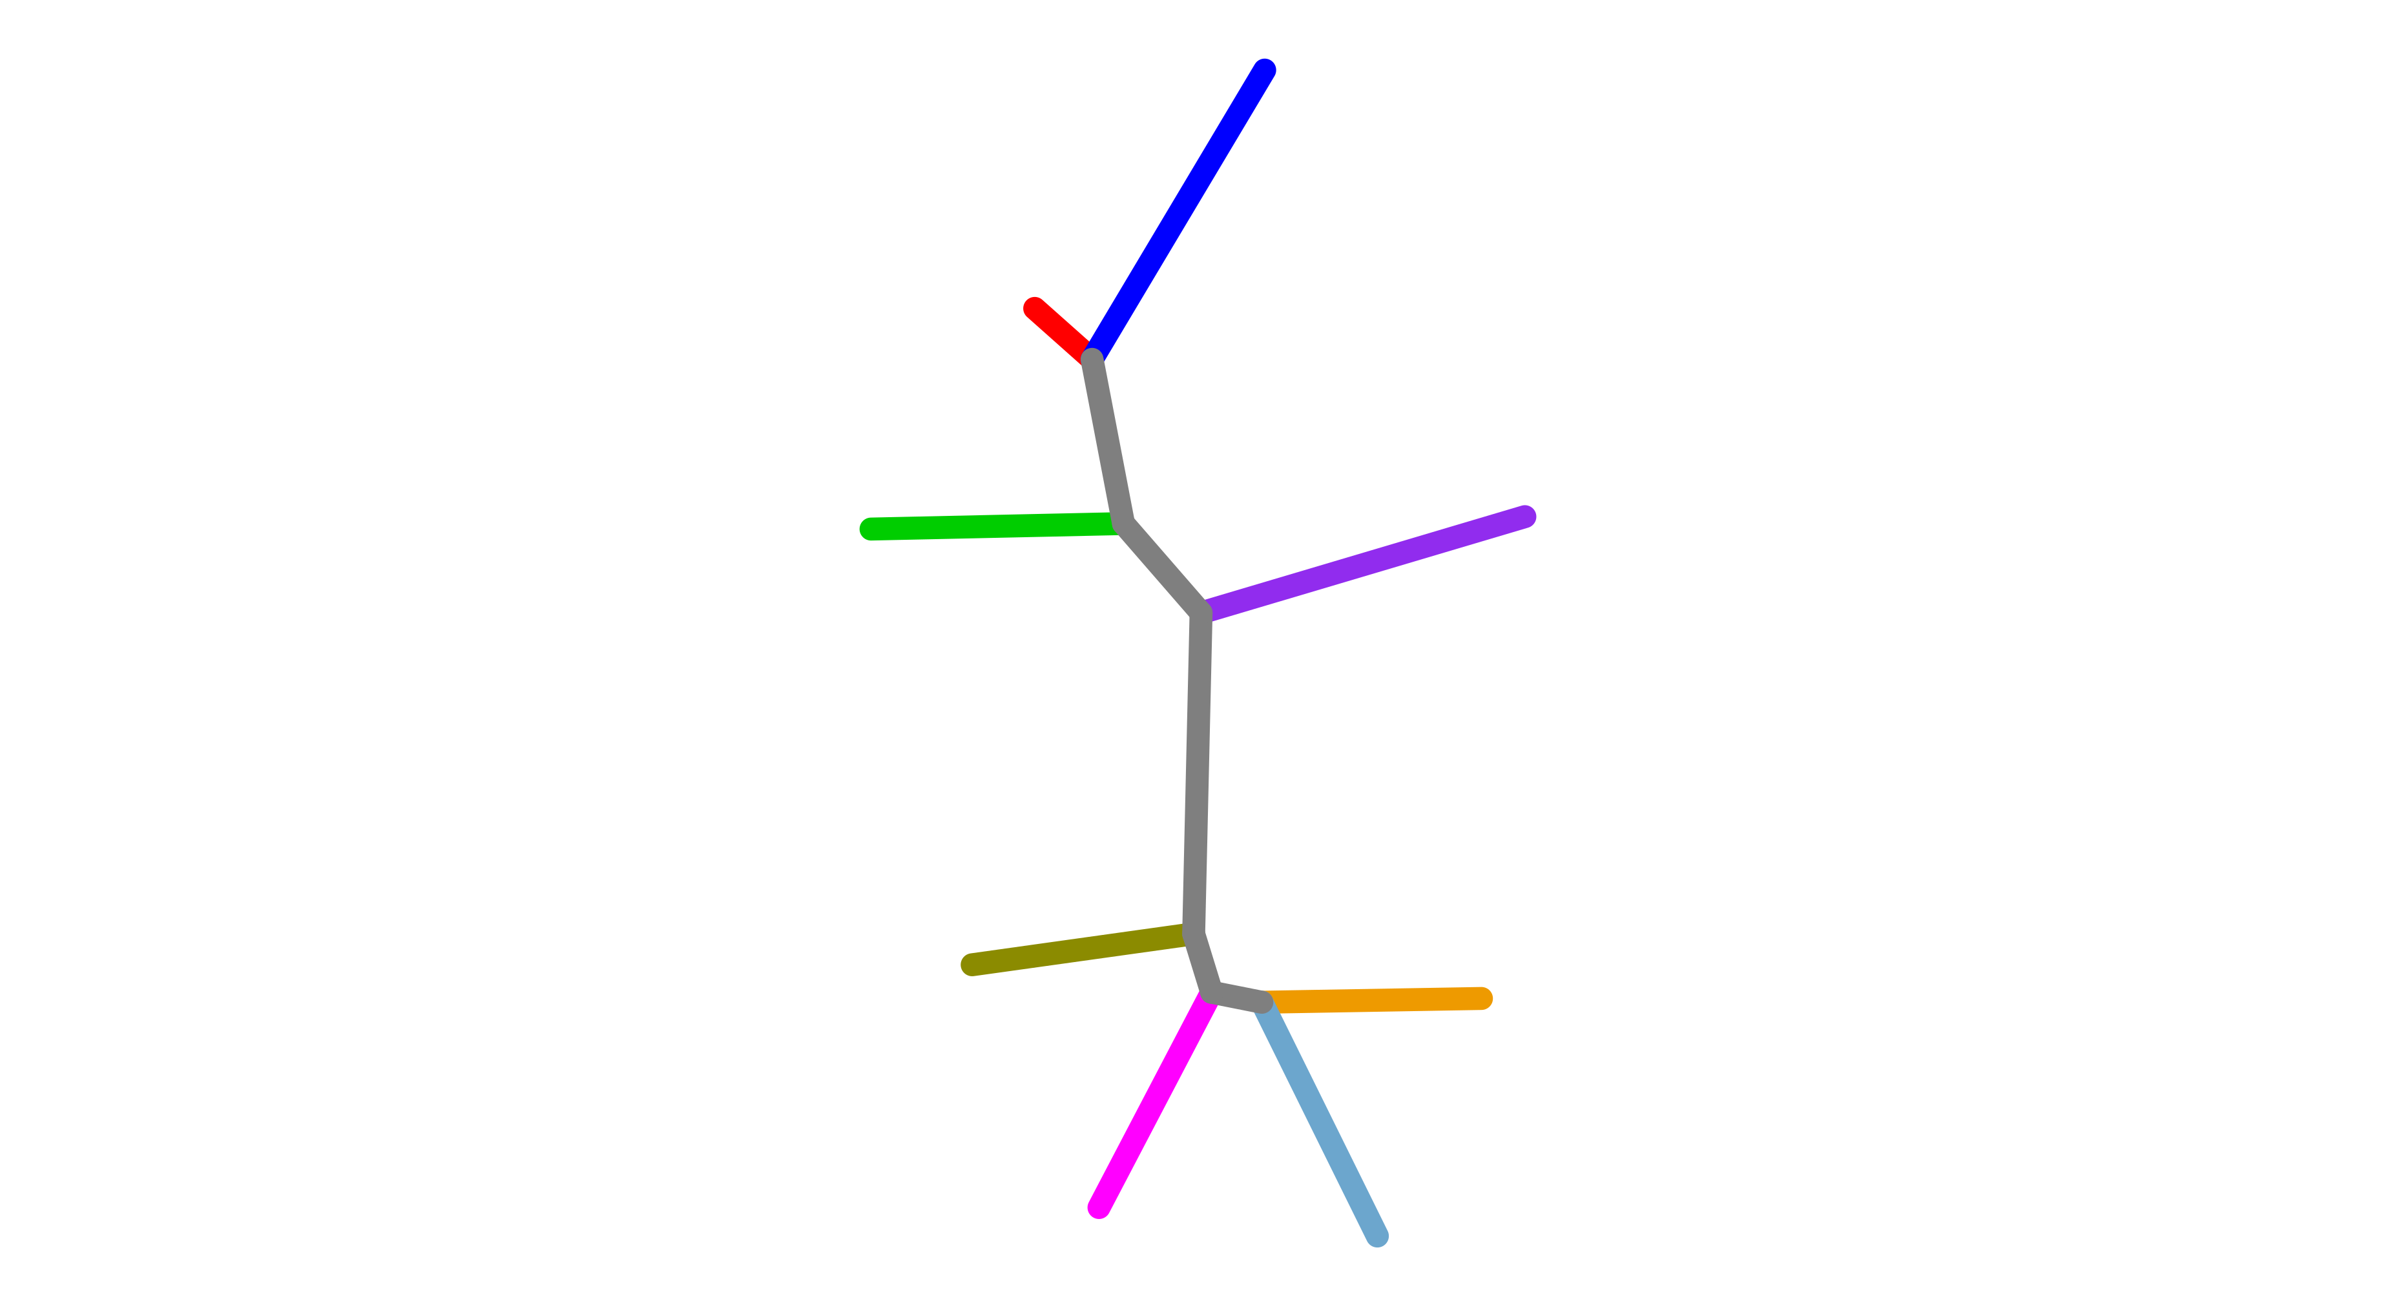
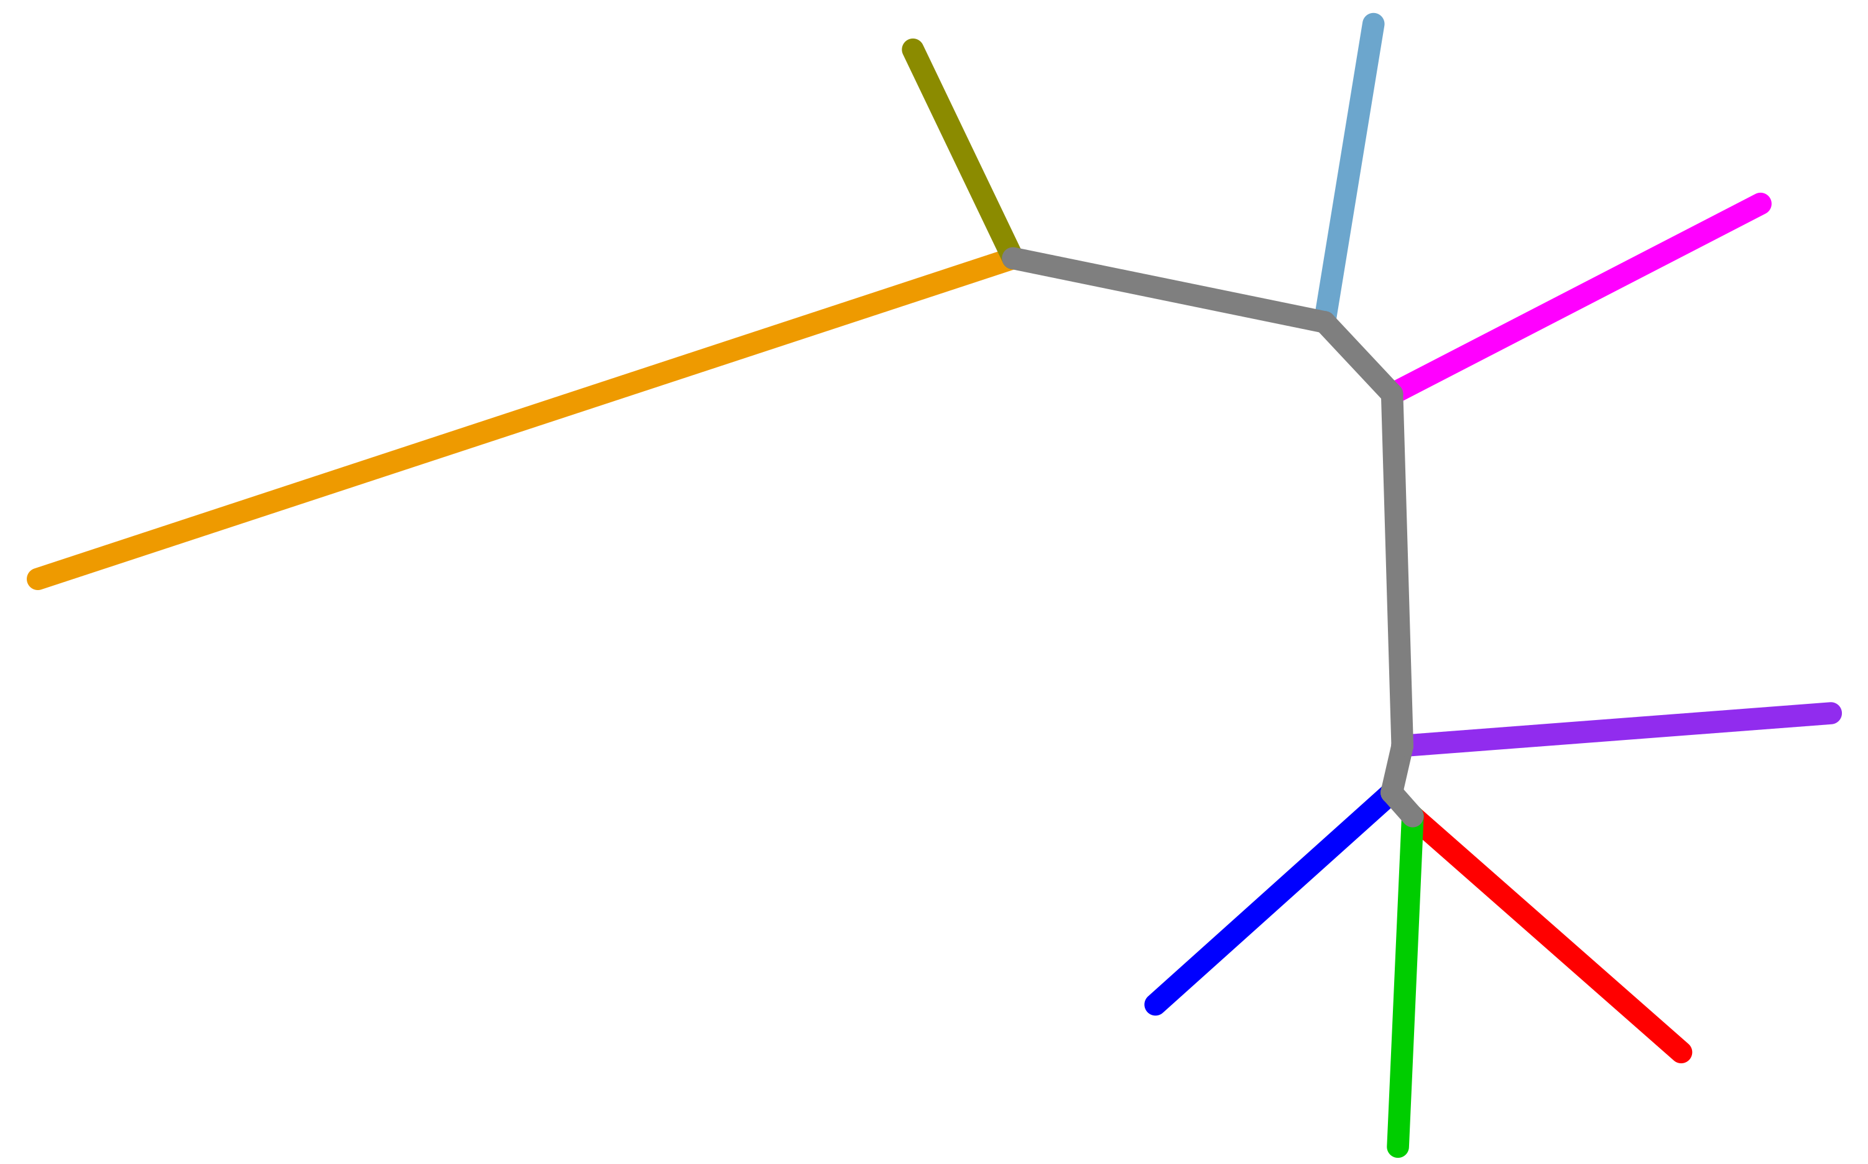
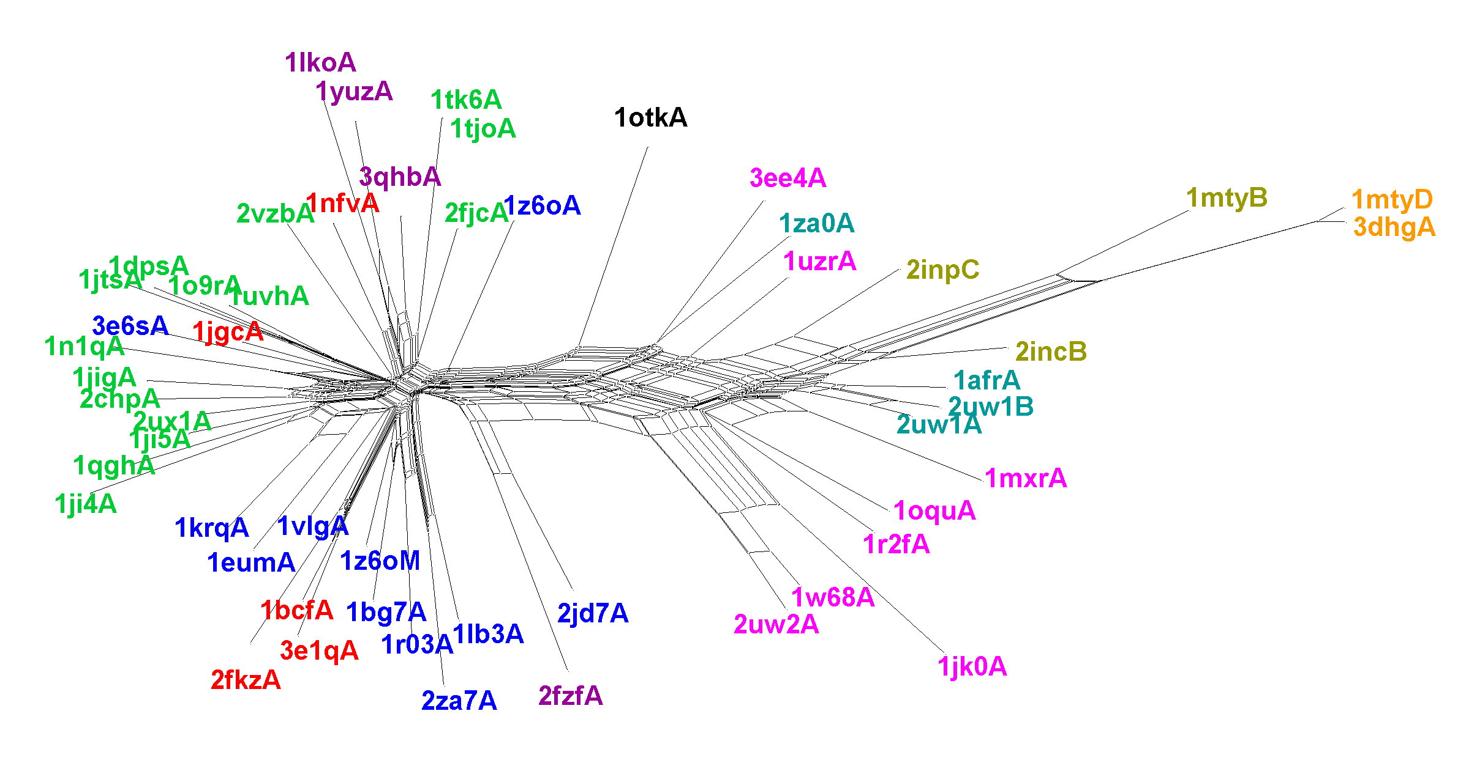
A
Subgroup | Pfam | Scop ID
Bacterioferirtin | 00210 Ferritin | a.25.1.1 Ferritins
Dps
Ferritin
Rubrerythrins | 02915 Rubrerythrins
1tokA | 05138 PaaA_PaaC
BMM alpha | 02332 Phenol_hydrox | a.25.1.2 Ribo nucleotide reductase-like
BMM beta
Fatty acid desaturase | 03405 FA_desaturase
RNR R2 | 00268 Ribonuc_red_sm
Manual Annotation
Ferritins
(1z6o)
Rubrerythrins
(1lko)
Fatty acid desaturases
(2uw1)
alpha
BMM
(1mty)
beta
Dps
(2vzb)
Bacterioferritins
(1bcf)
RNR R2
(1w68)
B
SPE
C
SPE
a.25.1.1 |  |  |  |  | a.25.1.2
D
E
TM-Vec
TM-Vec
a.25.1.1 |  |  |  |  | a.25.1.2
F
CPE
CPE
G
a.25.1.1 |  |  |  |  | a.25.1.2

