Slide 1
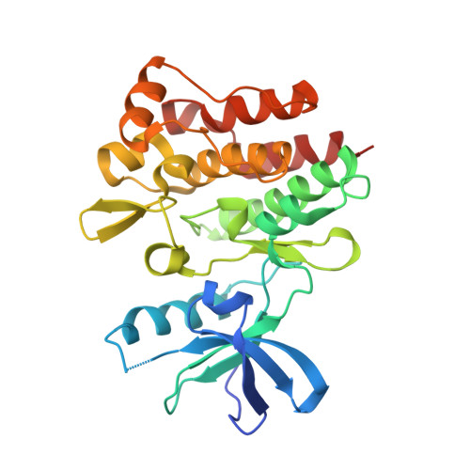
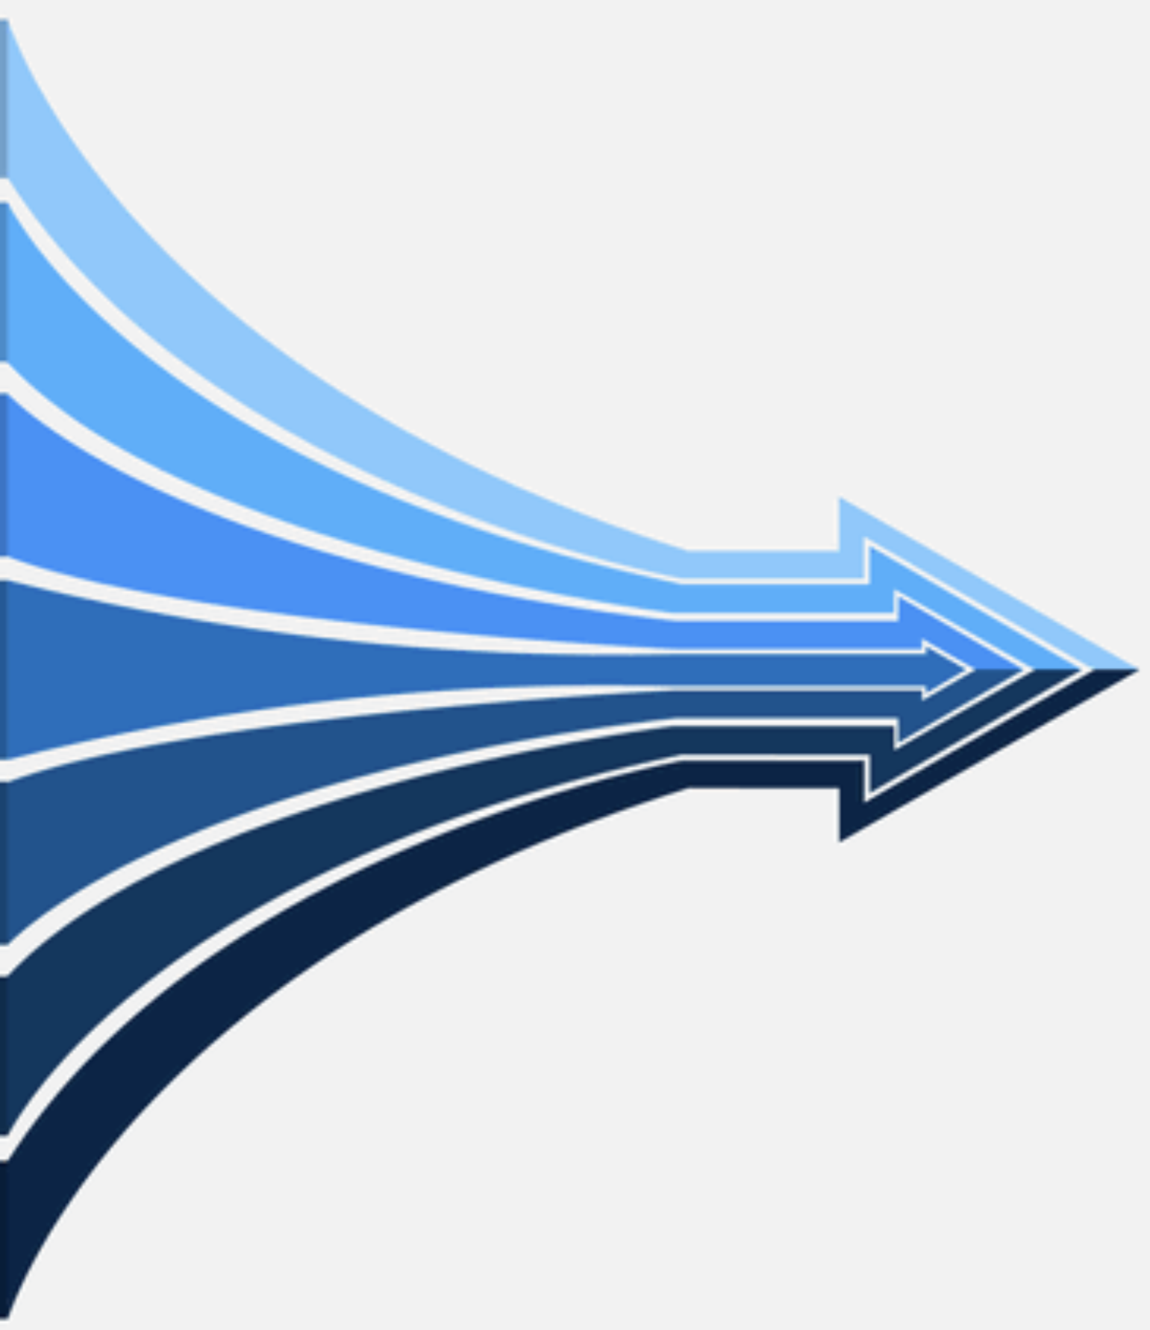
KBP
3D protein Data set, 6990 protein
Descriptor | C_{P}-C_{L} | . | . | . | S_{P}-I_{L}
Energy | -1 | . | . | . | -2.5
Descriptor | C_{P}-C_{L} | . | . | . | S_{P}-I_{L}
Frequency | 1 | . | . | . | 5

Slide 2
SPE
-2
-1.8

Slide 3
CPE
3D protein Data set
Descriptor | C_{P}-C_{L} | . | . | . | S_{P}-I_{L}
Energy | -1 | . | . | . | -2.5

