Slide 1
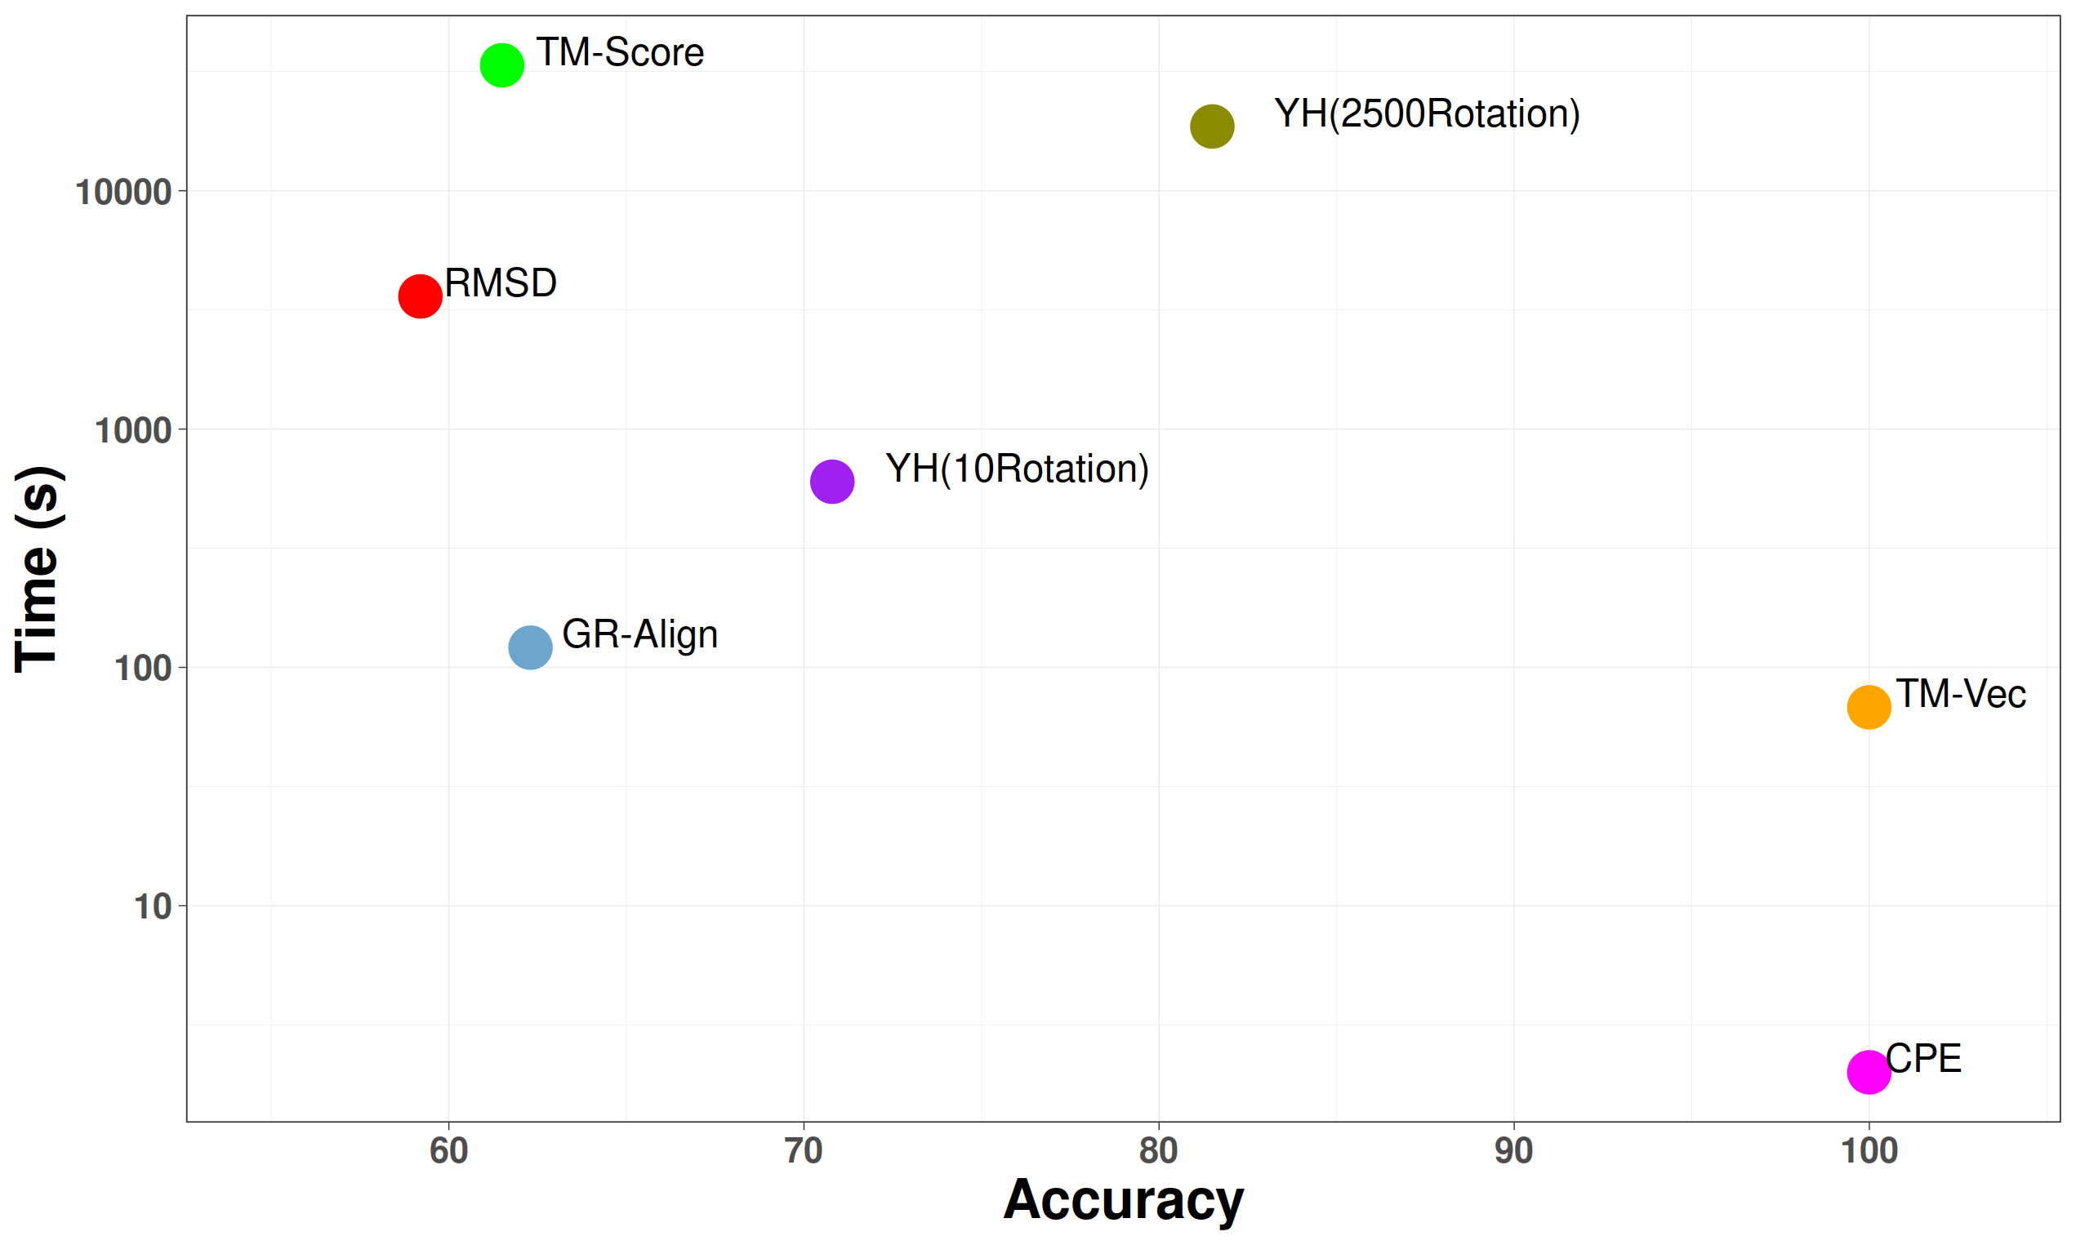
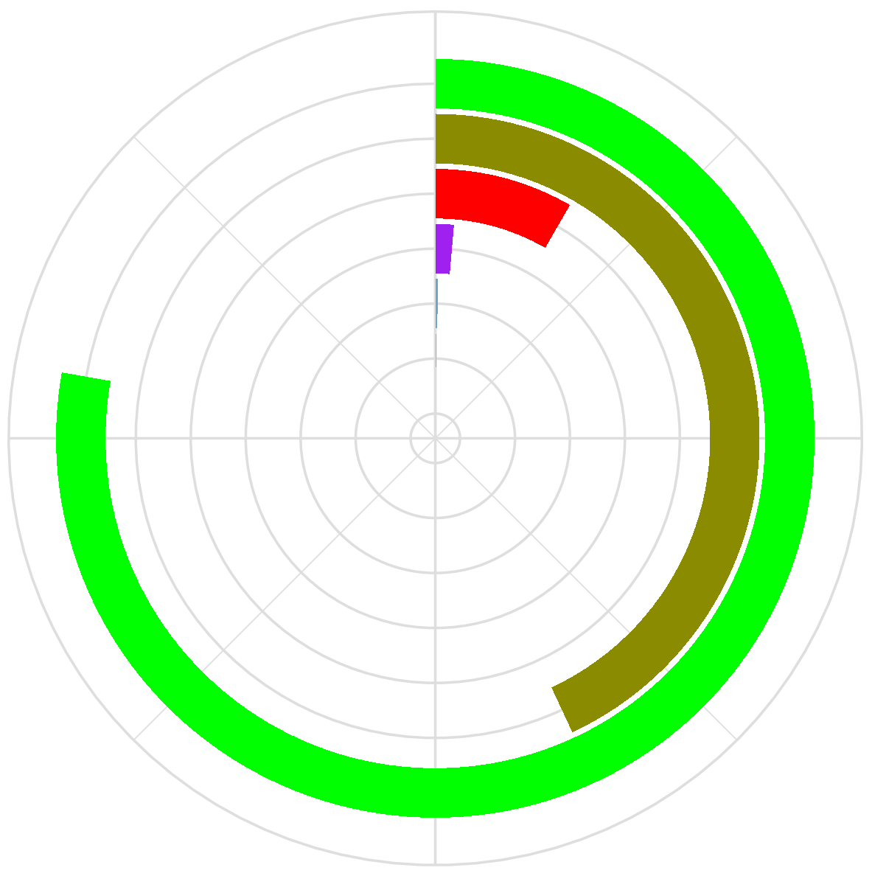
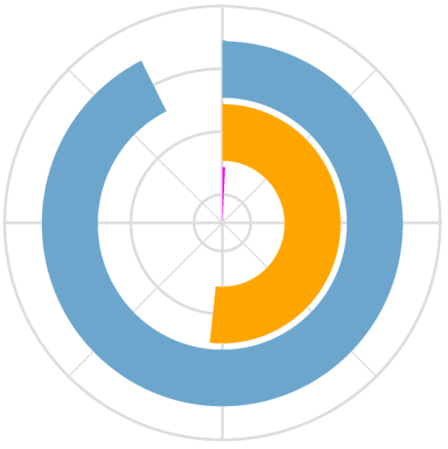
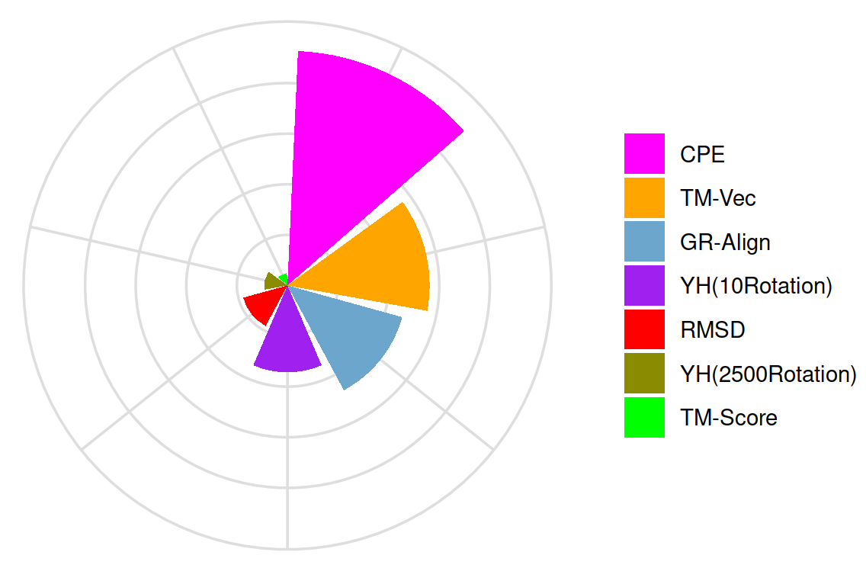


A
Table2
Method | Accuracy | Time
GR-Align | 62.3% | 59.2%
RMSD | 2 min | 1 h
TM-Score | 61.5% | 9 h 20 min
YH (10Rotation) | 70.8% | 10 min
YH (2500Rotation) | 81.5% | 4h 10 min
TM-Vec | 100% | 67 sec
CPE | 100% | 1 sec
B
C
12h
130s
$${efficiency=log}_{10}(\frac{Accuracy}{Time})$$
$$Running time$$

Slide 2
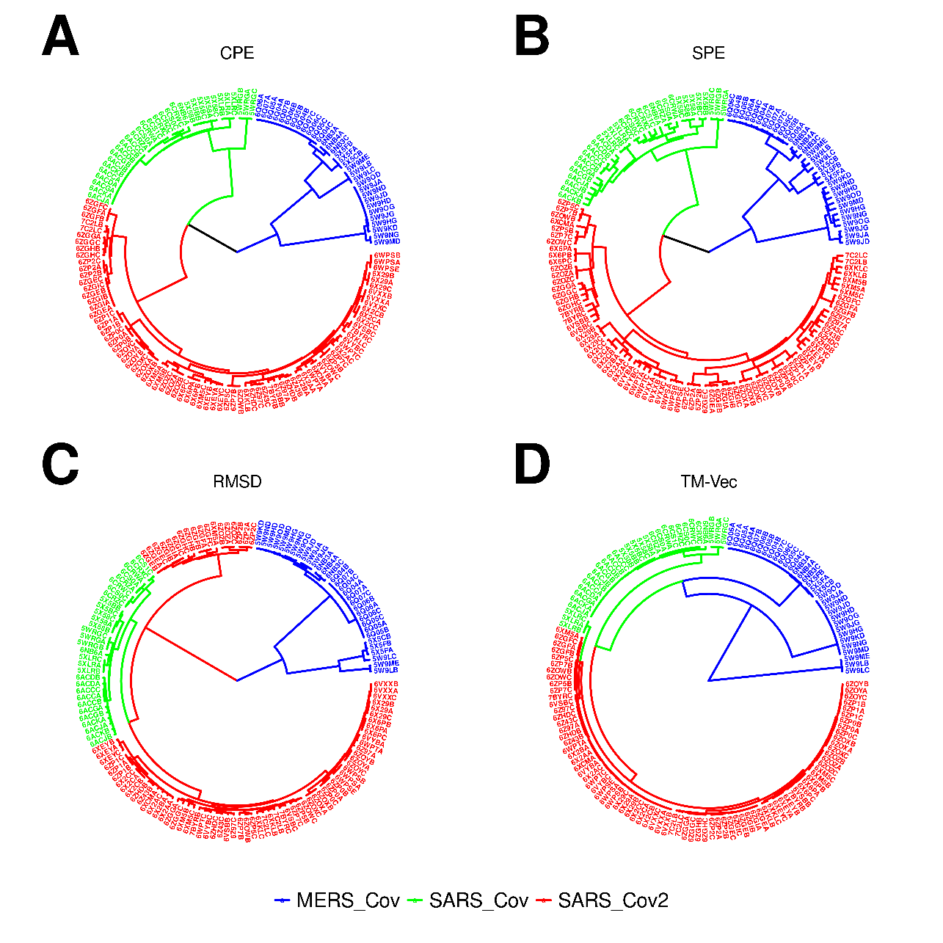
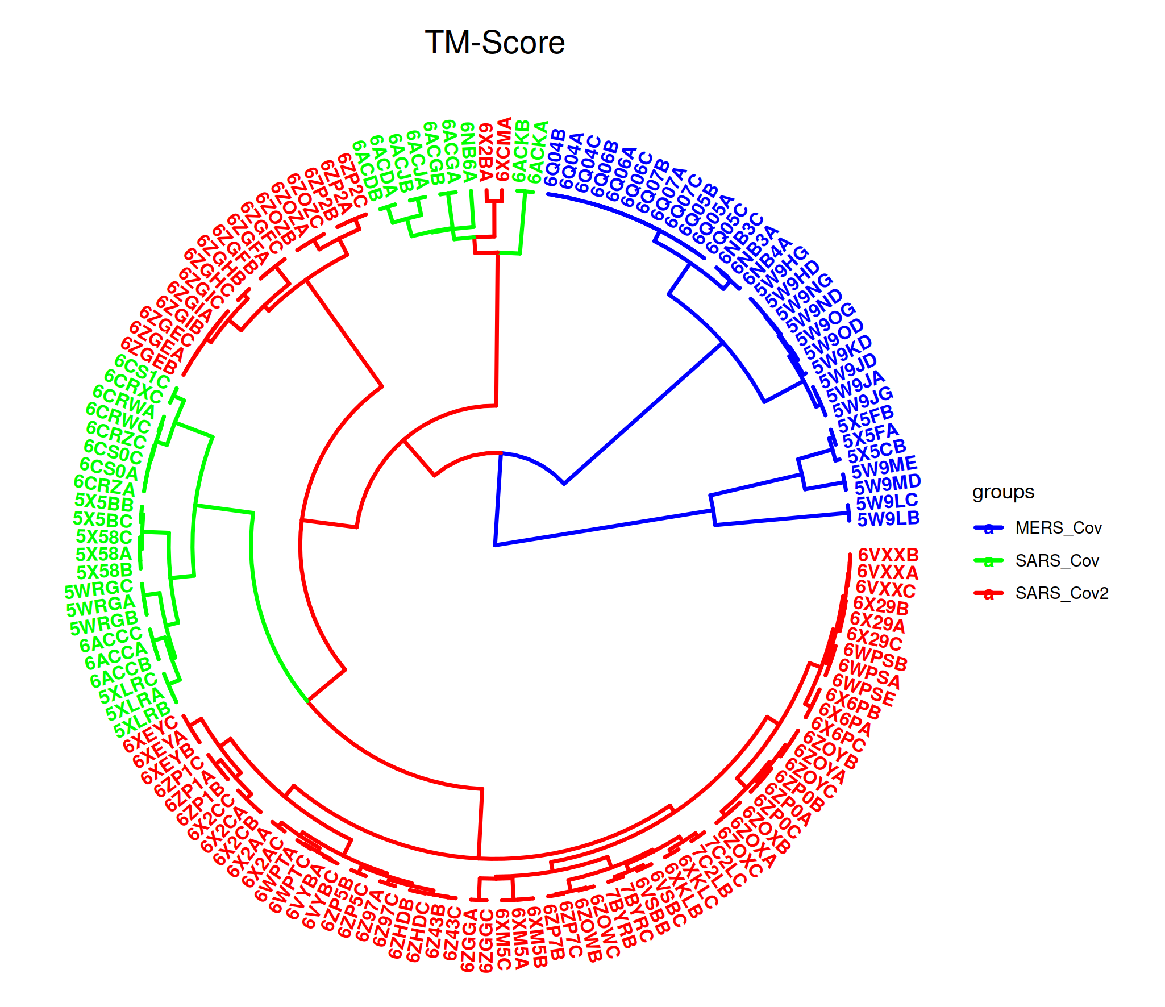
Table3
Method | Based | Time | ARI |  | CE
 |  |  | 3 | 4 | 3 | 4
CPE | sequence | 0.9 s | 0.5 | 0.95 | 0.22 | 0.08
SPE | structure | 3 m | 1 | 0.95 | 0 | 0.08
RMSD | structure | 70 m | 0.5 | 0.5 | 0.22 | 0.22
TM score | structure | 9.7 h | 0.5 | 0.56 | 0.22 | 0.17
TM-Vec | sequence | 63 s | 0.16 | 0.48 | 0.34 | 0.22
Table 3. Performance evaluation statistics of hierarchical clustering in the Adjusted Rand Index (ARI), Class Error (CE) and running time of various methods, using the Spike datasets. ARI and CE values were obtained for cuttree thresholds 3 and 4.
Supplementary

