Slide 1
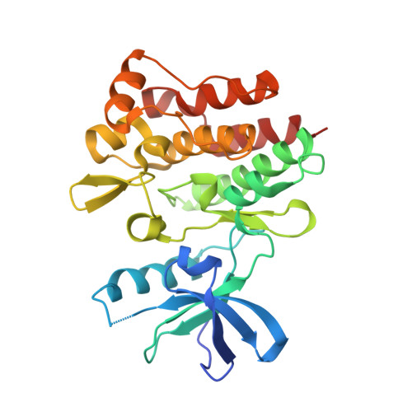

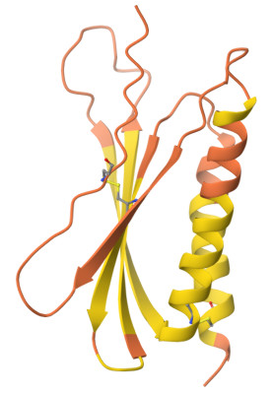
A
Atomic Pairs | C-C | . | . | . | N-S
Frequency | 19000 | . | . | . | 5400
d = 1
Atomic Pairs | C-C | . | . | . | N-S
Frequency | 19000 | . | . | . | 5400
d = 2
3D protein
structure Data set, 6990 proteins
Atomic Pairs | C-C | . | . | . | N-S
Frequency | 19000 | . | . | . | 5400
…
. .
. .
. .
Atomic Pairs | C-C | . | . | . | N-S
Frequency | 19000 | . | . | . | 5401
d = 6
Atomic Pairs | C-C | . | . | . | N-S
Energy | 1.5 | . | . | . | 0.90
d = 1
Atomic Pairs | C-C | . | . | . | N-S
Energy | 1.5 | . | . | . | 0.90
d = 2
Atomic Pairs | C-C | . | . | . | N-S
Energy | 1.5 | . | . | . | 0.90
…
Atomic Pairs | C-C | . | . | . | N-S
Energy | -1.5 | . | . | . | -0.90
d = 6

Slide 2
-1
-1.3
-2
-1
-2.3
Amino Acid |  |  | . | .
Energy | -11 | -54 | . | . | -75
B
-3
-3
-1.2
-1.8
-4
3D protein
structure Data set, 6990 proteins
0.8
0.2
. .
. .
. .
Estimate the Predictor Matrix: P
-1.2
1
-2
-4
Amino Acid |  |  | . | .
Energy | -23 | -65 | . | . | -64
-1
-1.3
-2
-1
-2
-1
-2.4
-3
-3
-0.6
0.8

Slide 3
C
-1
-1.3
210-Dimensional Profile of Energy
-2
-1
-2.3
Eq. 2
-3
AA |  |  | . | .
Energy | -12 | -74 | . | . | -35
-3
-1.2
-1.8
-4
0.8
0.2
210-Dimensional Profile of Energy
D
Amino Acid |  |  | . | .
Frequency | 3 | 2 | . | . | 1
Eq. 5
AA |  |  | . | .
Energy | -14 | -76 | . | . | -38

