Slide 1
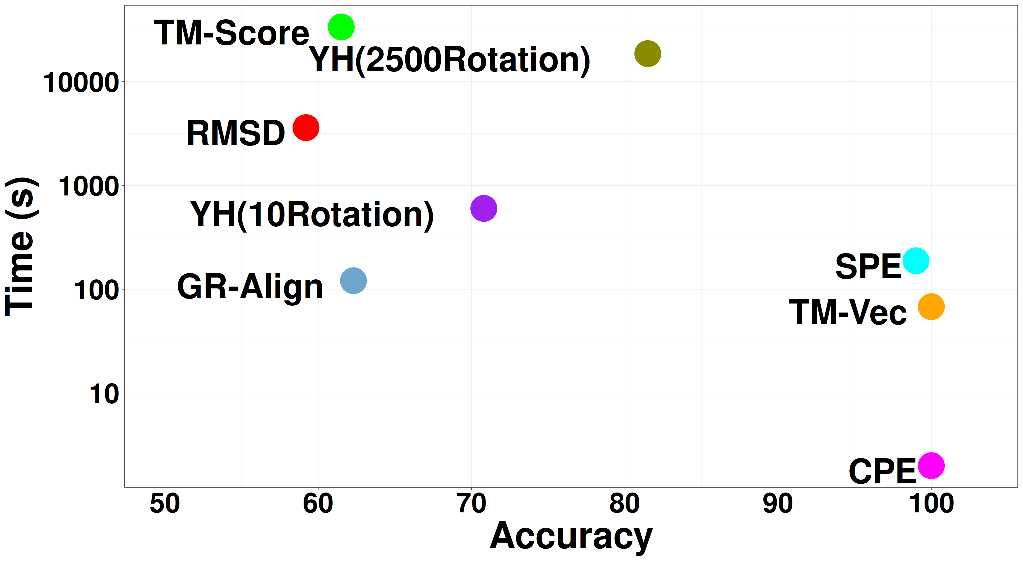
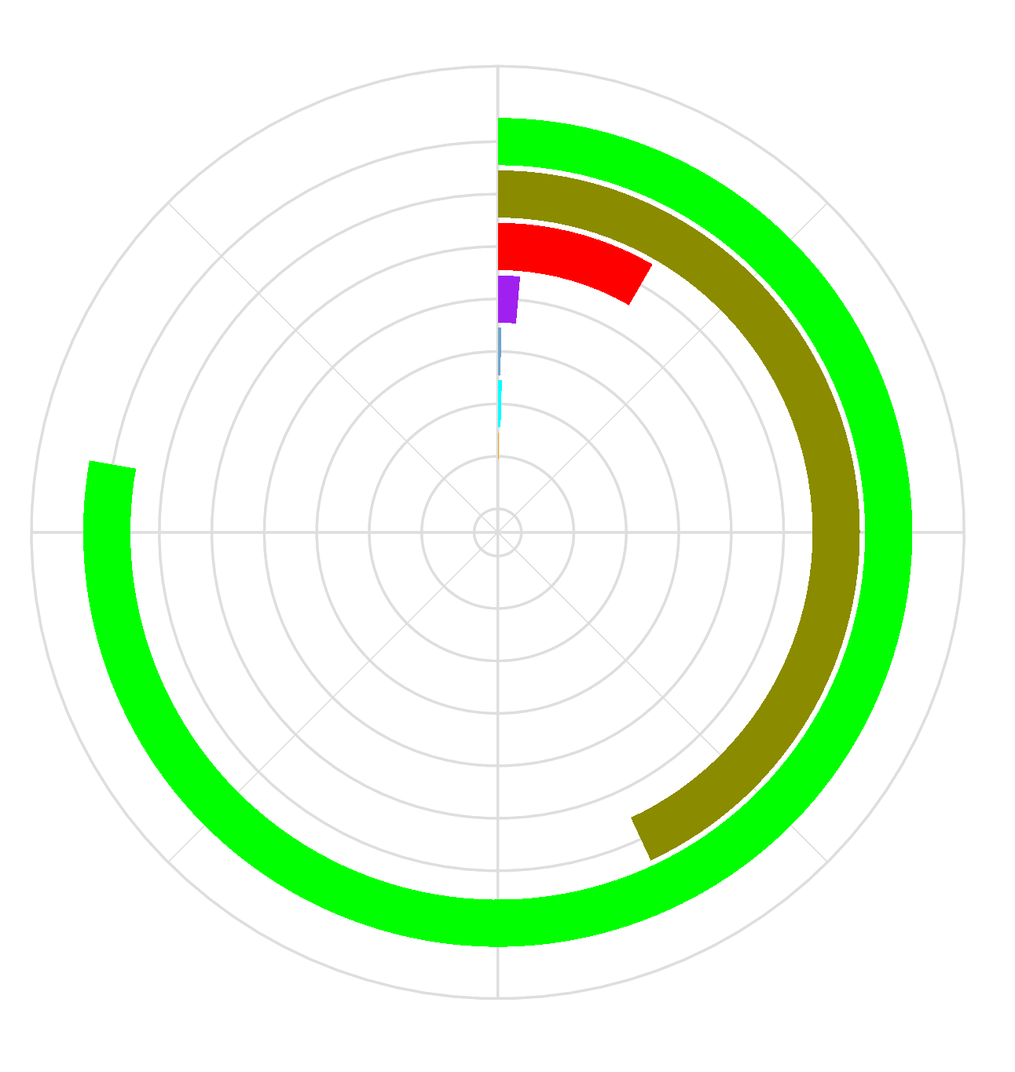
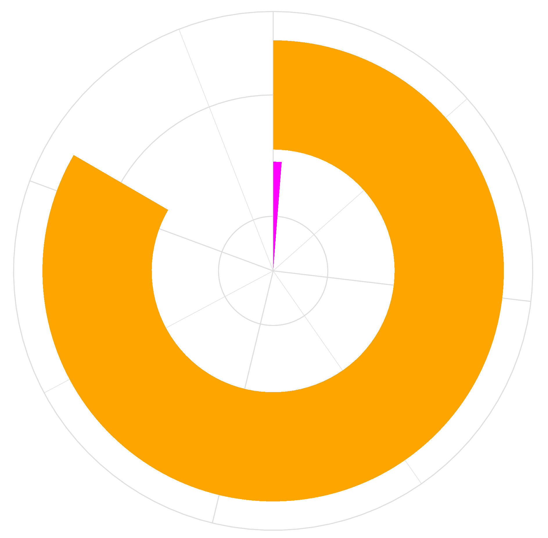
A
B
Running Time
12h
80s
CPE
SPE
TM-Vec
GR-Align
TM-Score
RMSD
YH(2500Rotation)
YH(10Rotation)

