Slide 1
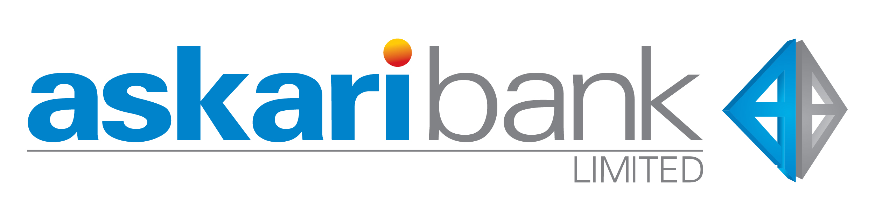
Askari Bank
Presentation by:
Abdul Rehman Shaukat
Jehanzeb Shahzad
Mirza Kashif
Muhammad Usman
Zain Khan

Slide 2
Overview
Cash in Hand
Trend Implications
KIBOR
Mark-Up Earned
Economic Implications
Conclusion

Slide 3
Total Cash in Hand
Notes:
Value of these foreign currencies are translated to Pakistani Rupee at the exchange rates prevailing at the reporting date.

Slide 4
Exchange Rate at Reporting Dates

Slide 5
Percentage Of Foreign Cash As A Percentage Of Total Cash In Hand

Slide 6
Implications
Trade: Since in general the overall incomes of people has been rising, commercial banks have to purchase foreign currency to facilitate import payments, which has contributed to the rise in demand for foreign currency over the years.
Remittances: Pakistan is one of the largest recipients of remittances in the world. In 2021, the country received over $31 billion in remittances, which was a record high. As a result, commercial banks in Pakistan have had to purchase foreign currency to convert the remittances into Pakistani rupees.

Slide 7
Implications (cont.)
Debt servicing: Pakistan has a large external debt, and Askari Bank had to purchase foreign currency to make payments on behalf of their clients for principal and interest on foreign loans.
Foreign investment: Pakistan has been attracting foreign investment, particularly in the energy and infrastructure sectors. Askari Bank had to meet the foreign currency demands of these investors, which has also contributed to the rise in demand for foreign currency.
Political and economic instability: Pakistan has faced political and economic instability in the past 5 years, which has led to fluctuations in the exchange rate. This has encouraged Askari Bank to hold foreign currency as a hedge against currency risk.
Speculation: Askari Bank may also hold foreign currency as a speculative investment, in anticipation of a potential appreciation in the value of the currency.
Market conditions: Fluctuations in the exchange rate or other market conditions could have led to increased demand for foreign currency by Askari Bank Limited, particularly if the bank was looking to manage currency risk on behalf of its clients.
Notes:
In addition to these factors, the COVID-19 pandemic has also had an impact on the demand for foreign currency by commercial banks in Pakistan. The pandemic has disrupted global supply chains, leading to shortages of some goods and a rise in prices. As a result, commercial banks have had to purchase foreign currency to facilitate import payments for essential goods. Overall, these factors have contributed to the rise in demand for foreign currency by commercial banks in Pakistan over the past 5 years. While some of these factors may change in the future, it is likely that demand for foreign currency by commercial banks in Pakistan will remain significant given the country's trade deficit, external debt, and large diaspora population.

Slide 8
KIBOR
Karachi inter-bank offered rate (KIBOR) is interbank clean (without collateral) lending/borrowing rates quoted by the banks.
The banks under this arrangement quote these rates at specified time i.e. 11:30 am at Reuters.
Currently 20 banks are members of KIBOR club.
KIBOR is used as a benchmark for corporate lending rates.

Slide 9
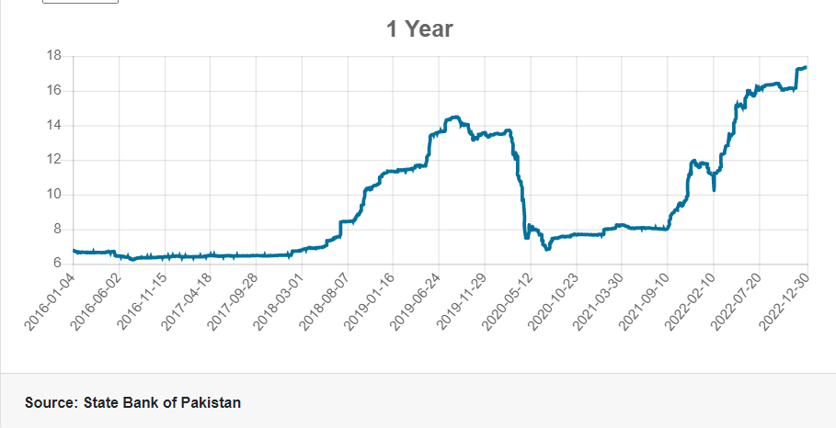
KIBOR rates (Daily 2016-2021)

Slide 10
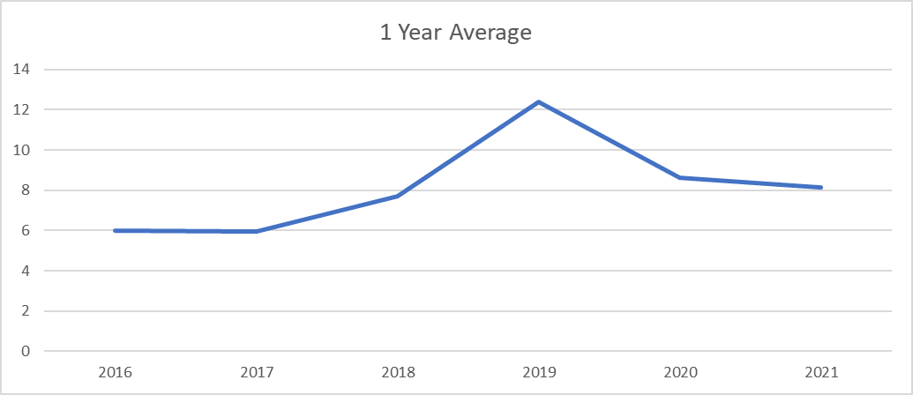
KIBOR rates (Yearly Average 2016-2021)

Slide 11
KIBOR
Karachi inter-bank offered rate (KIBOR) are interbank clean (without collateral) lending/borrowing rates quoted by the banks.
The banks under this arrangement quote these rates at specified time i.e. 11:30 am at Reuters.
Currently 20 banks are members of KIBOR club and, by excluding 4 upper and 4 lower extreme.
KIBOR is used as a benchmark for corporate lending rates.

Slide 12
KIBOR rates (Daily 2016-2021)

Slide 13
KIBOR rates (Yearly Average 2016-2021)

Slide 14
Mark-Up Earned on
Conventional Markup: When you buy a securities from a broker-dealer or market maker, you pay a markup. The markup is either a percentage of the selling price or a flat fee, over and above the amount it cost the broker-dealer to purchase the security.
Banking Markup: The profit that a banks earns when another banks borrows money from them at the current day KIBOR Rate. It’s the % above the cost of the amount of money borrowed
Islamic Banking: It is an agreement in which the bank agrees to finance the purchase of equipment or some commodity for its client at a price that includes a fixed pre- agreed profit for the bank.

Slide 17
Economic intuition
KIBOR was very low between 2016-2018
GDP was rising with modest inflation (4.09%)
Increased in 2019 and reached 14% in 2019
To control inflation – Banks would lend out less
Kept rising because of instability an contractionary policies

