Slide 1
Impact of Inflation and Exchange Rate Volatility on Economic Growth
Presentation By: Mirza Kashif Ijaz

Slide 2
Variable Checklist

Slide 3
List of Countries – Developed
Australia
Bahamas, The
Brunei Darussalam
Bulgaria
Canada
Chile
Croatia
Czechia
Denmark
Hong Kong SAR, China
Hungary
Iceland
Korea, Rep.
Macao SAR, China
New Zealand
Norway
Oman
Poland
Romania
Saudi Arabia
Sweden
Switzerland
United Arab Emirates
United Kingdom
Uruguay

Slide 4
List of Countries – Developing
Bhutan
Brazil
Burkina Faso
Burundi
Cambodia
Chad
Egypt, Arab Rep.
Ghana
Guinea
India
Indonesia
Iran, Islamic Rep.
Madagascar
Mali
Mozambique
Namibia
Nepal
Niger
Nigeria
Pakistan
Rwanda
Sudan
Tanzania
Togo
Turkiye

Slide 5
Summary

Slide 6
Summary Developed

Slide 7
Summary Developing

Slide 8
Correlation

Slide 9
Correlation - Developed

Slide 10
Correlation - Developing

Slide 11
T-Tests
Variables | T-Statistics
ER | 8.3
LN_GDP | 9.78
INFL | 8.25
GE | -13.43
NT | -13.08
FDI | -3.17
MS | -14.79
P_EDU | 9.40
LN_GFCF | 9.60

Slide 12
Pie Charts

Slide 13
LN_GDP

Slide 14
ER

Slide 15
INFL

Slide 16
GE

Slide 17
Net Trade

Slide 18
FDI

Slide 19
MS

Slide 20
P_EDU

Slide 21
LN_GFCF

Slide 22
Line Graphs

Slide 23
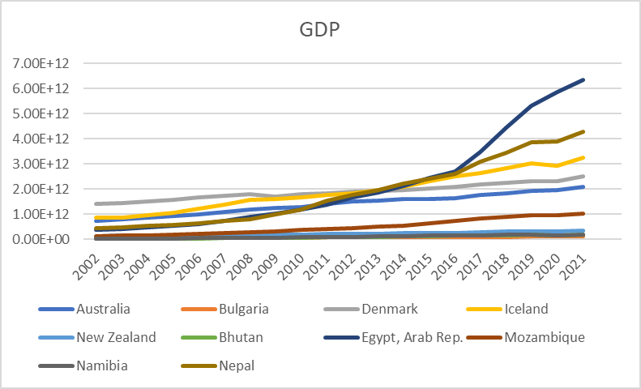
GDP

Slide 24
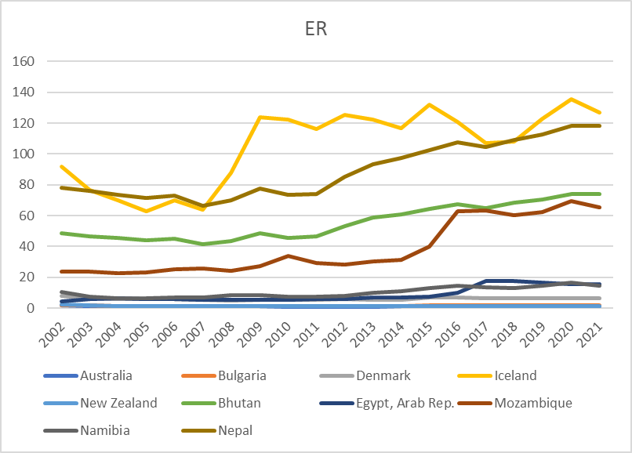
ER

Slide 25
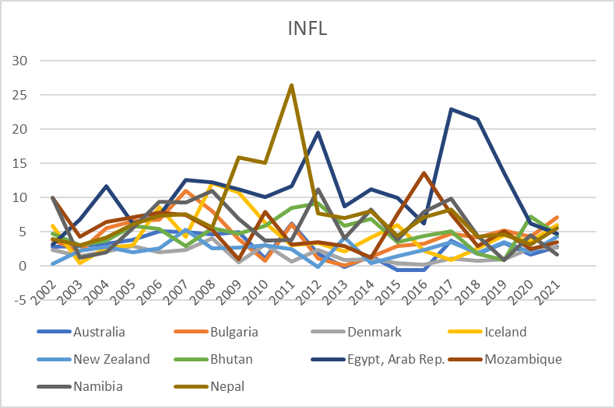
INFL

Slide 26
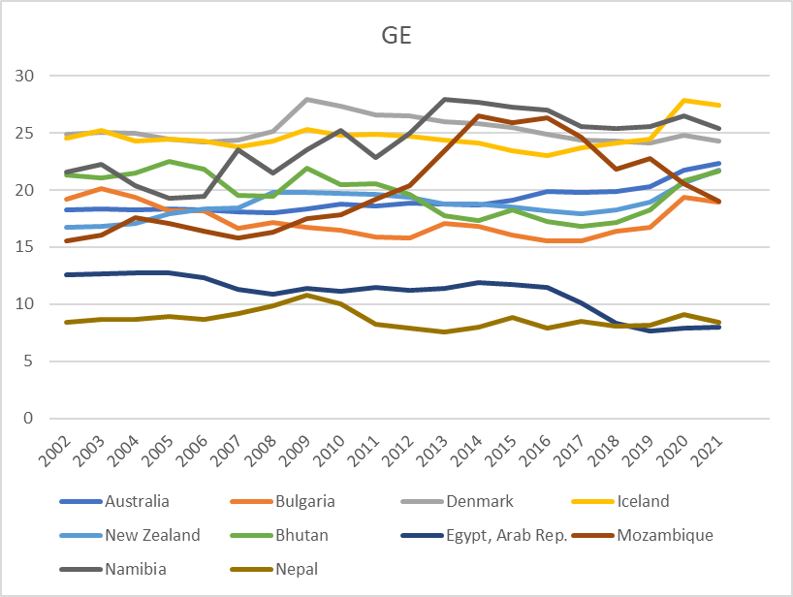
GE

Slide 27
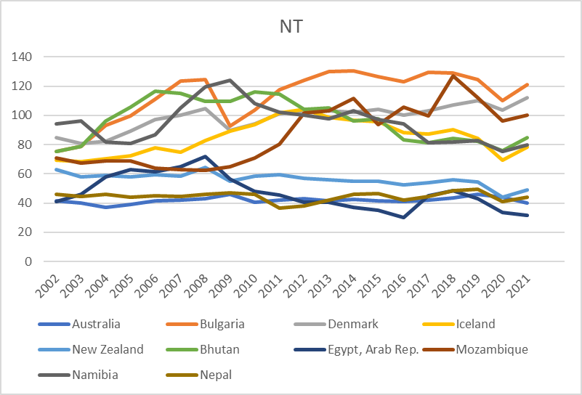
NT

Slide 28
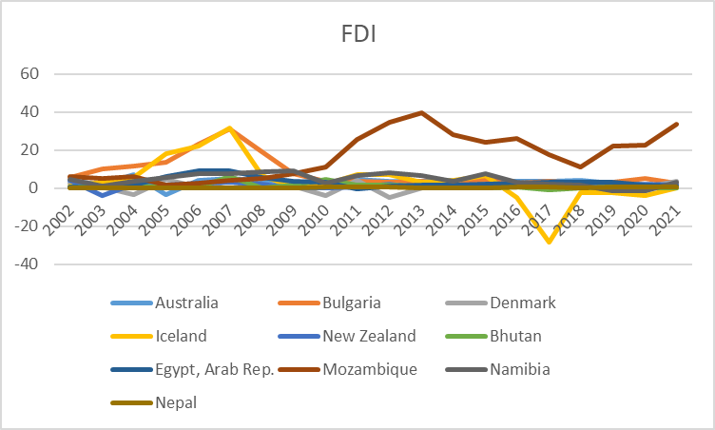
FDI

Slide 29
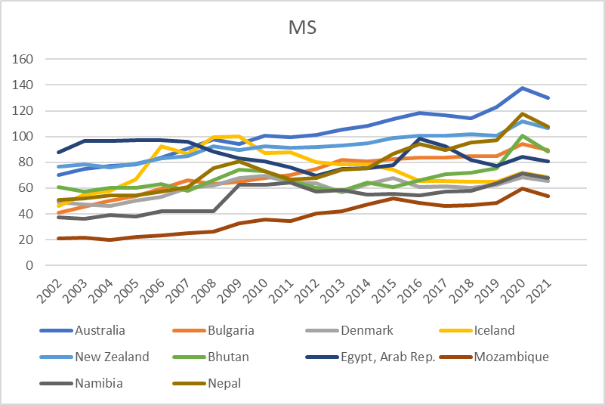
MS

Slide 30
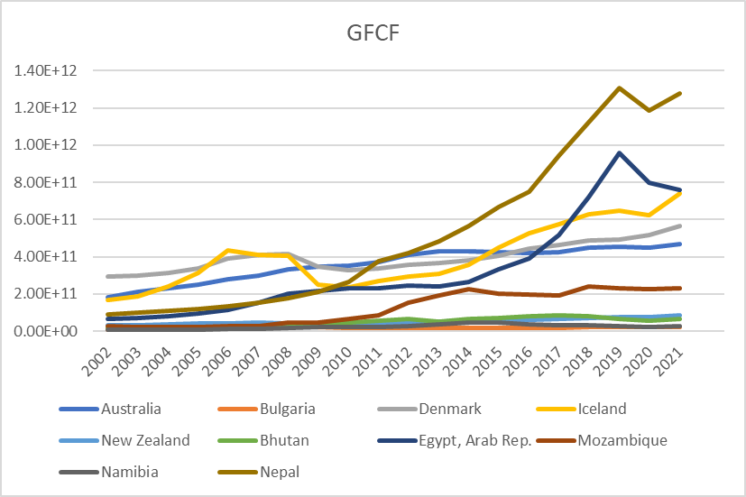
GFCF

Slide 31
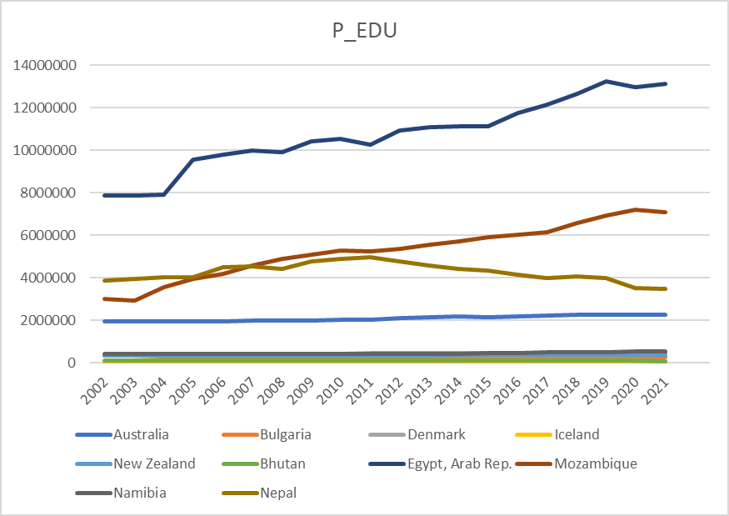
P_EDU

Slide 32
ThankYou!

